Slide 1


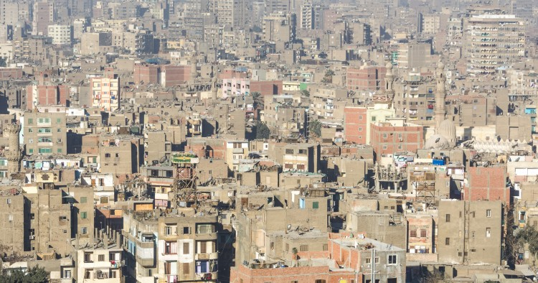
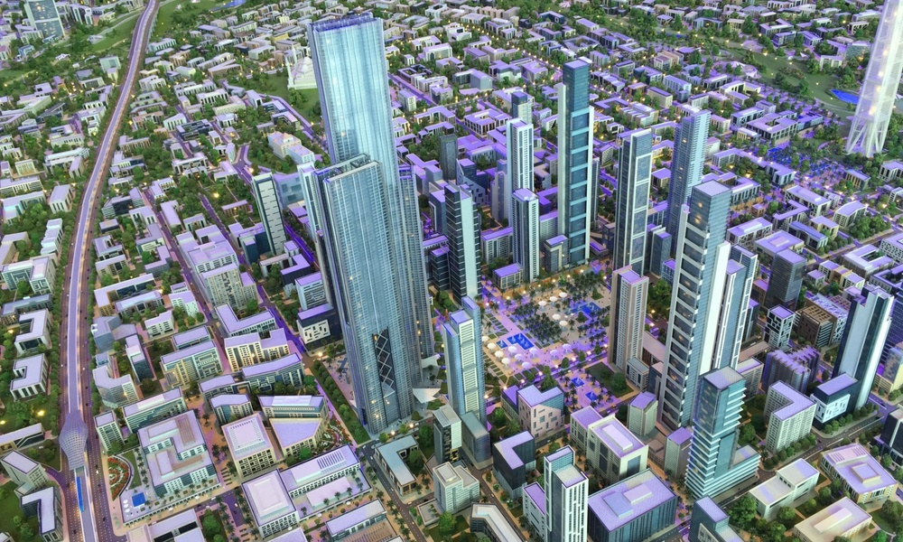
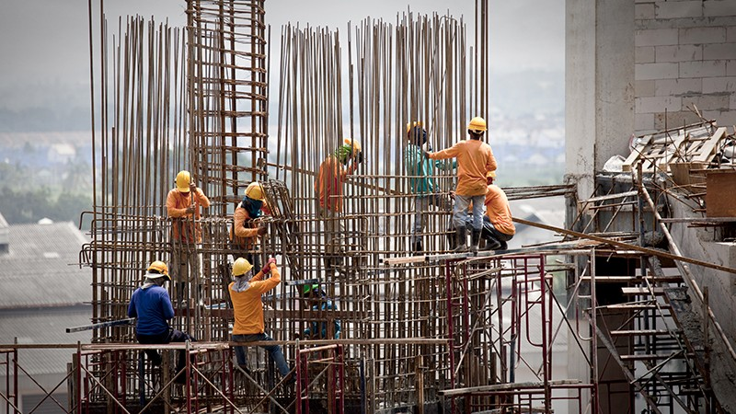
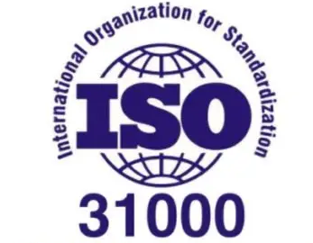
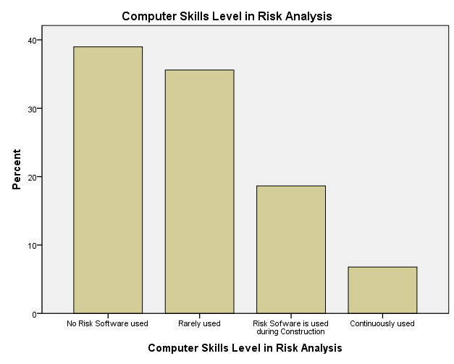

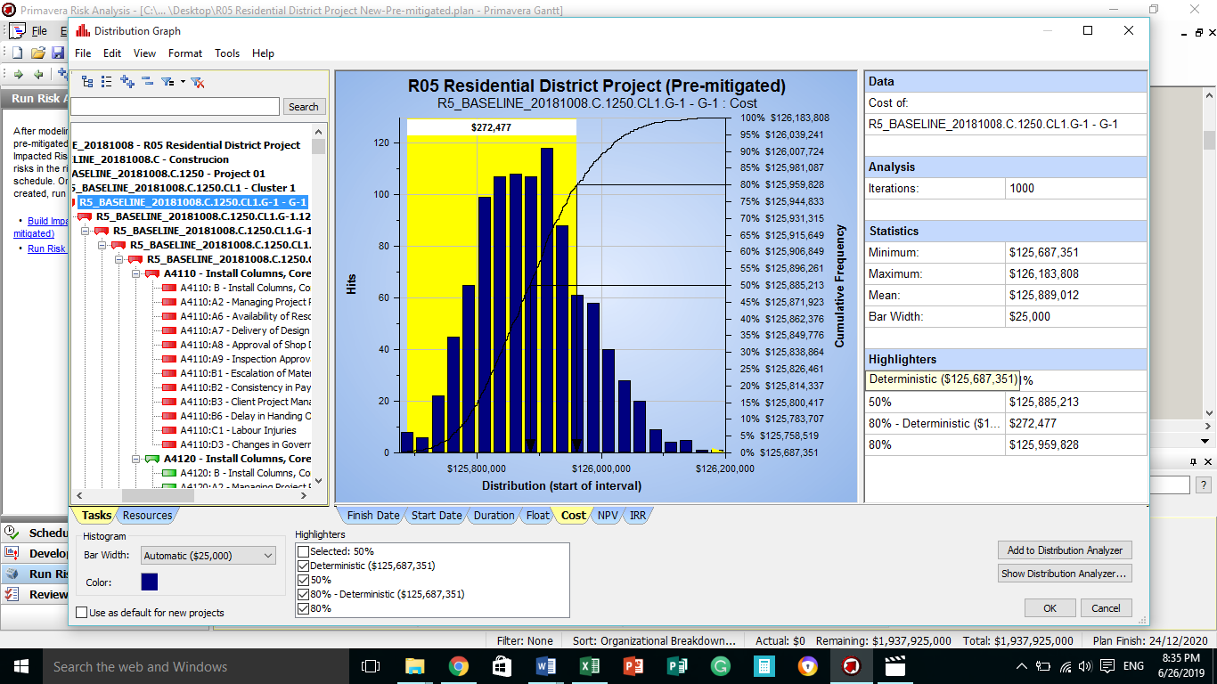

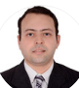
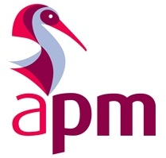

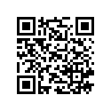
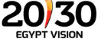

Risk Management in Construction of Megahousing Projects in Egypt
Mohamed Ibrahim^{1,2}, George Ofori¹, Maged Morcos²
¹School of Built Environment and Architecture, London South Bank University, 103 Borough Road, London SE1 0AA, United Kingdom
²Department of Civil Engineering, The British University in Egypt, El-Sherouk City, Cairo, Egypt
Motivation
Slum Urbanisation Crisis
Constructed with 95% delays, high cost, and poor quality buildings.
Slum vs. Mega Housing
Recently, Egypt strategy 2030 is targeting successful delivery of mega housing.
Risk management framework is an ideal solution to reduce the impact on delivery of mega housing projects
Risk Management Framework is developed using the Risk Management Standard ISO 31000
Methodology
Results
Philosophy
  Pragmatism Paradigm
Approach
  Abductive Approach
Respondents
Strategy
  Multi Methodological Strategy
Methods
  Interviews and Surveys
  Monte Carlo Analysis
Risk Knowledge
Low
Medium
High
Low risk knowledge was observed, 45% of project team do not participate in the process of risk management.
Qualitative risks are identified using interviews. Survey results allowed the recognition of impact scales. Monte Carlo analysed the impact of risks on delivery time and cost.
Aim
Conclusions
Monte Carlo highlighted that $273,000 are to be added to the construction budget.
To develop a risk management framework to improve risk management practices and success in delivery during construction of Mega housing projects in Egypt.
Risk Management Framework
Risk categories included
financial risks, safety risks, and
government support risks.
The Risk framework is in line with the
International Standardaisation (ISO31000).
The cost of a Mega housing project in Egypt “New Capital” ranged between $125,687,351 and $126,183,808. After implementing mitigations the cost ranged between $125,687,351 and 125,917,868 this means that the maximum completion cost is reduced by an amount of $265,940. This reduction is due to the implemented responsive actions.
Step 1
identify Risks
Step 2
Analyse
Step 5
Report
Step 4
Monitor
Step 3
Respond
Researcher Contacts
M.ASCE – Member of the American Society of Civil Engineers, USA.
MAPM – Member of the Association of Project Management, UK.
For better future in delivery of mega housing projects.
For better EGYPT
Researcher Mail: Ibrahm63@lsbu.ac.uk

