Slide 1
Paper ID: 5026
DEVELOPMENT OF CONCEPTUAL MOTIVATIONAL FRAMEWORK TO IMPROVE CONSTRUCTION LABOUR PRODUCTIVITY IN THE U.K.
Author: John Kojo Tawiah Hayford Sch: LSBU - Built Env. & Architecture
The 45th Australasian Universities Building Education Association (AUBEA) Conference, 23-25 November 2022, Western Sydney University, Australia

Slide 2
OUTLINE OF THE PRESENTATION
Background
Aim and objectives
Conceptual motivation framework
Conclusion.
The 45th Australasian Universities Building Education Association (AUBEA) Conference, 23-25 November 2022, Western Sydney University, Australia

Slide 3
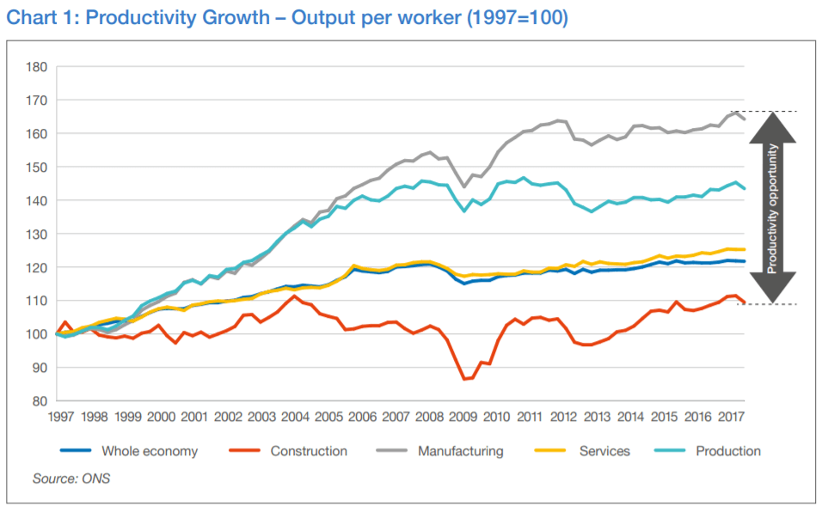
BACKGROUND
The construction industry in the U.K. is set to become the largest market by 2030. To achieve this, the U.K. government has called to cut the cost of construction by 33% and to deliver 50% faster projects by 2025.
However, the trend of construction industry productivity in the U.K. has been consistently low relative to other industries resulting in a skilled labour shortage, project delays, high construction costs, and low productivity growth.
The 45th Australasian Universities Building Education Association (AUBEA) Conference, 23-25 November 2022, Western Sydney University, Australia

Slide 4
AIM AND OBJECTIVES
AIM
The research aims to identify the motivational factors that influence labour productivity to develop a conceptual motivational framework to improve construction labour productivity in the U.K.
OBJECTIVES
To identify the motivational factors which influence construction labour productivity in the U.K.
To examine the relationship between motivation, social compliance, and labour productivity.
Examine the motivational factors that could improve labour productivity.
To develop a conceptual motivational framework to improve construction labour productivity.
The 45th Australasian Universities Building Education Association (AUBEA) Conference, 23-25 November 2022, Western Sydney University, Australia

Slide 5
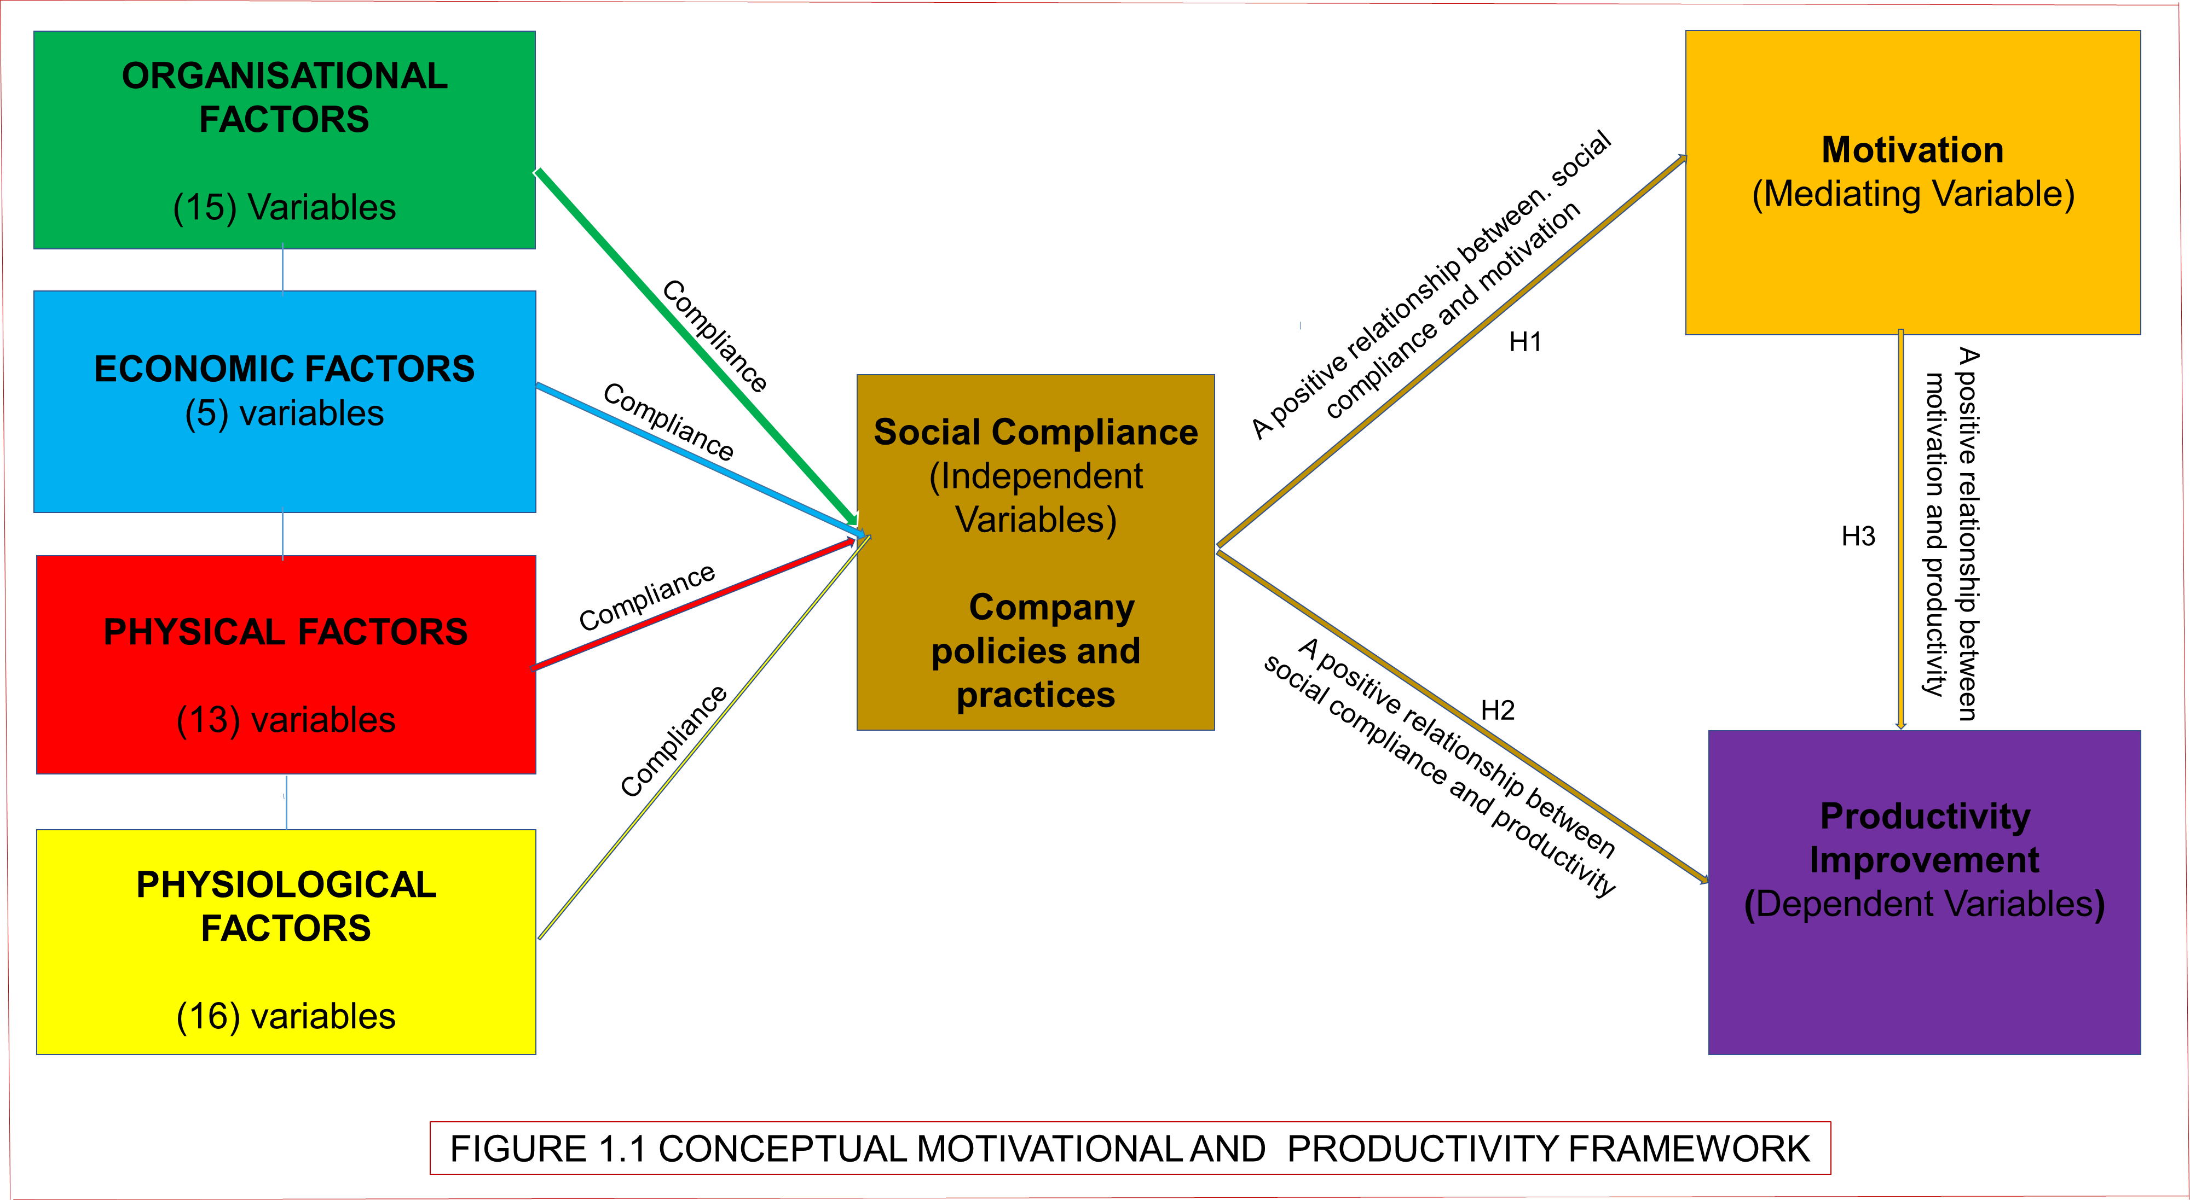
CONCEPTUAL MOTIVATION FRAMEWORK
H1: Social compliance ensures all these labour rights prescribed by U.K. labour rights and practices and the international labour organisation (ILO) labour rights convention (Fukunishi and Yamagata, 2013).
Supervision
Training
Material management
Requests delays
Motivational communication
Leadership management style
Welfare facilities
Company policy
Corporate image
Change order's during execution
Tools/equipment
Weather conditions
Site Conditions
Clarity and completeness of technical specifications
H3: Motivated labour enhances labour productivity (Baral, 2010; Ferdous, 2015; Alam and Alias, 2018)
H2: Companies engaged in social compliance policies and practices earn a positive image and attract skilled labour, improving productivity (Umeokafor et al., 2014).
The 45th Australasian Universities Building Education Association (AUBEA) Conference, 23-25 November 2022, Western Sydney University, Australia

Slide 6
CONTRIBUTION TO KNOWLEDGE
1) The employer’s right to monitor the employee’s motivation compliance is written for both parties as a right or duty.
2) Assessment process: recognition of motivation compliance certificate before labour or contractor is allowed to work on-site.
Compliance and enforcement in this study is an aspect of company management concerned with the extent to which a company operates by the terms and conditions of labour motivation policy and practices.
3) Contract process: employers create a framework to enable contractors to report motivation compliance activities.
4) Third-party Consultants to look for undiscovered compliance gaps and ensure motivation compliance.
5) Enforcement: non-compliant will incur penalties such as disciplinary action from a supervisor, employer issue an enforceable stop-work order, and Lawsuits brought by labour against their contractor.
6) Motivation in this study refers to good social compliance that enhances labour motivation and higher productivity.
The 45th Australasian Universities Building Education Association (AUBEA) Conference, 23-25 November 2022, Western Sydney University, Australia

Slide 7
CONCLUSION
The theoretical review has led to an understanding of these motivational factors and the constructs that have led to the development of the conceptual motivational framework to enhance labour motivation and improve labour productivity.
The next stage is to empirically test the framework in the U.K. construction sites.
The framework could enhance management decision when wanting to improve labour productivity on site.
The 45th Australasian Universities Building Education Association (AUBEA) Conference, 23-25 November 2022, Western Sydney University, Australia

