Slide 1
The likely adverse effects of “Profound Autism” and “PDA Profile of ASD” discourses.
Mr. Richard Woods.
London South Bank University PhD Student.

Slide 2
PROFILING MYSELF.
Conflicts of interest.
Developing various PDA tools, e.g., Pathological Demand-Avoidance-Beliefs Scale (PDA-BS).
Income from delivering training sessions on PDA.
Reluctantly advocates for it to be diagnosed as a standalone construct.

Slide 3
PROFILING MYSELF.
My perspective.
2012 autistic attribution, now “post-autistic identity”!
Meets Newson’s PDA profile, is not emotionally attached to it.
No-longer basing identity on diagnostic categories.
Favours a transdiagnostic approach & we should be stop utilising Disorder based constructs in the future.
PhD is investigating PDA & part of CADS at LSBU.

Slide 4
PROFILING MYSELF.
My perspective.
Frontiers in Education PDA special issue project lead.
Peer review PDA manuscripts.
Equally respects divergent views & evidence to critically synthesise appropriate interpretations on PDA.
My interpretation of PDA & its literature, others may disagree.

Slide 5
IN THE BEGINNING.
Introduction.
“Profound Autism” & “PDA Profile of ASD”.
Subgroup terminology.
Logical fallacies.
Arguments for & against subgroups.
Issues with “Profound Autism” & “PDA Profile of ASD”.
Reflective questions.
Trigger warning, preventable deaths, slides: 30-38.

Slide 6
FOOD FOR THOUGHT.
Is this person autistic?
Have a unique talent e.g., role play.
Preference for stability in e.g., best friend or routines.
Sensory sensitivities e.g., finds certain sounds painful.
Likes to have friends.
Perfectionism e.g., needs their work to be perfect.
Avoidance of eye contact.
Has high anxiety.
Restricted range of interests.
Social awkwardness.
Had language delay e.g., only spoke after 4 years old.

Slide 7
AN OLD ROLEPLAY.
Autism history.
Autism used to be a form of CS (Silberman 2015).
1966 prevalence rates 1 in 2500, now ~ 1 in 100.
Autism becomes a spectrum (Happé & Frith 2020).
DSM4: PDD-NOS was the most commonly subtype.
ASD Level One to Level Three (APA 2013).
“High Functioning Autism”, equivalent to Asperger’s.
Now accepted indistinguishable clinical differences & strategies between autism subtypes (Woods 2020b).
Subtypes excluded to reduce stigma (Happé 2011).

Slide 8
PROFOUNDLY DISTURBING?
“Profound Autism” definitions.
ID &/or language impairment (Lord et al 2021).
“Severe” autism added (Waizbard-Bartov et al 2023a).
Broadened to severe & challenging behaviours including self-injury, aggression and irritability (ASF 2022).
Need 24/7 support & cannot advocate for themselves.
“Non-Profound Autism” is for those autism is expressed less in (Hughes & Maenner 2023).
Using other co-occurring issues, e.g., anxiety, to create subtypes (Waizbard-Bartov et al 2023b).

Slide 9
ROLEPLAYING A “PROFILE OF ASD”.
“PATHOLOGICAL DEMAND-AVOIDANCE (PDA) PROFILE OF ASD” CONSTELLATION OF TRAITS WITHIN AUTISM SPECTRUM.
“PDA PROFILE OF ASD”.
“CLASSIC”/ “MORE STRAIGHT-FORWARD” AUTISM.
Anxiety.
High.
Low-none.
Avoidance of “ordinary” demands.
Pervasive.
Low-none.
Bullying, harassment, lying, stalking, stealing etc.
High.
Low-none.
Fantasy & roleplay.
Comfortable-excessive.
Low-none.
Please do not reify this diagram. Based on RW interpretations of “PDA Profile of ASD” clinical literature, diagnostic & screening tools.
Impulsivity.
High.
Low-none.
Obsessive behaviour focused on people-characters.
High-excessive.
Low-none.
“Need for control”/ “Drive for Autonomy”.
High-pervasive.
Low-none.
Rapid mood changes.
High.
Low-none.
Reinforcement-based approaches, e.g., ABA/ PBS.
Ineffective & causes distress.
“Effective & gold standard.”
Socially “strategic”-”manipulative” avoidance behaviour.
High.
“Theory of Mind.”
Low-none.
“Normal.”
“Deficits.”
ADHD, ANXIETY, CD, ODD & TRAUMA FEATURES.
AUTISM.

Slide 10
CIRCLE WARS.
DSM-5 AUTISM, “PROFOUND AUTISM”, & “PATHOLOGICAL” DEMAND-AVOIDANCE RELATIVE SUPPORT NEEDS COMPARED TO IQ.
Functioning (Inverse Support Needs.)
DSM-5 Autism.
Diagram is an aid to discussion, please do not take it literally & reify it.
“Profound Autism.”
“Pathological” Demand-Avoidance.
IQ.

Slide 11
BOB THE BUILDER’S PROFILE.
“PDA Profile of ASD” terminology.
“Non-PDA autism”, “conventional” autism (Christie 2007, p5), & “classic” autism (Kopp & Gillberg 2011, p2885).
Still used today, e.g., ‘classic autism’ (PDA Society 2022, p7), & “conventional understanding of autism” (PDA Society 2022, p12).
“PDA Profile of ASD” = Atypical/ unusual/ unconventional/ unorthodox/ unpopular
Connotation PDA is not autism.

Slide 12
BOB THE BUILDER’S PROFILE.
“PDA Profile of ASD” terminology.
“PDA Profile of ASD” = “complex” & ‘perplexing’ (PDA Society 2022, p4+6).
“Non-PDA autism” = “More straightforward presentation of autism” (Fidler & Christie 2019, p 59 & 73).
Connotation “Non-PDA autism” are easy etc.

Slide 13
BOB THE BUILDER’S PROFILE.
“PDA Profile of ASD” terminology.
“marked demand avoidance within their autism diagnosis, there is a range of terminology that is used in formulations, including ASD with: • a PDA profile/a Pathological Demand Avoidance profile • a demand avoidant profile/a profile of demand avoidance • extreme/pervasive demand avoidance” (PDA Society 2022, p22).

Slide 14
BOB THE BUILDER’S PROFILE.
Proposed subtypes terminology.
Excuses PDA’s non-autism features.
“PDA Profile of ASD” is a functioning category.
False dichotomy, allows some autistics to be viewed as less autistic, e.g., see Hughes & Maenner (2023).
Both proposed subtypes risk diagnosing non-autistic persons with autism (Kapp 2023; Woods 2022a), & risks confusing co-occurring issue with autism (Pukki et al 2022; Woods 2022a; Woods et al 2023).
Stereotypes cause us problems (Des Roches Rosa 2023).

Slide 15
AN OLD ROLEPLAY.
Autism advocacy history.
Traditionally dominated by caregivers.
Autism industry aimed at caregivers (McGuire 2016).
“Don’t mourn for us” (Sinclair 1993).
Most autistic persons do not want autism subtypes (Fletcher-Watson & Happé 2019; Kapp & Ne’eman 2019).
Many autistic advocates & researchers are against “Profound Autism” & functioning labels (Kapp 2023).
Recent activities e.g., Opposing AIMS-2 & Spectrum10K.

Slide 16
WHO HAS A “PATHOLOGICAL” NEED TO CONTROL WHOM?
Rationale for both proposed subtypes.
Has different support needs from other autistic persons.
Prioritise needs of this vulnerable & underserved group.
Group is often excluded from research.
Prioritise research funding to this group (Lutz 2021).
Split autism category into two (Singer 2022).
Strategic planning.
Comparison of research findings.
Enabling access to certain resources.
To better understand CYP (Christie 2019).

Slide 17
PROFOUNDLY DISTURBING?
Subtyping autism & DSM-5.
All attempts to divide autism have failed (Kapp 2023)
Its why “Profound Autism” constructed from co-occurring ID &/ or language issues (Woods et al 2023).
Indicates “PDA Profile of ASD” features are not-autism.
DSM-5 replaced autism subtypes with autism & SCD (APA 2013).

Slide 18
PROFOUNDLY DISTURBING?
Subtyping autism & DSM-5.
PDA was informally excluded from DSM-5.
Most autistics do not want autism subtyped.
Seems SCD is not used much (Kapp & Ne’eman 2019).
DSM-5 autism criteria not designed to create autism subtypes (Kapp 2023), let alone attribute “PDA Profile of ASD”…

Slide 19
MAKING SENSE?
Fallacies seem applicable to “PDA Profile of ASD”.
1) Begging the question = Assumes PDA is distinct thing and arguing to prove it is a thing.
2) No True Scotsman = if PDA descriptions/ diagnoses do not conform to “PDA Profile of ASD”, they are not PDA, such as instead are “Rational Demand Avoidance”.

Slide 20
MAKING SENSE?
Fallacies seem applicable to “PDA Profile of ASD”.
3) Appeal to popularity = Claiming that many hundreds/ thousands of people believe in “PDA Profile of ASD”, so it must be a thing.
4) Equivalence = Claiming “PDA Profile of ASD” is a different and distinct thing, with its features being different in nature to autism, but “PDA Profile of ASD” is a “Profile of ASD.”. A + B + C ≠ A is applicable.

Slide 21
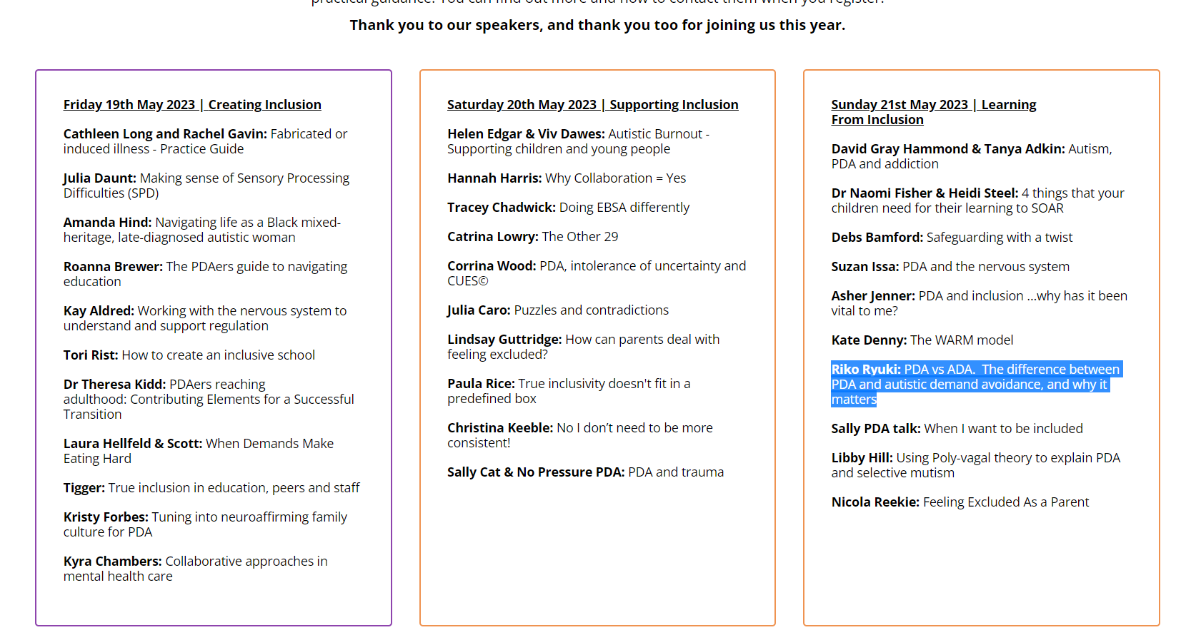
THE “LIGHT-BULB MOMENT”?
“PDA Profile of ASD” used to other (from PDA Space, 2023).

Slide 22
THE “LIGHT-BULB MOMENT”?
Fallacies seem applicable to “PDA Profile of ASD”.
5) False dichotomy = “PDA Profile of ASD” is “complex” / “perplexing” versus non-“Profile of ASD” autism is “more straightforward”/ “classic”.
6) Texas sharpshooter = Assuming PDA is a “Profile of ASD” and then conducting research to support it:
- Assuming PDA features = autism features.
- Designing tools which assume PDA is a “Profile of ASD”.
- Recruiting participants from sources which are knowledgeable in “PDA Profile of ASD”.

Slide 23
A FEATURE FILM?
What do these features indicate?
“I complain about illness or physical incapacity to avoid a request or demand.” (Egan et al 2019, p485).
“Attempts to negotiate better terms with adults.” (O’Nions et al 2014, p763).
“Apparently manipulative behaviour.” (O’Nions et al 2016, p415).

Slide 24
WHO HAS A “PATHOLOGICAL” NEED TO CONTROL WHOM?
Proposed subtypes problems for self-advocacy.
Many features pathologised in PDA, are those people often express to exert their self-agency when distressed/ stressed (Moore 2020).
“PDA Profile of ASD” represents pathologising of autistic advocacy (Milton 2017; Woods 2017a).

Slide 25
WHO HAS A “PATHOLOGICAL” NEED TO CONTROL WHOM?
Proposed subtypes problems for self-advocacy.
“When people generally said to be incapable of communication find ways of making clear what they do and don’t want through means other than words, this is self-advocacy” (p. 223). Baggs clarified that self-advocacy includes what some refer to as behavioral problems in response to abuse or violence against them [176].” (Kapp 2023, p10).

Slide 26
WHO HAS A “PATHOLOGICAL” NEED TO CONTROL WHOM?
Proposed subtypes problems for advocacy.
PDA contains many unpleasant-criminal behaviours which requires intent to commit them (Woods 2022b).
PDA, but not autistic traits predicted stalking (Linenberg 2021).
PDA does not have ToM deficits (Bishop 2018).
PDA’s social avoidance behaviours described as “manipulative” or “strategic”, gives others carte blanche to ignore our views (Woods 2017b).

Slide 27
WHO HAS A “PATHOLOGICAL” NEED TO CONTROL WHOM?
Proposed subtypes problems for advocacy.
“Profound Autism” advocates claiming autistic neurodiversity supporters are harassing them (Singer et al 2023).
“Non-disabled” autistic persons cannot advocate for those with “Profound Autism” (Singer 2022).
Ignore preferences of “non-disabled” autistic persons.
“Profound Autism” & other ableist terms should be used (Singer et al 2023).

Slide 28
WHO HAS A “PATHOLOGICAL” NEED TO CONTROL WHOM?
Proposed subtypes problems for advocacy.
“Profound Autism” intended for those who cannot advocate (ASF 2022; Singer 2022; Singer et al 2023).
Autistic IQ scores often depends on context of the IQ test & the tool being used, e.g., best tool to RPM (Kapp 2023).

Slide 29
CIRCLE WARS.
DSM-5 AUTISM, “PROFOUND AUTISM”, & “PATHOLOGICAL” DEMAND-AVOIDANCE RELATIVE SUPPORT NEEDS COMPARED TO IQ.
Functioning (Inverse Support Needs.)
DSM-5 Autism.
Diagram is an aid to discussion, please do not take it literally & reify it.
“Profound Autism.”
“Pathological” Demand-Avoidance.
IQ.

Slide 30
A “PROFOUND” CHALLENGE FOR WHOM?
Risk of diagnostic overshadowing.
What is diagnostic overshadowing?
Diagnostic overshadowing is an issue for autistics: “dismissal of explicitly severe physical symptoms of amyotrophic lateral sclerosis, and multiple sclerosis as “oppositional behavior” due to the patients being non-speaking Autistics.” (Woods et al 2023, p1656).
Especially with ID, such as constipation.
Can result in deaths due physical ill health issues not being treated in time (Woods 2023).

Slide 31
A FEATURE FILM?
Associated with trauma or highly distressed individuals:
“Seems as if s/he is distracted ‘from within’” (O’Nions et al 2014, p763).
“Knows what to do or say to upset specific people.” (O’Nions et al 2014, p763).
“(Lacks) Awareness of own identity.” (O’Nions et al 2016, P415).
“I am driven by the need to be in charge.” (Egan et al 2019, p485).

Slide 32
A FEATURE FILM?
An act any person would display to assert their self-agency:
“I complain about illness or physical incapacity to avoid a request or demand.” (Egan et al 2019, p485).
“Attempts to negotiate better terms with adults.” (O’Nions et al 2014, p763).
“Apparently manipulative behaviour.” (O’Nions et al 2016, p415).

Slide 33
A “PROFOUND” CHALLENGE FOR WHOM?
Risk of diagnostic overshadowing.
“If “profound autism” is realized, at best co-occurring conditions and their associated supports will be missed, at worst it will likely contribute towards preventable deaths.” (Woods et al 2023, p1656).
Diagnostic overshadowing concerns are applicable to “PDA Profile of ASD”.

Slide 34
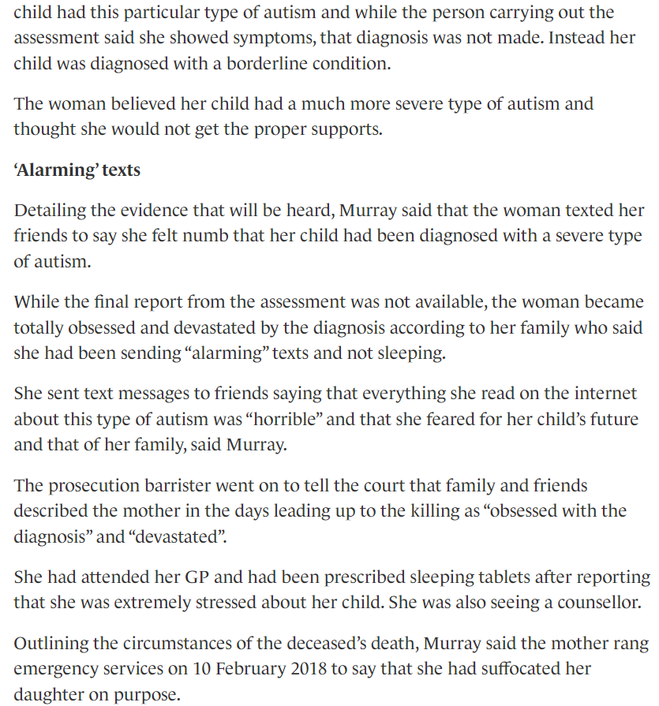
PREDICTABLY CRIMINALLY IGNORANT?
O'Riordan (2019).

Slide 35
DEFINITION OF MADNESS?
Practical & ethical problems with proposed autism subtypes.
“Profound Autism” is unhelpful descriptor, not convey a person’s specific features & needs (Pukki et al 2022).
Same can be said of “PDA Profile of ASD”, as it is meant to much more than only demand-avoidance (PDA Society 2022).
Both “Pathological Demand Avoidance” & “Profound Autism” are demeaning & negative terms to attribute to a person (Pellicano et al 2022; Woods 2020b).

Slide 36
NO RESISTANCE IS FUTILE.
Proposed subgroups are likely a risk to autistic lives.
“This is particularly important for some people with autism, including those with Asperger syndrome, who may face very significant challenges in their everyday lives, despite having average or above average IQ.” (DoH 2015, p15).
Autistic persons not attributed with either proposed subgroup likely have their difficulties dismissed due to misconception it is ‘mild’ autism/ not autism (Woods 2017b).

Slide 37
NO RESISTANCE IS FUTILE.
Proposed subgroups are likely a risk to autistic lives.
Autistics systemically poorly treated by broader society & culture (Botha 2021; Grant et al 2023; Woods 2017b).
Autistics high rates co-occurring mental health issues (Lai et al 2019; Woods 2020a).
High suicide rates (Hirvikoski et al 2016; Moses 2017).
If both subgroups are accepted, likely many autistics would be denied support, either through needs being dismissed, or suitable strategies being denied to them.
Predictable consequences!

Slide 38
AVOIDING VARIANCE?
Reflective questions.
What is the impact of efforts to sub-type autism upon solidarity amongst the autistic community?
How many autistic deaths are required before we stop attempting to create subgroups?
What do autistics need to do for other stakeholders to respect wishes to not divide autism into subgroups?

Slide 39
ANY QUESTIONS?
The End Game.
Contact Details: richardwoodsautism@gmail.com
Twitter handle: @Richard_Autism
My researchgate: https://www.researchgate.net/profile/Richard_Woods10
My Youtube channel: https://www.youtube.com/@autimedes
Any questions?

Slide 40
THE FIRST JOB REFERENCE.
References.
American Psychiatric Association. (2013). Diagnostic and Statistical Manual of Mental Disorders, Fifth Edition. Washington, DC, American Psychiatric Association.
Autism Science Foundation. (2022). Apply for a Profound Autism Pilot Grant (Online resource). Retrieved from: https://autismsciencefoundation.org/apply-for-a-profound-autism-pilot-grant/#:~:text=Autism%20Science%20Foundation%20will%20award,used%20to%20cover%20tuition%20payments (Accessed 18 December 2023).
Bishop, E. (2018). The Relationship between Theory of Mind and Traits Associated with Autism Spectrum Condition and Pathological Demand Avoidance Presentations. Doctorate of Clinical Psychology, University College London.
Botha, M. (2021). Academic, Activist, or Advocate? Angry, Entangled, and Emerging: A Critical Reflection on Autism Knowledge Production. Frontiers in Psychology. DOI: https://doi.org/10.3389/fpsyg.2021.727542
Christie, P. (2007). The distinctive clinical and educational needs of children with pathological demand avoidance syndrome: guidelines for good practice. Good Autism Practice, 8(1), 3–11.
Christie, P. (2019). Towards an understanding of Pathological Demand Avoidance (PDA): clinical, research and educational perspectives. In: National Autistic Society (Ed), Pathological Demand Avoidance Conference. London: National Autistic Society.
Department of Health. (2015). Statutory guidance for Local Authorities and NHS organisations to support implementation of the Adult Autism Strategy (Online Government Guidance). Retrieved from: https://assets.publishing.service.gov.uk/government/uploads/system/uploads/attachment_data/file/422338/autism-guidance.pdf (Accessed 18 December 2023).

Slide 41
THE SECOND JOB REFERENCE.
References.
Des Roches Rosa, S. (2023). GRAVE CONCERNS ABOUT “PROFOUND AUTISM” AND DIAGNOSTIC OVERSHADOWING (Online news interview). Retrieved from: https://thinkingautismguide.com/2023/09/grave-concerns-about-profound-autism-and-diagnostic-overshadowing.html (Accessed 18 December 2023).
Egan, V., Linenburg, O., & O’Nions, L. (2019). The Measurement of Adult Pathological Demand Avoidance Traits. Journal of Autism and Developmental Disorders, 49(2), 481-494.
Fidler, R and Christie, P. (2019). Collaborative Approaches to Learning for Pupils with PDA: Strategies for Education Professionals. London: Jessica Kingsley Publishers.
Fletcher-Watson, S., & Happé, F. (2019). Autism: a new introduction to psychological theory and current debate, 2nd edition. Abingdon-on-Thames, UK: Routledge.
Grant, A., Williams, G., Williams, K., & Woods, R. (2023). Unmet need, epistemic injustice and early death: how social policy for Autistic adults in England and Wales fails to slay Beveridge’s Five Giants. In Cefalo, R., Rose, R., & Jolly, A. (Eds). Social Policy Review 35 Analysis and Debate in Social Policy, 2023 (pp. 239-257). Bristol, UK, Bristol University Press.
Happé, F. (2011). Criteria, categories, and continua: Autism and related disorders in DSM-5. American Academy of Child and Adolescent Psychiatry, 50(6), 540–542.
Happé, F., & Frith, U. (2020). Annual Research Review: looking back to look forward – changes in the concept of autism and implications for future research. Journal of Child Psychology and Psychiatry, 61(3), 218-232
Hirvikoski, T., Mittendorfer-Rutz, E., Boman, M., Larsson, H., Lichtenstein, P., & Bölte, S. (2016). Premature mortality in autism spectrum disorder. British Journal of Psychiatry, 208(3), 232–238.

Slide 42
THE THIRD JOB REFERENCE.
References.
Hughes, M., & Maenner, M. (2023). Response to Letter to the Editor: “Profound Autism Label Does Not Predict Strengths or Help Plan Supports”. Public Health Reports, 138(6):851-852.
Kapp, S. (2023). Profound Concerns about “Profound Autism”: Dangers of Severity Scales and Functioning Labels for Support Needs. Education Sciences. Doi: https://doi.org/10.3390/educsci13020106
Kapp, S., & Ne’eman, A. (2019). Lobbying autism’s diagnostic revision in the DSM-5. In: Kapp, S. (Ed.), Autistic Community and the Neurodiversity Movement (pp. 167–194). New York: Springer Nature.
Kopp, S., & Gillberg, C. (2011). The Autism Spectrum Screening Questionnaire (ASSQ)-Revised Extended Version (ASSQ REV): An instrument for better capturing the autism phenotype in girls? A preliminary study involving 191 clinical cases and community controls. Research in Developmental Disabilities, 32(2011), 2875–2888.
Lai, C., Kassee, C., Besney, R., Bonato, S., Hull, L., Mandy, W.,…Ameis, S. (2019). Prevalence of co-occurring mental health diagnoses in the autism population: a systematic review and meta-analysis. The Lancet Psychiatry, 6(10), 819-829.
Linenberg, O. (2021). The relationship of Stalking to Autism Spectrum Disorders and Personality. Doctor of Forensic Psychology thesis. University of Nottingham.
Lord, C., Charman, T., Havdahl, A., Carbone, P., Anagnostou, E., Boyd, B.,… McCauley, J. (2021). The Lancet Commission on the future of care and clinical research in autism. The Lancet, 399(10321), 271-334.
Lutz, A. (2021). Lancet Commission Calls for New Category: "Profound Autism" (Online magazine article). Retrieved from: https://www.psychologytoday.com/gb/blog/inspectrum/202112/lancet-commission-calls-new-category-profound-autism (Accessed 25 May 2023).

Slide 43
THE FOURTH JOB REFERENCE.
References.
McGuire, A. (2016). War on autism: on the cultural logic of normative violence. Ann Arbor: University of Michigan Press.
Milton, D. (2017). 'Natures answer to over-conformity': deconstructing Pathological Demand Avoidance. In: Milton, D. (Ed), A Mismatch of Salience: Explorations of the nature of autism from theory to practice (pp. 27-38). Hove, UK, Pavilion Publishing and Media Limited.
Moore, A. (2020). Pathological Demand Avoidance: what and who are being pathologized and in whose interests? Global Studies of Childhood, 10(1), 39-52.
Moses, T. (2018). Suicide Attempts Among Adolescents with Self-Reported Disabilities. Child Psychiatry & Human Development, 49(3), 420–433.
O'Nions, E., Christie, P., Gould, J., Viding, E., & Happé, F. (2014). Development of the ‘Extreme Demand Avoidance Questionnaire’ (EDA-Q): Preliminary observations on a trait measure for Pathological Demand Avoidance. Journal of Child Psychology and Psychiatry, 55, 758–768.
O'Nions, E., Gould, J., Christie, P., Gillberg, C., Viding, E., & Happé, F. (2016). Identifying features of ‘pathological demand avoidance’ using the Diagnostic Interview for Social and Communication Disorders (DISCO). European Child & Adolescent Psychiatry, 25(4), 407–419.
O'Riordan, A. (2019). Mother who admits suffocating her three-year-old daughter was 'obsessed' over autism, court hears (Online news report). Retrieved from: https://www.thejournal.ie/murder-trial-child-4862600-Oct2019/ (Accessed 27 November 2023).
PDA Space. (2023). The PDA Space Summit 2023 (Online webpage). Retrieved from: https://www.thepdaspace.com/summit-2023 (Accessed 18 December2023).

Slide 44
ARE WE THERE YET?
References.
PDA Society. (2022). Identifying & Assessing a PDA profile - Practice Guidance (Online research). Retrieved from: https://www.pdasociety.org.uk/wp-content/uploads/2023/02/Identifying-Assessing-a-PDA-profile-Practice-Guidance-v1.1.pdf (Accessed 18 December 2023).
Pellicano, E., Fatima, U., Hall, G., Heyworth, M., Lawson, W., Lilley, R.,… Stears, M. (2022). A capabilities approach to understanding and supporting autistic adulthood. Nature Reviews Psychology, 1(2022), 624–639.
Pukki, H., Bettin. J., Outlaw. A., Hennessy, J., Brook, K., Dekker, M.,… Yoon, W. (2022). Autistic Perspectives on the Future of Clinical Autism Research. Autism in Adulthood, 4(2), 93-101.
Silberman, S. (2015). Neurotribes: The Legacy of Autism and the Future of Neurodiversity. London: Allen and Unwin.
Sinclair, J. (1993). Don’t Mourn For Us (Online conference paper). Retrieved from: https://philosophy.ucsc.edu/SinclairDontMournForUs.pdf (Accessed 18 December 2023).
Singer, A. (2022). It’s time to embrace ‘profound autism’ (Online news article). Retrieved from: https://doi.org/10.53053/HPJN5392 (Accessed 18 December 2023).
Singer, A., Lutz, A., Escher, J., & Halladay, A. (2023). A full semantic toolbox is essential for autism research and practice to thrive. Autism Research, 16(3), 497-501.
Waizbard-Bartov. F., Fein, D., Lord, C., & Amaral, D. (2023a). Autism severity and its relationship to disability. Autism Research, 16(4), 685-696.
Waizbard-Bartov, E., Fein, D., Lord, C., & Amaral, D. (2023b). Response to Mottron et al. (2023) and Woods et al. (2023). Autism Research, 16(9), 1660-1661.

Slide 45
THE SIXTH & LAST JOB REFERENCE.
References.
Woods, R. (2017a). Pathological demand avoidance: my thoughts on looping effects and commodification of autism. Disability & Society, 34(5), 753–758
Woods, R. (2017b). Exploring how the social model of disability can be re-invigorated for autism: in response to Jonathan Levitt. Disability & Society, 32(7), 1090–1095.
Woods, R. (2020a). 17th OF MARCH 2020 BLOG POST: UPDATING MY CURRENT THOUGHTS ON THE MEDICAL NATURE OF DEMAND AVOIDANCE PHENOMENA. (Online resource). Retrieved from: https://rationaldemandavoidance.com/2020/03/17/17th-of-march-blog-post-updating-my-current-thoughts-on-the-medical-nature-of-demand-avoidance-phenomena/ (Accessed 18 December 2023).
Woods, R. (2020b). Pathological Demand Avoidance and the DSM-5: a rebuttal to Judy Eaton’s response. Good Autism Practice, 21(2), 74-76.
Woods, R. (2022a). Demand Avoidance Phenomena (Pathological Extreme ” Demand Avoidance): What if it is a Neurodevelopmental Disorder? (Online conference paper). Retrieved from: https://www.researchgate.net/publication/366205629_Demand_Avoidance_Phenomena_Pathological_Extreme_Demand_Avoidance_What_if_it_is_a_Neurodevelopmental_Disorder (Accessed 18 December 2023).
Woods, R. (2022b). Rational (Pathological) Demand Avoidance: As a mental disorder and an evolving social construct. In: Milton, D., & Ryan, S. (Eds), The Routledge International Handbook of Critical Autism Studies (pp. 56-75), Abingdon-on-Thames, UK, Routledge Publishing.
Woods. R., Williams, K., & Watts, C. (2023b) ‘Profound Autism’: The Dire Consequences of Diagnostic Overshadowing. Autism Research, 16(9), 1656-1657.

