Slide 1


Can the language we choose help us reduce alcohol-related harms?
Dr James Morris and Dr Gemma Mitchell

Slide 2
COI
Declaration of interests: JM and GM report no conflicts of interest/scientific funding for this talk to declare

Slide 3
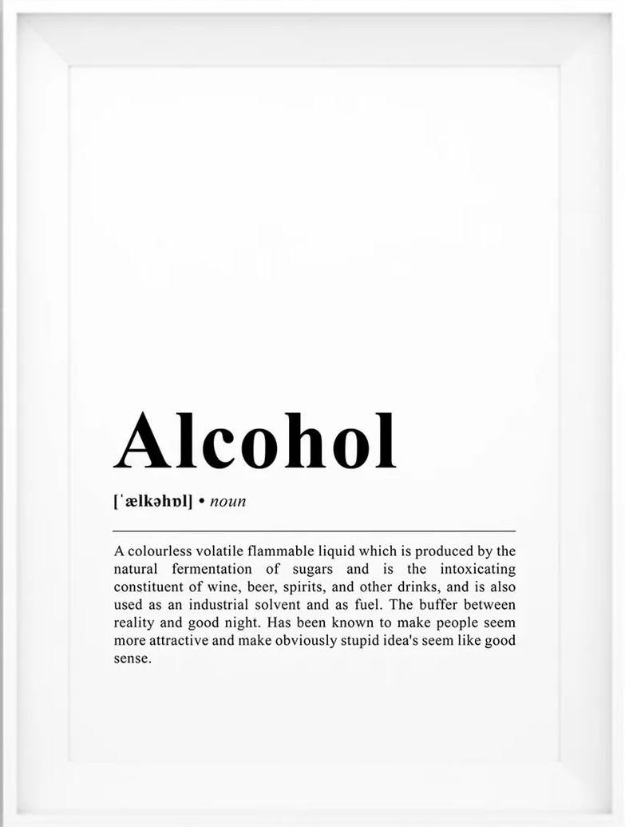
overview
What is ‘framing’? How does it apply to ‘Alcohol Use Disorder’ (AUD)?
How does language interact with AUD stigma?
How does AUD framing affect public health objectives?
Can we use language to help reduce alcohol harm?
How does the alcohol industry try to influence how we think about alcohol harms and possible solutions?

Slide 4

Framing: how language shapes beliefs and behaviour
‘Framing’ is how we represent or portray a certain issue
Framing includes - but extends beyond - word choice
Alcohol problems/addiction may be framed as:
  A ‘disease’ (in various senses, including metaphorically)
  A ‘weakness of will’ (moral model)
  A trauma/self-medication response (e.g. Gabor Mate)
  A ‘disorder’ of choice (e.g. Nick Heather)
  A biopsychosocial issue (‘pluralism’)
  A ‘continuum of use and harms’… (e.g., IoM/Morris et al.)
Each ‘frame’ has implications for AUD ‘sense making’ and responses

Slide 5

Framing in AUD contexts
What are ‘alcohol problems’ according to ‘professionals?
  ‘Alcohol use disorder’ (AUD) meaning varies e.g., DSM-5 Vs NICE
  UK alcohol policy discourse: framed mainly around behaviour
  The ‘two worlds of alcohol problems’ (Storbjörk and Room, 2008)
    Treatment/clinical focus (i.e., ‘dependence’)
    Public health approaches as ‘upstream’ prevention (‘risk’)
Some specific framing challenges..
  How to communicate CMO’s ‘low risk guidelines’
    “No safe level” / ‘group 1 carcinogen’ – technically correct but is this effective messaging?
  ‘Lived experience’ perspectives
    What counts as lived experience? Who do they include/exclude?
‘Safe. Sensible. Social’: 2007 national alcohol strategy

Slide 6
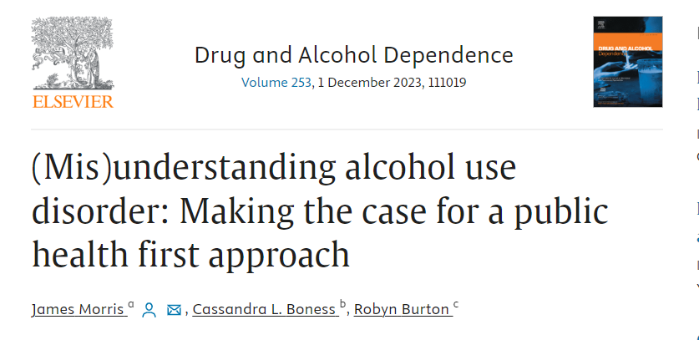
‘AUD’ language & the public?
The public’s language around alcohol use and problems is largely discordant from professional approaches, e.g.:
  ‘Alcoholism’ Vs ‘AUD’/dependence
  ‘Knowing my own limits’ Vs ‘risk’ or ‘heavy episodic drinking’
  Short term effects (e.g., hangxiety) Vs long term conditions
Recovery terminology is more universal but can be problematic outside of recovery contexts
  ‘Denial’, ‘relapse’, ‘disease’
What do film and media depictions convey?

Slide 7
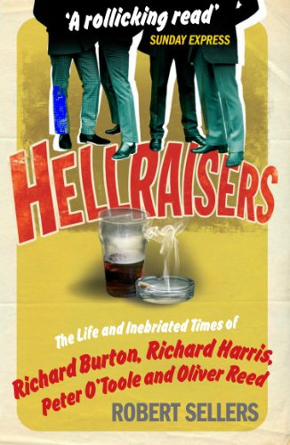
“Hellraisers” (2009)
A book about Richard Burton, Richard Harris, Peter O’Toole and Oliver Read’s drinking which offers:
“…a celebratory catalogue of their miscreant deeds, a greatest-hits package, as it were, of their most breathtakingly outrageous behavior, told with humor and affection.”

Slide 8
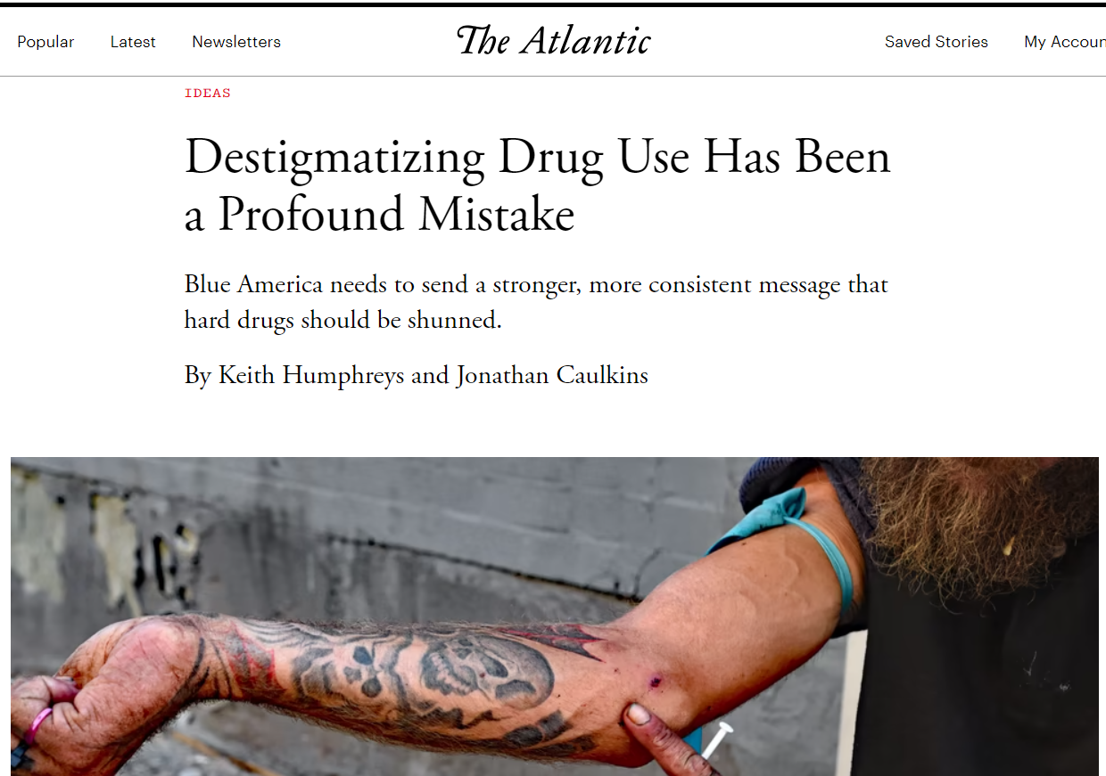
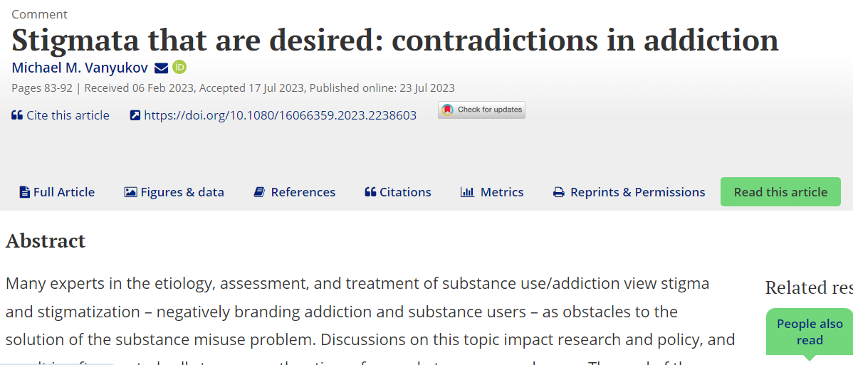
From Glamourising to ‘disapproval’?
Recent calls have been made that society needs to be wary of ‘destigmatizing’ addiction (Humphreys & Caulkin 2023) or that societal ‘disapproval’ is needed for disincentivizing harmful substance use (Vanyukov 2023a, 2023b)
Vanyukov argues that societal ‘disapproval’ must be separated from stigma as discrimination
But what does this look like in practice?
  Social norms do steer behaviour, but can society enact disapproval without inducing stigma? (Morris et al. 2024, under review/pre-print)

Slide 9

What is stigma?
‘Spoiled identity’ (Goffman, 1963)
  “When a person carries a mark or stigma that sets them apart, this can discredit them in the eyes of others and threaten their sense of identity.”*
But.. stigma is a complex process of social devaluation
Stigma ‘sets apart’ others through a process of**:
  labelling
  stereotyping
  separation
  status loss
  discrimination
Cognitive processes
**Conceptualizing Stigma
Link & Phelan (2001)
harmful consequences
* Anne Moyer Ph.D*.
https://www.psychologytoday.com/gb/blog/beyond-treatment/201708/cancer-and-stigma

Slide 10

Public Vs self-stigma
Public stigma reflects negative beliefs (stereotypes) the public hold about a group. E.g.
A 2005 study*: UK public said people with ‘alcoholism’ were:
  a danger to others (64%)
  unpredictable (70%)
  only had themselves to blame (54%)
This results in social identity threat (stereotype threat) - people know they will be stigmatised if labelled as problem drinkers in the eyes of others
Self-stigma is internalised stigma - believing negative stereotypes apply to oneself, leading to negative health and behavioral effects, e.g.:
‘I am worthless, why try?’
‘I can’t change my drinking’
*Crisp et al. (2005) ‘Stigmatization of people with mental illnesses: a follow-up study within the Changing Minds campaign of the Royal College of Psychiatrists.

Slide 11
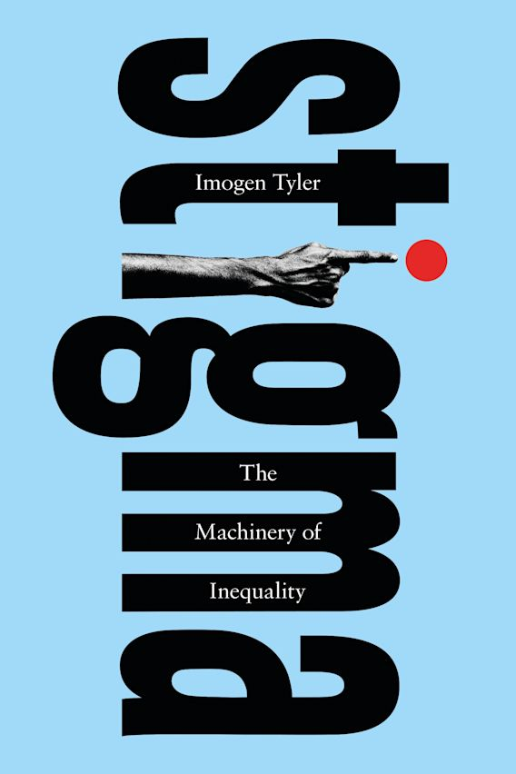
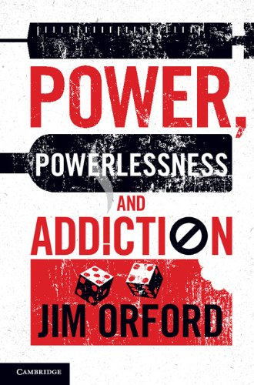
Stigma and power
Many contemporary perspectives focus on stigma as part of the machinery of inequality (Tyler, 2020)
Stigma is embedded within power structures (money, power, social dominance etc.) – it is used to enact or maintain unfair systems and systematic discrimination
Stigma Power Theory (Link & Phelan 2014). Stigma is motivated by:
  Keeping people ‘down’ (oppression/discrimination)
  Keeping people ‘in’ (enforcing social norms)
  Keeping people ‘away’ (discrimination)
Throughout the history through to modern politics of division, dehumanizing narratives are deployed to incite, justify or normalize mistreatment of an ‘out-group’

Slide 12
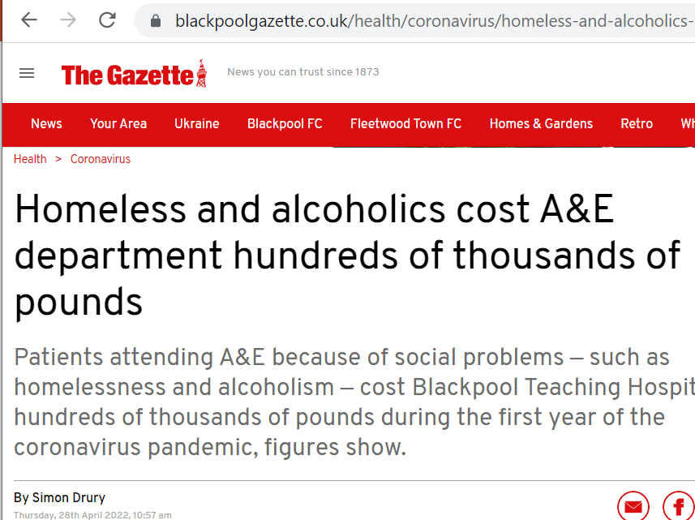
Alcohol stigma
Alcohol problems are amongst the most stigmatised conditions (Killian et al., 2021)
Media representations of substance use problems perpetrate the same negative stereotypes as mental health issues (dangerous, criminal) as well as ‘denial’ and ‘selfishness’ (Nieweglowski et al., 2018)
As well as discrimination and shame, stigma harms recovery by hindering problem recognition and help-seeking (Morris et al. 2020, Wallhed-Finn et al,. 2014)
A systematic review of barriers to alcohol treatment consistently identified “Shame, fear of stigma, lack of perception of treatment need…” (May et al., 2019)
“I actually wouldn’t acknowledge I was [seeking alcohol help], or what is it you say, you know, airing your dirty washing in public.”
(online help-seeker, Khadjesari et al. 2015)

Slide 13
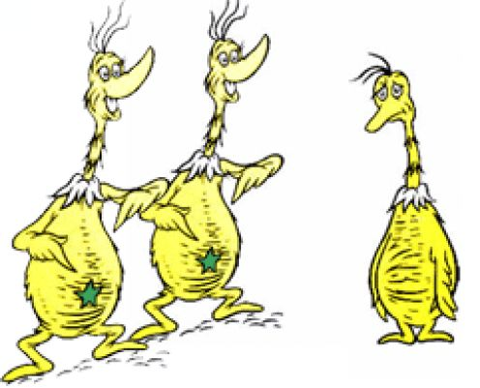
Labelling: a key stigma stage
Labelling is a key component of stigma processes; labels are the basis for marking out socially perceived difference and attaching stereotypes
As such, labelled people become targets for separation and stereotyping:
“…labeled persons are placed in distinct categories so as to accomplish some degree of separation of ‘us’ from ‘them’ ”
(Link & Phelan, 2001, p. 367)
  “I wanted to be able to come out there and say ‘see I’m not an alcoholic ‘cause I’m not like these people’ [ ] I just wanted somebody to prove to me that I wasn’t an alcoholic…”
  (AA participant, Hill & Leeming, 2014, p. 765)

Slide 14
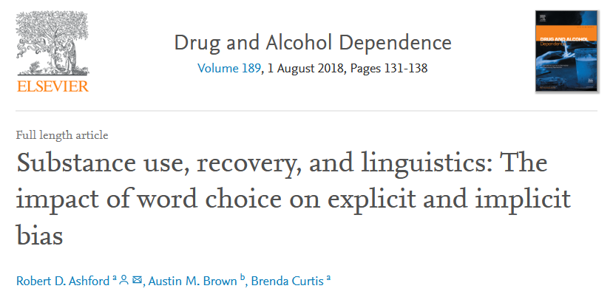
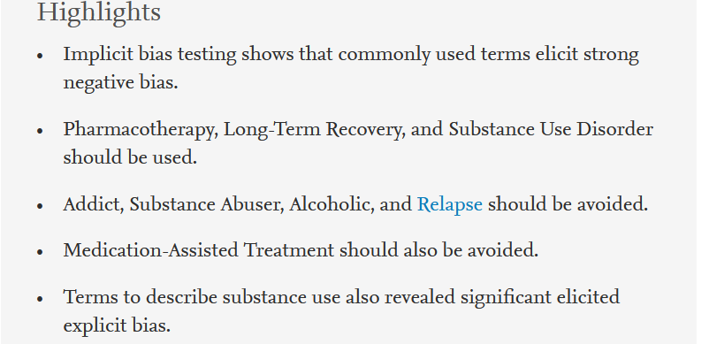
Labelling in alcohol stigma
In an otherwise identical vignette, the term ‘alcoholic’ Vs ‘person with an Alcohol Use Disorder’ was associated with higher stigma on both explicit (conscious) and implicit (subconscious) measures amongst the public (Ashford et al., 2018, see also Kelly et at., 2009)
I.e. ‘Words matter’

Slide 15
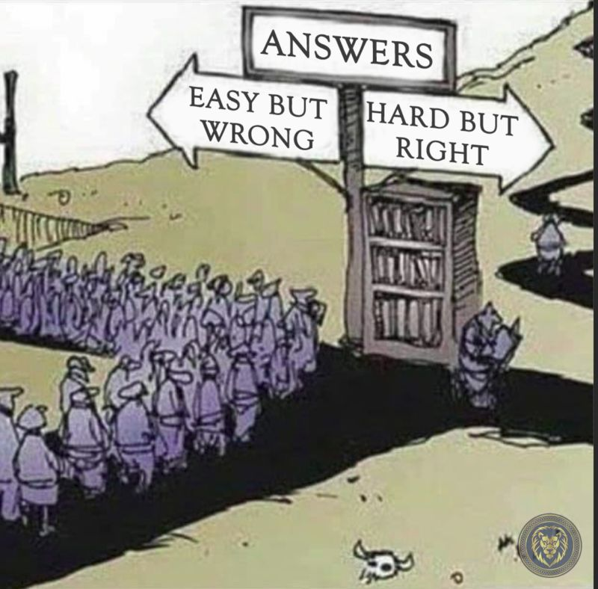
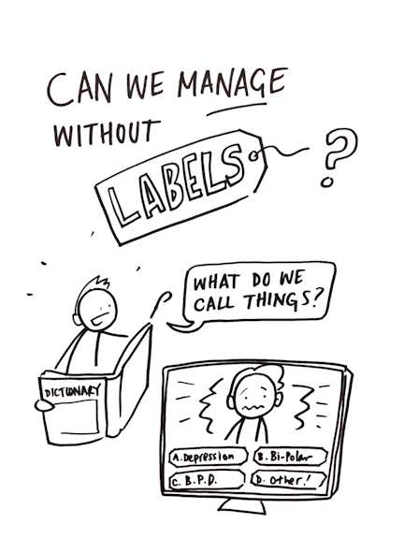
In defence of labelling…
Labelling is an essential part of language and cognition (‘thinking’)
It helps us to communicate and make sense of the world
It enables quick decision making (mental shortcuts/heuristics)
Labelling therefore functions to:
        Identify things e.g. an ‘alcohol problem’
        Determine what we might want or need to do (esp quickly)
        But.. our language shapes and makes our ‘realties’ via ‘received wisdom’ or ‘social facts’

Slide 16
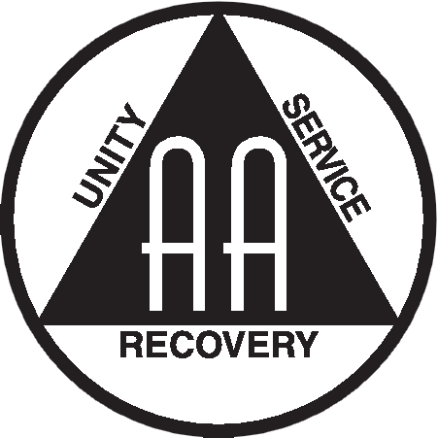
Alcoholic self-labelling
Alcoholics Anonymous (AA) members self-label as “alcoholics”
This is part of the sense making process of ‘alcoholism’ as ‘disease’/’illness’ to facilitate ‘recovery’
The adoption of the alcoholic identity is required for AA success (Glassman 2022)
Alcoholic self-labelling represents problem recognition i.e. not being ‘in denial’/step 1 (‘we admitted we were powerless’)
Self-labeling may help in dealing with shame/blame
Bonding with stigmatised others e.g. fellow AA members is empowering (Cruwys & Gunaseelan, 2016)
‘Recovering alcoholic’ is a positive identity shift within AA

Slide 17

When ‘Alcoholism’ framing spills over
Most people with alcohol problems will never self-identify as ‘alcoholics’ – yet most will resolve them, usually without formal support (‘natural recovery’/’self-change’)
‘Alcoholism’ framing is embedded within beliefs about alcohol problems as:
  A ‘disease’ (many interpretations – metaphorical, spiritual, physical, psychological)
  Individually located (vs environmentally influenced)
  Abstinence as the only route to recovery
  Existing as a distinct group of ‘alcoholics’
  Low problem recognition labelled as ‘denial’
Alcoholism framings dominate language and thinking around alcohol problems, in turn undermining public health goals, e.g. via ‘othering’
Participant with ‘harmful’ AUDIT-C score (10):
“I drink in moderation. Like my daughter, she’s alcoholic… I’ve seen her drink two bottles of vodka. She’s terrible. I couldn’t do that”
Gough et al., 2019

Slide 18
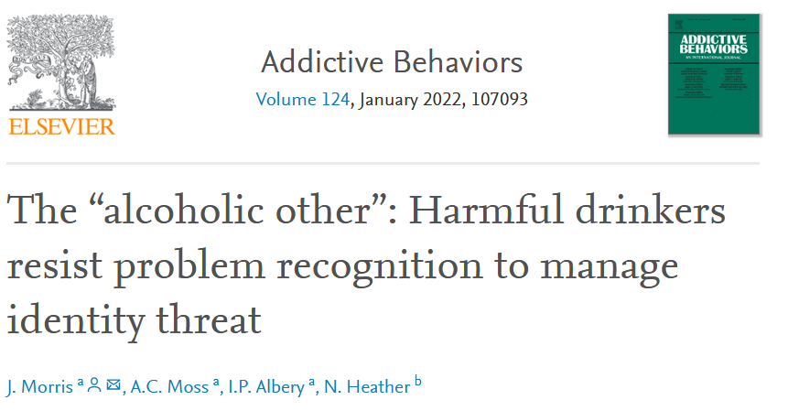
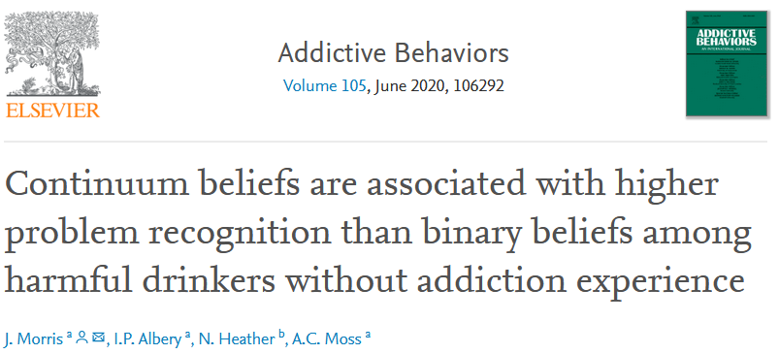
Using Continuum beliefs to counter ‘othering’?
Study 1:
Video vignette “I’m not so different from most people.. Anyone can develop a problem with alcohol..”
People with harmful drinking and no self-identified addiction experience had higher problem recognition in the continuum condition versus control (p=.007) and binary (p<.001) conditions
Study 2:
Using a script based text, continuum beliefs did not increase problem recognition
Participants had lower problem recognition when exposed to ‘alcoholic’ terminology
The ‘alcoholic’ label resulted in ‘identity threat’ - as seen with rejecting a ‘mental illness’ label (Thoits, 2016)

Slide 19
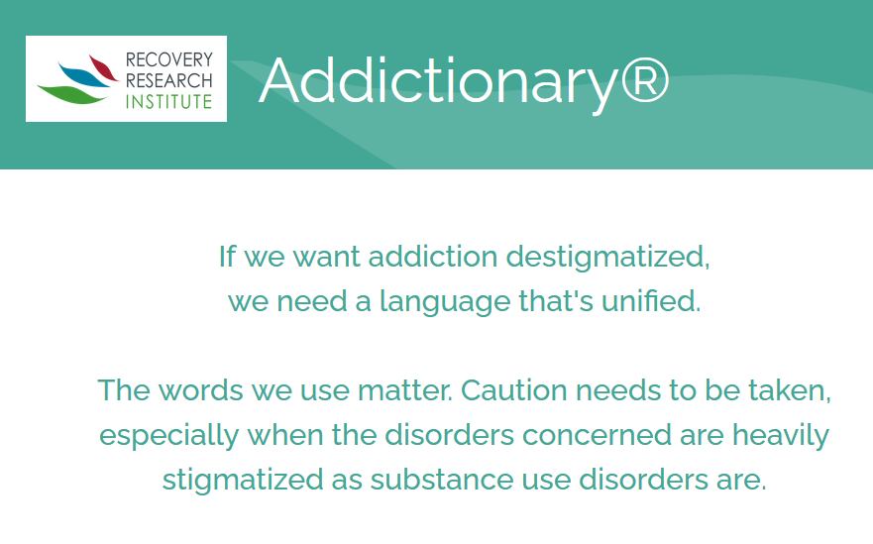
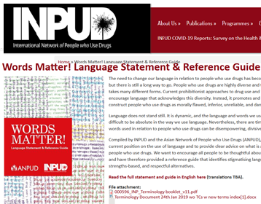
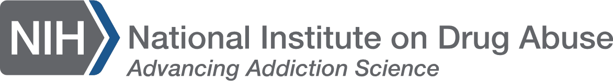
‘person first’ language: A quick fix?
Calls for ‘person first’ language (‘person with alcohol use disorder’) are now widely endorsed outside of self-labelling

Slide 20
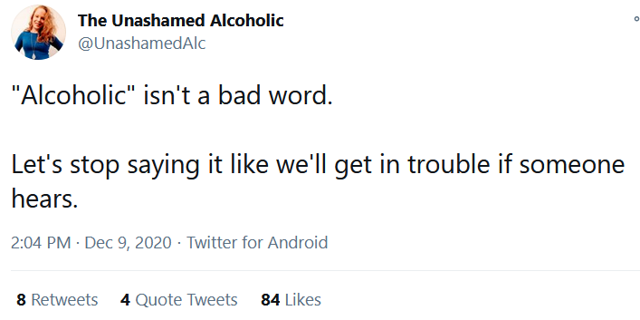
Can’t we just de-stigmatise
‘alcoholism’?
Some argue we should fight stigma by normalising stigma laden terms/labels
This strategy has been described as ‘revaluing’ as seen in some racial and homophobic discourse, but with unclear results (Wang et al., 2017)
Whilst self-labelling can be important within recovery contexts, it is not a panacea for self-stigma (e.g., Hill & Leeming, 2014, Schomerus et al., 2011)
No evidence that revaluing can shift public stigma for addiction
Revaluing is only possible where “the pejorative use of the term is not yet entrenched” (Bolinger, 2020)

Slide 21
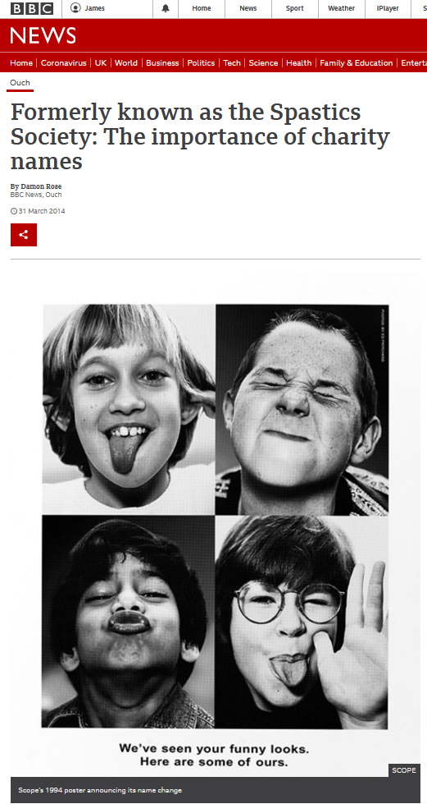
‘Renaming’ …
Disability charities have changed their names from those that are deficit/stigma laden, e.g., the Spastics Society is now Scope
But does it work?
Limited AUD/addiction stigma evidence but:
In Japan, legislative change resulted in the renaming of the term ‘schizophrenia’ was linked to less stigmatising media reporting of mental health problems in following years (Aoki et at., 2016)
We know ‘person first’ terms are associated with less public stigma than alcoholic labelling and ‘abuse’, ‘relapse’ etc can be problematic outside of recovery contexts

Slide 22

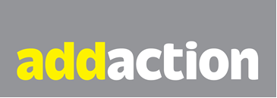
Renaming in practice: providers
In 2020, the drug, alcohol and mental health charity formerly known as Addaction announced it was changing name to We Are With You, stating:
  ‘The focus of the rebrand is on using “non-judgmental” language that makes it easier for people to ask for help.’
Laura Bunt, acting chief executive, said:
“Our research shows that language around addiction can in itself be a huge barrier to people seeking help. As We Are With You, we will use everyday language and focus on the help we offer, not the problem.”

Slide 23
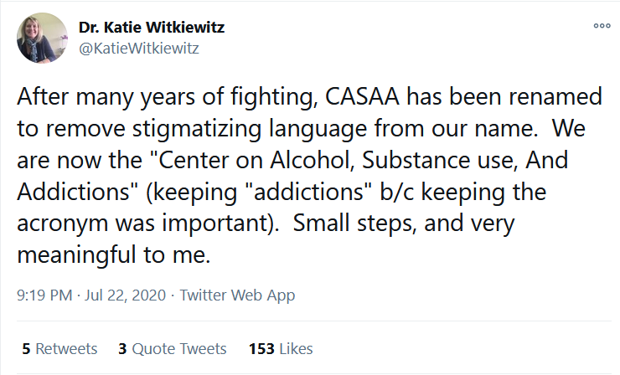
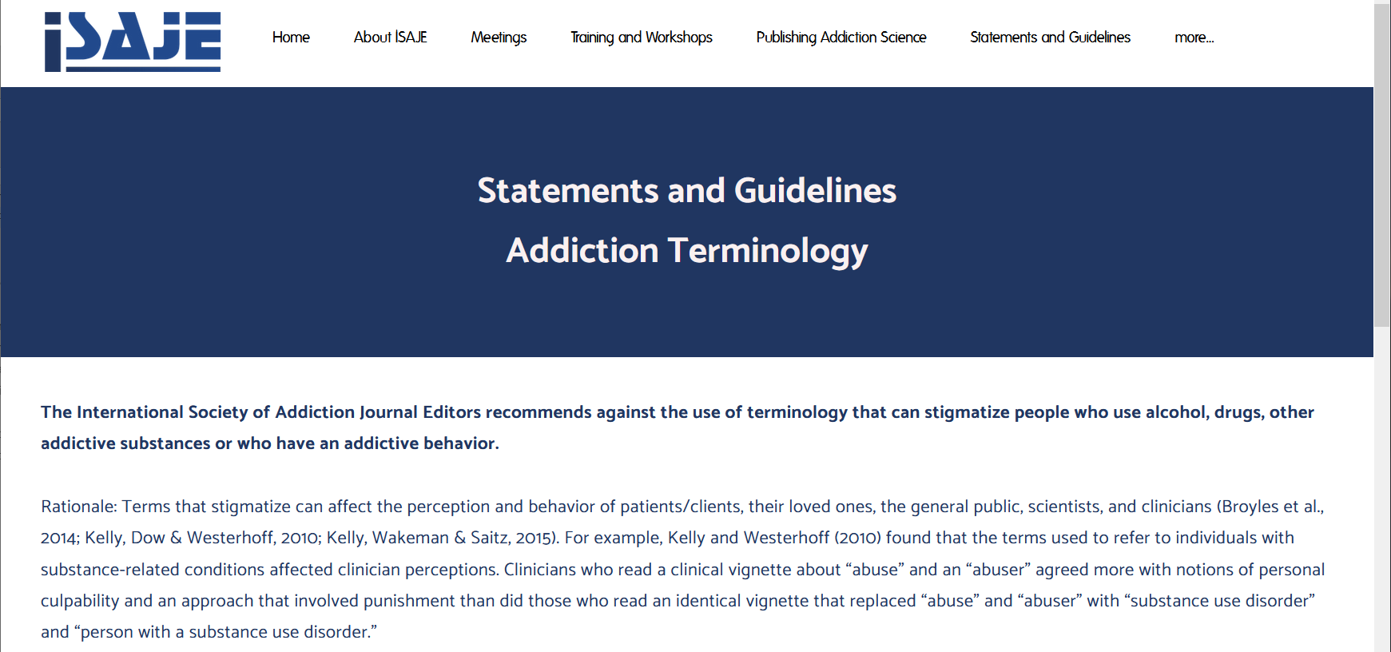
Renaming in practice: academia
Addiction research centres/bodies are also leading by example e.g.:
University of New Mexico’s ‘CASAA’ changed ‘Alcoholism’ and ‘Abuse’ to ‘Alcohol’ and ‘Use’
The International Society of Addiction Journal Editors urges against stigmatising language and encourages person-first language

Slide 24
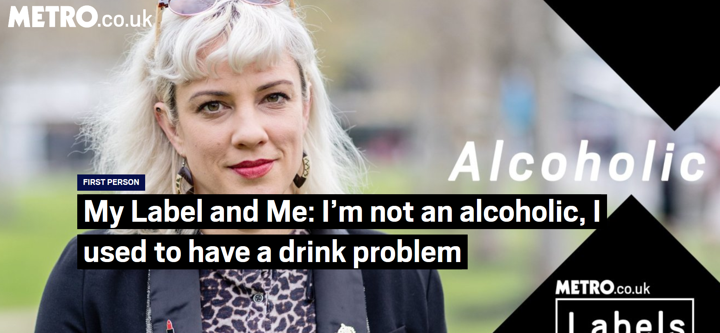
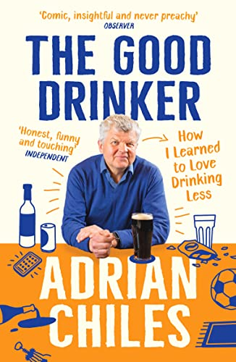
Renaming/framing in practice: people
The ‘Adrian Chiles effect’
Challenging ‘abstinence only’ & ‘alcoholism’ stereotypes to increase problem recognition (Morris et al. 2022)
“Some people like to apply ‘alcoholic’ to themselves…I respect that, but I would argue that they are the only people with the right to wield the label. Personally, I’ll stick with ‘I used to have a drink problem.’ ”
Jenny Valentish
The Metro, 29 Nov 2018

Slide 25
The ‘euphemism treadmill’?
Words and meanings change over time
  Toilet; W.C, privy house, bog house, Necessary House etc.
  Mental health; melancholia, neurosis, hypochondria etc.
  Addiction terminology
Replacing stigmatized language with non-stigmatized terms (e.g. PFL) is one iteration of more to come
This does not render PFL pointless – it reflects the inevitability of language shift whilst signalling the importance of language
Of course, structural and wider action is still needed – but this is bi-directional!
Stephen Pinker in a 1994 New York Times article, “The Game of the Name” wrote:
“People invent new ‘polite’ words to refer to emotionally laden or distasteful things, but the euphemism becomes tainted by association and the new one that must be found acquires its own negative connotations.”

Slide 26
Framing is not the solution.. But it is part of it
Language does not address the root causes of alcohol problems…but…
Language shapes how alcohol problems are framed and understood, and in turn what responses are deemed valid
The alcohol industry is not the only actor trying to shape how alcohol problems are framed, but it does have a lot of resources
Using language to shift societal views of alcohol problems away from an individually located framings (disease/behaviour etc) to a complex societal issue can facilitate more effective responses (e.g., policy levers, less stigma, prevention etc.)
“there is the shame and stigma related to [alcohol] … that makes it a lot harder to ask about.”
(GP, Nygaard & Aasland 2010)

Slide 27
Recommendations & next steps
“We learnt the importance of narrative.. Statistics should not be the only way”
Prof Ian Gilmore on the ‘The report of the commission on alcohol harm’ at Health and Social Care Committee 20.05.24
Recognise the importance of language and framing in discussions about alcohol use and harms – but remember context matters
Emphasise that alcohol use and harms are:
  More complex than our language and media portray
  Most people resolve ‘AUD’ - often without formal help and via moderation
  Strongly environmentally influenced (‘commercial determinant of health’)
Further work to understand how framing affects alcohol outcomes across a range of contexts, e.g.:
  Further work required to understand just how much the alcohol industry has shaped what we know about alcohol
  Alcohol Change UK funded project led by Institute of Social Marketing (Stirling) forthcoming, including toolkit to support framing/communications (contact@alcoholchange.org.uk to receive when available)

Slide 28
Thank you & questions?
Dr James Morris, Research Fellow, Centre for Addictive Behaviours Research, London South Bank University
E: morrrij24@lsbu.ac.uk
Twitter/X: @jamesmorris24
The Alcohol ‘Problem’ Podcast @alcoholpodcast
Dr Gemma Mitchell, Research Fellow, Institute of Social Marketing and Health, University of Stirling
E: gemma.mitchell@stir.ac.uk
Twitter/X: @GemmaMi38728064

Slide 29
References
Aoki, A., Aoki, Y., Goulden, R., Kasai, K., Thornicroft, G., & Henderson, C. (2016). Change in newspaper coverage of schizophrenia in Japan over 20-year period. Schizophrenia Research, 175(1–3), 193–197. https://doi.org/10.1016/j.schres.2016.04.026
Ashford, R. D., Brown, A. M., & Curtis, B. (2018). Substance use, recovery, and linguistics: The impact of word choice on explicit and implicit bias. Drug and Alcohol Dependence, 189, 131–138. https://doi.org/10.1016/j.drugalcdep.2018.05.005
Bartlett, A., & McCambridge, J. (2024). Different Disciplines Have Different Perspectives, So What Are the Implications for the Multidisciplinary Field of Alcohol Public Health Science? A Reply to “All Boundaries Have Two Sides” by Bray and Kenkel (2024). Https://Doi.Org/10.15288/Jsad.24-00090, 85(3), 430–432. https://doi.org/10.15288/JSAD.24-00090
Bolinger, R. J. (2021). The language of mental illness. In J. Khoo & R. Sterken (Eds.), The Routledge Handbook of Social and Political Philosophy of Language (pp. 389–404). https://doi.org/10.4324/9781410606686-12
Crisp, A., Gelder, M., Goddard, E., & Meltzer, H. (2005). Stigmatization of people with mental illnesses: a follow-up study within the Changing Minds campaign of the Royal College of Psychiatrists. World Psychiatry : Official Journal of the World Psychiatric Association (WPA), 4(2), 106–113. http://www.ncbi.nlm.nih.gov/pubmed/16633526
Cruwys, T., & Gunaseelan, S. (2016). “Depression is who i am”: Mental illness identity, stigma and wellbeing. Journal of Affective Disorders, 189, 36–42. https://doi.org/10.1016/j.jad.2015.09.012
Gilmore, A. B., Fabbri, A., Baum, F., Bertscher, A., Bondy, K., Chang, H. J., Demaio, S., Erzse, A., Freudenberg, N., Friel, S., Hofman, K. J., Johns, P., Abdool Karim, S., Lacy-Nichols, J., de Carvalho, C. M. P., Marten, R., McKee, M., Petticrew, M., Robertson, L., … Thow, A. M. (2023). Defining and conceptualising the commercial determinants of health. The Lancet, 401(10383), 1194–1213. https://doi.org/10.1016/S0140-6736(23)00013-2
Glassman, H. S., Moensted, M., Rhodes, P., & Buus, N. (2022). The politics of belonging in Alcoholics Anonymous: A qualitative interview study. American Journal of Community Psychology, 70(1–2), 33–44. https://doi.org/10.1002/ajcp.12568
Goffman, E. (1963). Stigma: notes on the management of spoiled identity. Englewood Cliffs, N.J., Prentice-Hall.
Golder, S., & McCambridge, J. (2021). Alcohol, cardiovascular disease and industry funding: A co-authorship network analysis of systematic reviews. Social Science & Medicine, 289, 114450. https://doi.org/10.1016/J.SOCSCIMED.2021.114450
Gough, B., Madden, M., Morris, S., Atkin, K., & McCambridge, J. (2019). How do older people normalise their drinking?: An analysis of interviewee accounts. Appetite, 104513. https://doi.org/10.1016/J.APPET.2019.104513

Slide 30
References
Heyman, G. M. (2023). Disapproving of destructive drug use should not be confused with stigmatizing drug addicts. Addiction Research & Theory. https://doi.org/10.1080/16066359.2023.2254224
Hill, J. V., & Leeming, D. (2014). Reconstructing “the Alcoholic”: Recovering from Alcohol Addiction and the Stigma this Entails. International Journal of Mental Health and Addiction, 12(6). https://doi.org/10.1007/s11469-014-9508-z
Humphreys, K., & Caulkins, J. (2023). Destigmatizing Drug Use Has Been a Profound Mistake - The Atlantic. The Atlantic. https://www.theatlantic.com/ideas/archive/2023/12/destigmatizing-drug-use-mistake-opioid-crisis/676292/
Jernigan, D., & Ross, C. S. (2020). The Alcohol Marketing Landscape: Alcohol Industry Size, Structure, Strategies, and Public Health Responses. Journal of Studies on Alcohol and Drugs, 2020(s19), 13–25. https://doi.org/10.15288/jsads.2020.s19.13
Kelly, J. F., Dow, S. J., & Westerhoff, C. (2010). Does our choice of substance-related terms influence perceptions of treatment need? An empirical investigation with two commonly used terms. Journal of Drug Issues, 40(4), 805–818. https://doi.org/10.1177/002204261004000403
Khadjesari, Z., Stevenson, F., Godfrey, C., & Murray, E. (2015). Negotiating the “grey area between normal social drinking and being a smelly tramp”: A qualitative study of people searching for help online to reduce their drinking. Health Expectations, 18(6), 2011–2020. https://doi.org/10.1111/hex.12351
Kilian, C., Manthey, J., Carr, S., Hanschmidt, F., Rehm, J., Speerforck, S., & Schomerus, G. (2021). Stigmatization of people with alcohol use disorders: An updated systematic review of population studies. Alcoholism: Clinical and Experimental Research, 45(5), 899–911. https://doi.org/10.1111/acer.14598
Knai, C., Petticrew, M., Douglas, N., Durand, M. A., Eastmure, E., Nolte, E., & Mays, N. (2018). The Public Health Responsibility Deal: Using a Systems-Level Analysis to Understand the Lack of Impact on Alcohol, Food, Physical Activity, and Workplace Health Sub-Systems. International Journal of Environmental Research and Public Health 2018, Vol. 15, Page 2895, 15(12), 2895. https://doi.org/10.3390/IJERPH15122895
Link, B. G., & Phelan, J. (2014). Stigma power. Social Science & Medicine, 103, 24–32. https://doi.org/10.1016/J.SOCSCIMED.2013.07.035
Link, B. G., & Phelan, J. C. (2001). Conceptualizing Stigma. Annual Review of Sociology, 27(1), 363–385. https://doi.org/10.1146/annurev.soc.27.1.363

Slide 31
References
May, C., Nielsen, A. S., & Bilberg, R. (2019). Barriers to treatment for alcohol dependence. In Journal of Drug and Alcohol Research (Vol. 8, Issue 2, pp. 1–17). Journal of Drug and Alcohol Research. https://doi.org/10.4303/jdar/236083
Mialon, M., & McCambridge, J. (2018). Alcohol industry corporate social responsibility initiatives and harmful drinking: a systematic review. European Journal of Public Health, 28(4), 664–673. https://doi.org/10.1093/EURPUB/CKY065
Mitchell, G., Lesch, M., & McCambridge, J. (2020). Alcohol industry involvement in the moderate alcohol and cardiovascular health trial. American Journal of Public Health, 110(4), 485–488. https://doi.org/10.2105/AJPH.2019.305508
Mitchell, G., & McCambridge, J. (2022). The ‘snowball effect’: short and long-term consequences of early career alcohol industry research funding. Addiction Research & Theory, 30(2), 119–125. https://doi.org/10.1080/16066359.2021.1952190
Mitchell, G., & McCambridge, J. (2023). Interactions Between the U.S. National Institute on Alcohol Abuse and Alcoholism and the Alcohol Industry: Evidence From Email Correspondence 2013–2020. Https://Doi.Org/10.15288/Jsad.22-00184, 84(1), 11–26. https://doi.org/10.15288/JSAD.22-00184
Morris, J., Albery, I. P., Heather, N., & Moss, A. C. (2020). Continuum beliefs are associated with higher problem recognition than binary beliefs among harmful drinkers without addiction experience. Addictive Behaviors, 105, 106292. https://doi.org/10.1016/j.addbeh.2020.106292
Morris, J., Boness, C. L., & Burton, R. (2023). (Mis)understanding alcohol use disorder: Making the case for a public health first approach. Drug and Alcohol Dependence. https://doi.org/https://doi.org/10.1016/j.drugalcdep.2023.111019
Morris, J., Boness, C. L., & Witkiewitz, K. (2023). Should we promote alcohol problems as a continuum? Implications for policy and practice. Drugs: Education, Prevention and Policy. https://doi.org/10.1080/09687637.2023.2187681
Morris, J., Kummetat, J. L., & Schomerus, G. (2024). Can ‘justified disapproval’ be separated from addiction stigma? An empirical focus is required. OSF PrePrints. https://osf.io/preprints/osf/vx9r3
Morris, J., Moss, A. C., Albery, I. P., & Heather, N. (2022). The “alcoholic other”: harmful drinkers resist problem recognition to manage identity threat. Addictive Behaviors, 124, 107093. https://doi.org/10.1016/j.addbeh.2021.107093
Nieweglowski, K., Corrigan, P. W., Tyas, T., Tooley, A., Dubke, R., Lara, J., Washington, L., Sayer, J., & Sheehan, L. (2018). Exploring the public stigma of substance use disorder through community-based participatory research. Addiction Research and Theory, 26(4), 323–329. https://doi.org/10.1080/16066359.2017.1409890
Nygaard, P., & Aasland, O. G. (2011). Barriers to Implementing Screening and Brief Interventions in General Practice: Findings from a Qualitative Study in Norway. Alcohol and Alcoholism, 46(1), 52–60. https://doi.org/10.1093/alcalc/agq073

Slide 32
References
Smith, S. W., Atkin, C. K., & Roznowski, J. A. (2006). Are “Drink Responsibly” Alcohol Campaigns Strategically Ambiguous? Health Communication, 20(1), 1–11. https://doi.org/10.1207/S15327027HC2001_1
Stockwell, T., Zhao, J., Clay, J., Levesque, C., Sanger, N., Sherk, A., & Naimi, T. (2024). Why do only some cohort studies find health benefits from low volume alcohol use? A systematic review and meta-analysis of study characteristics that may bias mortality risk estimates. Https://Doi.Org/10.15288/Jsad.23-00283. https://doi.org/10.15288/JSAD.23-00283
Storbjörk, J., & Room, R. (2008). The two worlds of alcohol problems: Who is in treatment and who is not? Addiction Research and Theory, 16(1), 67–84. https://doi.org/10.1080/16066350701578136
Thoits, P. A. (2016). “I’m Not Mentally Ill”: Identity Deflection as a Form of Stigma Resistance. Journal of Health and Social Behavior, 57(2), 135–151. https://doi.org/10.1177/0022146516641164
Tyler, I. (2020). Stigma, The Machinery of Inequality. Bloomsbury. https://books.google.co.uk/books?hl=en&lr=&id=Y_80EAAAQBAJ&oi=fnd&pg=PP1&dq=stigma+the+machinery+of+inequality&ots=eVWYg0CnEa&sig=J03OOejMlWM4p6fZHBuHeSDhCBY
Ulucanlar, S., Lauber, K., Fabbri, A., Hawkins, B., Mialon, M., Hancock, L., Tangcharoensathien, V., & Gilmore, A. B. (2023). Corporate Political Activity: Taxonomies and Model of Corporate Influence on Public Policy. International Journal of Health Policy and Management, 12(1), 7292. https://doi.org/10.34172/IJHPM.2023.7292
Vanyukov, M. M. (2023). The misnomer of substance use “stigma”: beneficial disapproval should not be conflated with mistreatment of users. Addiction Research & Theory, 1–3. https://doi.org/10.1080/16066359.2023.2283574
Wallhed Finn, S., Bakshi, A.-S., & Andréasson, S. (2014). Alcohol consumption, dependence, and treatment barriers: perceptions among nontreatment seekers with alcohol dependence. Substance Use & Misuse, 49(6), 762–769. https://doi.org/10.3109/10826084.2014.891616
Wang, C. S., Whitson, J. A., Anicich, E. M., Kray, L. J., & Galinsky, A. D. (2017). Challenge Your Stigma: How to Reframe and Revalue Negative Stereotypes and Slurs. Current Directions in Psychological Science, 26(1), 75–80. https://doi.org/10.1177/0963721416676578

