Slide 1
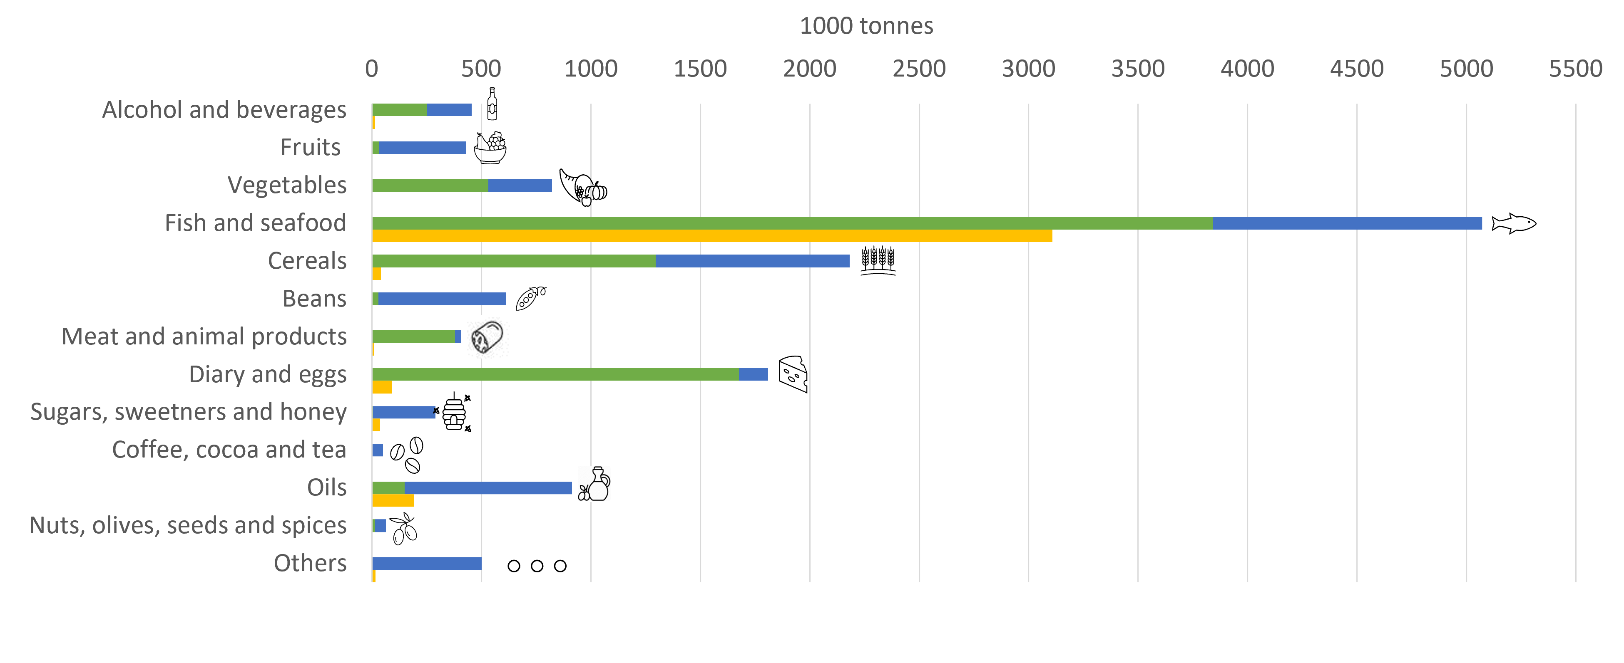
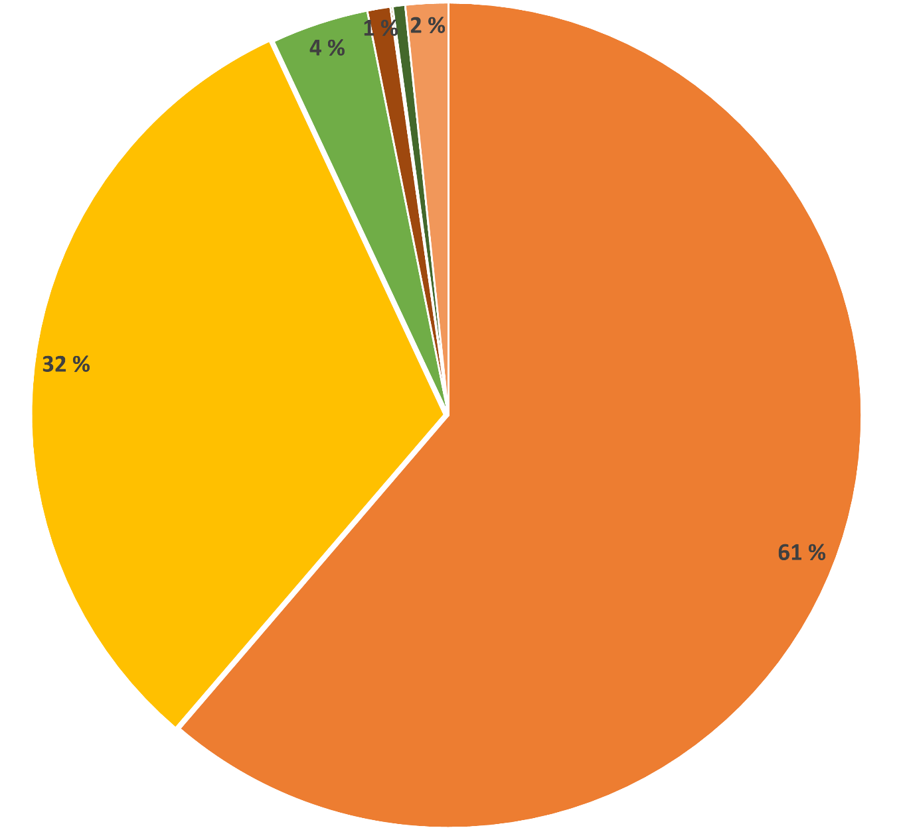
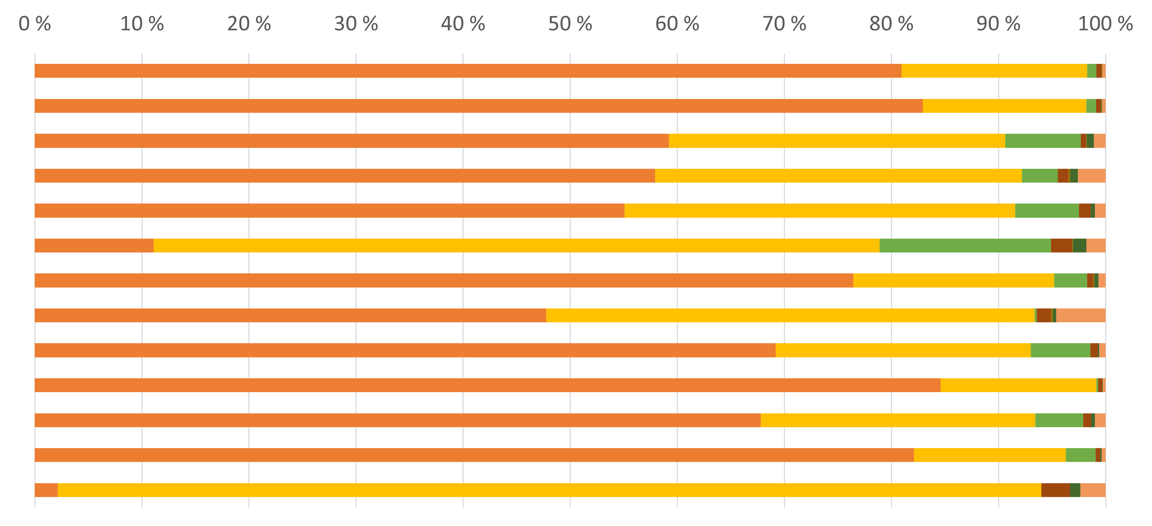
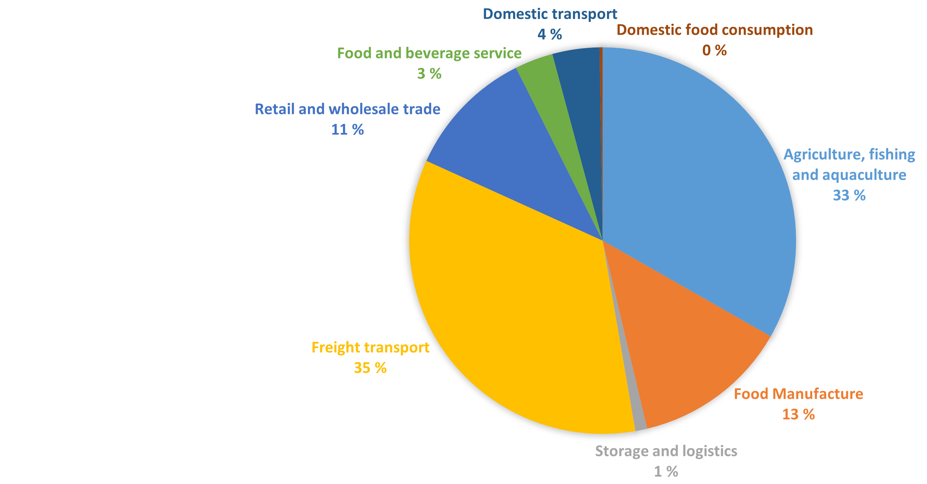
Greenhouse gas emissions in the Norwegian Food Sector using different approaches
Cristina-Maria Iordan¹, Shraddha Mehta¹, Andrea Viken Strand¹, Aminu Owonikoko², Judith Evans², Alan Foster², Antonio Rossetti³
¹SINTEF Ocean (Norway), ² London South Bank University (United Kingdom), ³The Construction Technologies Institute - National Research Council of Italy (Italy)
Food production, import and export
Produced in Norway
Imported into Norway
Exported from Norway
The original 74 food items reported in the annual statistic are aggregated here in 13 categories
Source: FAO
Year: 2019
Bottom-up emissions model – preliminary results (FAO data)
Breakdown of the total CO2eq. emissions from the 2019 Norwegian food sector into the 7 different stages based on the FAO production, import and export data
Production to arrival to regional distribution centre
Regional distribution centre to and including retail
Transport to home
Food service
Home cold storage
Home cooking
Food loss and waste (across all chain)
Breakdown of the CO2eq. Emissions in 2019 for each food category into the 7 different stages, based on the FAO production, import and export data
Top-down emissions model (Eurostat data)
Categories based on the Statistical classification of economic activities in the European Community (NACE).
All food sectors (except consumption) are included in the NACE defined sectors, and the food related part of the emissions are separated from the rest with "food shares“.
Scope 1 emissions (3.79 Mt CO2eq.) are from the Air Emissions Accounts from EUROSTAT and represent on-site fuel combustion for generation of electricity and heat, fuel combustion for food transport and other GHG gases.
Scope 1 fugitive emissions (0.12 Mt CO2eq.) are caused by fugitive emissions of F-gases leakage from refrigeration equipment.
Scope 2 emissions (0.16 Mt CO2eq.) are from the purchased energy, e.g. grid electricity and heat networks. A carbon intensity factor of 0.017 kg CO2eq./kWh the grid was applied for 2019 to convert grid electricity to carbon emissions.
0,03%
0,16 Mt CO2eq.
0,13 Mt CO2eq.
1,35 Mt CO2eq.
0,44 Mt CO2eq.
TOTAL EMISSIONS
4,07 Mt CO2eq.
1,4 Mt CO2eq.
0,53 Mt CO2eq.
This project has received funding from the European Union’s Horizon 2020 research and innovation programme under grant agreement No 101036588.

