Slide 1

Before ‘rock bottom’
Does a disease model hinder public health goals for alcohol?
Dr James Morris
Research Fellow, Centre for Addictive Behaviors Research
London South Bank University
@jamesmorris24

Slide 2
What I want to say..
From a public health approach to alcohol, a (brain) disease model of alcohol problems is harmful
Notably, a BDMA hinders problem recognition amongst many harmful drinkers who will not identify as ‘diseased’ or ‘alcoholics’
In part this is because of the significant stigma of alcohol problems embedded within BDMA/alcoholism narratives
I have no conflicts of interest to declare
10m 1.6m 0.6m

Slide 3

Alcohol stigma
Stigma is a complex multi-level process of social devaluation in
Stigmatized groups are ‘set apart’’ and become subject to discrimination, status loss and internalize negative steroptypes affecting self-worth, efficacy etc.
Alcohol problems are amongst the most stigmatised conditions (e.g.,Kilian et al., 2021)
As well as discrimination and shame, stigma harms recovery by hindering problem recognition, help-seeking & self-change (Morris et al. 2020, Wallhed-Finn et al,. 2014, Witkiewitz et al., 2021)

Slide 4
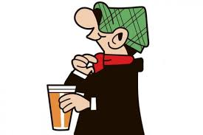
Managing stigma: ‘label avoidance’ & ‘othering’
Amongst harmful drinkers not in recovery/treatment, studies consistently show how drinking groups describe their drinking as ‘non-problematic’ versus ‘other’ problem drinkers (e.g., Parke et al., 2018)
‘Label avoidance’ immunises the self from stigma:
  No label – no judgement /discrimination (public stigma)
  No label – no shame/no loss of self-worth (self-stigma)
  No label – no need to give up drinking/valued identity
As such, heavy “social” drinkers inadvertently increase stigma by reinforcing negative ‘alcoholic’ stereotypes to contrast to their own ‘social’ drinking

Slide 5
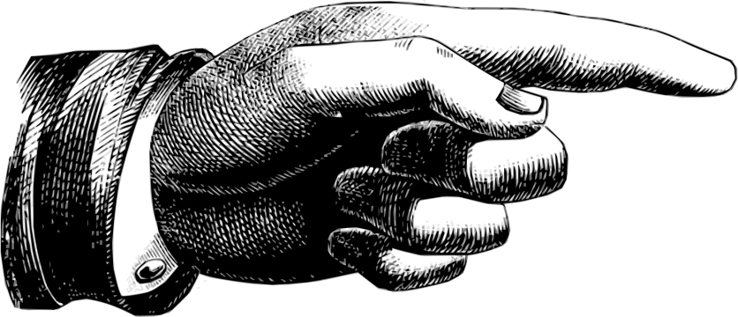
‘Label avoidance’ & ‘othering’
“I drink in moderation. Like my daughter, she’s alcoholic… I’ve seen her drink two bottles of vodka. She’s terrible. I couldn’t do that”
Participant with harmful drinking AUDIT-C score (10), Gough et al., 2019
“I have my mate, what’s it called, yes his godfather for instance is a superalcoholic...”
Participant with alcohol dependence, Walhed-Finn et al 2014
“It’s them!”
“It’s them!”

Slide 6

‘Framing’: how language shapes beliefs and behaviour
Framing is the selection and salience of certain information in a context, thus promoting “a particular problem definition, causal interpretation, moral evaluation, and/or treatment recommendation” (Entman, 1993, p. 52).
Alcohol problems/addiction may be framed as:
  A ‘disease’ (in various senses, including metaphorically)
  A ‘weakness of will’ (moral model)
  A consequence of trauma (e.g. Gabor Mate)
  A ‘disorder’ of choice
  A biopsychosocial issue (‘pluralism’)
  A continuum of use and harms…
Each ‘frame’ has implications for ‘sense making’ and stigma related beliefs for the self and others

Slide 7
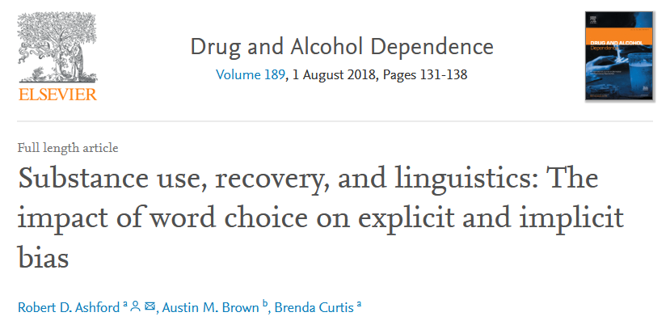
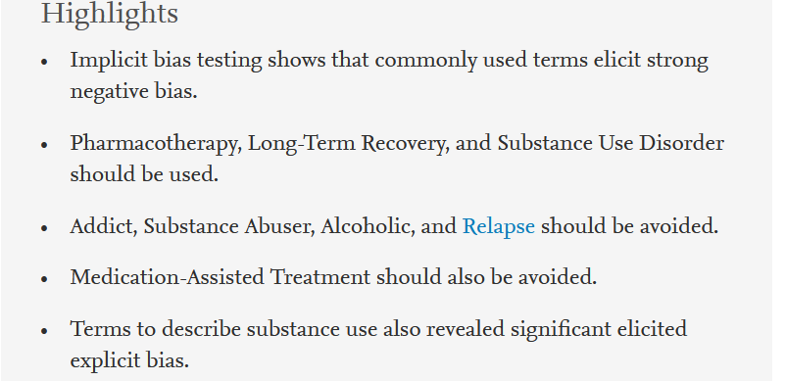
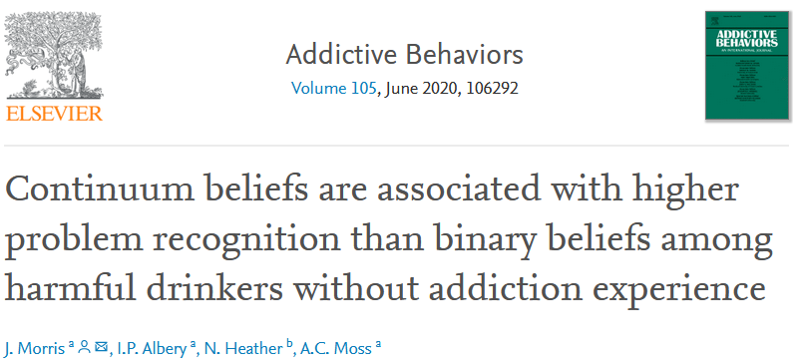
Framing effects on alcohol stigma
Using ‘alcoholic’ instead of ‘person with an Alcohol Use Disorder’ in an otherwise identical vignette was associated with higher stigma on both explicit (conscious) and implicit (subconscious) measures (Ashford et al., 2018, see also Kelly et at., 2009)
Harmful drinkers had higher problem recognition when exposed to continuum framing versus alcoholism framing (Morris et al., 2020)
Harmful drinkers had lower problem recognition when exposed to alcoholic stereotypes (Morris et al., 2021)

Slide 8
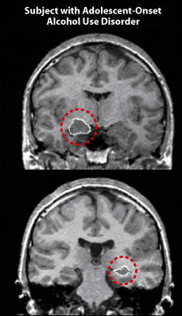
But doesn’t a disease model reduce stigma?
‘Alcoholism’ framing generally involves disease related beliefs, i.e., genetic/neurobiologically rooted
As per attribution theory, if a person is not to blame, they should not be stigmatised for the condition
Mental health issues have therefore been promoted as a “disease like any other”
“If we embrace the concept of addiction as a chronic disease in which drugs have disrupted the most fundamental brain circuits that enable us to do something that we take for granted—make a decision and follow it through—we will be able to decrease the stigma…Once people understand the underlying pathology of addiction, people with the disease…will simply, nonjudgmentally, receive the help they need, like a child with diabetes or a person with heart disease or cancer. They won’t have to feel that shame, or feel inferior, because people understand that they are suffering from a disease that should be treated like any other”
(Volkow, 2015, NIDA website).

Slide 9
But doesn’t a disease model reduce stigma?
However,
Blame is just one component (stereotype) of stigma
Some emphasise that attitudes or beliefs (blame) are not directly related to key stigma behaviours (discrimination) e.g.
There is still stigma for diseases with no/low blame because to be ‘diseased’ evokes fear (e.g., disease avoidance) and differentness
Empirical studies show…

Slide 10
Meta-analysis
Kvaale et al., (2013, 2015) meta-analysis of 53 studies on effects of biogentic beliefs (genetic/neuro) relating to mainly mental health problems found:
Lougham et al. (2018) meta-analysis of 26 studies on neuroscientific beliefs relating mainly to mental health problems:
Both conclude need for communicating complexity of aetiology
Beneficial | Detrimental
Reduced blame | Increased prognostic pessimism
 | Perceptions of dangerousness
 | Social distance*
Beneficial | Detrimental
Reduced blame | Increased prognostic pessimism
 | Perceptions of dangerousness
 | Social distance
*Found in correlational studies only

Slide 11
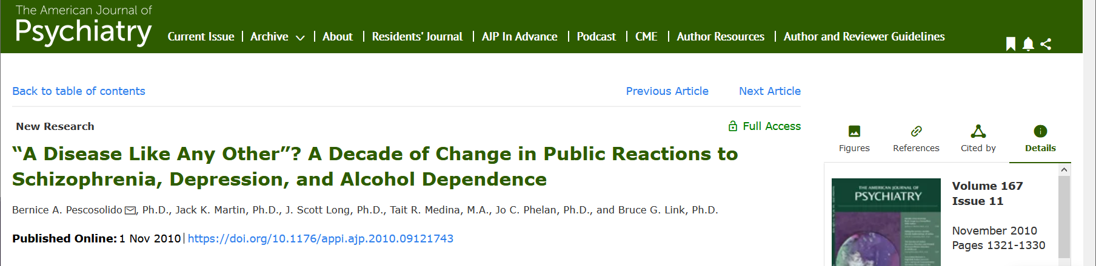
Despite rising beliefs in mental ‘illness’ & addiction issues as ‘disease’…
…public stigma was not reduced in the US (2006 vs 1996)..
Over the 10 years, more people believed alcohol dependence was an ‘illness’, genetic, or a problem of the brain
‘No significant decrease was reported in any indicator of stigma, and levels remained high’
Increase in people unwilling to have someone with alcohol dependence marry into their family (from 70% to 79%)’
Similar other population survey findings e.g Schomerus et al. (2003)

Slide 12
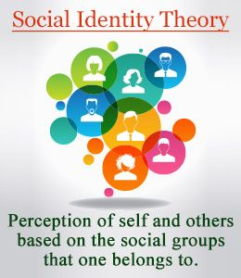
Why doesn’t a disease model reduce public stigma?
A disease model promotes separation – i.e. ‘healthy us’ (social drinkers) vs ‘diseased them’ (alcoholics)
Separation and difference are a central stigma processes in which there is the majority ‘in group’ vs the minority ‘out group’
Therefore people may ‘blame’ less but still discriminate (e.g. social rejection)
Approaches to reduce stigma point to humanising approaches e.g.
  Increasing empathy and reducing anxiety via contact and reducing perceived difference
  Identifying addiction as owing to difficult life events or adverse child experiences can reduce stigma (e.g. Weine et al., 2016, Summnal et al., 2020)

Slide 13
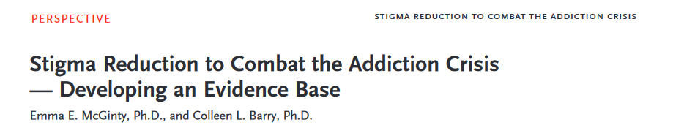
The New England Journal of Medicine 2020
Highlights the urgent need for evidence-based attention to address addiction stigma
Calls for:
Person-first language
Communicating prognostic optimism
Sharing humanising narratives
An emphasis on societal rather than individual causes of addiction problems

Slide 14
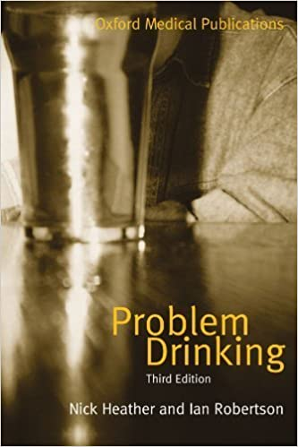
Implications?
‘Alcoholism’ framings are familiar and embedded in the public mindset
These are central to many in recovery/AA and people have the right to self-label
However…
Alcoholism framings ‘spill over’ into wider contexts where alternative framings have benefits for other AUD populations
Efforts to reduce public stigma based on disease attributions have not worked
More access to alternative framings are not an attempt to curtail self-labelling/AA, rather:
A larger library of ways for people to ‘make sense’ of the spectrum of alcohol use and problems offers public health benefits of earlier problem recognition and lower public stigma

Slide 15
Thank you
Dr James Morris, Research Fellow, Centre for Addictive Behaviours Research, London South Bank University
E: morrrij24@lsbu.ac.uk
Twitter: @jamesmorris24
The Alcohol ‘Problem’ Podcast @alcoholpodcast

