Slide 1
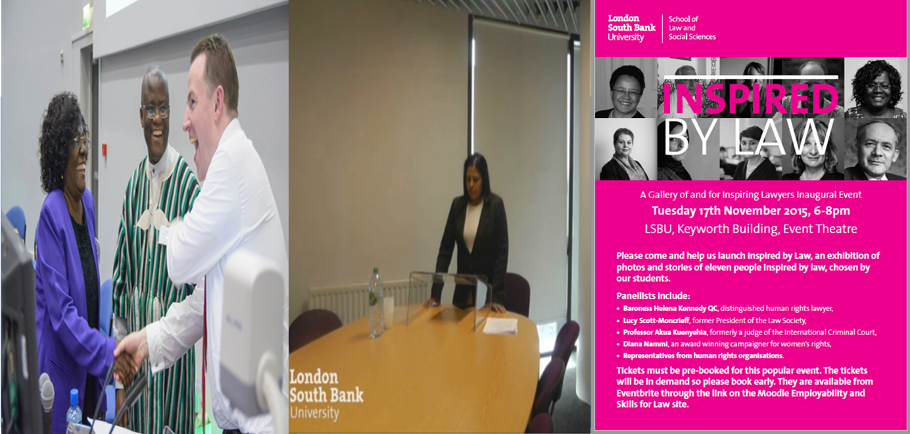
Aspiring to Inspire: Student Engagement and Advocacy Teaching. Alan Birbeck, LSBU-Law Division

Slide 2
Introduction and Roadmap
Alan Birbeck
Aspiring to Inspire: Student Engagement and Advocacy Teaching
Theme One: Who are we?
Theme Two: What do we do?
Theme Three: Why are we aspiring to inspire?

Slide 4
Theme One: Who are we?

Slide 5
A. LSBU University Context
London South Bank University
Modern post 1992 University
Committed to providing quality contextual legal education
Committed to a vision of a community law school
Committed to the promotion of social justice, human rights and the rule of law

Slide 6
B. LSBU Student Context
The Law Division is explicit about widening participation and promoting access to education.
Student demographics
-77% students from within the GLA
-69% do not self define as white (52% self define as Black African, Black Caribbean or Asian)
-67% completing their first degree
-50% over the age of 25
-10% notify they have a disability
(Latest Law and Social Science Data 2014-2015)
LLB students data revealed
-52% of students were employed
-Of whom 80% were working 9 hours+ per week
(An Unpublished 2008 Departmental survey)

Slide 7
C. LSBU Student Barriers
Fixed barriers not easily controlled:
family commitments, housing, and employment
Barriers within our control:
1.Mutual expectation barriers
2.Lack of role models
3.‘Social identity incompatibility’*
4.‘Skills and confidence barriers’*
5. Students want more and more feedback
(*Murtagh, S & Ridley, A et al 2015 Journal of Higher and Further Education)

Slide 8
D. Practical and experiential learning
Practitioners are highly critical of legal education for practice (Amongst others Koo, 2007, Harvard Law School Survey, Quoted in Ashford et al; The Legal Academics Handbook 2016: 90)
In our LLM Advocacy we have developed (albeit unconsciously from the pedagogy) an Experiential Learning Process i.e. Learning through doing (Deriving from the work of D. A. Kolb 1939-)
Cycle for the LLM
-Novice Seminar 1 Presentation
-Advanced beginner Seminar 2 Presentation
-Competent Seminar 4 Bail Application
-Proficient Seminar 7 Closing speech
-Expert Assessment 2 Closing speech

Slide 9
D. Kolbs experiential learning cycle
Concrete experience
Encouraging students to gain concrete experience presenting advocacy
2. Reflective observation
Encouraging students to reflect on their own skills through individual feedback
3. Abstract conceptualisation Encouraging students to review generic feedback and examples of good practice and common errors
4. Active experimentation
Doing it again and again
(Model deriving from the work of D. A. Kolb 1939-)

Slide 10
E. Creating a community of Practice- ‘Think Like a Lawyer’
In any Induction we attempt to embed three things as expectations of my students
1. Hard work-preparation, attendance and engagement
2. Integrity-honesty and respect for each other and staff
3. Week by week skills building-step by step
We attempt to embed realistic expectations of the relationship between the student and the academic
We seek to create a community of practice: -Passing on from academic to student -Passing on from student to student.
Inculcating an enthusiasm: ‘a passion for something they do and [how they can] learn …to do it better’
(Étienne Charles Wenger; Paula Barona & Lillian Corbina; The Law Teacher; Volume 46, Issue 2, 2012: 100-119;; and Egle Dagilyte & Peter Coea; The Law Teacher; Volume 48, Issue 1, 2014: 35-50; Lisa Claydon; The Law Teacher; Volume 43, Issue 3, 2009: 269-283)

Slide 11
Theme Two: What do we do?

Slide 12
A. Embedding Ethics
‘If lawyers and judges are not competent and honest, …independent and ethical …the rule of law is severely undermined; indeed scarcely maintainable’ (Para 6)
‘Nothing except perhaps a bent Judge is more corrosive of the rule of law than a bent lawyer’ (Para 46)
‘…[My] plea [is] for [a] greater prominence for ethics in legal training both on University law courses and on professional legal training courses…the earlier and more effectively, we train and encourage potential professional lawyers and advocates to appreciate and understand the importance and nature of their ethical duties the stronger the legal profession we will have and the stronger the rule of law will be’ (Para 49)
(Lord Neuberger –Lord Slynn Memorial Lecture 2016: Ethics and Advocacy, 15/06/16)

Slide 13
A. Embedding Ethics
‘degrees offer a unique opportunity to inculcate students with the importance of ethical considerations’
(Clare Sandford-Couch & Jonathan Bainbridge; The Law Teacher; Volume 49, Issue 3, September 2015, pages 336-352)
In the LLM Advocacy Module we embed in Week 1 Professional Ethics through the profession codes and three recent case examples of the contested issues:
The Five P’s (PPPPP) (R v Cole (Dean) [2008] EWCA Crim 3234)
Mouthpieces? Judges and opponents? (R. v Farooqi (Munir Ahmed) [2014] 1 Cr. App. R 8)
Who writes the speech? (R. v Ekaireb (Robert David) [2015] EWCA Crim 1936)

Slide 14
B. Embedding storytelling
Storytelling is crucial to how trials are presented and decisions are made.
We teach both a narrative and chart methodology
We attempt to foster the skills of persuasion
(Robert McPeake; The Law Teacher; Volume 41, Issue 3, 2007: 303-313)

Slide 15
C. Embedding ground rules and fostering trust
1) Setting Ground rules: Preparation; Respect; Structure; Positivity; Dressing up; Reflection; Chatham house rules;
2) Gaining and fostering trust
Introduce our version of a modified Hampel method
I) What did you do well?;
II) What do you need to improve upon?;
III) What additional detail is needed or could be considered?

Slide 16
D. Tools across the degree
1. Presentation of legal knowledge
Students A4 Summaries and presentations
2. Presentation of law applied to factual problems
Structuring using the IRAC approach
3. Presentation of the critical evaluation of legal issues
Structuring essays and planning for critical evaluation-the graphic descriptor.
4. Formative and summative assessment and examples of best practice by Audio and Video

Slide 17
E. How do we attempt to foster confidence?
1. Challenging confidence barriers
i) ‘You either have it or you don’t’-
ii) ‘99% perspiration 1% inspiration’
2. Reflecting on expectations and bedrocks
3. Feedback and reflection logs for students to demonstrate progress

Slide 18
F. Feedback Loop
On the day the student receives the same feedback orally and in writing
The student individually privately receives and reviews their own video via Moodle and reviews
The student receives and reviews a demonstration video (and sometimes the advocates notes)
The student reflects on their feedback and video and where possible at the next session discusses this with the lecturer
The student repeats the exercise on a different factual matrix

Slide 19
G. Concrete Cycle
1. Ground Rules
2. Brief
3. Standard form
4. Student
5. Individual Oral and Written Feedback
6. Individual Video Feedback
7. Generic Feedback
8. Example of good practice Video
9. Reflective Logs
AND repeat…

Slide 20
Ground Rules

Slide 21
The Brief

Slide 22
The Standard Form

Slide 23
The Student in action

Slide 24
The Individual Feedback

Slide 25
The Student Video

Slide 26
The Generic Feedback

Slide 27
The demonstration Video

Slide 28
The reflective log

Slide 29
Theme Three: Why are we aspiring to inspire?

Slide 30
A. Why are we aspiring to inspire?
Engagement
Preparation
Attendance
iii) Confidence and employability

Slide 31
B. Does it work?
Yes
Quantitative: Attendance up; Marks up; Getting it right first time up;
Qualitative: Student satisfaction up (in particular positivity about assessment feedback) and employability up

Slide 32
C. Students Feedback
‘My advocacy skills have improved, my confidence has improved a lot with public speaking as well as my analytical and research skills’
‘The weekly oral presentations with feedbacks…forced me to speak in public but in a nice environment, allowing me to improve and gain confidence’

Slide 33
C. Students Feedback
‘[W]e were particularly pushed and driven by this module. However it was all worth it because we were kept on our toes throughout in order to have positive learning experiences…Particularly the [Seminars]….has been most inspirational in exposing one to the realities and learning experiences of legal work. This means one has to be full of grit, organised and focused’
‘I learnt life long skills in relation to advocacy both oral and written…[it] impacted my life for the better’

Slide 34
D. Role Models-Inspired by Law: A gallery of and for inspiring lawyers

Slide 35
1. What is Inspired by Law?
1. A physical gallery of Inspiring Lawyers and Legal campaigners nominated by the students
2. An annual awards event in November
3. An annual lecture event in February
4. An online gallery –Via the Website

Slide 36
2. What are the aims? Student reflection…
A) On Motivations: Encourage reflection why people become lawyers
B) On Skills: Encourage reflection on what makes a good lawyer 1) Hard work; 2) Integrity; 3) Skills acquisition
C) On social goods: Encourage reflection on social justice, the protection of human rights and the rule of law.
D) Research and reasoning skills-structured around Who? What? Why?
E) Presentation and modelling-Drafting the written profile, presenting the profile orally and modelling by shadowing the lawyer

Slide 37
3. Concrete Cycle…
Nominations
Shortlisting
Invitations
Profiles
Mock eventing
Shadowing
The awards, the Q & A and the Website

Slide 39
4. For More details on IBL
Visit the LSBU Website
-School of Law and Social Sciences
-Law Division
-Inspired by Law
Attend on Friday 16th September 2016-Sheffield University conference on
‘How do we research and teach equality and diversity in legal education?’
Myself and a team will be presenting the IBL story

Slide 40
Conclusion-Aspiring to Inspire: Student Engagement and Advocacy Teaching
Theme One: Who are we?
We have barriers to learning such as engagement, confidence, the lack of role models and the demand for more and more feedback.
Theme Two: What do we do?
We have made a concrete push towards learning by doing, setting expectations, embedding ethics, fostering well grounded confidence and reflection and fostering practical skills and academic learning.
Theme Three: Why are we aspiring to inspire?
We aspire to foster a community of practice and facilitate the learning journey.
We aspire to create and foster the student to build their stepping stones through their education and beyond.
We aspire to inspire our students to be lawyers for the social good.

Slide 41
Any Questions?

Slide 42
Contact Alan Birbeck, London South Bank University birbeca2@lsbu.ac.uk

