Slide 1
Clinical Legal Education – Running drop-in advice services in an university setting
Alan Russell
Dr John Russell
LSBU Legal Advice Clinic Directors

Slide 2
BACKGROUND
A widening participation institution
Southwark ranked 17th most deprived area of 354 local authorities and districts
Practising solicitors with substantial experience of drop-in advice services
Premises on the public highway

Slide 3
LETTER OF ADVICE MODEL
No public drop in service
Clinic administrator fields telephone enquiries
Supervising solicitor decides if case suitable and has educational benefit
Students tasked with researching enquiry and producing letter of advice
Advice letter reviewed several times by supervising solicitor before being sent out to the client.
3 weeks from initial contact to advice letter

Slide 4
LEVELS OF ADVICE
Information
Specialist Advice and Advocacy
Signpost/
Referral
e.g. from leaflets, factsheet or Adviceguide (the CAB publicly available resource)
sending a client elsewhere with or without having made a specific arrangement
Solicitor-level advice in contemplation of legal proceedings
basic information -not tailored to the individual
Generalist Advice and Casework
e.g. from Advisernet (the CAB subscription-only resource)
"generalist advice" - individually appropriate

Slide 5
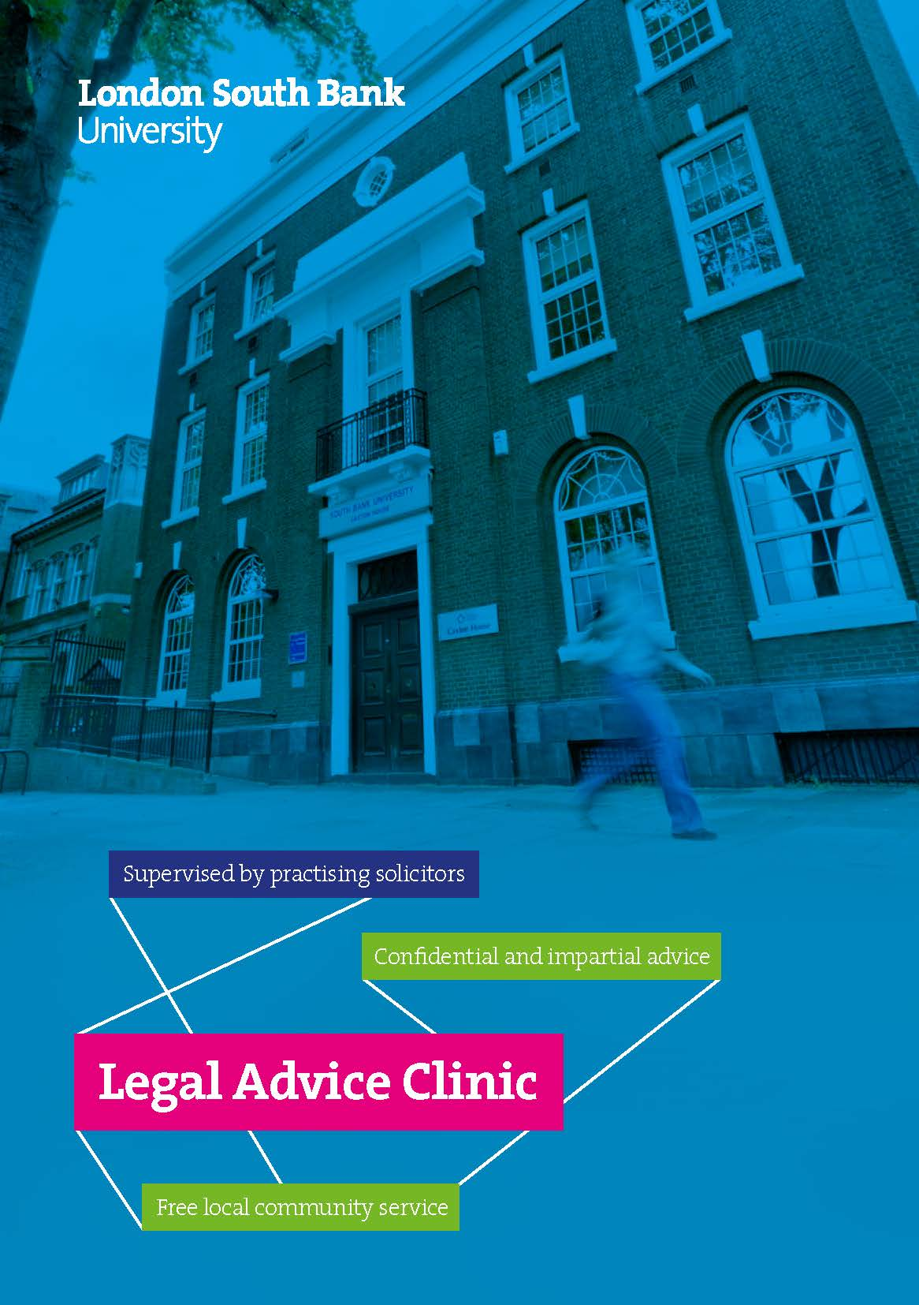
DROP-IN SESSIONS
Provide basic information on any topic
Give generalist advice on social welfare law (except immigration)
Signpost and refer to appropriate local advice agencies and legal services
Or refer to the Clinic’s own evening sessions

Slide 6
Reception
Initial details
Interview Part 1
Research enquiry
Consult supervisor
Interview Part 2
Fact-finding
Establish what client wants
Using Advice-guide and other resources
Advise the client
Agree the content of your advice to the client
Finish the enquiry
Write up an accurate case record

Slide 7
STUDENT PROGRESSION AT DAYTIME DROP-IN
Modelling
Collaborating
Students taking control

Slide 8
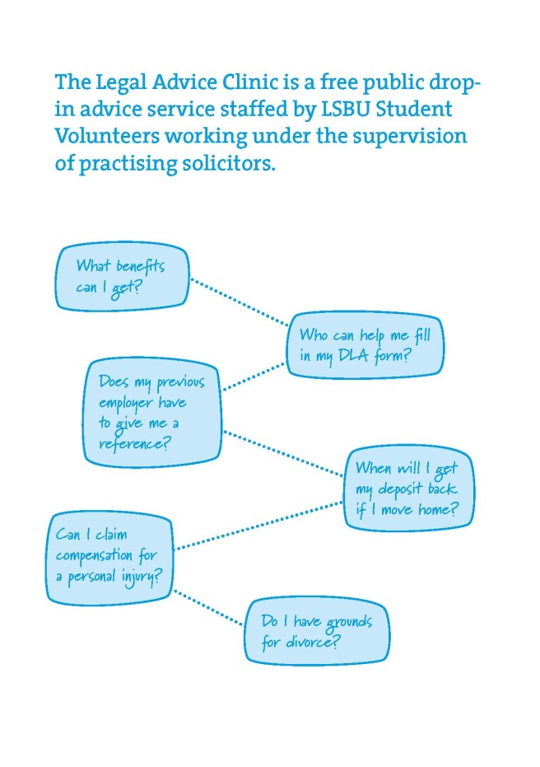
EVENING SESSIONS
Student Volunteers shadow pro bono solicitors & barristers giving specialist legal advice in
Housing
Family
Employment
Personal injury and
Long leasehold matters

