Slide 1
Reflecting on the experiential journey: Creating, developing and understanding leadership in Equality, Diversity and Inclusion within a Faculty
Preethi Premkumar
Zoë Leadley-Meade (They/Them)
London South Bank University

Slide 2
Session plan
Time
10 minutes
Our experiential journey as EDI leads
30 minutes
Groups:
Rate yourself from 0 to 10 on your skills in applying EDI
Divide the class into two groups
High EDI skills (scoring <5 on EDI skills)
Low EDI skills (scoring 5 and below on EDI skills)
Form groups of four based on skill level
All members of a group must be from one category
Choose a question to answer in your group
Discuss skills needed to achieve those goals
Make notes on the flip chart and post to the notes to the Padlet site
5 minutes
Summarise the Take-home action points from the group discussions

Slide 3
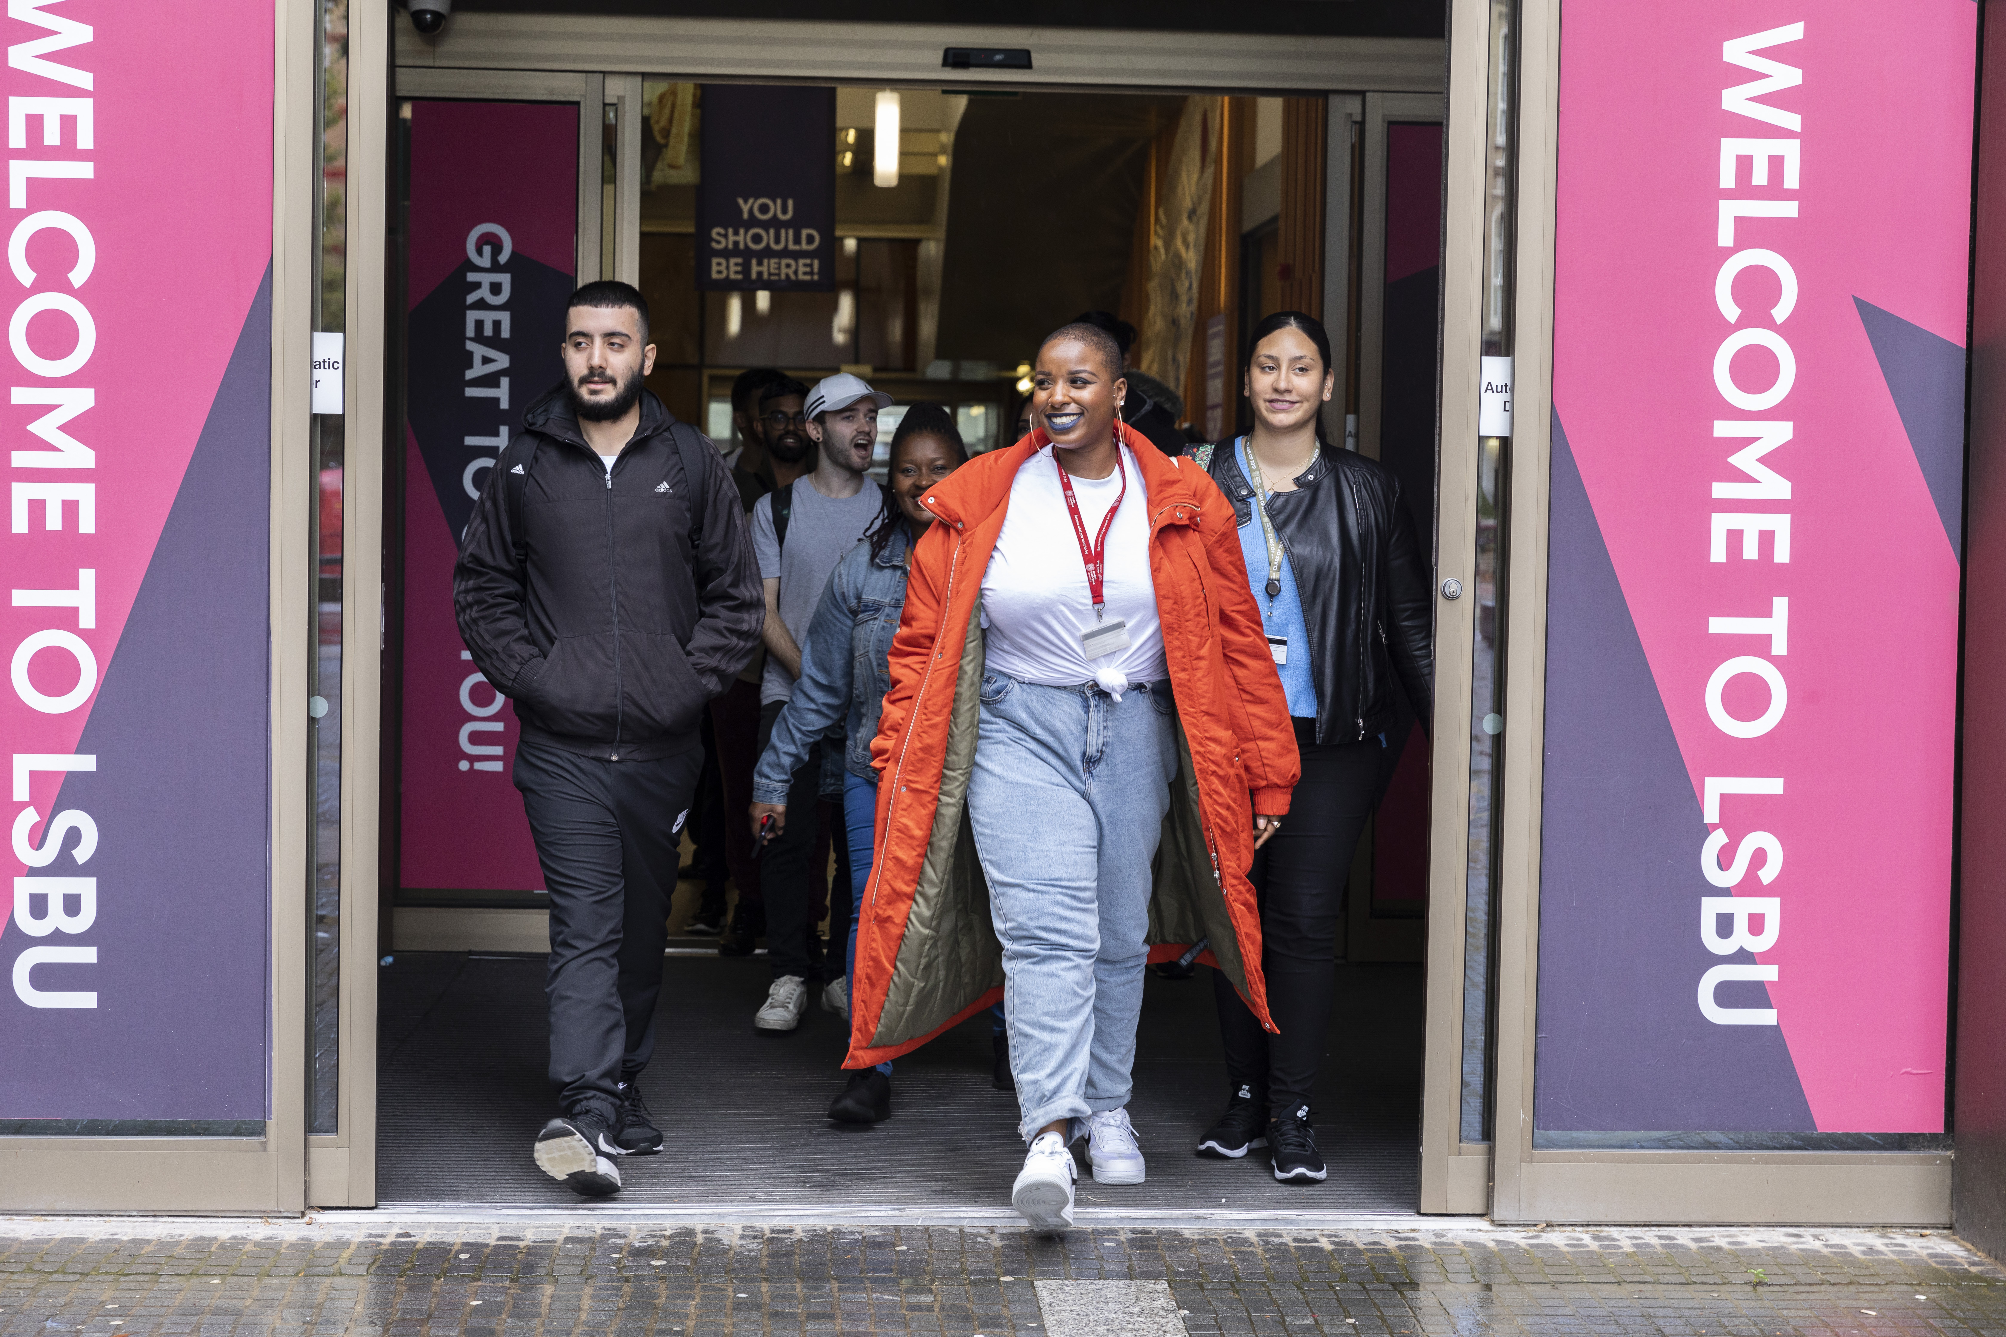
LSBU Strategic pillars
Ownership and Agency
Belonging and Engagement
Excellence and Ambition
Leadership

Slide 4
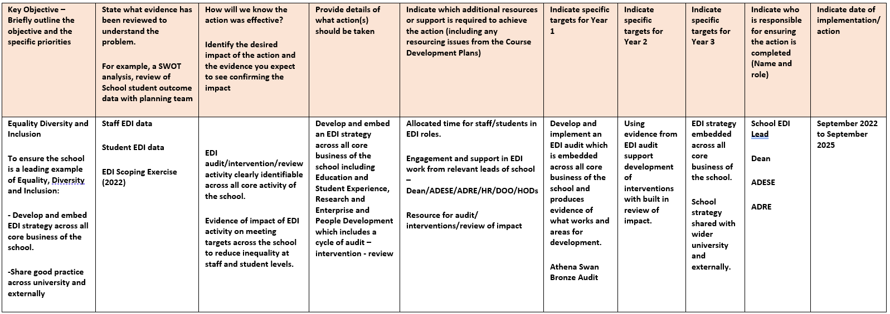
How can we establish EDI leadership roles at a faculty level?
AUDIT
Embedded in strategic planning
Shared responsibility
Critical friend
Collaboration
Realistic and protective of resource available
Review
Intervention

Slide 5
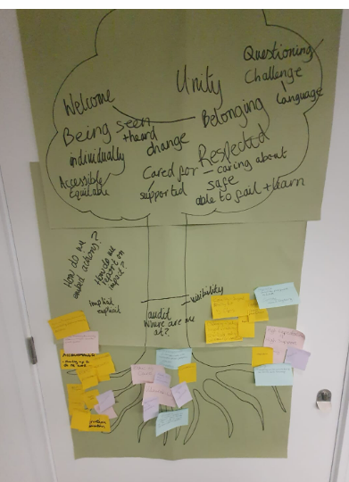
What are the benchmarks for EDI leadership in Higher Education contexts?
Equality Act (2010)
Teaching Excellence Framework (TEF)
Research Excellence Framework (REF)
Equality Charter Marks
Institutional Policy and targets
Local/Faculty Policy and targets
Personal and professional values and ethics

Slide 6
How can EDI leadership address inequalities and support the development of an inclusive environment for members of staff?
AUDIT
Audit:
What data is already available?
What questions need to be asked?
Who needs to ask those questions?
Intervention:
‘Compulsory plus training’ for all as well as targeted
Evidence based – tailored to need – reviewed
High expectations with high level of support
Collaborating within, across and beyond faculties
Review
Intervention

Slide 7
How can EDI leadership address inequalities and support the development of an inclusive environment for students?

Slide 8
Student-Centred Active Learning Environment with Upside-down Pedagogies
Two-hour workshop for academic staff by an external facilitator
Three-hour workshop for seminar leaders by an external facilitator
Training in techniques of SCALE-UP
Modifying seminar worksheets to suit SCALE-UP
Seminar leaders delivered modified seminars to encourage active collaborative learning
Written feedback on their experience of SCALE-UP

Slide 9
Student-Centred Active Learning Environment with Upside-down Pedagogies
SCALE-UP seminars are more enjoyable
“I love working in groups. Teamwork is something I really enjoy doing”;
SCALE-UP fosters collaboration and positive participation
“[SCALE-UP] was making them work harder…In other modules is a lot easier for them to stay quiet and don't say anything”
Challenenges
The SCALE-UP group roles were not adopted
Success of SCALE-UP relies on attendance and engagement
“I enjoyed working in smaller groups”; It helped us communicate with each other and form friendships much easier”

Slide 10
Decolonising the Curriculum

Slide 11
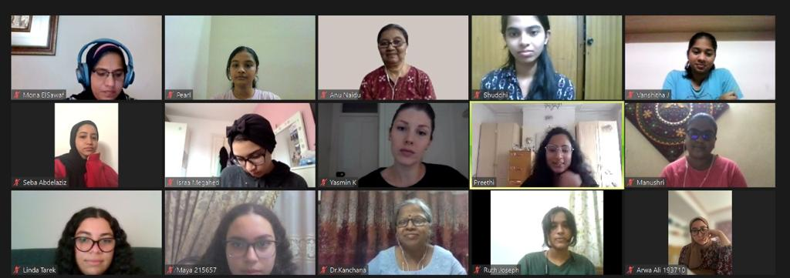
Online International Learning
Students from LSBU, Women’s Christian College (University of Madras, India) and British University in Egypt took part in online international learning for six weeks
They produced joint videos on cultural diversity of social virtues, such as altruism, generosity and mourning
We are repeating the online international learning this year.

Slide 12
Online International Learning - Feedback from students
‘I enjoyed every aspect of this activity. At first I was quite nervous because I don’t socialise much. During the first meeting with my group it lasted quite a long time and a range of topics were discussed. It was more about getting to know each other such as our interests and what we study so a rapport was constructed. After the first meeting, we started working on the project and stayed in touch through messaging on WhatsApp.’

Slide 13
Athena Swan charter
Preparing
Preparing the application
Engaging
Engaging the school in reviewing the data on staff and student experiences
Understanding
Understanding how EDI informs policies
Developing
Developing action plans to address gaps in gender equality

Slide 14
What type of training and support would be beneficial for the development of EDI leaders?

Slide 16
Paul Miller’s workshop on anti-racism

Slide 17
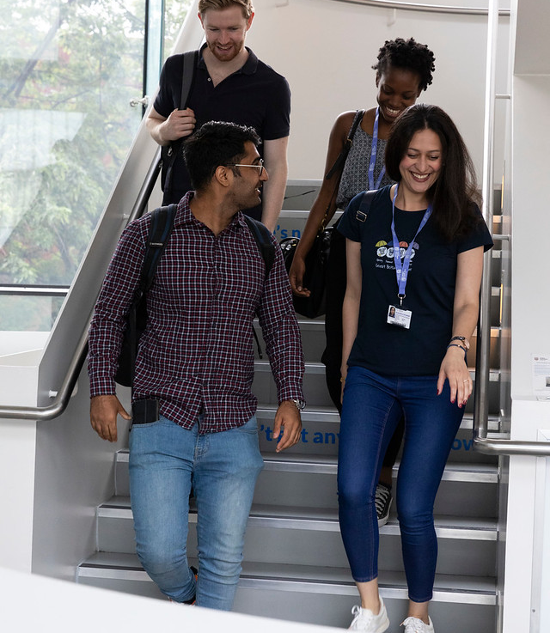
How might EDI leadership differ between faculties?

Slide 18
School of Built Environment and Architecture
Staff
Gender
A smaller proportion of female staff (33%), 13% at senior level
Most females (70%) are on the lower (lecturer/senior lecturer) grades.
Ethnicity
54% white
50% BAME at senior levels and 22% at lower levels
Students
Low proportion of female students on Built Environment courses
Must reach out to schools to ‘advertise’ BEA careers
BAME awarding gap exists
need to recruit BAME students either

Slide 19
School of Applied Sciences

Slide 20
Group Activity
Consider in your own institution – opportunities – challenges – support
How can we establish EDI leadership roles at a faculty level?
What are the benchmarks for EDI leadership in Higher Education contexts?
How can EDI leadership address inequalities and support the development of an inclusive environment for members of staff?
How can EDI leadership address inequalities and support the development of an inclusive environment for students?
How might EDI leadership differ between faculties?
What type of training and support would be beneficial for the development of EDI leaders?
Notes:
Zoe (15 mins)
X 6 groups – set up padlet + QR code

Slide 21
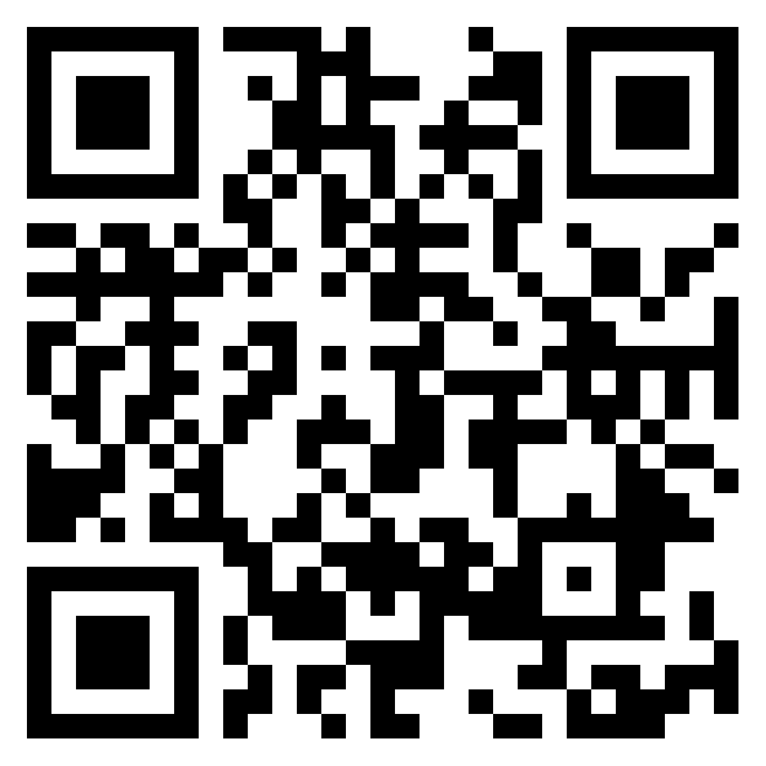
Feedback + Take-home Action Points
https://padlet.com/PPremkumar/EDI
Notes:
Preethi+Zoe (10 mins)

Slide 22
Thank You
Presenter name
Email address
Website address

