Slide 1
The role of Dynamic contrast-enhanced MRI perfusion imaging in post treatment surveillance of patients with high grade gliomas
Pigott Laura Elin^{1,2,4}; Mancini L. ^{1,2,3}; Bisdas S. ^{1,2}
1: Faculty of Brain Science, Queen Square Institute of Neurology, University College London, London, Uk
2: Lysholm Department of Neuroradiology, The national Hospital for Neurology & Neurosurgery University College London, London, UK
3: Department of Brain Repair and rehabilitation, UCL Queen Square Institute of Neurology, London, UK
4: Institute of Health and Social Care, London South Bank University, London, UK

Slide 2
What are High Grade Gliomas?
Gliomas are the most common type of malignant brain tumours – 80% of all malignant primary central nervous system tumours
Glioma Grades:
Grade 1 and 2 → Low grade
Grade 3 and 4 → High grade (20% of CNS tumours)
Survival rates averaging 1 year
High recurrence rate → poor prognosis
(Philips et al., 2018; Xiong, Feng and Xie, 2019; Colman, 2020)

Slide 3
The Importance of Neuroimaging
Assist in prognostication and management
Magnetic Resonance Imaging (MRI) has multiple sequences.
MRI sequence: measurement of molecular behaviour by detecting variable responses of hydrogen atoms in different tissues during the application of external radiofrequency.
Result of MRI: Image that distinguish between cerebrospinal fluid, vasculature, meninges, grey and white matter.
The Current Gold Standard for Head MRI?
T1-weighted MRI with contrast (usually gadolinium) and T2 or FLAIR
(Klein and Dietrich, 2017; Sharma, Juthani and Vogelbaum, 2017; National Institute for Health and Care Excellence, 2018; Newton, 2018)
Notes:
Neuroimaging has proven to be a crucial modality during the assessment and management of gliomas by providing critical information for decisions regarding prognostication and management

Slide 4
Study Objectives
To examine the usefulness, accuracy, and diagnostic role of DCE-MRI in the surveillance of patients with high-grade gliomas and associate the imaging findings to the clinical data.
To evaluate the added predictive and diagnostic value of implementing a secondary DCE-MRI exam after three months from the baseline DCE-MRI.
Hypotheses
DCE-MRI would prove to be an accurate and clinically useful tool in the surveillance of high-grade gliomas, by being able to depict the differences, clearly and accurately, between tumour growth and treatment related changes, such as pseudo-progression.
The addition of the secondary DCE-MRI assessment will enhance the survival analysis prediction and subsequently the accuracy of the prognosis.

Slide 5
Dynamic Contrast Enhanced MRI
DCE-MRI calculates perfusion parameters by measuring the T1 relaxation, induced by a gadolinium-based contrast bolus passing through tissue.
DCE-MRI quantitatively evaluates tumour biology → microcirculation and the enhancement patterns in the surrounding tissue
DCE-MRI is the standard approach for the observation of cancers in many body organs (Onishi et al., 2020; Song et al., 2020; Zhu et al., 2021)
(Bonekamp et al., 2014; Kickingereder et al., 2014).
Notes:
DCE-MRI has been established as a method to quantitatively evaluate tumour biology, concentrating mostly on the microcirculation and the enhancement patterns in the surrounding tissue. The assessment of these neurovascular parameters could provide markers or indicators which could contribute to the grading of aggressive brain tumours

Slide 6
Methods – Study Design
Retrospective observational study, of 48 patients (Age: 49.85 ± 12.81)
Approval from the National Hospital for Neurology and Neurosurgery and University College London, Institute of Neurology Joint Ethics, with strict confidentiality and anonymity guidelines
Images that were analysed were obtained from the Picture Archiving and Communication System

Slide 7
Methods - Participants
Gross total tumour resection or tissue biopsy for histological examination
Histologically confirmed high-grade glioma per WHO classification
Baseline measurement was obtained between 2015 to 2020
Chemoradiation protocol in accordance with NICE guidelines and when clinically necessary adjuvant chemotherapy treatments
Subsequent development of progressively contrast enhanced enlarging region, identified in two or more consecutive MRIs
At least 2 consecutive DDCE-MRI scans
(National Institute for Health and Care Excellence, 2018)

Slide 8
Methods - Participants
Notes:
Baseline DCE-MR images were obtained from all patients. Additionally, follow-up DCE-MRI scans were obtained at the three-month, six-month, nine-month, and twelve-month follow-ups.
This table shows the percentage of patients that underwent each of the follow-up scans at each of the timepoints. Patients who did not complete their second follow up at the three month timepoint, completed it at the 6 month timepoint.

Slide 9
Methods – Neuroimaging Processing
Pre-processing with Olea Sphere and NordicICE software in accordance with literature.
DCE Analysis utilising extended Tofts Model, produced 6 parametric perfusion maps
Vp map (volumetric parameter)
Kep map (kinetic parameter)
BF map (blood flow)
Ktrans map (kinetic parameter)
Ve map (volumetric parameter)
AUC map (permeability map)
(Brix et al., 1991; Chikui et al., 2012; Bazyar et al., 2016; Jansen, 2016; Choi et al., 2017; Jansen et al., 2017).
Notes:
Six parametric perfusion maps were generated per scan:
the blood flow (BF) map, which establishes the volume of blood passing through a fixed amount of tissue per unit of given time (Bonekamp, Degaonkar and Barker, 2011),
the Ktrans map (a kinetic parameter), which is the volume transfer rate and determines blood flow of the tissue and vessel permeability,
the Ve map, which is the volume of the extravascular, extracellular space and is a marker of cell density,
the Kep map (a kinetic parameter), which is the transfer rate constant extracellular extravascular space to the plasma,
the Vp map, which is the fractional volume of the plasma space, and reflects the distribution of contrast agent within a tissue voxel (Chikui et al., 2012; Bazyar et al., 2016; Jansen, 2016),
the AUC map, which is not dependent on model selection or AIF, reflects permeability and perfusion, which are both associated with prognosis

Slide 10
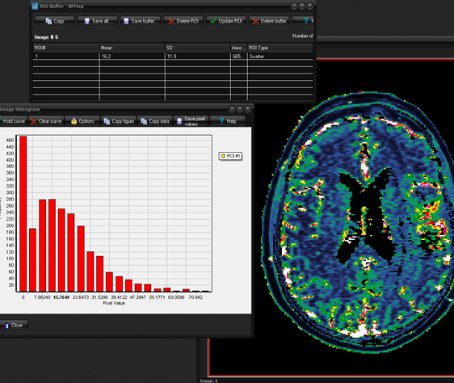
Methods – Disease State
Evaluation of percent change for timepoints:
Baseline
3 month follow up
6 month follow up
9 month follow up
12 month follow up
Equation: 100*(Vt2-Vt1)/Vt1
More than or equal 25% → Progressive disease
0-25% → stable disease
Pseudo-progression → progression at bassline with regression at follow up

Slide 11
Methods – Survival Analysis
Univariate Cox Proportional Hazard Regression to identify significant variables at 6 and 12 months
Significant predictor variables and the perfusion maps were included in the predictive model.
Threshold was established with the cut point (with nearest to (0,1) method)
Threshold produced two groups:
Patients with high perfusion values
Patients with low perfusion values.
Median survival time was established and graphed with a Kaplan Meier Survival Analysis.

Slide 12
Survival Models
Model | Disease status | Time point | Maps included in the model | Model equation
Model 1 | Stable/regression vs progression | 6 months | Baseline: Ve, Vp | model_1 = .07711* age_baseline+ .0090714 * Baseline_VeMap + .5687629 * Baseline_VpMap
Model 2 | Stable/regression vs progression | 12 months | Baseline: Ve, Vp | model_2 = .0837632 * age_baseline + .0036835 * B_VeMap + .7076702 * B_VpMap
Model 3 | True progression vs pseudo progression | 6 months | Baseline: BF, Ktrans, Ve, Vp | model_3 = .0771591 * age_baseline - .0129942 * B_Bfmap + 1.2373 * BP_K21map + .0040047 * B_VeMap + .1464732 * B_VpMap
Model 4 | True progression vs pseudo progression | 12 months | Baseline: Vp | model_4 = .0421877 * age_baseline + .4490081 * B_VpMap
Model 5 | Stable/regression vs progression | 6 months | Baseline: Ve, Vp 3-months: BF, Kep, Vp | model_5 = .100202 * age_baseline + .0198866 * B_VeMap + .4017944 * B_VpMap + .0004573 * m3_Bfmap + .3613811 * m3_K21map + 3.02e-07 * m3_VpMap
Model 6 | Stable/regression vs progression | 12 months | Baseline: Ve, Vp 3-months: Kep, Vp | model_6 = .1209808 * age_baseline + .0049757 * B_VeMap + .6778823 * B_VpMap + .3699599 * m3_K21map + .1394876 * m3_VpMap
Model 7 | True progression vs pseudo progression | 6 months | Baseline: BF, Kep, Ve 3-months: Vp | model_7 = .0670389 * age_baseline - .0132765 * B_Bfmap + .699975 * BP_K21map + .0048207 * B_VeMap + .1705033 * B_VpMap - .0509623 * m3_VpMap
Model 8 | True progression vs pseudo progression | 12 months | Baseline: Vp 3-months: Kep, Vp | model_8 = 1.069261 * age_baseline + 1.363248 * B_VpMap + 1.3278 * m3_K21map + 1 * m3_VpMap
Notes:
Eight models were generated, as detailed in Table 2. Models 1 to 4 only considered baseline DCE-MRI maps, whist models 5 to 8 included DCE-MRI maps at both baseline and 3-months. Models 1, 2, 5 and 6 differentiated stable/regression from pseudo-progression, whilst models 3, 4, 7 and 8 differentiated true progression from pseudo-progression. Models 1, 3, 5, and 7 assessed the survival at 6 months, whilst models 2, 4, 6, and 8 assessed the survival at 12 months.

Slide 13
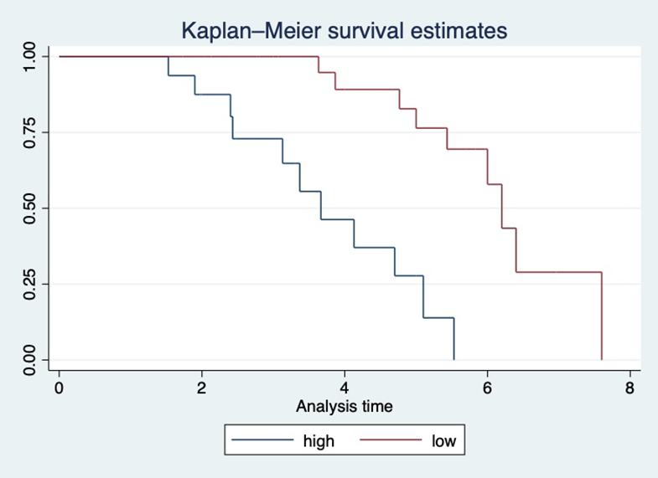
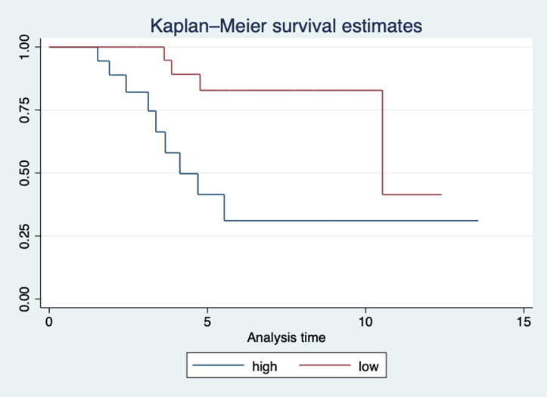
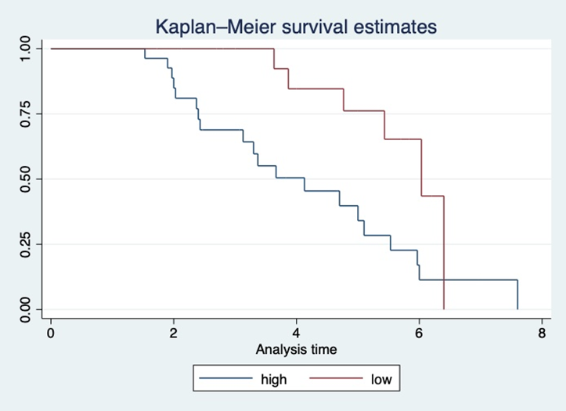
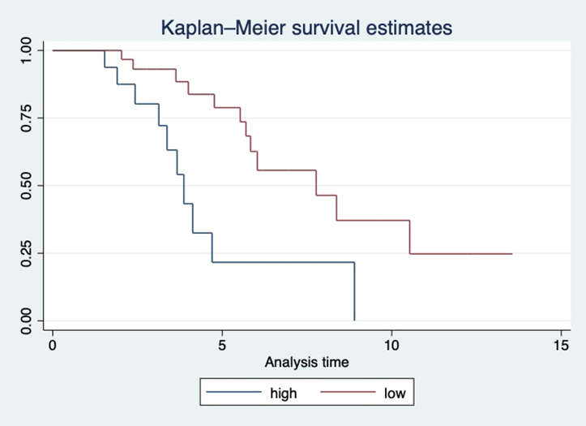
Results - Kaplan Meier Graph
Model 1
0=progression, 1=stable disease
Timeframe : 0-6 months
Model 2
0=progression, 1=stable disease
Timeframe : 0-12 months
Model 3
0=true progression, 1=pseudo-progression
Timeframe: 0-6 moths
Model 4
0=true progression, 1=pseudo-progression
Timeframe: 0-12 moths
Notes:
All models were statistically significant
Models 1 through 4 assessed disease progression based on the initial baseline scan

Slide 14
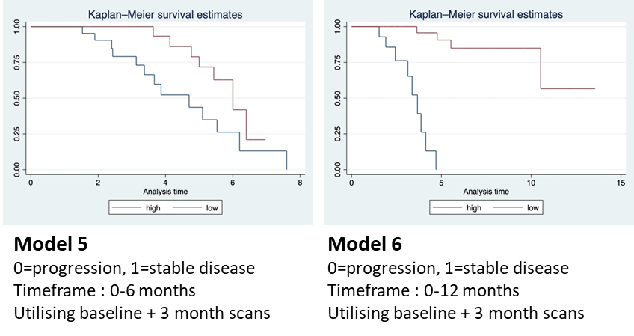
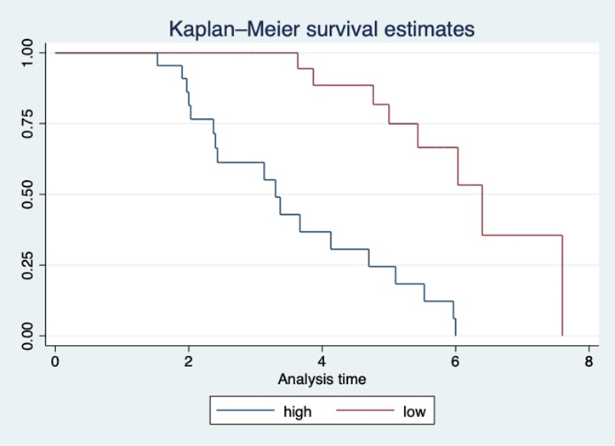
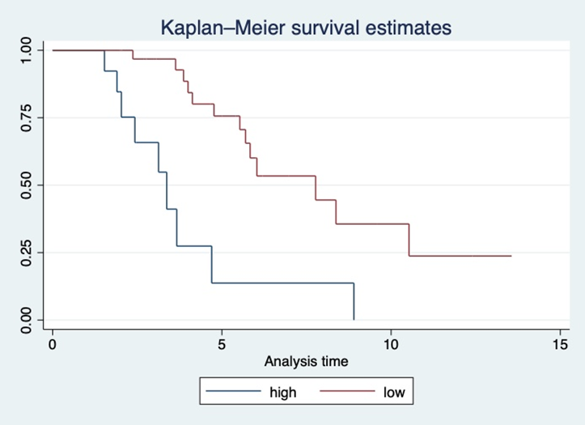
Results - Kaplan Meier Graph
Model 3
0=true progression, 1=pseudo-progression
Timeframe: 0-6 moths
Utilising baseline + 3 month scans
Model 4
0=true progression, 1=pseudo-progression
Timeframe: 0-12 moths
Utilising baseline and 3 month scans
Notes:
While models 5 through 8 assessed progression based on the baseline and the 3-month DCE-MRI scan.
What one might determine when comparing these 8 graphs is that the last 4 are more detailed and this is because they have the added benefit of the information provided by 3 month follow up scan.

Slide 15
Results – Survival Models
Model | Disease status | Time point | Threshold Sensitivity Specificity | p-value | Median survival time, high perfusion (months) | Median survival time, low perfusion (months)
Model 1 | Stable/regression vs progression | 6 months | 5.79 81% 68% | <0.0001 | 3.7 | 6.2
Model 2 | Stable/regression vs progression | 12 months | 6.24 74% 72% | <0.0013 | 3.1 | 10.5
Model 3 | True progression vs pseudo progression | 6 months | 4.32 77% 65% | <0.0027 | 4.1 | 6
Model 4 | True progression vs pseudo progression | 12 months | 3.07 85% 75% | <0.003 | 3.9 | 7.8
Model 5 | Stable/regression vs progression | 6 months | 8.2 91% 78% | <0.0071 | 4.7 | 6
Model 6 | Stable/regression vs progression | 12 months | 9.48 82% 81% | <0.0001 | 3.7 | >12
Model 7 | True progression vs pseudo progression | 6 months | 4.02 80% 76% | <0.0001 | 3.3 | 6.4
Model 8 | True progression vs pseudo progression | 12 months | 66.51 50% 81% | <0.0001 | 3.4 | 7.8
Comparison of models utilising
Only baseline scan to predict 6- and 12-month outcome (Pink)
Baseline and 3 month follow up scan to predict 6- and 12-month outcome (Yellow)
Notes:
The comparison of Model 1 and Model 5 suggests the use of the baseline and 3-month DCE-MRI assessments combined provides a more accurate measurement of progression (higher sensitivity and specificity in Model 5, Table 14). Although both models evaluated identical patients during the same timeframe, the time to progression for patients with high perfusion values was 1.1-month later in Model 5 when compared to Model 1. The findings of Model 6 are similar to the findings of Model 2, which did not incorporate the perfusion maps of the 3-month measurement during the survival analysis, thus suggesting that the differentiation of stable disease and disease change or progression at 12 months is not dependant on a second assessment with DCE-MRI.
Model 7 also had higher sensitivity and specificity than Model 3.
However, interestingly, Model 8, when compared to Model 4, produced a lower sensitivity, but a higher specificity. This indicates that the incorporation of the 3-month follow-up for the prediction of true progression (differentiating form pseudo-progression) was beneficial at 6 months, but it was not beneficial at 12 months. However the higher specificity would indicate that the incorporation of the 3 month scan is of importance as it assists with the differentiation of pseudo progression.
It is important to note that as the number of patients repeating the DCE scan at 12 months was much lower, so it may be that this impacted the results.
Thereby, supporting our two hypotheses.

Slide 16
Discussion
What causes pseudo-progression?
Some cancer treatment, example Immunotherapy
21% patients underwent immunotherapy
Other confounding factors?
Histologic/genetic components of tumour
 | IDH mutation | MGMT methylation
Frequency | 17 | 20
Percentage | 36.96% | 62.50%
(Abbasi et al 2017; Ribas and Wolchok, 2018).

Slide 17
Clinical Application
Currently the Response Assessment in Neuro-Oncology (RANO) criteria only call for the use of conventional MRI
NICE guidelines currently consider advanced neuroimaging such as DSC
- Literature indicates DCE may be more effective than DCE-MRI
This study and literature indicates DCE-MRI is superior to conventional MRI when differentiating between pseudo-progression and true progression
Pseudo-progression differentiation could be crucial:
Treatment and management strategies
Future research/drug trials
(Bisdas et al., 2011; Narang et al., 2011; Larsen et al., 2012; Choi et al., 2013; Suh et al., 2013; Hamilton et al., 2014; Shin et al., 2014; Alcaide-Leon et al., 2015; Arevalo-Perez et al., 2015; Yun et al., 2015; Thomas et al., 2015; Abbasi et al., 2017; Zhang et al., 2017; Rowe et al., 2018; van Dijken et al., 2019; Zakhari et al., 2019; Filice, Ortenzia and Crisi, 2021).

Slide 18
Limitations
Disparities relating to (i) MR scanners (ii) imaging acquisition protocols (iii) contrast administration (iv) method of post-processing
Lack if standardisation when post-processing and quantifying the images
No optimal method of ROI selection
Single-arm design and sample size
(Zhang et al., 2017).
Notes:
Despite these interesting and optimistic results, some difficulties arise during the clinical application of DCE-MRI, as there are variations across institutions that cannot be accounted for in the realm of theoretical research. Some of these disparities can be seen relating to (i) MR scanners, such as field strength and pulse sequences, (ii) imaging acquisition protocols, such as acquisition parameters, temporal and spatial resolution, (iii) contrast administration, such as dose, preload, dynamic bolus, rate and timing, (iv) method of post-processing, such model selection, AIF, leakage correction, voxel-wise analysis.

Slide 19
Future Direction
This study was at it’s time of research the first of its kind.
Determine correlation between immunotherapy and pseudo-progression
Standardised of post-processing of images
What could be interesting!
The use of DCE-MRI to determine imaging biomarkers in pseudo-progression
Utilising Artificial Intelligence to enhance survival analysis and potential predictive models.

Slide 20
Thank you Any Questions?

Slide 21
References
Abbasi, A.W., Westerlaan, H.E., Holtman, G.A., Aden, K.M., van Laar, P.J. and van der Hoorn, A. (2017). Incidence of Tumour Progression and Pseudoprogression in High-Grade Gliomas: a Systematic Review and Meta-Analysis. Clinical Neuroradiology, 28(3), pp.401–411.
Alcaide-Leon, P., Pareto, D., Martinez-Saez, E., Auger, C., Bharatha, A. and Rovira, A. (2015). Pixel-by-Pixel Comparison of Volume Transfer Constant and Estimates of Cerebral Blood Volume from Dynamic Contrast-Enhanced and Dynamic Susceptibility Contrast-Enhanced MR Imaging in High-Grade Gliomas. American Journal of Neuroradiology, 36(5), pp.871–876.
Arevalo-Perez, J., Peck, K.K., Young, R.J., Holodny, A.I., Karimi, S. and Lyo, J.K. (2015). Dynamic Contrast-Enhanced Perfusion MRI and Diffusion-Weighted Imaging in Grading of Gliomas. Journal of Neuroimaging, 25(5), pp.792–798.
Bazyar, S., Ramalho, J., Eldeniz, C., An, H. and Lee, Y.Z. (2016). Comparison of Cerebral Blood Volume and Plasma Volume in Untreated Intracranial Tumors. PLOS ONE, 11(9), p.e0161807.
Bisdas, S., Naegele, T., Ritz, R., Dimostheni, A., Pfannenberg, C., Reimold, M., Koh, T.S. and Ernemann, U. (2011). Distinguishing Recurrent High-grade Gliomas from Radiation Injury. Academic Radiology, 18(5), pp.575–583.

Slide 22
References
Bonekamp, D., Deike, K., Wiestler, B., Wick, W., Bendszus, M., Radbruch, A. and Heiland, S. (2014). Association of overall survival in patients with newly diagnosed glioblastoma with contrast-enhanced perfusion MRI: Comparison of intraindividually matched T1- and T2*-based bolus techniques. Journal of Magnetic Resonance Imaging, 42(1), pp.87–96.
Brix, G., Semmler, W., Port, R., Schad, L.R., Layer, G. and Lorenz, W.J. (1991). Pharmacokinetic Parameters in CNS Gd-DTPA Enhanced MR Imaging. Journal of Computer Assisted Tomography, 15(4), pp.621–628.
Chikui, T., Obara, M., Simonetti, A.W., Ohga, M., Koga, S., Kawano, S., Matsuo, Y., Kamintani, T., Shiraishi, T., Kitamoto, E., Nakamura, K. and Yoshiura, K. (2012). The Principal of Dynamic Contrast Enhanced MRI, the Method of Pharmacokinetic Analysis, and Its Application in the Head and Neck Region. International Journal of Dentistry, [online] 2012, pp.1–10. Available at: https://www.ncbi.nlm.nih.gov/pmc/articles/PMC3483829/ [Accessed 23 Aug. 2019].
Choi, Y.S., Ahn, S.S., Lee, H.-J. ., Chang, J.H., Kang, S.-G. ., Kim, E.H., Kim, S.H. and Lee, S.-K. . (2017). The Initial Area Under the Curve Derived from Dynamic Contrast-Enhanced MRI Improves Prognosis Prediction in Glioblastoma with UnmethylatedMGMTPromoter. American Journal of Neuroradiology, 38(8), pp.1528–1535.
Colman, H. (2020). Adult Gliomas. CONTINUUM: Lifelong Learning in Neurology, 26(6), pp.1452–1475.

Slide 23
References
Filice, S., Ortenzia, O. and Crisi, G. (2021). How tissue T1-variability influences DCE-MRI perfusion parameters estimation of recurrent high-grade glioma after surgery followed by radiochemotherapy. Acta Radiologica, p.028418512110359.
Hamilton, J.D., Lin, J., Ison, C., Leeds, N.E., Jackson, E.F., Fuller, G.N., Ketonen, L. and Kumar, A.J. (2014). Dynamic Contrast-Enhanced Perfusion Processing for Neuroradiologists: Model-Dependent Analysis May Not Be Necessary for Determining Recurrent High-Grade Glioma versus Treatment Effect. American Journal of Neuroradiology, 36(4), pp.686–693.
Jansen, J.F. (2016). Texture analysis on parametric maps derived from dynamic contrast-enhanced magnetic resonance imaging in head and neck cancer. World Journal of Radiology, 8(1), p.90.
Jansen, M.J.A., Kuijf, H.J., Veldhuis, W.B., Wessels, F.J., van Leeuwen, M.S. and Pluim, J.P.W. (2017). Evaluation of motion correction for clinical dynamic contrast enhanced MRI of the liver. Physics in Medicine & Biology, 62(19), pp.7556–7568.
Kickingereder, P., Wiestler, B., Graf, M., Heiland, S., Schlemmer, H.P., Wick, W., Wick, A., Bendszus, M. and Radbruch, A. (2014). Evaluation of dynamic contrast-enhanced MRI derived microvascular permeability in recurrent glioblastoma treated with bevacizumab. Journal of Neuro-Oncology, 121(2), pp.373–380.

Slide 24
References
Klein, J.P. and Dietrich, J. (2017). Neuroradiologic Pearls for Neuro-oncology. CONTINUUM: Lifelong Learning in Neurology, 23(6), pp.1619–1634.
Larsen, V.A., Simonsen, H.J., Law, I., Larsson, H.B.W. and Hansen, A.E. (2012). Evaluation of dynamic contrast-enhanced T1-weighted perfusion MRI in the differentiation of tumor recurrence from radiation necrosis. Neuroradiology, 55(3), pp.361–369.
Narang, J., Jain, R., Arbab, A.S., Mikkelsen, T., Scarpace, L., Rosenblum, M.L., Hearshen, D. and Babajani-Feremi, A. (2011). Differentiating treatment-induced necrosis from recurrent/progressive brain tumor using nonmodel-based semiquantitative indices derived from dynamic contrast-enhanced T1-weighted MR perfusion. Neuro-Oncology, 13(9), pp.1037–1046.
National Institute for Health and Care Excellence (2018). Primary and metastatic brain tumours in adults: summary of NICE guidance. BMJ, p.k3680
Newton, H.B. (2018). Handbook of brain tumor chemotherapy, molecular therapeutics, and immunotherapy. London: Academic Press.
Philips, A., Henshaw, D.L., Lamburn, G. and O’Carroll, M.J. (2018). Authors’ Comment on “Brain Tumours: Rise in Glioblastoma Multiforme Incidence in England 1995–2015 Suggests an Adverse Environmental or Lifestyle Factor.” Journal of Environmental and Public Health, [online] 2018, pp.1–3. Available at: https://www.hindawi.com/journals/jeph/2018/2170208/.

Slide 25
References
Ribas, A. and Wolchok, J.D. (2018). Cancer immunotherapy using checkpoint blockade. Science, [online] 359(6382), pp.1350–1355. Available at: https://science.sciencemag.org/content/sci/359/6382/1350.full.pdf.
Rowe, L.S., Butman, J.A., Mackey, M., Shih, J.H., Cooley-Zgela, T., Ning, H., Gilbert, M.R., Smart, D.K., Camphausen, K. and Krauze, A.V. (2018). Differentiating pseudoprogression from true progression: analysis of radiographic, biologic, and clinical clues in GBM. Journal of Neuro-Oncology, 139(1), pp.145–152.
Sharma, M., Juthani, R.G. and Vogelbaum, M.A. (2017). Updated response assessment criteria for high-grade glioma: beyond the MacDonald criteria. Chinese Clinical Oncology, 6(4), pp.37–37.
Shin, K.E., Ahn, K.J., Choi, H.S., Jung, S.L., Kim, B.S., Jeon, S.S. and Hong, Y.G. (2014). DCE and DSC MR perfusion imaging in the differentiation of recurrent tumour from treatment-related changes in patients with glioma. Clinical Radiology, 69(6), pp.e264–e272.
Suh, C.H., Kim, H.S., Choi, Y.J., Kim, N. and Kim, S.J. (2013). Prediction of Pseudoprogression in Patients with Glioblastomas Using the Initial and Final Area Under the Curves Ratio Derived from Dynamic Contrast-Enhanced T1-Weighted Perfusion MR Imaging. American Journal of Neuroradiology, 34(12), pp.2278–2286.
Thomas, A.A., Arevalo-Perez, J., Kaley, T., Lyo, J., Peck, K.K., Shi, W., Zhang, Z. and Young, R.J. (2015). Dynamic contrast enhanced T1 MRI perfusion differentiates pseudoprogression from recurrent glioblastoma. Journal of Neuro-Oncology, 125(1), pp.183–190.

Slide 26
References
van Dijken, B.R.J., van Laar, P.J., Smits, M., Dankbaar, J.W., Enting, R.H. and van der Hoorn, A. (2019). Perfusion MRI in treatment evaluation of glioblastomas: Clinical relevance of current and future techniques. Journal of Magnetic Resonance Imaging, [online] 49(1), pp.11–22. Available at: https://www.ncbi.nlm.nih.gov/pmc/articles/PMC6590309/ [Accessed 16 Apr. 2020].
Xiong, L., Feng, X. and Xie, X.Q. (2019). Advanced treatment in high-grade gliomas. J BUON, 24(2), pp.424–430
Yun, T.J., Park, C.-K., Kim, T.M., Lee, S.-H., Kim, J.-H., Sohn, C.-H., Park, S.-H., Kim, I.H. and Choi, S.H. (2015). Glioblastoma Treated with Concurrent Radiation Therapy and Temozolomide Chemotherapy: Differentiation of True Progression from Pseudoprogression with Quantitative Dynamic Contrast-enhanced MR Imaging. Radiology, 274(3), pp.830–840.
Zakhari, N., Taccone, M.S., Torres, C.H., Chakraborty, S., Sinclair, J., Woulfe, J., Jansen, G.H., Cron, G.O., Thornhill, R.E., McInnes, M.D.F. and Nguyen, T.B. (2019). Prospective comparative diagnostic accuracy evaluation of dynamic contrast-enhanced (DCE) vs. dynamic susceptibility contrast (DSC) MR perfusion in differentiating tumor recurrence from radiation necrosis in treated high-grade gliomas. Journal of Magnetic Resonance Imaging, 50(2), pp.573–582.
Zhang, J., Liu, H., Tong, H., Wang, S., Yang, Y., Liu, G. and Zhang, W. (2017). Clinical Applications of Contrast-Enhanced Perfusion MRI Techniques in Gliomas: Recent Advances and Current Challenges. Contrast Media & Molecular Imaging, 2017, pp.1–27.

