Slide 1
Students’ perception of future learning in accounting education Usha Mistry London South Bank University

Slide 2
How do you see future learning in accounting education to be?
In this research definition of learning is teaching delivery mode.
On campus face to face
Online synchronous
Online asynchronous
Hybrid online/on campus
Hyflex (face to face synchronous with online asynchronous)

Slide 3
Content
Introduction
Study contribution
Teaching approaches before, during and post pandemic
Literature Review
Research Method
Findings
Recommendations
Limitation
Conclusion
Any Questions?

Slide 4
Introduction
Boris Johnson, announced on the 16th March 2020, “Now is the time for everyone to stop non-essential contact and travel”.
Technology to deliver online has been around for some time.
HE sector and students were completely unprepared and had to adapt and train in the virtual world in record time to deliver and receive education.
The pandemic accelerated the usage of current available technology within a matter of weeks.
Teaching from on-campus, to online synchronous to hybrid synchronous has been experienced over the last three years March 2020 – June 2023 in a dramatic way due to lockdowns and socially distancing.
Research question:
What are undergraduate accounting, business, and economics students’ teaching delivery preferences for the post-COVID-19 pandemic lockdown, and do the teaching delivery preferences vary with certain characteristics of students?

Slide 5
Study contribution:
It examines students' experiences in both traditional on-campus face to face teaching, online synchronous teaching and hybrid synchronous teaching during the post-COVID-19 pandemic lockdown.
Reveals importance of student voice and calls for flexibility in teaching mode as we have a diverse student body and their needs.
Reveals that university students’ mental health and degree of loneliness reached an all-time high during the pandemic because of online teaching.
It highlights the importance of traditional on-campus teaching with the incorporation of the benefits students gain from on-line synchronous teaching.
Practical subjects like financial accounting, which require hands-on learning and the application of numbers, should be taught on campus.
Reveals most common obstacles and barriers encountered by students, as well as the future solutions, in the context of post COVID-19 pandemic delivery.

Slide 6
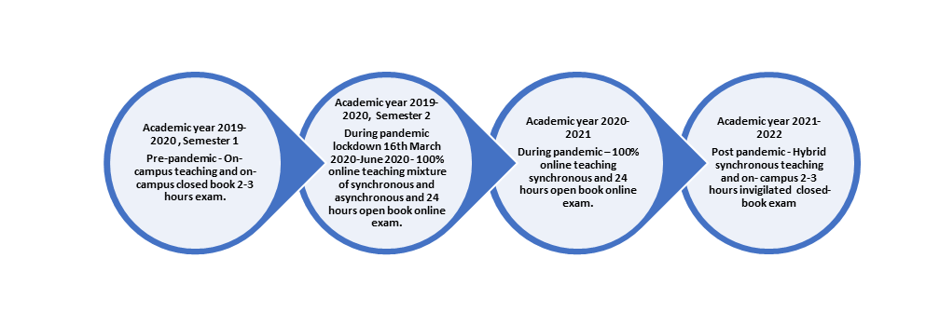
Figure 1: Teaching and exam approaches before, during and post pandemic

Slide 7
Literature Online teaching
Online – synchronous (MS TEAM) and asynchronous (Panopto Recordings)
Students who preferred looking for abstract concepts to concrete learning experiences demonstrated better performance in online learning (Kolb, 1999).
Mann and Hennberry (2012) barriers to on campus learning as being conflicting schedules with work or family time, traffic, and physical distance to the location of classes offered. Other factors were institutional barriers, including place, time, and term availability, that prevent students from enrolling in their preferred face-to-face class.
Online classes can be just as effective as traditional classes if they are designed correctly (Rajabalee & Santally, 2020).

Slide 8
Literature On-campus teaching
A major weakness of online learning was the student’s feelings of isolation and the lack of a sense of community in class Peytcheva-Forsyth & Aleksieva, (2021), increasing student dropout rates Frankola (2001) & Ryan (2001) and the requirement for self–motivation, discipline, and time commitment that online students need to dedicate to learning. Weaknesses linked to classmates in terms of collaborating with peers as well as technical problems associated with online learning (Song et al., 2004).

Slide 9
Literature – Hybrid teaching
Hybrid learning is when a portion of the learning is face-to-face and a portion is online, where more activities are online and less time is spent in the traditional classroom environment (Bennett et al., 2020).
One of the drawbacks of hybrid learning is that it is not clear for students. A common concern with hybrid learning is how much of the learning should be online and how much should be face-to-face (Jones et al., 2007).
In our study, student’s hybrid teaching experience took place in 2021–2022, whereby students had the option to attend on-campus classes or join online synchronous live streamed classes due to various reasons, e.g., being stranded abroad or isolating.

Slide 10
Research Methods
Mixed methods of quantitative and qualitative methods to explore the effectiveness of online, hybrid and on campus learning experiences post-COVID-19 through data collection and statistical analysis.
Ethics cleared, completion of online questionnaire using Google Forms.
All 604 undergraduate students registered on all three years of financial accounting/reporting module VLE sites were invited to voluntarily participate in the online questionnaire straight after the completion of their academic year in June 2022
96 usable responses were received, i.e., a 16% response rate.
The questionnaire:
Part A asked students first their characteristics.
Part B asked students' preferences for teaching post COVID-19 pandemic (online/campus/hybrid) and reasons.
Quantitative data was grouped by Google form, checked and analysed by Excel and further analysed using software STATA.
Qualitative data grouped according to common shared experiences
quoted.

Slide 11
Findings

Slide 12
Findings Quantitative Analysis
In this study, a p value of 0.1 was considered statistically significant for only online teaching. Other teaching delivery methods preferences were insignificant.
Students’ preference to online teaching
$$logit \left(teaching online delievery mode\right)= −4.572+0.823.caring+1.756.female−1.554.disability$$
Students prefer an online synchronous teaching approach increases by 0.823% when the probability of the student being a carer increases by 1%. Similarly, the probability that students prefer an online teaching approach increases by 1.756% when the probability of the student being female increases by 1%. Online teaching approach decreases by 1.554% when the probability of the student being disabled increases by 1%. There were no significant effects of any other factors on the students’ preference for the online learning approach.

Slide 13
Findings Qualitative Analysis
Hybrid synchronous teaching
Below are typical common quotes in favour of hybrid synchronous teaching.
‘Any lectures, as long as the teaching mode is hybrid, and I will be able to see the teacher of that module at one point.’
‘Online is easier for theory-based modules. And calculations based on those should be face to-face.’

Slide 14
Findings Qualitative Analysis
On campus teaching
Meeting fellow students and socialising (81%), Asking academic questions directly (72%), and Easier to engage and focus on (8%).

Slide 15
Findings Qualitative Analysis
On-line synchronous teaching
Access to recorded sessions (84%), Ease of access (78%), Saving commute costs (63%), Saving commute time (60%), Independence, flexibility and can perform better (3%), Developing future work preparation (1%).

Slide 16
Recommendations
Practical subjects like accounting, requiring calculations, need to be on-campus to enable better engagement in the subject. Theoretical subjects like Business Law be taught online.
Accounting and finance academics and students are provided with infrastructure, training, and development time for an effective accounting education pedagogy of hybrid teaching to be put in place.
Accounting educators consider providing access to at least recorded lectures, if not seminars with on-campus teaching, as 84% of students found this to be of use in the survey.
Higher education providers educate accounting students on the new additional employability skills of the work/life balance world. Students must be ready for the new work environment of a hybrid office and ensure their wellbeing is put first and their voices are heard.

Slide 17
Limitations to research
Study carried out in only one higher education institution with a limited sample in each student characteristic category.
This study could have explored students’ perceptions and ethnicity.
Subjective as it involves data gathered from students' perceptions and learning styles.
Despite the limitations, the study does provide useful insights for those practitioners seeking ways to develop their learning preferences based on the student experiences of learning post-COVID-19 lockdowns.

Slide 18
Conclusion
The aim of this research paper is a unique one that seeks to capture students' experiences of teaching post-pandemic COVID-19 lockdowns.
As per Lux et al. (2022), students’ engagement is a significant determinant of their satisfaction.
Research question about preference for teaching delivery mode (on campus, online, or hybrid) in the accounting major shows an insignificant correlation at a p value of 0.05. However, a p value of 0.1 shows a preference towards online synchronous teaching if a student is a carer or female. Students with disabilities prefer to be taught on campus.
The qualitative data has highlighted the most common obstacles and barriers encountered by students in the context of post-COVID-19 pandemic delivery. Moreover, the qualitative data reveals that practical subjects like financial accounting should be taught on campus.

Slide 19
Thank you!
Any Questions?

