Slide 1
Flipped classrooms using pre-recorded lectures and their impact on exam performance in accounting education
Usha Mistry

Slide 2
Content
Introduction
Study contribution
Pre-recorded lectures and Flipped Classroom Model
Literature Review
Research Method
Findings
Recommendations
Limitation
Conclusion
Any Questions?

Slide 3
Introduction
The "flipped classroom" is a pedagogical model that transforms the traditional learning environment. In this model, students were instructed to learn before the class by watching pre-recorded video lectures, followed by in-class activities, presentations, or discussions focused on knowledge construction
(Blau and ShmirInbal, 2017).
This research was conducted in the post-COVID-19 pandemic winter of 2022 at a U.K. university.
Mladenovic (2000) asserts that introductory accounting courses often play a role in shaping or reinforcing unfavourable perceptions about accounting.
This study examines the use of pre-recorded lectures as an additional pedagogical resource and aims to answer the following research questions: ‘What are students' experiences of pre-recorded lecture recordings used in flipped lectures, and how do they impact exam performance?’
To address our research questions a set of prerecorded lectures using Panopto covering the entire semester Level 4 module 'Elements of Financial Accounting’ were made available for students to review before their scheduled in-person lectures.

Slide 4
Study contribution:
Aims to address the literature gap by evaluating students' preferences for flipped classrooms, including pre-recorded lectures and Excel worksheets as additional learning resources, alongside the usual lecture notes.
Examines the impact of this approach, taking into consideration student characteristics.
Examines the impact of this approach on students' exam performance.
Provides empirical evidence regarding the effectiveness of this approach for first-year undergraduate accounting students. The selection of first-year students for this study is aimed at supporting their transition to higher education.
It adds to the continuing debate about how to best employ technology to assist student learning.
The findings of this study could be valuable for academics seeking a better understanding of the most effective ways to implement the flipped classroom approach.
Finally, the study provides recommendations and limitations for consideration.

Slide 5
Figure 1:Pre-recorded lectures and Flipped Classroom Model
Pre-Lecture
Prepare to participate in lectures by reading slides,watching prerecorded videos, and completing Excel worksheets.
During lecture
Participate in active learning activities during the lecture.
Post lecture
Check understanding by revisiting and replaying videos post-lectures and during revision.

Slide 6
Literature Online teaching
In higher education, students' active engagement in class has long been a research priority. The flipped classroom has been suggested as a potential remedy for enhancing student engagement since it maximises classroom contact time and offers opportunities for the integration and application of information (Niekerk and Delport, 2022).
Pre-recorded videos allow for two modes of information processing: visual and auditory. According to this theory, the more sensory modes learners engage with while interacting with the subject, the better their chances of recalling the learned material (Thomas, 2014).
Yadave et al. (2011) proposed that videos are a more influential medium for affective and cognitive processing compared to other flipped classroom modalities, such as the use of readings.

Slide 7
Ketz (2021) concluded, based on the experience during the pandemic and the use of pre-recorded videos, that the flipped classroom model has become increasingly appealing and will likely be adopted more widely in the future. It was found that this approach saves valuable class time for discussions and active learning projects.
Fogarty (2020) following the pandemic, where the flipped classroom approach was implemented, and students watched pre-recorded lectures while class time was dedicated to answering questions and engaging in activities.
Students reported enjoying the flexibility of learning at their own pace and expressed a preference for the flipped classroom approach over traditional approaches (Davies et al., 2013; McLaughlin et al., 2014; Roach, 2014; Gilboy et al., 2015).
Some students do not prefer taking control of their own learning outside of class and find it difficult to perform tasks independently (Long et al., 2017; O’Flaherty & Phillips, 2015).

Slide 8
Research Method
The research was conducted on Elements of Financial Accounting, a core module primarily studied by undergraduate first-year BA (Hons) Accounting and Finance students after the COVID-19 pandemic during the winter of 2022, spanning 12 weeks in semester 1.
The module is assessed through mid-semester coursework and an end-of-semester, two-hour closed-book examination, each contributing 50% to the final module mark.
Mixed methods of quantitative and qualitative methods to explore the effectiveness of prerecorded lectures through data collection and statistical analysis.
Online questionnaire using Google Forms.
81 responses were received, i.e., a 44% response rate.
The questionnaire:
Part A asked students first their characteristics/background.
Part B asked whether students watched pre-recordings before/after class, students’ likes/dislikes of prerecorded lecture
Quantitative data analysed using descriptive statistics, multiple regression
Qualitative data grouped according to common shared experiences quoted.

Slide 9
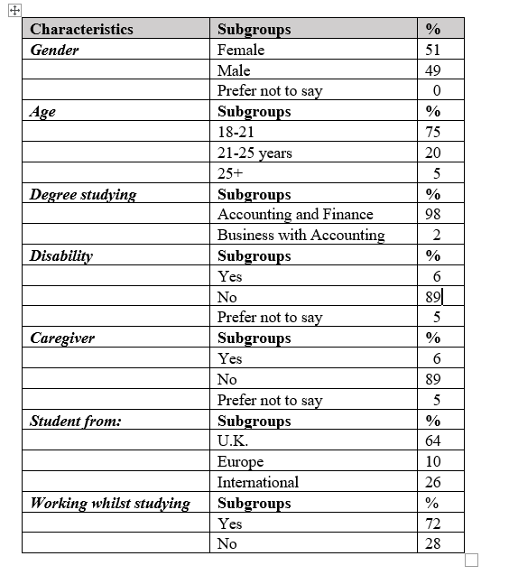
Findings
Students’ characteristics& background

Slide 10
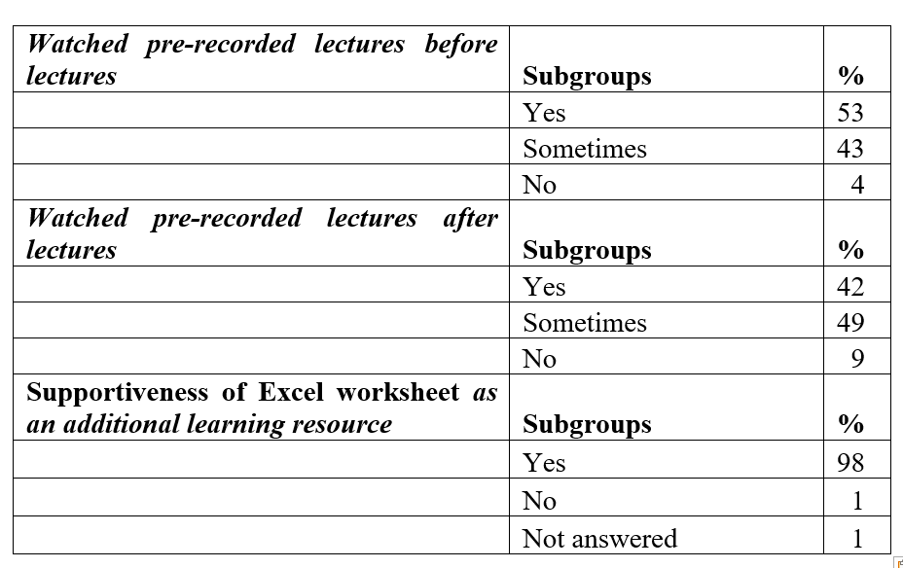
Findings Students’ experience of pre-recorded lectures

Slide 11
Excel worksheet

Slide 12
Findings Supportiveness of prerecorded lecture to learning–Quantitative
The supportiveness of prerecorded lectures was measured on a 5-point Likert scale, with 5 indicating 'extremely supportive' and 1 indicating 'not at all supportive'. In terms of students' experiences with the supportiveness of prerecorded lectures as an additional learning resource, the mean score for all participants was 4.60, indicating a high level of support. The best fit multiple regression model.
 | Coefficients | Standard Error | t Stat | P-value | Lower 95% | Upper 95%
Intercept | 3.604334 | 0.275931 | 13.06245 | 2.51E-21 | 3.054997 | 4.15367
Watching before | 0.299753 | 0.149111 | 2.010266 | 0.04786 | 0.002896 | 0.59661
Watching after | 0.414619 | 0.135043 | 3.070267 | 0.002943 | 0.145769 | 0.68347
Students’ characteristics and supportiveness insignificant.

Slide 13
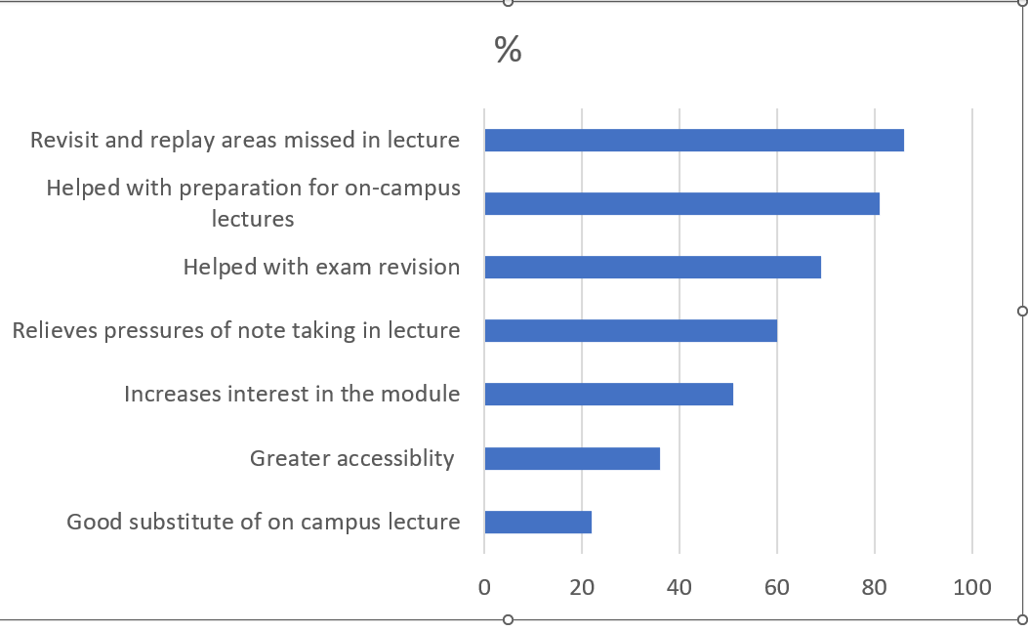
Findings Students’ experiences of pre-recorded lecture-Qualitative
‘It was very useful as I got to understand all the concepts and principles of the topic in a short summary, which helped me apply this knowledge quickly into the lecture as well as the seminars.’ (RS_063)

Slide 14
Findings – Exam performance
The relationship between exam performance and watching prerecorded lectures is significant at a p-value of 0.08. However, there is no significant relationship between students' characteristics, exam performance, and watching prerecorded lectures.
Typical Qualitative Response
‘The ability to review the topics taught at our own pace is valuable, especially for the purpose of exam revision.' (RS_063)

Slide 15
Recommendations
Pre-recorded lectures with accompanying Excel worksheets could serve as supportive additional pedagogical learning resources.
Pre-recorded lectures could have the potential to enhance students' engagement in class by allowing them to prepare at their own pace before the face-to-face flipped lecture.
Pre-recorded lectures watched before the lecture demonstrate a statistical improvement in average mean exam marks and pass rate significant at p value 0.1 but not at p value of 0.05.
Finally, pre-recorded lectures offer a tangible opportunity for post-lecture catch-up, assisting students in clarification, preparation for seminars, and exam revision.

Slide 16
Limitations to research
Study carried out in only one higher education institution with a limited sample in each student characteristic category.
Research relies on students' experiences of these additional resources, which may vary from one student to another and are subjective depending on whether the students made use of the resources or not.
To address these limitations, future studies could explore the benefits of pre-recorded lectures, Excel worksheets, and flipped lectures in other accounting modules studied in years 2, 3, and at postgraduate levels.
The study could also investigate the impact of pre-recorded lectures and attendance.
Despite these limitations, the study offers valuable insights into student experiences, providing academics with useful information to enhance their teaching methods.

Slide 17
Conclusion
The study aims to address the existing knowledge gap by investigating student experiences and the impact of watching pre-recorded lectures before the lecture as an additional learning resource. Furthermore, the research explores the impact of watching prerecorded lectures on exam performance.
The study is expected to assist academics seeking to implement alternative teaching pedagogies to meet students' demands and possibly enhance their engagement and performance.
Aggregate mean score on a 5-point Likert scale was 4.60, indicating a high level of support for the utilisation of pre-recorded lectures as an additional pedagogical learning resource. The multiple regression analysis demonstrates a positive significant relationship between watching pre-recorded lectures and perceiving them as supportive of pedagogical learning.
Improvement in students’ mean exam grade and pass rate was evident among those who actively engaged in flipped learning. Not significant at p value 0.05 but significant at 0.1.
Lectures are widely used as the primary form of teaching in most disciplines (Jones, 2007), and this research shows that pre-recorded lectures could be suitable learning method.

Slide 18
References:
Blau, I., & Shamir-Inbal, T. (2017). Re-designed flipped learning model in an academic course: The role of co-creation and co-regulation. Computers & Education, 115, 69-81.
Davies, R. S., Dean, D. L., & Ball, N. (2013). Flipping the classroom and instructional technology integration in a college-level information systems spreadsheet course. Educational Technology Research and Development, 61, 563-580.
Fogarty, T.J. (2020). Accounting education in the post-COVID world: looking into the Mirror of Erised. Accounting Education, 29(6), pp.563-571.
Gilboy, M. B., Heinerichs, S., & Pazzaglia, G. (2015). Enhancing student engagement using the flipped classroom. Journal of nutrition education and behavior, 47(1), 109-114.
Jones, S. E. (2007). Reflections on the lecture: Outmoded medium or instrument of inspiration? Journal of Further and Higher Education, 31(4), 397–406.
Ketz, J. E. (2021). Teaching forensic accounting in a covid environment. In Advances in Accounting Education: Teaching and Curriculum Innovations (Vol. 25, pp. 93-100).
Long, T., Cummins, J., & Waugh, M. (2017). Use of the flipped classroom instructional model in higher education: instructors’ perspectives. Journal of computing in higher education, 29, 179-200.
McLaughlin, J. E., Roth, M. T., Glatt, D. M., Gharkholonarehe, N., Davidson, C. A., Griffin, L. M., ... & Mumper, R. J. (2014). The flipped classroom: a course redesign to foster learning and engagement in a health professions school. Academic medicine, 89(2), 236-243.
Mladenovic, R., 2000. An investigation into ways of challenging introductory accounting students' negative perceptions of accounting. Accounting Education, 9(2), pp.135-155.
O'Flaherty, J., & Phillips, C. (2015). The use of flipped classrooms in higher education: A scoping review. The internet and higher education, 25, 85-95.
Roach, T. (2014). Student perceptions toward flipped learning: New methods to increase interaction and active learning in economics. International review of economics education, 17, 74-84.
Thomas, N. (2014). Dual coding and common coding theories of memory. Stanford encyclopedia of philosophy.
Yadav, A., Phillips, M. M., Lundeberg, M. A., Koehler, M. J., Hilden, K., & Dirkin, K. H. (2011). If a picture is worth a thousand words is video worth a million? Differences in affective and cognitive processing of video and text cases. Journal of Computing in Higher Education, 23(1), 15-37.

Slide 19
Thank you! Any Questions?

