Slide 1


Changing public perceptions of alcohol harms through framing.
SPECTRUM Workship 2023
Prof. Niamh Fitzgerald, Professor of Alcohol Policy, Institute for Social Marketing & Health
Dr. James Morris, Research Fellow, London South Bank University
Prof. Niamh Fitzgerald, Professor of Alcohol Policy, Institute for Social Marketing & Health
Dr. James Morris, Substance Use and Behaviours Group, London South Bank University

Slide 2
What is framing?
Discuss…
Framing is the selection and salience of certain information in a context, thus promoting “a particular problem definition, causal interpretation, moral evaluation, and/or treatment recommendation” (Entman, 1993, p. 52).

Slide 3

Framing: how language shapes beliefs and behaviour
‘Framing’ is how we represent or portray a certain issue
Alcohol problems/addiction may be framed as:
  A ‘disease’ (in various senses, including metaphorically)
  A ‘weakness of will’ (moral model)
  A consequence of trauma (e.g. Gabor Mate)
  A ‘disorder’ of choice (e.g. Nick Heather)
  A biopsychosocial issue/multi-factorial (‘pluralism’)
  A continuum of use and harms… (e.g., Morris et al.)
  A public health issue (value frame)
Each ‘frame’ has implications for how we understand and respond to addictions/AUD… e.g., policy support, problem recognition, stigma etc.

Slide 4
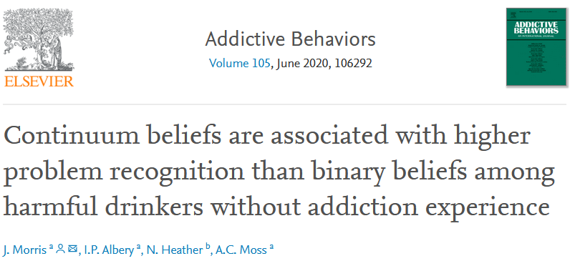
An experimental example (Morris et al. 2020)
People tend to think in binary terms e.g., ‘alcoholics’ vs not
Harmful drinkers (AUDIT-C >8f/9m) were randomised to a continuum frame vs a binary disease model frame
Harmful drinkers showed higher problem recognition in the continuum condition versus control (p=.007) and binary (p<.001) conditions
Continuum framing therefore beneficial to ‘problem recognition’

Slide 5
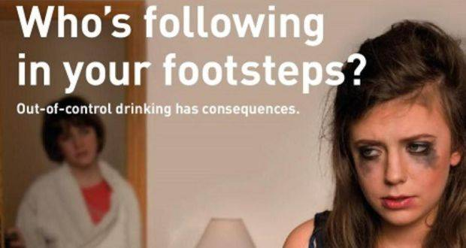
A comms & policy example: Diageo’s ‘Stop out of control drinking’ campaign, Ireland

Slide 6
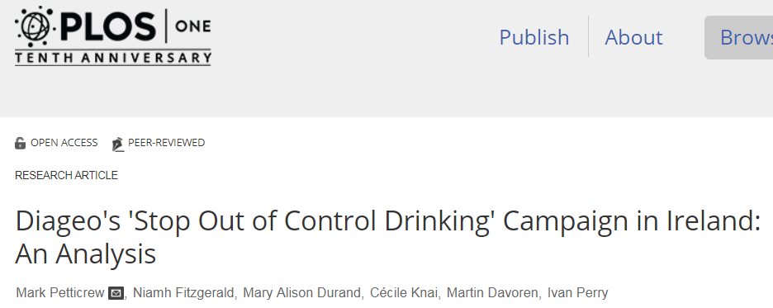
Twitter: @niamhcreate @petticrewmark
Unfunded work.

Slide 7
Overview
How we ‘frame’ alcohol use and harms has wide ranging implications
To date, little empirical research has looked at framing in the context of how alcohol charities (or public bodies) communicate – what works?
ACUK commissioned a consortium of researchers to explore, develop and test different framing strategies to evaluate this which will result in a ‘communications tookit’ for stakeholders

Slide 8
Alcohol Harms Framing project
Aim:
To inform and enable a ‘reframing’ of conversations about alcohol harm, leading to a deeper understanding of the problem, and greater and more effective action to drive change.
ISMH, University of Stirling
University College London
University of Sheffield
London South Bank University
London School of Hygiene & Tropical Medicine
FrameWorks UK

Slide 9
Five stage mixed-methods project
(1) conducted a rapid literature review of the influence of framing on behaviour change, attitudes and policy discourse for both alcohol and other social issues;
(2) conducted four focus groups (n=20) and consulted experts to identify gaps between public and expert understanding;
(3) developed, consulted on and shortlisted framing strategies to address this gap;
(4) conducted 15 focus group workshops (n=90) to explore public responses to candidate framing strategies and
(5) will examine the impact of selected strategies on knowledge, understanding and attitudes in an online survey of a representative UK adult sample.
This will all feed into a communications toolkit developed by FrameWorks UK

Slide 10
Group Activity:
Intro: Do you currently use framing?
In your groups:
To what extent do you think about framing when you’re communicating about alcohol currently?
  Whether in research papers, press releases, campaigns, twitter, PPI etc.
What guides your current communication (language, frames)?
What does success look like in your current communication? What are you hoping to achieve?

Slide 11
Reflections
Framing is unavoidable.
Anytime we talk or write about alcohol, we are choosing what to include and what to leave out, and so using framing, even if unconsciously.
Even trying to write objectively in a research paper, we have to choose some ways of describing issues over others.
(Apart from the work on behaviour change as earlier), we know almost nothing about what framing strategies ‘work’ to change public attitudes to policy, stigma, norms etc.

Slide 12
Stage 1 Findings: Desk-based research
Alcohol ‘problems’ are heavily stigmatized; frames that reduce or avoid stigma threats appear important. For instance, continuum or psychological models (in contrast to binary/ ‘alcoholic’ models) might reduce stigma/identity threats and increase problem recognition.
Frames that directly encourage or support behaviour change (e.g. via increasing motivation or self-efficacy) may be important.
Mediums that are engaging may be important (i.e., relatable narratives over dry statistical information), and the message source, but clear reasons/motives for change also important.
Frames which emphasise the need to protect children and public health may be successful in engaging public support.
Frames which identify population-level causes of alcohol related problems and population-level gains of policy solutions may also be successful in engaging public support.
Frames which focus on the gains of specific groups (e.g. ‘problem’ drinkers) should also incorporate population-level arguments.
Avoid crisis messaging in, for example explanatory metaphor frames, as this may lead to fatalist thinking.

Slide 13
Stage 2 Findings “the GAP”: key differences between current public understanding and where we want them to be?
Public Views | Expert Views
Overarching: positive about alcohol; harms not salient; concentrated in minority at the extreme. | Alcohol as toxic, addictive substance; harms are diverse – not just health harms, not just for a minority, not just drinkers.
Nature & Causes of alcohol harms: individual deficits, v. few mentioned availability, advertising, sponsorship. | Societal and regulatory deficits; Inherent properties of alcohol lead to more consumption and addiction.
Notes:
Taking these findings and comparing them to the expert story that we have just discussed, we can identify several key gaps that the framing strategies we develop have the task of bridging. CLICK.
Talk through these gaps but need to stick to time.

Slide 14
The GAP2: key differences between current public understanding and where we want them to be?
Public Views | Expert Views
Causes, continued: Social pressure: little reflection on this but feeling that drinking is normal ‘its odd not to drink’. | See not drinking alcohol as a positive choice, whether on occasion or at all; not necessary to drink to enjoy other activities/socialising.
Solutions to alcohol harms: focused on treatment/support rather than prevention (fatalism about people with deficits developing problems, can’t prevent this); some recognition of the role of ease of access, advertising, cheap alcohol. No blame attributed to industry. | See clear solutions in addressing a deficit of regulation, and industry activity directly driving drinking as well as influencing government not to regulate. Also believe in power of society to change to be more supportive of people not drinking.

Slide 15
Tasks for the framing strategies to achieve
Overarching Task: Increase the salience and understanding of alcohol harm and public demand for effective action to address it.
Task 1: Build public understanding of how alcohol affects us and that is not the same as other types of food and drink and so needs to be handled more carefully.
Task 2: Build public understanding that alcohol causes diverse harms for a diverse range of people.
Task 3: Increase public recognition of societal pressures to drink and their support for choices to not drink alcohol.
Task 4: Build public support for greater restrictions on the promotion, availability and affordability of alcohol.
Task 5: Build a sense of collective efficacy that, together, we can prevent and reduce alcohol harms.
Task 6: Build public recognition of the role big companies play in driving increased alcohol consumption both directly and indirectly.
Notes:
Shift the UK public’s position on alcohol from one of overwhelming positivity to one where alcohol harms come to mind more readily, are recognised as widespread and diverse, caused by multiple factors including big companies, government and society actions (or inaction), which can and should be urgently addressed to reduce harms.

Slide 16
Next steps
Focus group workshop analysis
  Individual change within focus groups
  Overall impact of different framing strategies
Survey testing against specific outcome statements
  We need to narrow down to outcome statements that can demonstrate whether the framing strategies are working or not.
  To do this we need to be clear on what we mean by ‘working’.
Communications toolkit

Slide 17

Thanks for listening!
niamh.fitzgerald@stir.ac.uk
@NiamhCreate
morrij24@lsbu.ac.uk
@jamesmorris24

Slide 18
Some reflections & learning to date
The framing strategies that will emerge do not tell us what to say – its not about trying to find exact wording but concepts that the field can use.
  A framing strategy for testing is long - more like a ‘story’ or ‘explanation’ that may use metaphor or values within it – not a short ‘frame’ or phrase or slogan.
The framing strategies are not segmented for specific audiences – they need to work for the general public, anyone; as well as being easy to explain and use.
Popular strategies are not always effective and often backfire e.g. crisis messaging; messaging about financial costs; empathy for people in specific circumstances.
When testing the strategies in the survey, it is important to test against outcomes that everyone won’t already agree with, to avoid ‘ceiling effects’.
Notes:
This is very new to us as a team, we are learning all the time from FrameWorks who specialise in this work. They are clearly experts in this process but that comes with some language and learning that we were not familiar with.

