Slide 1
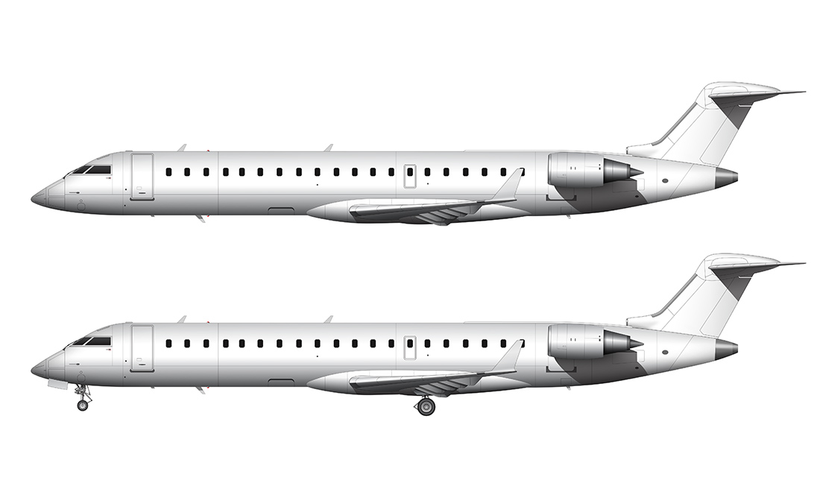
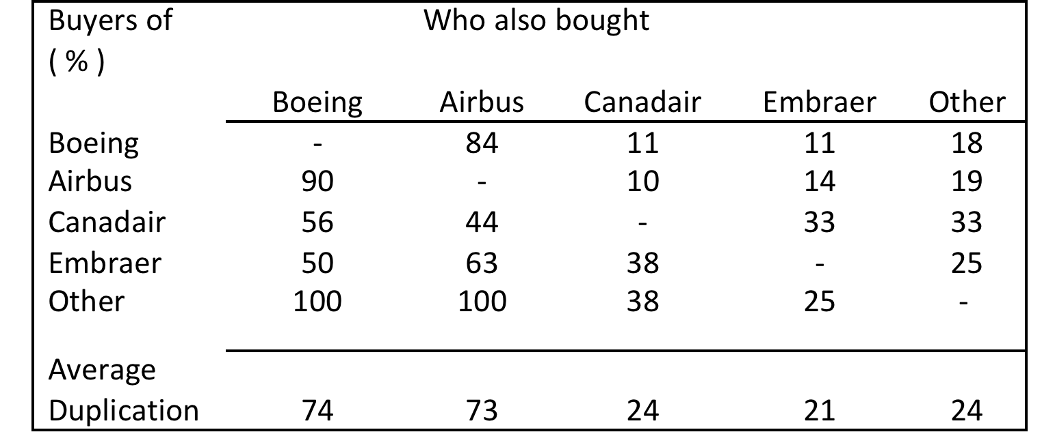
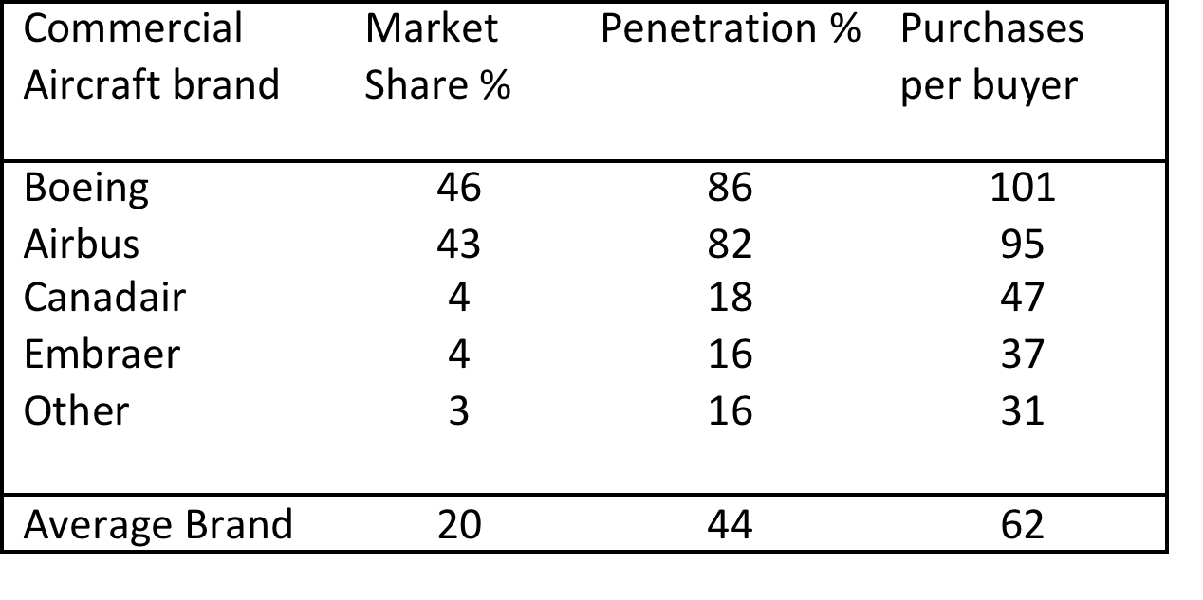
Airplanes are like really big candy bars
Dag Bennett, Helen Aston
The Ehrenberg Centre for Research in Marketing
The Ehrenberg Initiative
Encouraging LSBU students and staff
to contribute to our international programme of evidence-based research in marketing science
Our Contribution
Our new finding is that the competitive structure of a capital goods market conforms to the laws of marketing
Contrary to contemporary theory (e.g. McCabe & Stern, 2009, Stacey & Wilson, 2015) we show that the market structure is like that for consumer goods
Buying is stochastic, but predictable based on underlying buying propensities
Readily available, and reliable information makes analysis accessible and straightforward
$380,000,000
We show that
Brand performance metrics are predictable for capital goods.
.
Large Commercial Aircraft
1900 aircraft sold each year
$80-380 million each
- 20 year life
- multi-year purchasing process
Planes are not FMCG
Drawn out purchasing
Final prices and services are negotiated
Buying centres, Dozens of participants
$95,000,000
Airbus
We have great products, but now it’s clear we can market them better.
John Leahy, COO- Customers
Aircraft makers share customers
.
Conceptual Framework
NBD-Dirichlet model (Goodhardt, Ehrenberg & Chatfield, 1984) of buying behaviour.
Validated by application to many different FMCG categories, consumer durables and services, leading to empirical generalizations through replication and extension.
Existing Knowledge
1. Double Jeopardy Law (DJ) ---- Big brands have more customers, who are slightly more loyal
2. Duplication of Purchase Law (DoP) ---- Brands share customers in line with the size of the other brands
3. Portfolio loyalty is the norm
4. Brand shares are stable
5. Penetration leads to growth and raises brand loyalty
6. Brand loyalty is a function of brand size
This illustrates the duplication of purchase law—brands share their customers more with other big brands than with smaller brands
Implications for Researchers
Brand performance needs to be analysed in context, using established knowledge
Interpret BPMs (loyalty, switching, share of buyers) in reference to established patterns
Predictive power of stochastic models of buyer behavior provide a rich context to study buyer/seller interactions
Implications for Managers
Sales increases come from attracting new customers across the board and stochastic modeling allows managers to predict sales success. This can use off-the-shelf software, readily available data, and simple analysis techniques
Frequency of purchase doesn’t vary much between suppliers, so strategies to capture more of a company’s capital allocations won’t work
But strategies to increase market penetration will
Market Structure
This research makes us question all our thinking about industrial market behaviour.
Prof. Øyvind Bøhren, Industry consultant
Nerd Power
The data was from Planespotters.net– a world wide network of aviation nerds who are very keen to know exactly which airline has which plane—each of which has a unique code number, and a unique charm to the planespotters.

