Slide 1
Higher Education Strategy in Responding to the Generative AI Revolution: Decolonising the Standard Response and Action-Planning Protocols

Slide 2
Contents
Problem and solution
What did we do?
What was the outcome?
What were the experiences?
What was the impact?
What was the actual problem?
Next steps

Slide 3
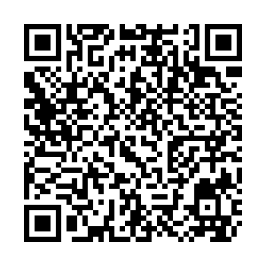
Let’s get “warmed up”!
Use your phone to scan the QR code
www.PollEv.com/dannyclegg360

Slide 4
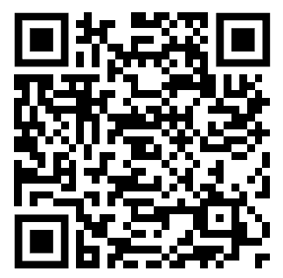
The Inspiration
The wheel is an application of decolonial praxis, actions start developing by exploring questions for unlearning, learning and re-learning the curriculum, for example, what content is centred or pushed to the margins or hidden or ignored? -who is doing this and why?
1. Why and how are policies, processes and culture/s enabling this?
2. You must centre the Black, Indigenous and Minoritised voices at every layer of the process.
Reference: Ahmed-Landeryou, M. (2023). Developing an evidence-Informed decolonising curriculum wheel –A reflective piece. Equity in Education & Society, 0 (0). https://doi.org/10.1177/27526461231154014
[open access]

Slide 5
The Problem - AI
High priority issue in Higher Education (HE)
Strategy needed to address it
Broad spectrum of thinking and ideas
Opportunities vs Risks

Slide 6
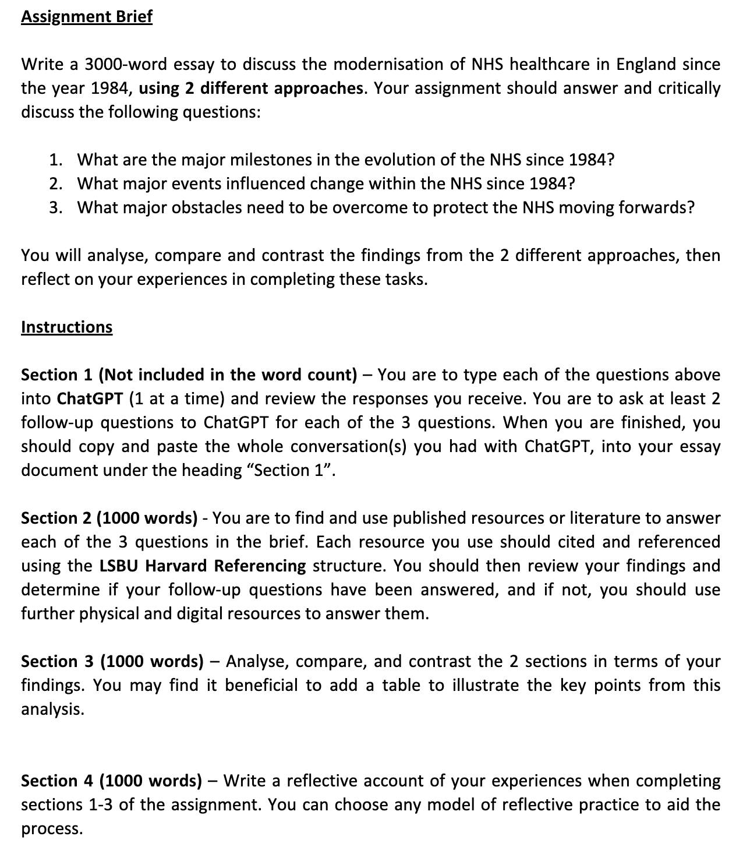
The Solution – Assignments Project
Remove
Remove “temptation” by integrating ChatGPT (or other generative AI) into assignment tasks
Provide
Provide experiential learning and transferable skills
Teach
Teach students to appraise and appreciate the potential of AI as a learning tool
Create
Create opportunity for HEI to reform and rethink assessment criteria measurements
Stay ahead
Stay ahead of the challenges, by embracing AI

Slide 7
The Problem with the Solution
Draft project proposal and assignment created by the “digital lead” for iHSC at LSBU
Carefully planned structure of processes from start to finish
Decolonising processes were planned at every stage of reviewing outcomes
Pre-submission discussion with a decolonising expert
“Why not decolonise the planning stage?”
“You must centre the Black, Indigenous and Minoritised voices at every layer of the process”

Slide 8
What we did
Invitation for “Black, Asian and Minority Ethnicity” academics to take part in the development stage (students were also invited, only 1 participated)
1-2-1 discussions on the project & documents via MS Teams
All changes suggested were made indiscriminately
Open for wider discussion – no rigid instruction on what each person could bring to the development

Slide 9
What was the outcome? (project)
Clarity of language being used in documents
Inaccuracies and “bad habits” identified and improved
Discussion of additional projects and ideas
Collective ownership of the work
Proposal submitted
Individual experiences and observations

Slide 10
Experiences of the planning phase of a decolonising project
The use of ChatGPT/ AI tools
Djamila Hamdaoui
Lecturer, Diagnostic Radiography

Slide 11
My initial reaction and reflections
“I don’t know enough about it”
Concern regarding its use to replace independent research and authentic analysis.
How do I and others ‘label’ different types of AI tools and perceive usage.
For example, tools to enhance and correct language, reference formatting tools.
Who is responsible for deciding the limits of acceptability and value?
Djamila Hamdaoui

Slide 12
Questions this phase has generated
1. To what extent are my perceptions shaped by my own educational journey and preferences?
2. How can the challenges/issues be made into a learning opportunity for both educators and learners?
Djamila Hamdaoui

Slide 13
Questions this phase has generated
What are the key drivers for its usage by students undertaking AHP degree programmes?
Could it be a lack of resources and instruction that speaks to them within their classroom settings?
Are resources dated or too restrictive, or overly complicated leading learners to experiment themselves to find solutions and answers?
Djamila Hamdaoui

Slide 14
Experiences of the decolonising process
Breaking protocols through decolonising
Danny Clegg
Associate Professor, Digital Lead iHSC

Slide 15
About me (part 1)
42-year old, White, Male
Associate Professor, Digital Lead
Chair and Vice chair of committees in EDI, Disability, and NHSE London and National Technology forums
“Spot the privilege?”

Slide 16
What was the actual problem?
AI evolution is a major event in technology and education
Those considered “experts” will often lead
The people in specific positions “expected” to lead
Funding, time, space, opportunity given to the “experts”
Privilege? Hard work? Both?
But how did they “expert” achieve that position?
Processes exist to respond to major events

Slide 17
What problems does this create?
What about everybody else who could be affected by ChatGPT/ AI?
What about those who could benefit from the use?
What about the opinions of others?
Who are those who historically have less voice in decision making?
What potential power is involved in the process…

Slide 18
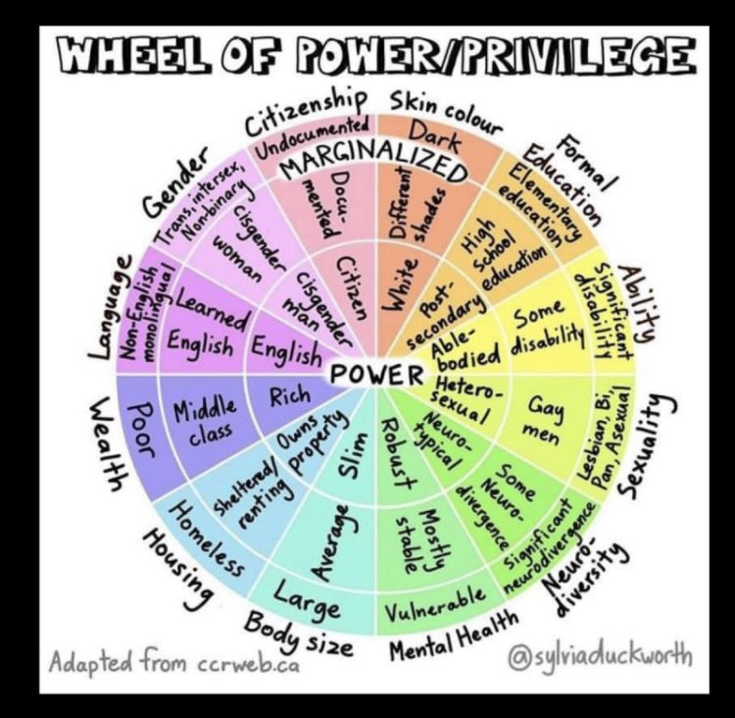
The Actual Problem - Power
Relinquishing or redistributing power in action-planning and protocols
Decolonising at the planning stage
Sharing the credit for the outcome
Creating a culture of “breaking” protocols
Opportunity!

Slide 19
About me (part 2)
Behaviours and actions:
See solutions immediately, struggle when others don’t
Hyperfocus and can produce rapid speed of delivery
Want to do the best for everyone, often to my own detriment
Severe difficulties deviating from my routines & processes
Autistic-ADHD, OCD, Dyslexic

Slide 20
The Challenges and Realisation
The effects of “breaking” the hard-wiring
Anxiety, emotions, tears, unrest, fear, support!
The realisation:
Decolonising isn’t supposed to feel easy all the time
Existing “behaviours & actions” will need to be broken in order to decolonise
Fear is to be expected, but does that mean giving into it?
Does the need to avoid my difficulties occurring, outweigh the need to decolonise?

Slide 21
Key Experiences
Project that feels stronger and more authentic at the point of proposal submission
Experiences of those voices who could have been an “after-thought” demonstrate the benefits of decolonising
Personal and professional development in managing uncomfortable changes to my work style
Bloody enjoyed it! and we formed strong working bonds for future activities

Slide 22
Key Observations I made
Changes being “suggested” by those in the 1-2-1 discussions – I reframed the explanation to explain that “changes will be made” (transfer of power)
Enthusiasm and commitment across all contributors
Extensive experience in individuals who would not have been identified as “experts” in the initial stages
Future projects and working relationships
Additional protocols needing to be broken!

Slide 23
Key Learning Outcomes for me
Order of documents for students needs to be considered when asking them to decolonise – label them as doc 1, doc 2 etc.
Note to self: Remember to explain to students that the proposal is the central document, otherwise they may review things differently!
Additional note – email content: language used when asking for expressions of interest
Practice change – confirm the choice of language being used is accurate. It was unclear if participants in the decolonising had to be of all 3 named ethnicities, or exclusive to just those stated.
Don’t pluck “good numbers” out of the air when creating methodologies or writing assignment tasks!!!
Strong support for items needing review in the marking grids – references, citations, spelling & grammar

Slide 24
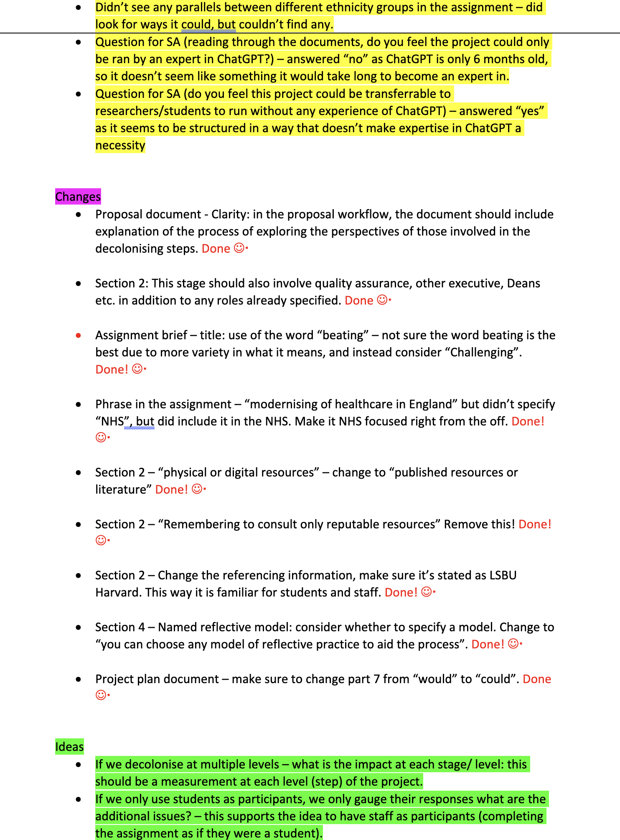
Additional (unexpected) items

Slide 25
Additional Decolonising Protocols – Authors & Lead Author
Tradition in academia – “who is the lead author?”
How does someone ACHIEVE the position of “lead author”?
Funding, time, space, opportunity
(sounds familiar??)
Recognise the imbalance of power existing in authorship
Alternative practice to “share” lead authorship

Slide 26
Authors – collective leads
No identifiable lead
Focus on shared contributions
Next steps?
Break conventions!

Slide 27
Final thoughts
“Decolonising processes require a change in our thinking, a breaking of behaviours and habits, and conducting meaningful actions.
If an Autistic-ADHD, OCD, Dyslexic individual can achieve this, anybody can!”
Clegg, D. (2023)
Decolonising is not a “buzz word”
Equity does not mean the same as Equality
The effects can’t always be predicted, but the benefits of decolonising are evident
The purpose is ensuring equity for voices of Black, Indigenous & Minority individuals

Slide 28
Thank you – Any questions?
Questions for you to consider
What protocols can you think of that need to be broken in Higher Education?
What could you do to decolonise your own practice?
Poll will become active soon ☺

