Slide 1


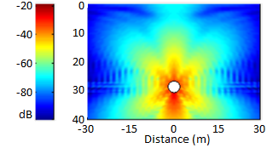
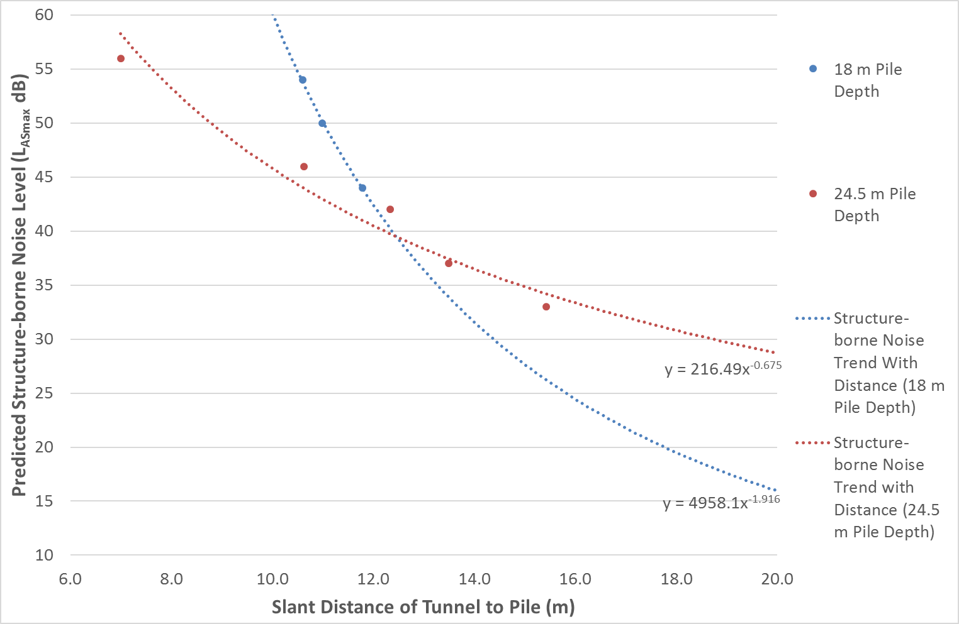
London South Bank University
Assessment of Ground-Borne Vibration from Underground Trains on a Proposed Residential Development
Jerry Rees ^{a+b}; Luis Gomez-Agustina ª
a) London South Bank University; b) Hilson Moran Partnership Ltd
Hilson Moran Partnership Ltd
INTRODUCTION
Underground railway traffic can emit significant levels of vibration into the soil surrounding the train tunnels. In heavily populated areas space for habitable buildings is reducing all the time as available locations are developed at an increasing rate. Many sensitive buildings are therefore built on top of or in proximity to underground railway lines, causing perceptible levels of vibration within these buildings. This vibration has the potential to disturb the occupants through tactile vibration and/or structure-borne noise or even cause cosmetic or, in extreme cases, structural damage to the building.
Good construction practice requires the estimation of vibration levels in proposed buildings of sensitive use and to assess whether any mitigation would be required.
AIM
THE SITE
The aim of the investigation was to provide a methodology for the estimation of tactile vibration and structure-borne noise caused by underground railway vibration and apply it to a specific case study where a development is proposed above an underground railway line.
Objectives:
To predict the level of vibration at the bottom of new pile foundations;
To predict the level of vibration transmission into the building; and
To assess the effects of predicted tactile vibration and structure-borne noise levels on the occupants of the building
A site where a new development with piled foundations is proposed was chosen to assess vibration from London Underground Piccadilly Line tunnels passing beneath the north-west corner.
The Piccadilly Line tunnels are 28m below the ground at the site within the London Clay geological formation, a relatively impermeable soil with typically low water content.
Tunnel and Pile Locations (Waterman [1])
METHOD
Step 1 – Prediction of Vibration at Pile Bases
Step 2 – Prediction of Foundation to Slab Transmission, Vertical Transfer and Surface Resonance
The sensitive residential room spaces of the proposed development will be situated at first floor level and above. The loss of energy as vibration travels from the soil into the foundations and then vertically through the structure to first floor and above was assessed using Nelson’s transfer functions [4].
Surfaces such as raised floors, light-weight walls and suspended ceilings within room spaces will be excited by any vibration energy that is transmitted to them, with the level of excitation dependent on the intrinsic properties of the materials and their dimensions. Nelson’s [4] transfer functions were also used to assess the likely resonance in the rooms of the proposed development.
Pipe-in-Pipe (PiP) software was used to calculate the difference between predicted vibration at the surface and predicted vibration at the bottom of proposed piles. This difference was then applied to measured surface vibration levels to find the vibration level at the pile.
PiP [2],[3] is an analytical 3D model for the dynamics of a circular underground railway tunnel. The model assumes the train/tunnel system to be a cylindrical line-source and the surrounding soil is modelled using wave equations.
PiP Predicted Vibration Propagation at 100 Hz
RESULTS
The results showed a correlation between the depth of the piles and the level of vibration transmitted to them, where deeper piles resulted in a greater level of vibration incident upon them. A correlation was also seen with distance, where greater distances resulted in greater attenuation of vibration through the soil.
Predicted tactile vibration levels were low enough so as not to cause annoyance or building damage but structure-borne noise levels were above the adopted criteria in many of the proposed development room spaces.
Structure-borne Noise Levels with Distance from the Tunnels
Predicted Structure-borne Noise Levels
Red = Above max allowable criterion; Green = Below max allowable criterion; Ground floor criterion is greater as proposed retail space at ground floor is less sensitive than residential spaces at floors above
CONCLUSIONS
The assessment showed that tactile vibration would not be large enough to cause adverse human response. Tactile vibration levels were also predicted as being well below the levels required to cause building damage.
The assessment of structure-borne noise showed a strong likelihood of significant exceedances of the adopted criteria for the proposed building above piles located up to 14.9 m away from the Piccadilly Line tunnels.
Structure-borne noise levels were shown to have an inverse power trend with distance away from the tunnels, with the trend depending on the depth of the piles.
REFERENCES
Waterman (2016); ‘Tactile Vibration and Structure-Borne Noise at London Square Caledonian Road, London N7 9NQ’, Waterman Infrastructure & Environment Limited, London.
J. Forrest, H. Hunt: A three-dimensional tunnel model for calculation of train-induced ground vibration. Journal of Sound and Vibration 294 (2006) 4 – 5, 706 – 736.
M. Hussein, H. Hunt: A Software Application for Calculating Vibration due to Moving Trains in Underground Railway Tunnels. NOVEM 2009, Oxford.
P.M. Nelson: Transportation Noise Reference Book. Butterworth & Co. (Publishers) Ltd, 1987.

