Slide 1
Developing, implementing and evaluating the Yorkshire Patient Experience Toolkit (PET): How process evaluation can strengthen action research Thomas Mills, PhD Senior Research Fellow Bradford Institute for Health Research 2nd July 2019

Slide 2
Setting the scene…
An explosion in the collection of patient experience feedback (Davidson et al., 2017) has not been matched with efforts to actively use it in service improvement (Coulter et al., 2014; Reeves et al., 2013)
There appears to be an assumption that simply providing feedback to Healthcare Professionals (HCPs) is enough (Reeves et al., 2013)
Yet – a significant body of research highlights barriers to the effective use of patient feedback in practice (Davies and Cleary, 2005; Gleeson et al., 2016; Krawczyk et al, 2018; Sheard et al., 2017)

Slide 3
A 2.5 year NIHR/HS&DR funded research study
How might health professionals be supported to act on patient experience feedback data to improve patient experience at ward-level?
Phase 1 – Co-design stage: six ward teams from three NHS Trusts develop a toolkit for improving patient experience
Phase 2 – Toolkit implemented and refined through action research over a 12-month period; ‘intervention’ evaluated using process evaluation methodology

Slide 4
A unique process evaluation…
What is ‘it’? Whether, how, for whom and in what contexts does ‘it’ work? (Pawson and Tilley, 1997)
Data collection/analysis: large, qualitative database, organised using a framework approach (Gale, 2013) and analysed using inductive analysis techniques (Braun and Clarke, 2006)

Slide 5
Findings…
Partial implementation of the toolkit was achieved despite difficult circumstances
The toolkit documentation was perceived by HCPs as being too bulky and time-consuming to be used by them
The facilitator role was more expansive than originally envisioned
Strong and trusting relationships between the people involved was a key enabler of the project
Organisational support was a further core enabler of the project
A Typology of Logic Models

Slide 6
Implications…
The Yorkshire “PET” is an effective guide for facilitators if implemented as part of a participatory improvement strategy – But the challenge now is to achieve success at scale
Toolkits have potential in knowledge mobilisation/transfer – But toolkits designed for use by HCPs in busy healthcare environments should be used sparingly
Action research is an effective mode of inquiry/implementation – But staff and service pressures moderate the success of the approach

Slide 7
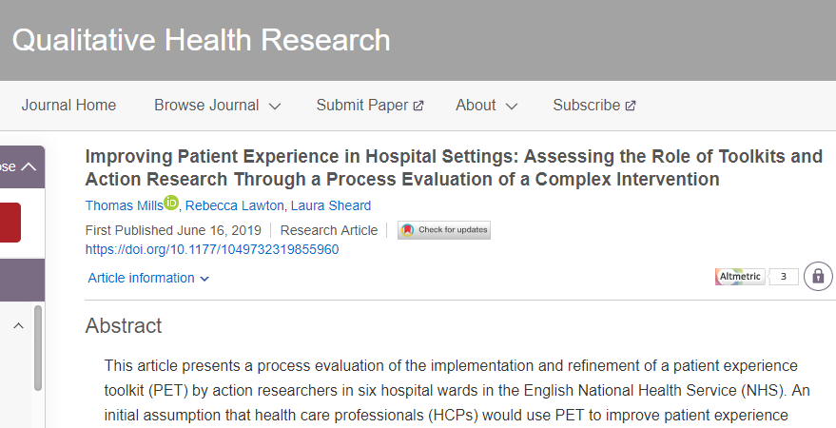
Check out our website:
http://www.improvementacademy.org/tools-and-resources/the-yorkshire-patient-experience-toolkit.html
And our new paper in Qualitative Health Research:

Slide 8
Any questions?
Please contact me if you have any further questions or require references:
Thomas.Mills@bthft.nhs.uk
Twitter handle – @TomMills1984

