Slide 1
Challenges of using participatory and creative research methods
Nicole Brown
@ncjbrown @FibroIdentity
www.nicole-brown.co.uk
Notes:
Overview:
Participatory and creative research and its benefits
A brief overview and introduction to my research
Some examples of data
Challenges and less successful aspects of the making processes and creative methods

Slide 2
Participatory and creative research
Power differentials between researcher and researched
Getting closer to experiences
Richer data: photo elicitation, journaling, photo/video diary
Notes:
Examples of recent existing work:
Bagnoli, A. (2009). Beyond the standard interview: The use of graphic elicitation and arts-based methods. Qualitative Research, 9(5), 547-570.
Guell, C., & Ogilvie, D. (2015). Picturing commuting: photovoice and seeking well-being in everyday travel. Qualitative Research, 15(2), 201-218.
Hagens, C., Beaman, A., & Bouchard R.E. (2003). Reminiscing, poetry writing, and remembering boxes: person-centred communication with cognitively impaired older adults. Activities, Adaptation and Aging, 27 (3/4), 97-112.
Jones, A., & Woolley, J. (2015). The email-diary: a promising research tool for the 21st century?. Qualitative Research, 15(6), 705-721.
Orr, N., & Phoenix, C. (2015). Photographing physical activity: using visual methods to ‘grasp at’ the sensual experiences of the ageing body. Qualitative Research, 15(4), 454-472.
Kara, H. (2015). Creative research methods in the social sciences: A practical guide. Bristol: Policy Press.

Slide 3
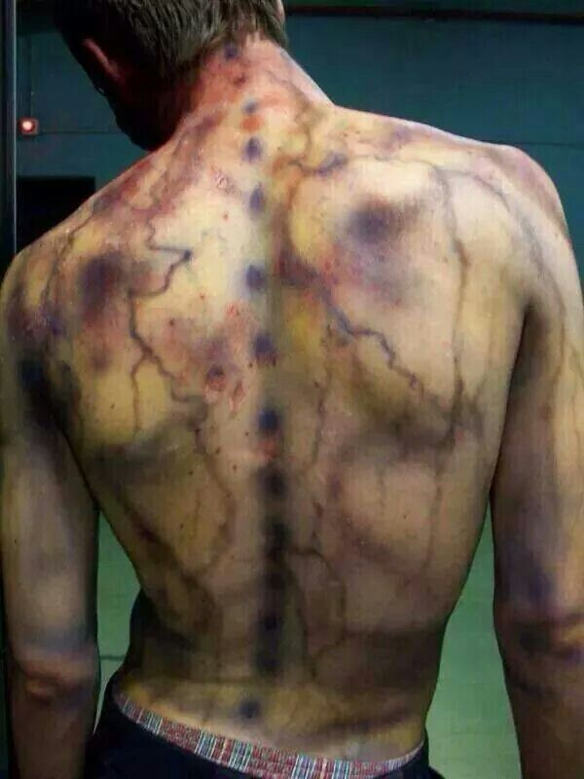
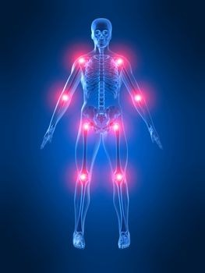
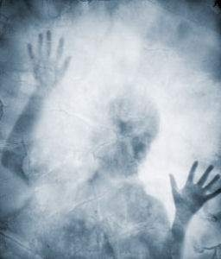
Fibromyalgia and academic identity
Notes:
My research: The construction of academic identity under the influence of fibromyalgia.
Marginalised within an elite: I attempt to uncover the marginalised voices of the unheard and underrepresented academics diagnosed with fibromyalgia
Fibromyalgia: is a complex, contested syndrome characterised by widespread pain, chronic fatigue, sleep problems, psychological disorders and cognitive dysfunctions, and is on the cusp of the physiological, psychological and somatic.
Concepts that are difficult to explain: Fibromyalgia and academic identity
Identity: difficult, but then what is an academic – teaching only? research? PhD student? someone who works in HE? what about FE?
Fibro: variable symptoms, variable levels and severity, contested illness
Interviews on their own not enough, especially where the pain and brain fog are concerned.
Therefore creative methods.
To encourage participants to reflect on, make sense of and express their experiences, which are usually difficult to express in words, I use making and doing.
Timelines and identity box – objects in response to questions

Slide 5
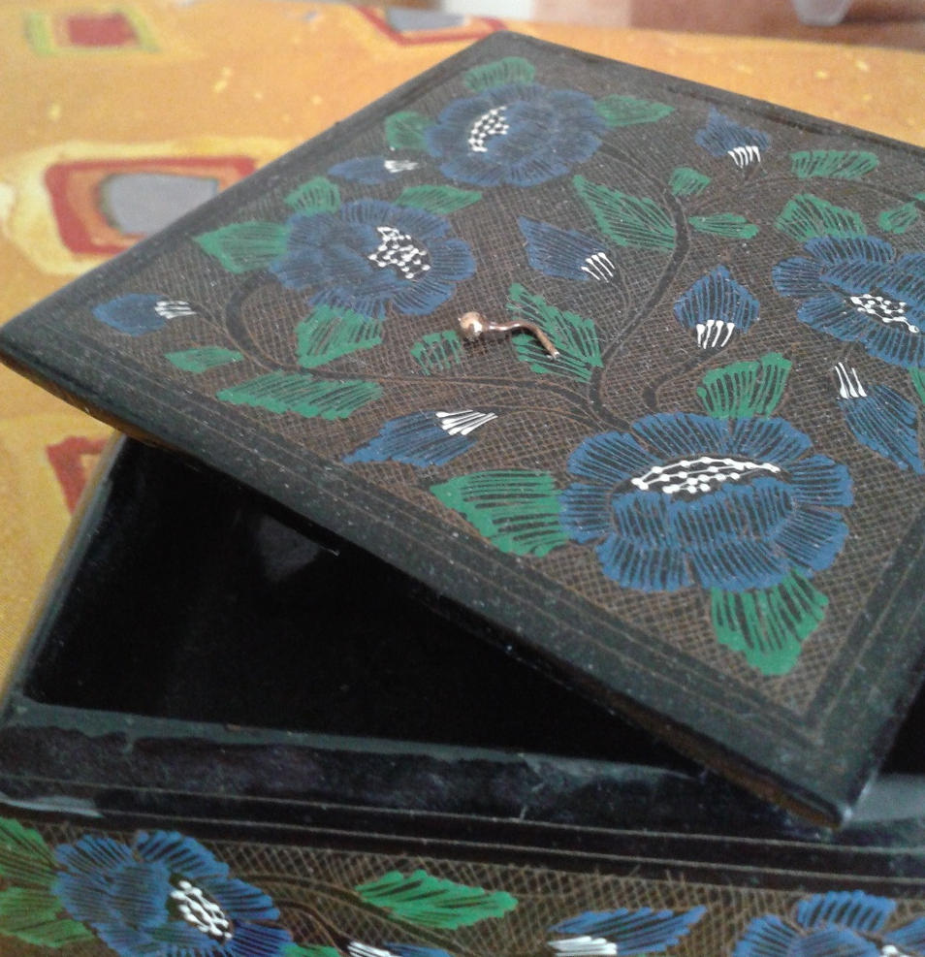
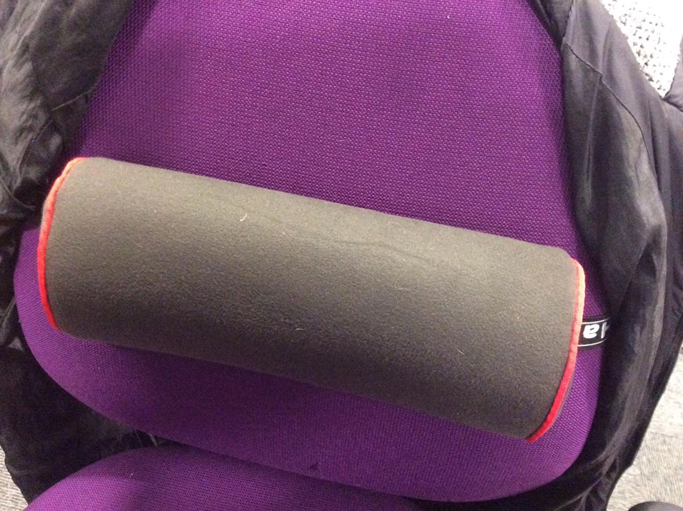
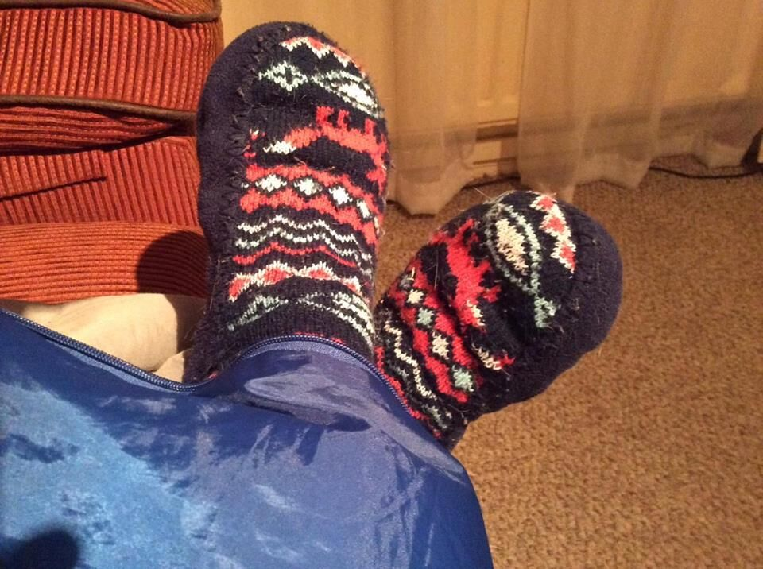

Slide 7
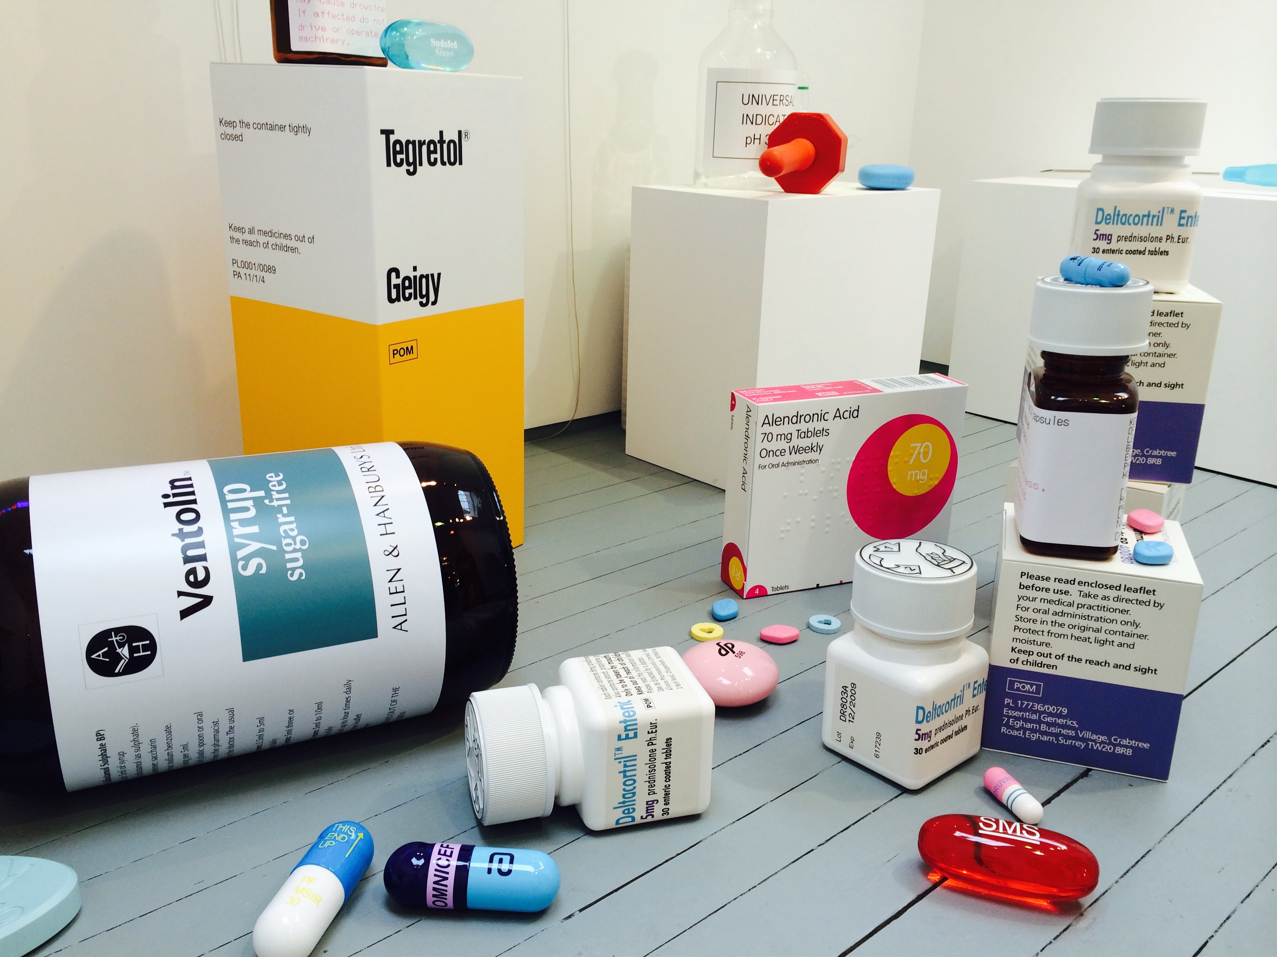
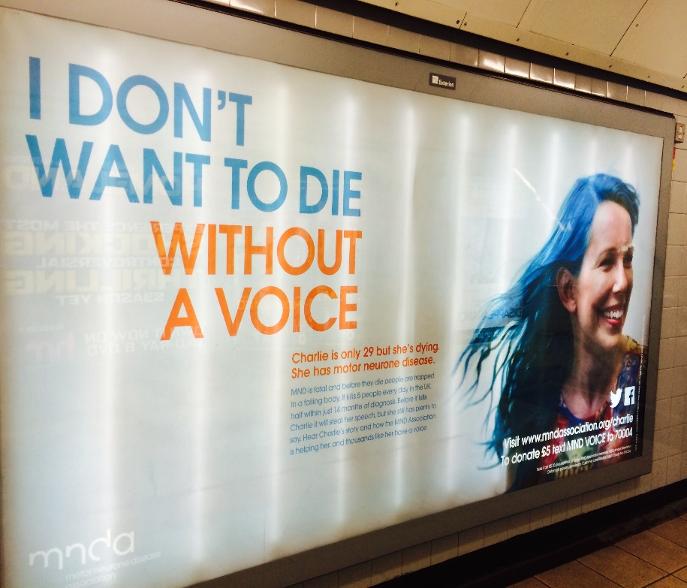

Slide 8
Challenges and concerns
Doing it right and meeting the criteria
Is this real research?
Recognisability
Time, commitment, demands
Analysis
Notes:
And Concepts that are difficult to explain: Fibromyalgia and academic identity
Identity: difficult, but then what is an academic – teaching only? research? PhD student? someone who works in HE? what about FE?
Fibro: variable symptoms, variable levels and severity, contested illness
Interviews on their own not enough, especially where the pain and brain fog are concerned.
Therefore creative methods:
identity box – objects in response to questions
Issues with methods and so:
open to expressive methods – photos, poems, songs
Concerns:
Doing it right
Meeting the criteria
Is this real research?
Recognisability – an issue as many participants have not disclosed
Time to be spent on it – trying to hold down the jobs and social life with fibro

Slide 9
Analysing data from creative, participatory methods
Which framework?
Value and validity of interpretations
Is there a solution?
Notes:
Concepts that are difficult to explain: Fibromyalgia and academic identity
Identity: difficult, but then what is an academic – teaching only? research? PhD student? someone who works in HE? what about FE?
Fibro: variable symptoms, variable levels and severity, contested illness
Interviews on their own not enough, especially where the pain and brain fog are concerned.
Therefore creative methods:
identity box – objects in response to questions
Issues with methods and so:
open to expressive methods – photos, poems, songs
Concerns:
Doing it right
Meeting the criteria
Is this real research?
Recognisability – an issue as many participants have not disclosed
Time to be spent on it – trying to hold down the jobs and social life with fibro

Slide 10
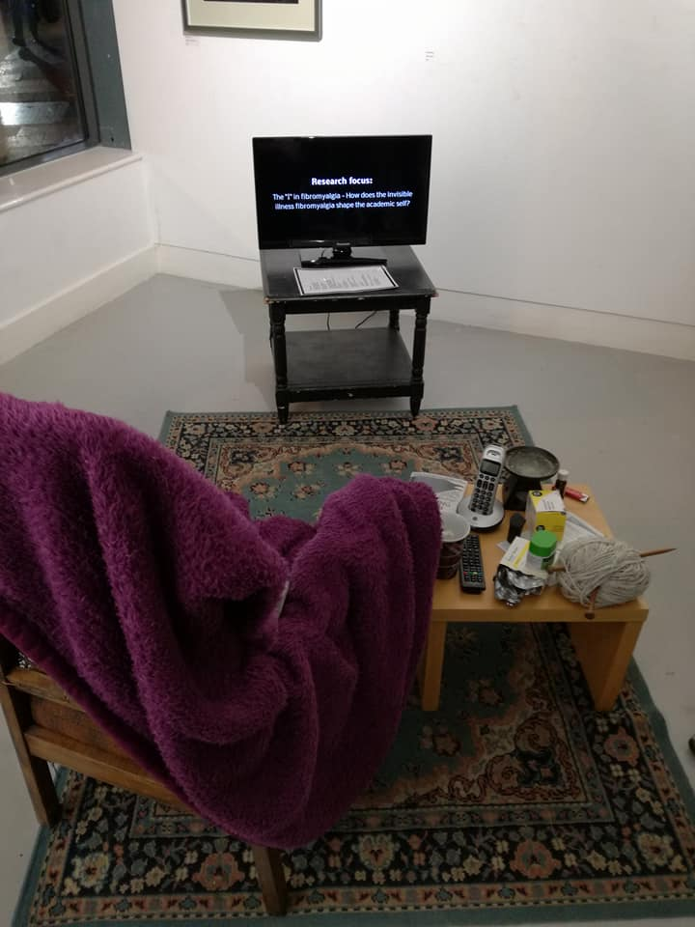

Slide 12
Challenges of using participatory and creative research methods
Nicole Brown
@ncjbrown @FibroIdentity
www.nicole-brown.co.uk
Notes:
Issues with methods and so:
open to expressive methods – photos, poems, songs
Concerns:
Recognisability – an issue as many participants have not disclosed
Time to be spent on it – trying to hold down the jobs and social life with fibro (compare with non-academics)
Doing it right and meeting the criteria
Is this real research? - role the researcher plays within the triad of research, conversations amongst peers and therapy

