Slide 1
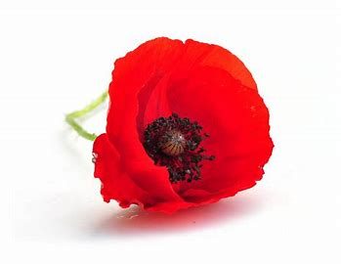
The effect of team sport on the perceived health and wellbeing of medically discharged United Kingdom Wounded, Injured or Sick (WIS) military veterans- phase 1 of a mixed methods study
Clare Pope
MCSP HCPC FHEA Reader: Brunel university
Phd candidate London south bank university
Bench, De Olivera, cable

Slide 2
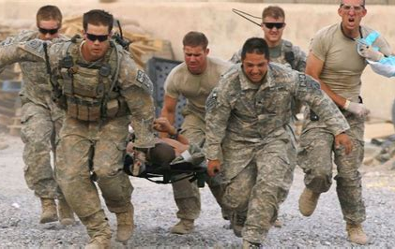
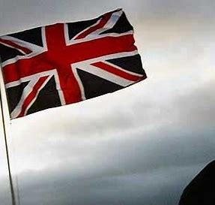

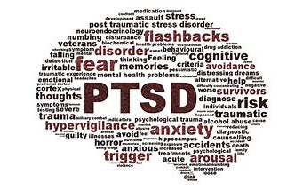
Research Question
How do medically discharged United Kingdom WIS military veterans perceive the effect of team sport on their health and wellbeing?

Slide 3
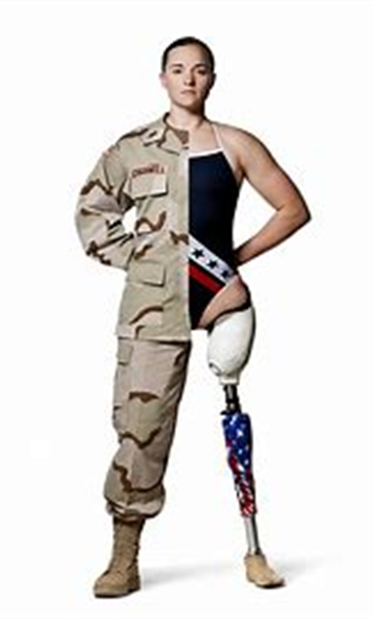
Justification
Over 1,500 medically discharged UK veterans each year, almost half with complex Mental Health and physical presentations (MoD, 2024)
Engaging in regular physical exercise improves mental and physical health (Caddick et al, 2014, Sharizipour et al, 2017) for this population
Other research suggested team sport quality of life in WIS veterans (Stam et al 2020)
Team sport may confer particular health benefits over individual sport (Anderson et al, 2019)

Slide 4
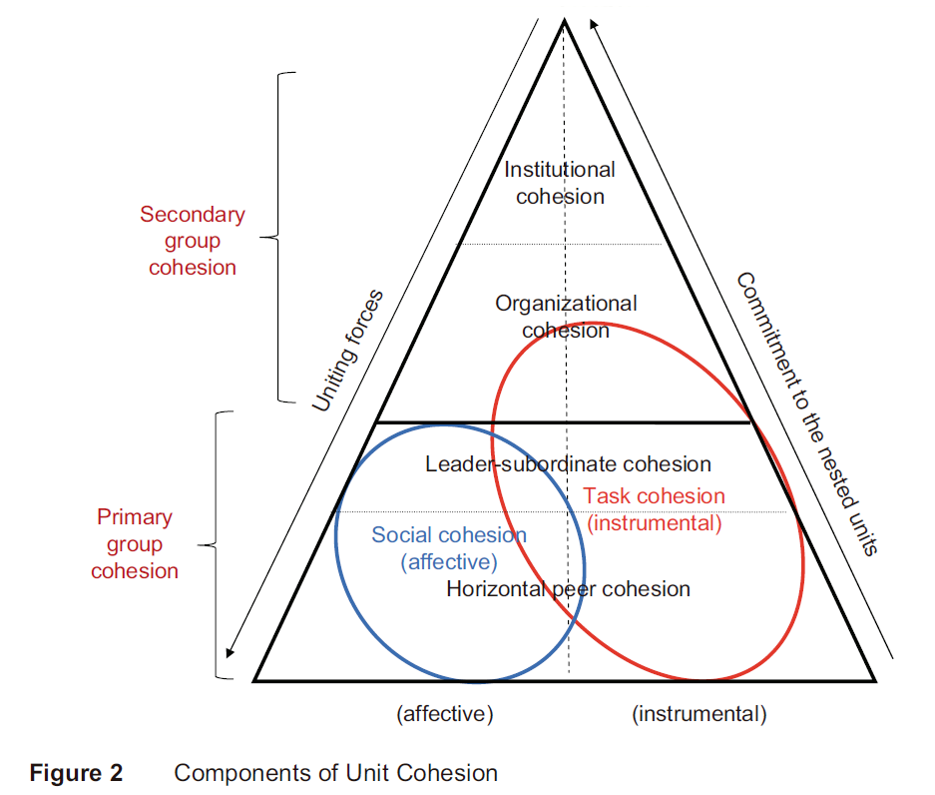
Theoretical framework model with permission (Salo, 2011)
The bond between military personnel and its effects on behaviours and health (Siebold, 2007)
Does it still exist in the veteran population?
Could it be a motivator to participate in team sport?

Slide 5
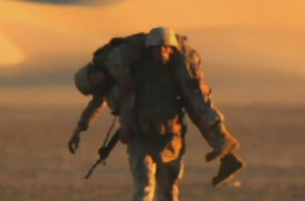
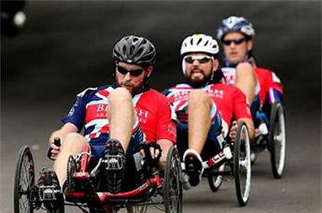
Aim of phase 1 - To compare perceived health and wellbeing of medically discharged WIS veterans engaged in team sports vs those not
Ethical approval gained [ETH2223-0218]
Online questionnaire
  Reviewed for face and content validity, patient, public participation
  Data collected 22/09/2022 –22/06/2023
The survey contained questions on:
  Demographic and social information related to findings from literature review
  Impairments
  Risk Factors for poor Mental Health
  Physical Activity- adapted from Activity Alliance (with permission)
  General - Warwick-Edinburgh Mental Well-Being Scale (WEMWBS)
  AUDIT – alcohol consumption
  GAD- 7 - anxiety
  PTSD – C post –traumatic stress disorder

Slide 6
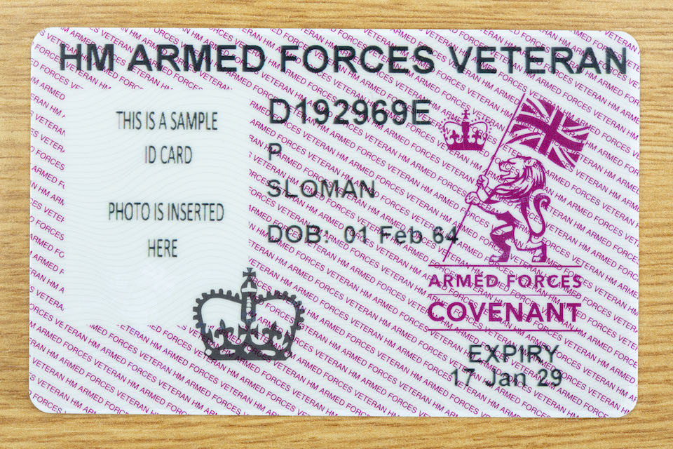
Participants – all medically discharged from uk armed forces
82 respondents
Aged 30-6, average 47 and SD 8.5.
70% male (n= 57) and 29% female (n=24), one preferred not to say
88% o identified as White British (n=72), 5% as Black British (n=4) with the remainder (n=3) or other/mixed ethnicity, one preferred not to say.
83% lived in England at the time of completing the survey.
52% British Army, 28% from the RAF, 16% from the Royal Navy (4%) the Royal Marines.
(61%) joined the Armed Forces when teenagers, with almost a quarter at the age of 18
Length of service ranged from 3 years to 34 years 7 months. Average 15 years 4 months SD 8.6, one early service leaver (ESL).
76% had been deployed to a combat zone, around half experienced combat while deployed
Other data on qualifications and rank on joining and leaving, skills gained during service

Slide 7
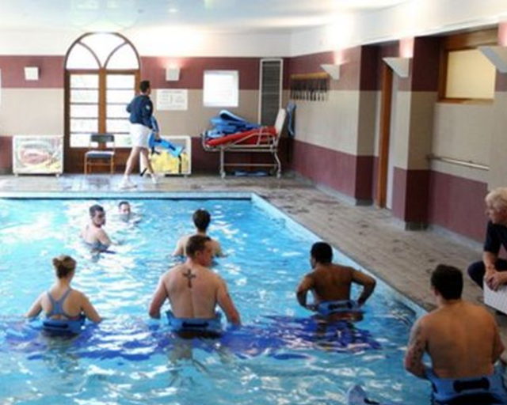
Data analysis and groups
Descriptive statistics only
Four groups:
  Group 1 no exercise
  Group 2 exercise/leisure non-group
  Group 3 exercise/leisure group
  Group 4 team sport

Slide 8
Well-being
The results show mental well-being as similar across participation groups; there seems to be no link between well-being and sports participant in this sample

Slide 9
Alcohol use disorders (audit)
The results for AUDIT suggest participants in group sport/leisure or activities or team sport report lower risk of alcohol misuse in this sample.
There was an unexpectedly large number of abstainers in the sample

Slide 10
Anxiety Gad-7
The results show participants in group sport/leisure activities or team sport report fewer symptoms of anxiety in this sample
High anxiety scores were found in the sample overall and were commonly cited as a factor in medical discharge

Slide 11
Post traumatic stress disorder PTSD - c
Symptomatic or Non-Symptomatic
The result show participants in group sport/leisure activities or team sport report fewer symptoms of PTSD than those who do not exercise or exercise alone or with one other in this sample

Slide 12
Unit Cohesion
The results do not suggest a relationship between unit cohesion while serving and participation in group activity in this sample
Further investigation into primary cohesion is required

Slide 13
summary
Whilst there was no evidence that participation in team sport improved overall well-being in this population, there was a difference in the other outcome measures for team sport and group exercise
The population reported lower risk of disordered alcohol consumption*, lower levels of anxiety and fewer symptoms of PTSD
Unit Cohesion-The results do not suggest a relationship between unit cohesion while serving and participation in group activity in this sample.

Slide 14
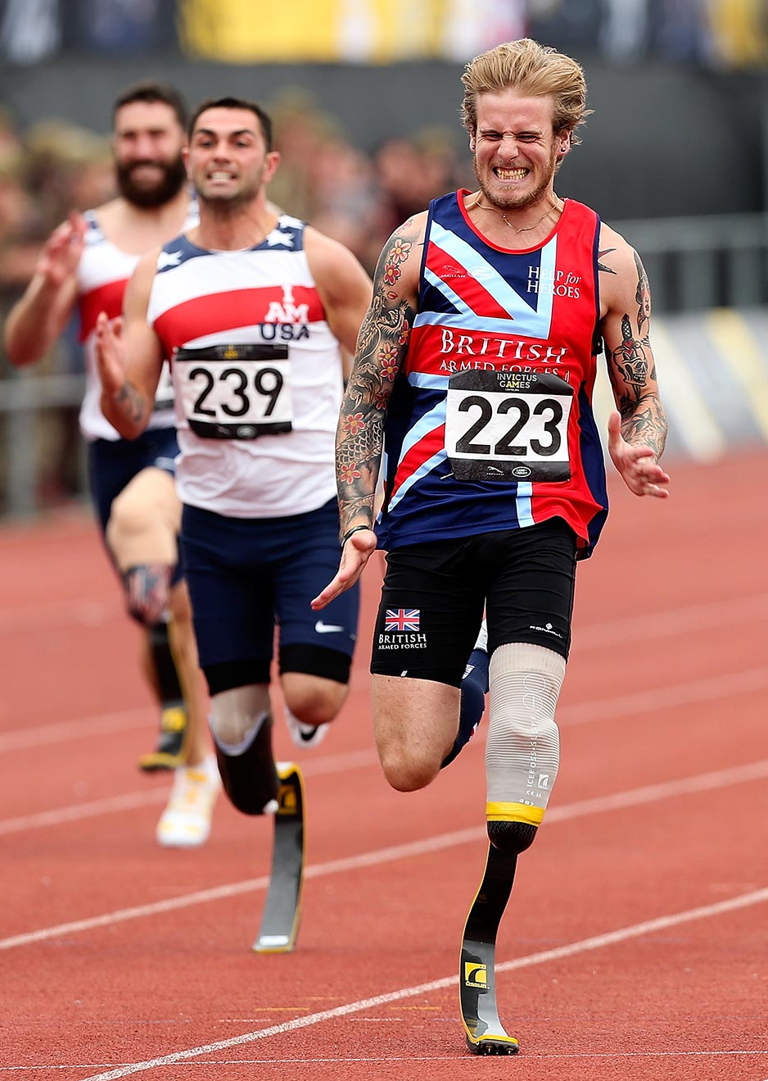
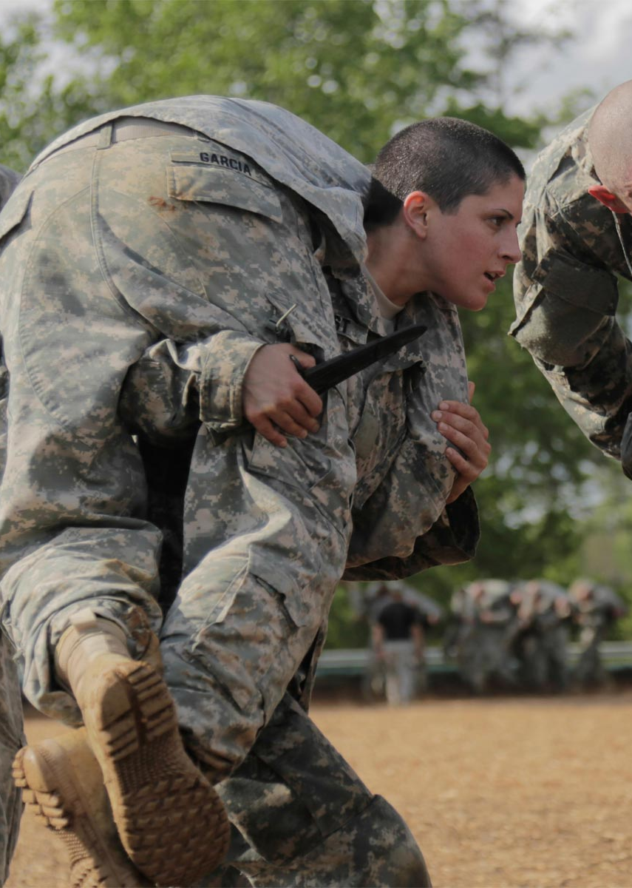
Phase 2
Explored thoughts and feelings in medically discharged veterans who participated in team sport
Online semi-structured interviews
Reflexive Thematic Analysis guided by by RTA Braun and Clarke (2021) almost complete

Slide 15
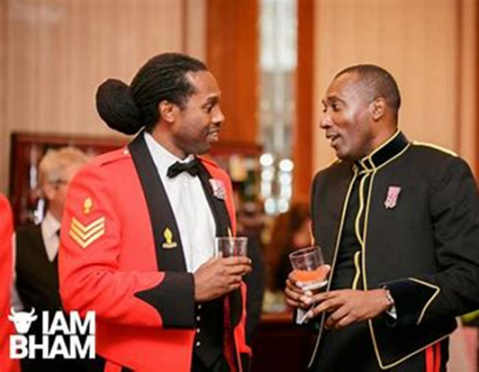
Phase 2 –analysis underway
Theme -Team sport helps address the challenges and losses of a medical discharge from the UK Armed Forces
I got medical discharge; we haven't done our bit because we had to leave abruptly. That's another reason why we're going to sport, because we still want to do something we still want to. We still got that urge that we want to prove that we are still the people that we are and that's why I think sport is a massive thing for injured veterans.
And that's why that team sport we wanna put on that top. We wanna go the extra mile for my teammate because that's what the basic training taught us to do and that's why I think it's so invaluable. I was like, I need to be part of the team again, so I was searching for other things as well

Slide 16
Key references
Andersen, M. H. , Ottesen, L., and Thing, L. F , (2019) The social and psychological health outcomes of team sport participation in adults: An integrative review of research, Scandanavian Journal of Public Health, 7 (8), 832-850
Braun, v., and Clarke, V. (2021) Thematic Analysis, A practical Guide, Sage, London
Caddick, N. and Smith, B. (2014) The impact of sport and physical activity on the well-being of combat veterans: A systematic review, Psychology of Sport and Exercise, 15 (1), pp. 9-18.
Cresswell, J.W, Plano Clarke, V.L., (2018) Designing and Conducting Mixed Methods Research 3rd ed, Sage, London
Salo, M. (2011) United we stand, divided we fall: a standard model of unit cohesion. Thesis, university of Helsinki
Siebold, G. L. (2007) The Essence of Military Group Cohesion Armed Forces & Society, 33(2), 286-295.
Shirazipour, C. H., Evans, M. B., Caddick, N., Smith, B., Aiken, A. B., Martin Ginis, K. A. and Latimer-Cheung, A. E. (2017) Quality participation experiences in the physical activity domain: Perspectives of veterans with a physical disability, Psychology of Sport and Exercise, 29 , pp. 40-50. DOI: 10.1016/j.psychsport.2016.11.007.
Stamm, R., Regenbaum, L., and Stamm, M. (2020) Life quality of injured defence forces veterans who play sitting volleyball, Papers on Anthropology (2020) 29(1) 73-85

