Slide 1
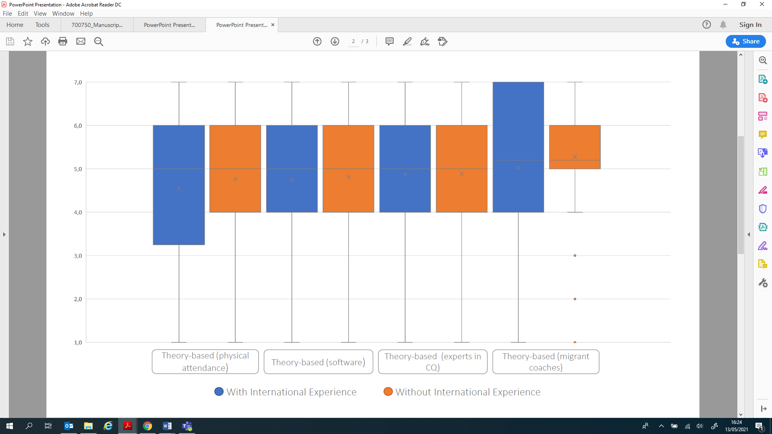
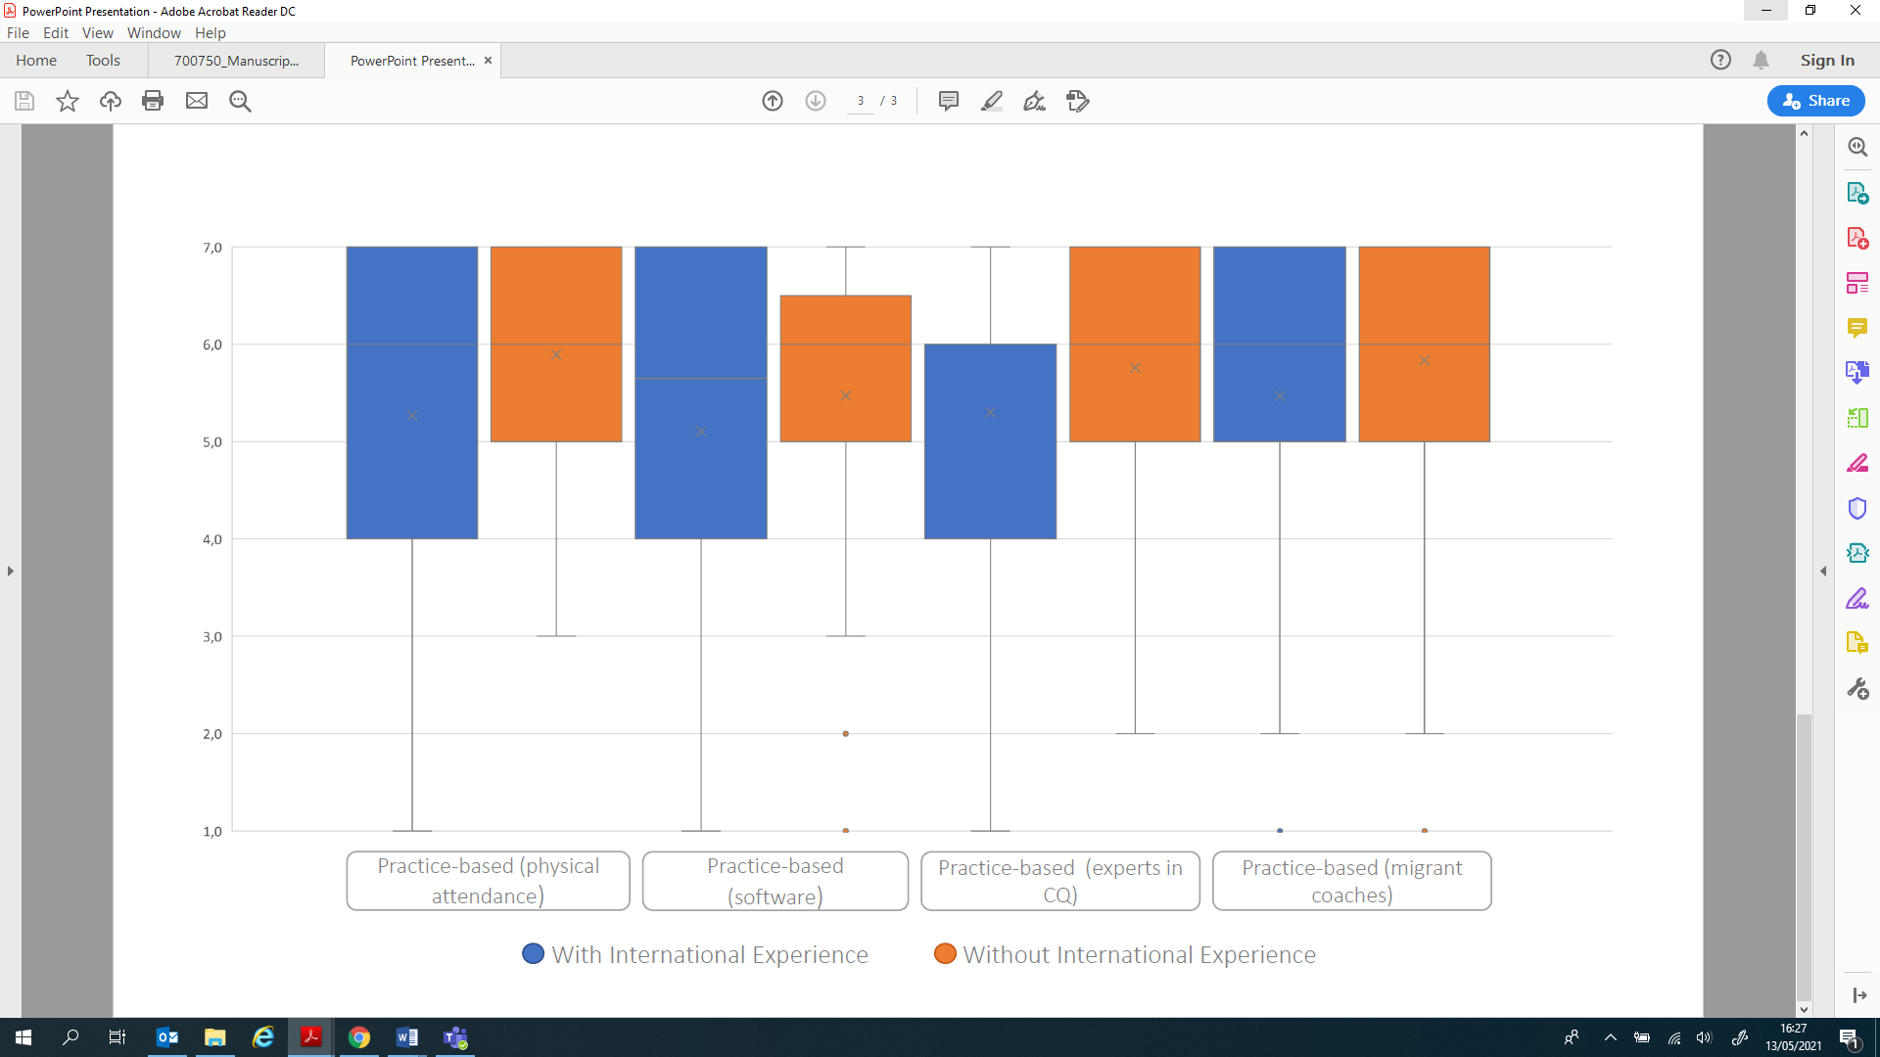
Coaches’ cultural intelligence:
How coaches rate themselves and what are their cultural training needs?
Borges, M.¹, Rosado, A.², Lobinger, B.³, Freitas, F.⁴, de Oliveira, R.F.¹
1 School of Applied Sciences, London South Bank University, London, UK
2 Faculty of Human Kinetics, University of Lisbon, Lisbon, Portugal
3 Institute of Psychology, German Sport University Cologne, Cologne, Germany
4 Faculty of Economy, University of Coimbra, Portugal
Introduction The rise of globalisation over the past decades has impacted nearly every aspect of modern sport across the world. In European football, for example, this phenomenon has changed the dynamics in the way coaches move between countries (1) and has also increased their need to rapidly adapt to new realities. Coaches and players interact with people from different cultures and backgrounds more than ever before, and whilst this cultural diversity can inspire creativity and drive innovation, it also poses some additional challenges (2,3). The ability to function effectively in different cultural contexts, called Cultural Intelligence (4), has never been more relevant for coaches.
Figure 1. CQsport dimensions considering coaches’ international experience.
Methods Participants were 209 football coaches (38.8±10.4 years) either with international experience (n=88) or without (n=121), and different levels of coaching certification (n=95 levels 1&2 and n=114 levels 3&4). The independent variables were migration experience, education level and certification level. The dependent variables were cultural intelligence and cross-cultural training needs assessed through the survey. One-Way ANOVA were used for comparisons across groups concerning cross-cultural training needs.
Table 1. Means, standard deviations, normality tests, factor loadings for the confirmatory factor analysis (CFA) and Cronbach’s α for the Cultural Intelligence in Sport Scale (CQsport)
Items | M | SD | skew | kurtosis | Loadings | CR
Metacognitive CQ sport |  |  |  |  |  | 0.89
I am conscious of my coaching philosophy when interacting with a sports stakeholder from a different culture | 5.79 | 1.39 | -1.39 | 2.09 | 0.90
I adjust my leadership style when interacting with a sports stakeholder from a different culture | 5.43 | 1.40 | -0.91 | 0.61 | 0.71
I check the efficacy of my coaching philosophy when interacting with a sports stakeholder from a different culture | 5.56 | 1.33 | -1.01 | 1.09 | 0.92
I adjust my coaching philosophy when interacting with a sports stakeholder from a different culture | 5.37 | 1.39 | -0.74 | 0.25 | 0.72
Cognitive CQ sport
I know how the organisation of a club works in a foreign country | 4.84 | 1.37 | -0.73 | 0.74 | 0.80 | 0.93
I know the competitive mentality in a foreign country | 5.11 | 1.43 | -0.94 | 0.85 | 0.92
I know the behaviour of the fans in a foreign country | 5.12 | 1.37 | -0.84 | 0.87 | 0.89
I know how the coach-sports stakeholders’ relationship works in a foreign country | 4.99 | 1.47 | -0.85 | 0.56 | 0.91
Motivational CQ sport
I enjoy interacting with sports stakeholders from different countries | 5.87 | 1.47 | -1.44 | 1.64 | 0.83 | 0.94
I am confident that I can work with a foreign sports stakeholder when working in my native country | 5.78 | 1.57 | -1.32 | 0.90 | 0.88
I am confident that I can work with a foreign sports stakeholder when working in a foreign country | 5.69 | 1.52 | -1.14 | 0.48 | 0.91
I am confident that I can deal with the stresses of adjusting my coaching style to a foreign country | 5.42 | 1.56 | -0.96 | 0.19 | 0.82
I enjoy coaching in cultures that are different from my native country | 5.53 | 1.52 | -1.00 | 0.12 | 0.82
I am confident that I can get used to the sport’s conditions/context in a different country | 5.68 | 1.51 | -1.17 | 0.46 | 0.89
Behavioural CQ sport
I change my verbal behaviour when interacting with a sports stakeholder from a different country | 5.16 | 1.52 | -0.83 | -0.02 | 0.90 | 0.92
I use pause and silence differently to suit my interaction with a sports stakeholder from a different country | 4.95 | 1.56 | -0.63 | -0.46 | 0.86
I vary the rate of my speaking when interacting with a sports stakeholder from a different country | 5.06 | 1.52 | -0.76 | -0.28 | 0.86
I change my non-verbal behaviour when interacting with a sports stakeholder from a different country | 4.80 | 1.58 | -0.58 | -0.60 | 0.79
I change my facial expressions when interacting with a sports stakeholder from a different country | 4.87 | 1.53 | -0.57 | -0.48 | 0.80
Multivariate |  |  |  | 166.06
Figure 2. Training needs considering international experience. A) Theory-based methods of delivery; B) Practice-based methods of delivery
Results Coaches without international experience rated themselves with less cultural intelligence in the sports context and more cross-cultural training needs than coaches with international experience. This was especially so at the stage of working in a foreign country. Both groups preferred practice-based delivery methods, or theory-based training delivered by migrant.
Discussion International experience may provide opportunities to interact, test cultural assumptions and understand cultural differences. This experiential learning (5) is probably the mechanism behind the differences observed between coaches with and without cultural experience of each of the CQsport dimensions. Cross-cultural training interventions can now use the validated CQsport to evaluate changes in cultural intelligence pre-post programme.
References 1. Borges, M., Rosado, A., Freitas, F., de Oliveira, R. F. (2020). Portuguese football coaches’ migration: Patterns and networks in 2009-2013. Sociología del Deporte, 2. 2. Borges, M., Rosado, A., de Oliveira R. & Freitas, F. (2015). Coaches’ migration: A qualitative analysis of recruitment, motivations and experiences. Leisure Studies, 34(5), 588-602. 3. Borges, M., Rosado, A., de Oliveira, R. F. (2022) Foreign coaches viewed through media discourse, Sports Coaching Review, DOI: 10.1080/21640629.2022.2077519 4. Earley, P. & Ang, S. (2003). Cultural Intelligence: Individual Interactions across Cultures. Stanford, CA: Stanford University Press. 5. Mesquita, I., Borges, M., Rosado, A. & Batista P. (2012). Self-efficacy, perceived training needs and coaching competences: the case of Portuguese Handball. European Journal of Sport Science. 12(2), 168-178.
Funding The research was funded by a UEFA grant: Supporting the football global coach through cross-cultural training.

