Slide 1
DEVELOPMENT OF CONCEPTUAL MOTIVATIONAL FRAMEWORK TO IMPROVE CONSTRUCTION LABOUR PRODUCTIVITY IN THE U.K.
Researcher: John Kojo Tawiah Hayford Sch: LSBU - Built Env. & Architecture
Supervisory Team
Director of Study : Dr Timothy Eccles
Supervisor : Dr Daniel Fong
Date: 9th November 2022

Slide 2
OUTLINE OF THE PRESENTATION
Background
Aim and objectives
Conceptual motivation framework
Conclusion
Methodology

Slide 3
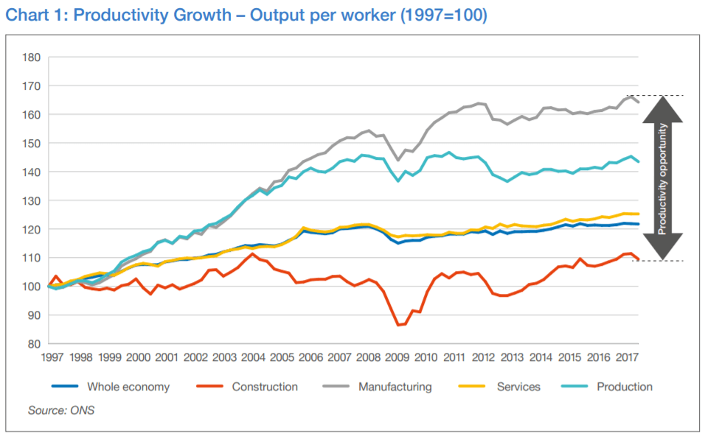
BACKGROUND
The construction industry in the U.K. is set to become the largest market by 2030. To achieve this, the U.K. government has called to cut the cost of construction by 33% and to deliver 50% faster projects by 2025.
However, the trend of construction industry productivity in the U.K. has been consistently low relative to other industries resulting in a skilled labour shortage, project delays, high construction costs, and low productivity growth.

Slide 4
AIM AND OBJECTIVES
AIM
The research aims to identify the motivational factors that influence labour productivity to develop a conceptual motivational framework to improve construction labour productivity in the U.K.
OBJECTIVES
To identify the motivational factors which influence construction labour productivity in the U.K.
To examine the relationship between motivation, social compliance, and labour productivity.
Examine the motivational factors that could improve labour productivity.
To develop a conceptual motivational framework to improve construction labour productivity.

Slide 5
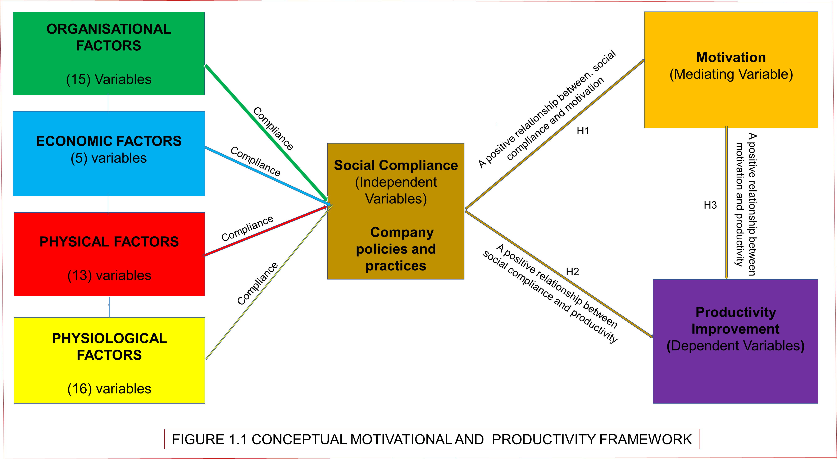
CONCEPTUAL MOTIVATION FRAMEWORK
H1: Social compliance ensures all these labour rights prescribed by U.K. labour rights and practices and the international labour organisation (ILO) labour rights convention (Fukunishi and Yamagata, 2013).
Supervision
Training
Material management
Requests delays
Motivational communication
Leadership management style
Welfare facilities
Company policy
Corporate image
Change order's during execution
Tools/equipment
Weather conditions
Site Conditions
Clarity and completeness of technical specifications
H3: Motivated labour enhances labour productivity (Baral, 2010; Ferdous, 2015; Alam and Alias, 2018)
H2: Companies engaged in social compliance policies and practices earn a positive image and attract skilled labour, improving productivity (Umeokafor et al., 2014).

Slide 6
CONTRIBUTION TO KNOWLEDGE
1) The employer’s right to monitor the employee’s motivation compliance is written for both parties as a right or duty.
CONTRIBUTION TO KNOWLEDGE
Compliance and enforcement in this study is an aspect of company management concerned with the extent to which a company operates by the terms and conditions of labour motivation policy and practices.
2) Assessment process: recognition of motivation compliance certificate before labour or contractor is allowed to work on-site.
3) Contract process: employers create a framework to enable contractors to report motivation compliance activities.
4) Third-party Consultants to look for undiscovered compliance gaps and ensure motivation compliance.
5) Enforcement: non-compliant will incur penalties such as disciplinary action from a supervisor, employer issue an enforceable stop-work order, and Lawsuits brought by labour against their contractor.
6) Motivation in this study refers to good social compliance that enhances labour motivation and higher productivity.

Slide 7
METHODOLOGY RESEARCH FLOW DIAGRAM
Pragmatism Philosophy
The research combine positivism and interpretivism.
The pragmatic recognises that there are several methods of interpreting reality and conducting research and that no single view can give the whole picture.
2) RESEARCH DESIGN
2.1) The literature review is conducted:
i) secondary data on motivational factors that influences
abour productivity construction site.
2.2) Questionnaire survey is deployed to get opinions:
i)motivational factors that influence labour productivity.
2.3) Test the developed conceptual motivation framework:
i) opinions of the respondents from quantitative analysis.
2.4) Semi-structured interview is conducted:
i) validate the workability of the conceptual framework.
3) OPINION:
i) To identify the motivational factors that influence labour productivity
3.1) SCOPE:
i) UK construction industry: The construction industry is labour-intensive.
3.2) SAMPLE POPULATION:
i) Skilled and Unskilled labour, and Management (AlAbbadi, 2020).
4) MIXED RESEARCH DESIGN METHOD
i) To understand the topic under investigation (Patton, 2002; Creswell and Clark, 2011).
4.1) QUANTITATIVE DATA COLLECTION METHOD
i) Web and Self-administered:
ii) increase population size and response rate (Creswell and Clark, 2011; Krosnick, 2018).
4.2) QUALITATIVE DATA COLLECTION METHOD:
i) Semi-structured interview:
ii) Generate large numbers of data, and develop new themes and ideas (Farrell, 2016; Creswell and Clark, 2017).
5) INTERVIEW TIME FRAME, AUDIO, PROTOCOL AND FELLOW-UP MEMBER CHECKING
i) Proposed 60 Minutes Interview Time Frame.
ii) Audio recorded and notes were taken:
For reliable information confirmation.
iii) Interview Protocol:
For uniformity of the process for the interview data collection ㅤ (Marshall et al. 2013).
iv) Follow-up Member Checking Method:
To capture the respondents’ responses (Houghton et al. 2013).
6) QUESTIONNAIRE DESIGN: CONSIST 2 SECTIONS
6.1) Respondents’ background information for validity and reliability.
6.2) 49 factors were identified from 61 significant articles.
i) 5 and 3 - degree Likert scale: (Ohueri, 2018; Eze et al. 2020; VanTam et at. 2021).
ii) Likert scale is relatively straightforward to create (Subedi, 2016; Krosnick, 2018)
7) CRITERIA FOR OBTAINING QUALITY DATA AND REDUCING BIASNESS:
i) must be involved in 2 or more projects,
ii) must have 5 years of work experience, and
iii) must be active on site (Cresswell and Clark, 2011; Eze et al. 2020).
8) DATA COLLECTION
i) SURVEY PERIOD: 16 weeks.
ii) SEMI-STRUCTURED INTERVIEW: 30 Experienced site Management
iii) WEB AND SELF-ADMINISTERED SURVEY: proposed 250 questionnaires.
9) PILOT STUDY
i) PILOT STUDY: 20 respondents.
ii) CRONBACH ALPHA – 49 factors identified:
iii) For internal reliability and consistency.
(Ohueri et al. 2018; AlAbbadi, 2020; Eze et al. 2020).
10) DATA ANALYSIS – SPSS
Factor analysis FA: Is used to examine how the variables will group into either related factors or components for the framework. It is used to correlate variables between factors to establish whether there are links between variables and if there is a high level of correlation between the 49 variables, then factor analysis is done in other to get data reduction through Principal component analysis (Pallant, 2007).

Slide 8
CONCLUSION
The theoretical review has led to an understanding of these motivational factors and the constructs that have led to the development of the conceptual motivational framework to enhance labour motivation and improve labour productivity.
The next stage is to empirically test the framework in the U.K. construction sites.
The framework could enhance management decision when wanting to improve labour productivity on site.

