Slide 1
Creating our Future Built Environment
Comfort, Energy, Heat, Storage

Slide 2
The Existing UK building Stock
Now

Slide 3
Building Services Engineers
‘The delivery of comfort’
Daylight
Ventilation
Cooling
Heating
Electricity
But who takes responsibility for Carbon?

Slide 4
Clarification for policy makers
‘Energy’ is not ‘Electricity’
‘Heat’ is not ‘Temperature’. It includes temperatures we feel as cold.
‘Cold’ is just heat at a temperature lower than that of our body
We must cascade our use of different temperatures

Slide 5
Renewable Heat and the link to Cooling
What is Cooling ?
If a building has too much solar heat coming into it in summer because designers have failed to prevent this happening.
Then in the summer we need to cool it.
If it was not a building it would be called a solar collector

Slide 6
Secondary Heat
Currently we create cooling using electricity generated by carbon based fuel
We use cooling plant to throw away heat into the city in summer when the city is hot.
This is not good and rightly castigated because it is wasteful.

Slide 7
Could cooling be good
If you were to cool your building and store the heat for 6 months then use it to heat your building
Suddenly your building is a useful thermal solar collector
It is waste that’s bad not cooling
Our cities are getting warmer

Slide 8
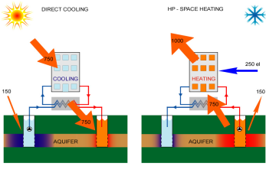
Seasonal Thermal Energy Storage

Slide 9
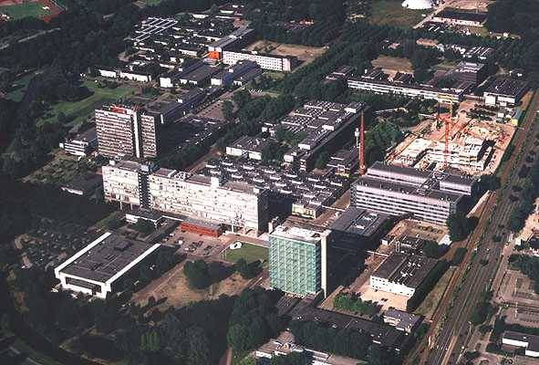
Commercial and Housing Old and New
Combining buildings which are heating dominated with those that are cooling dominated makes a lot of sense if we can give the rejected heat to old buildings.
Data Centres and office buildings convert electricity to heat
Eindhoven University
Cooling capacity ATES: 20 MWt
Max groundwater flow: 2000 m3/h
Thermal storage wells: 2 x 16

Slide 10
Time to Change
https://www.flickr.com/photos/freefoto/
Combining the creation of electrical energy and heat is not new
Last time we built central power stations and millions of thermally poor homes where people die due to cold.
In the winter of 2004/2005, 31,250 people over 65 died from cold-related illnesses in England and Wales. That’s ten pensioners per hour
We have now burned up most of the North Sea Gas and are importing
Now our carbon footprint is disastrous because of the poor houses we built. We are uncomfortable and fuel poor
Time to change

Slide 11
Time to Change
The two things we want most in the modern world are comfort and technology
This time lets think this through as a system
We create electricity and throw away heat
We use electricity and throw away heat
We cool and throw away heat
Our existing Homes are our greatest Infrastructure we need to heat them.
Demand and Supply are two sides of the same equation we must treat them as such in our infrastructure policies.
Improve total system efficiency

Slide 12
Performance Gap Risk Even in Germany
prebound effect’. They defined this as the difference between the calculated and actual consumption,
on average in Germany the (measured) Verbrauch is 30% lower than the (calculated) Bedarf, and this gap rises to over 50% for older, thermally leakier buildings

Slide 13
Green Deals
Category | US BBNP | UK Green Deal
Policy design | Market assessments determined need for comprehensive strategy to drive supply and demand. | Market assessments assumed financing mechanism was sufficient to drive demand and supply would follow.
Marketing and outreach | Active approach including personal outreach to convert interest to retrofit signups. Conversion rate ~ approx 50% | No active approach to outreach. Relied on cold calling in some communities. Low follow-up rates. Conversion rate ~ approx 1%
Workforce engagement | Technical training sponsored or facilitated by program. Sales and business training provided by many programs. | GD Assessor training required. Very little active push from program, limited referrals. No sales training.
Incentives | Slow but steady uptake of loan programs. Rebates calibrated to market, dramatic increases in retrofit sales. | Slow uptake of GD financing. Rebates popular but impact uncertain.
Data and evaluation | Detailed data collection across all local programs. | Some market data gathered, but insufficiently granular data on program impacts.
 | Total Program Spending $508M | No data
 | Annual Energy Cost Savings $69M | No data
 | Total Private Funds Leveraged $753M | No data

Slide 14
Time to Change
Green Deal is emphasising financing and rebates, but neglecting other areas of program design.
The Green Deal Finance Company, set up with more than £240m of public money, has run into trouble partly because it has been unable to convince the state-owned Green Investment Bank to continue funding.
The US examples show that only focusing on financing stimulates temporary demand, but the effects dissipate when the funding is removed.
In order to fundamentally change the market for domestic retrofits the UK should:
Drive more personal outreach through local groups using trusted messengers.
Emphasise workforce skills development and training including transferable skills such as sales.
Improve customer follow-ups to convert initial interest in the program into actual retrofits.
Implement a more detailed data tracking and evaluation system to enable iterative improvements in the program and better calibrate outreach and incentive strategies to local community needs.

Slide 15
National Infrastructure Plan
Total £ 377,100 Million
No mention of our demand side needs

