Slide 1
Measures of Revolution on the Local High Street
Kamran Khan, Dr Charles Graham & Dr Grace O’Rourke
Academy of Marketing
Revolutionary Placemaking, Moving Beyond Traditional Frontiers Conference
University of Birmingham | 5th July 2023

Slide 2
Is the High Street Really Dying?
(Onita, 2023)
(Partridge, 2023)
(Kollewe, 2023)
(Centre of Retail Research, 2023)

Slide 3
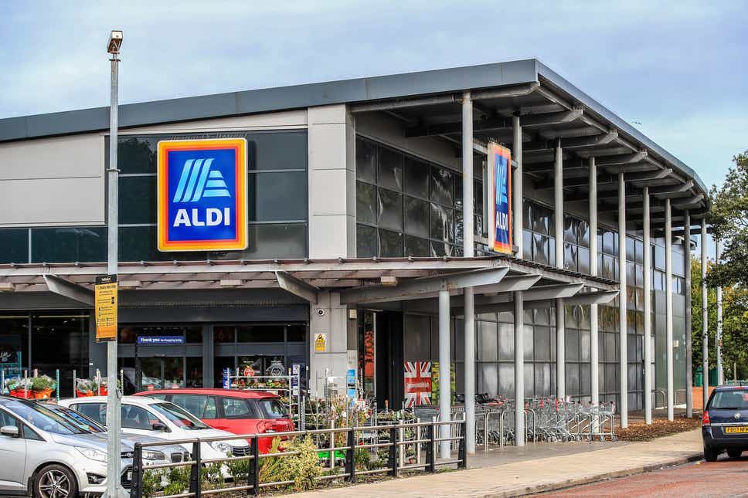
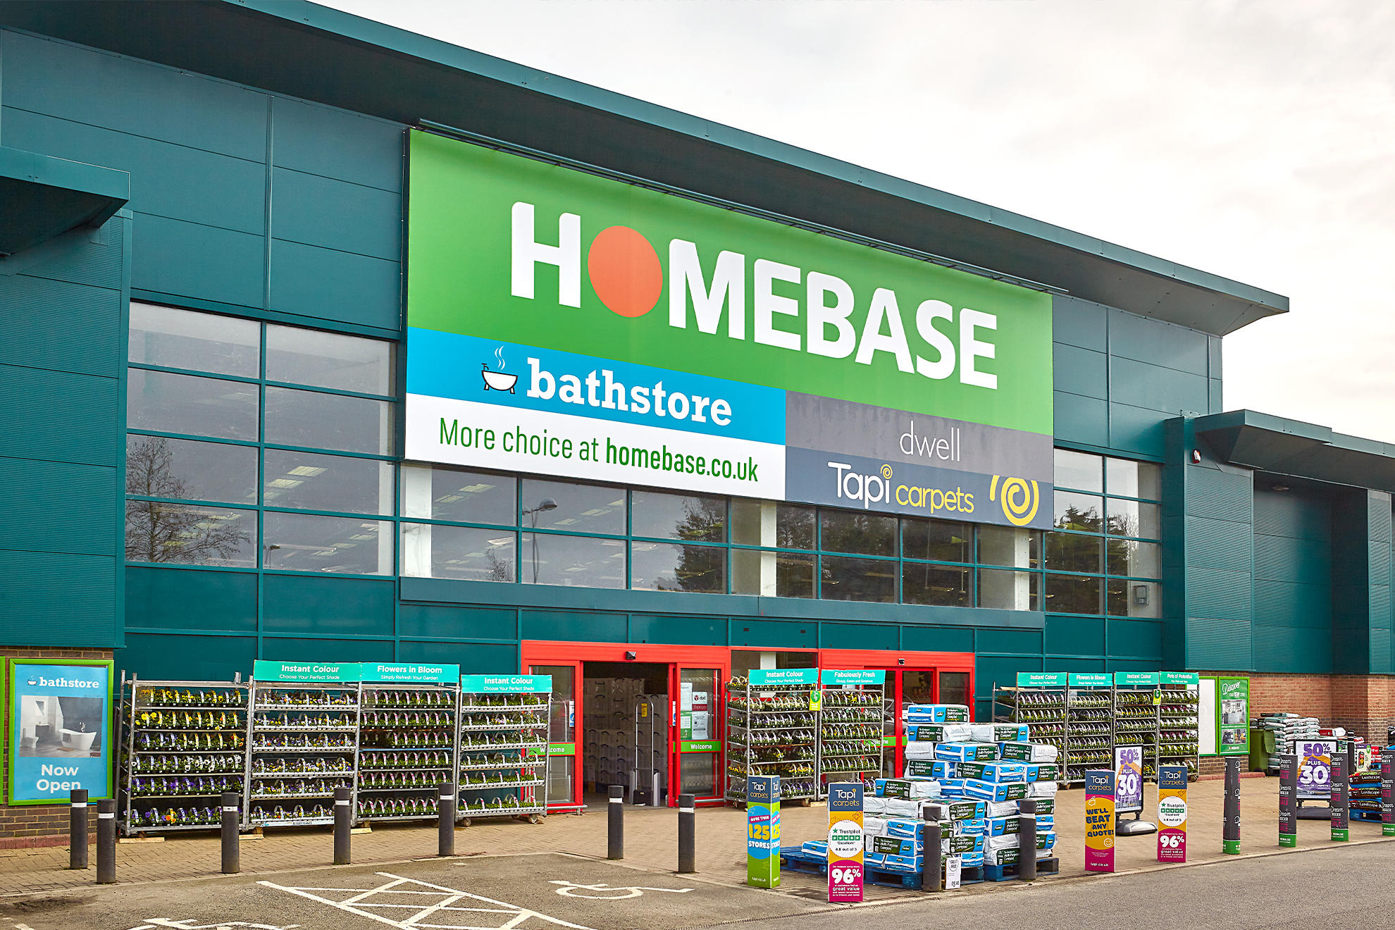
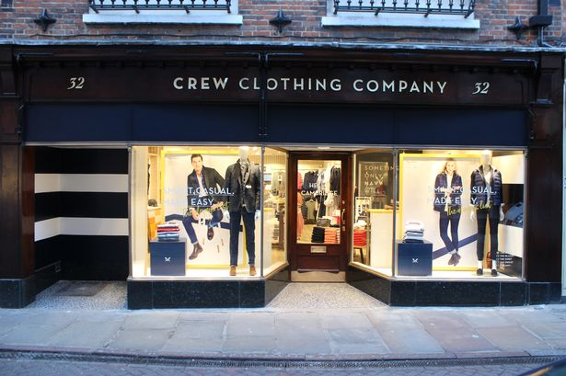
But businesses are opening too…
Business open as well as close, but at different rates and in different modes.
Planners and managers need to know if the high street or town center is in decline, or just changing.
(Nazir, 2022)

Slide 4
The Online Threat…
How should local economy managers develop a strategic response?
Is it really a head-to-head competition?
Should we be training independent business owners to develop e-commerce?

Slide 5
Theoretical Underpinning
The value place marketing research based on town centers provides policymakers and high street regeneration leaders, is questionable itself. The majority of town centers are modern decentralisation locations filled with corporate retailers whose support needs are incomparable to independent retailers (Hallsworth, 2010; Guy, 2011).
The high street, which houses the majority of retailers, both national and independent, lacks knowledge and understanding of contemporary change on these locations. Both Media and academic literature place entirely too much focus on closures/vacant stores on the high street (Dolega & Lord, 2020; Hughes & Jackson, 2015) and measures that affect footfall (Zhang et al, 2019).
But the problem of vitality is wider in scope and more nuanced than those indicators alone.
The retail stock in town centres and high streets are constantly being replenished and are being supported by local government place marketing policies (VanHoose et al, 2020). Therefore, a fuller interpretation of vitality is only possible by considering at least three measures: vacancies, churn, and evolving business composition, in longitudinal data, across location types.
Similar methodology was used by Findlay and Sparks (2012) on a single high street in Glasgow, and also provided by LDC at the national level commercially.

Slide 6
Research Problem
The study provided really good insights into the changes a high street has gone through but lacked the ability to determine a quantitative and comparative measure of churn and retail mix.
Furthermore, it was unable to establish links with commonly understood principles. Extending the paper could establish a more robust link with Huff models specifically, in examining high street attributes comparatively in terms of both size and “quality”.
There is a need to develop a longitudinal and systematic study on a wider scale that really focuses on two very important questions. This approach is called for in Parker et al., (2014).
How can empirical data about the organic changes in the business mix in town centers contribute to place marketing theory?
For example, are some centers that are competing for the same footfall evolving differently and more or less successfully (i.e., can this problem be conceived in marketing terms) to the detriment of others, perhaps in the same borough?
And what policy implications does this have?
Notes:
What were saying is we got the closing wrong, the theory is not working

Slide 7
Research Questions…
Our approach is different because it seeks to establish a measure of retail churn that can be used comparatively across a range of high streets within the remit of a single local economy team, and a measure of changes in attractiveness in that evolution to inform it. To more comprehensively understand the evolution in high street vitality (i.e. far beyond a simple measure of vacancy rates) we ask specifically, for a given set of centres:
RQ1. What are the changes in vacancy rates across the local high streets?
RQ2. What is the underlying churn ratio at each location?
RQ3. Describe the changes to the retail mix over time.

Slide 8
Methodology
We address these problems by conducting a longitudinal study by examining a fixed geographical space in a fixed time period across ten South London competing high streets and town centres to Local parades for Lewisham Council to establish quantitative and comparative measures of churn and retail mix.
The current vacancy rate is a product of vacancies at time one plus closures between time one and time two, less new openings. Thus, as part of the study, a retail audit is collected annually across identified premises, including observations of the type of store trading and the vacancies, hence openings and closures.
The character of the high street is also an important element of its attractiveness and can be captured in the nature of the businesses that close, and those that open, and in the resulting evolution of the retail mix. Reported here, the follow up 18 months later. Metrics analysed = Vacancy rates at T1 and T2; Churn Ratio between T1 and T2; comparative analysis of retail mix categories.

Slide 9
RQ1 Findings
 | Premises | Ind. | % | Voids | Voids | Count |  | Void %
 |  |  | Ind. | 2021 | 2023 | +/- |  | 2021 | 2023
Lewisham | 218 | 145 | 67 | 10 | 3 | -7 |  | 5 | 1
Deptford | 184 | 148 | 80 | 18 | 21 | 3 |  | 10 | 11
Sydenham | 165 | 119 | 72 | 6 | 5 | -1 |  | 4 | 3
New Cross | 143 | 111 | 78 | 15 | 22 | 7 |  | 10 | 15
Catford | 133 | 72 | 54 | 13 | 14 | 1 |  | 10 | 11
Blackheath | 121 | 58 | 48 | 12 | 6 | -6 |  | 10 | 5
Forest Hill | 114 | 84 | 74 | 6 | 14 | 8 |  | 5 | 12
Crofton Park | 112 | 85 | 76 | 9 | 2 | -7 |  | 8 | 2
Honor Oak | 35 | 31 | 89 | 0 | 3 | 3 |  | 0 | 9
 | 1225 | 853 | 70 | 89 | 90 | 1 |  | 6.8 | 7.7
v
v
Notes:
9 high streets in London
Coming in at less the average vacancy rate.
On coupe high street – it’s gone quite bad such as New Cross and Forrest hill.
On other hand, most high streets have improved.
Reason for this the less well off areas, high street struggle to keep going – related to the micro economy.
If vacancy rate is the same or changing, it doesn’t mean it hasn’t changed. The vacancy rate is masking the opening rate.
The store can be the same but changed hands and still be open.
In isolation 2 things interesting, the Lewvisaham on the whole is doing better than the country on the whole.
The busy areas have improves and worse off areas are worse off.
Can learn some stuff from vacany but not the full picture.

Slide 10
RQ2 Findings
 | Closed |  | Opened
 | No. | % | No. | %
New Cross | 28 | 20 | 23 | 16
Deptford | 26 | 14 | 17 | 9
Catford | 21 | 16 | 20 | 15
Sydenham | 14 | 8 | 15 | 9
Crofton Park | 9 | 8 | 10 | 9
Lewisham | 9 | 4 | 17 | 8
Forest Hill | 8 | 7 | 2 | 2
Blackheath | 7 | 6 | 13 | 11
Honor Oak | 6 | 17 | 3 | 9
Total | 128 | 11 | 120 | 10
Notes:
Openign and closings are pretty much in balance.
This is what is supporting the 7% vacancy rate in RQ1.
It has got a lot of openings and closings. A really high churn rate. A quarter of them have changed hands in a year.
The retail mix is very volatile.
Bottom of the table is much more stable. These locations, business can stay long term and make a living. Other vacanct places are getting filled up as well. If you want to be a long kasting brand that maintains market share then you need to be in these better locations.
Tge other locations have incoming people.
Top 3 are the low socio economic parts of the borugh and that’s why they cant support the high street,
Council wants to support the top 3 to keep them alive.
The closures are not automatically replaced by openings. Stores open elsewhere on the high street.
This tells us more about the vacant stores. It tells us different high streets have different problems in the borough.

Slide 11
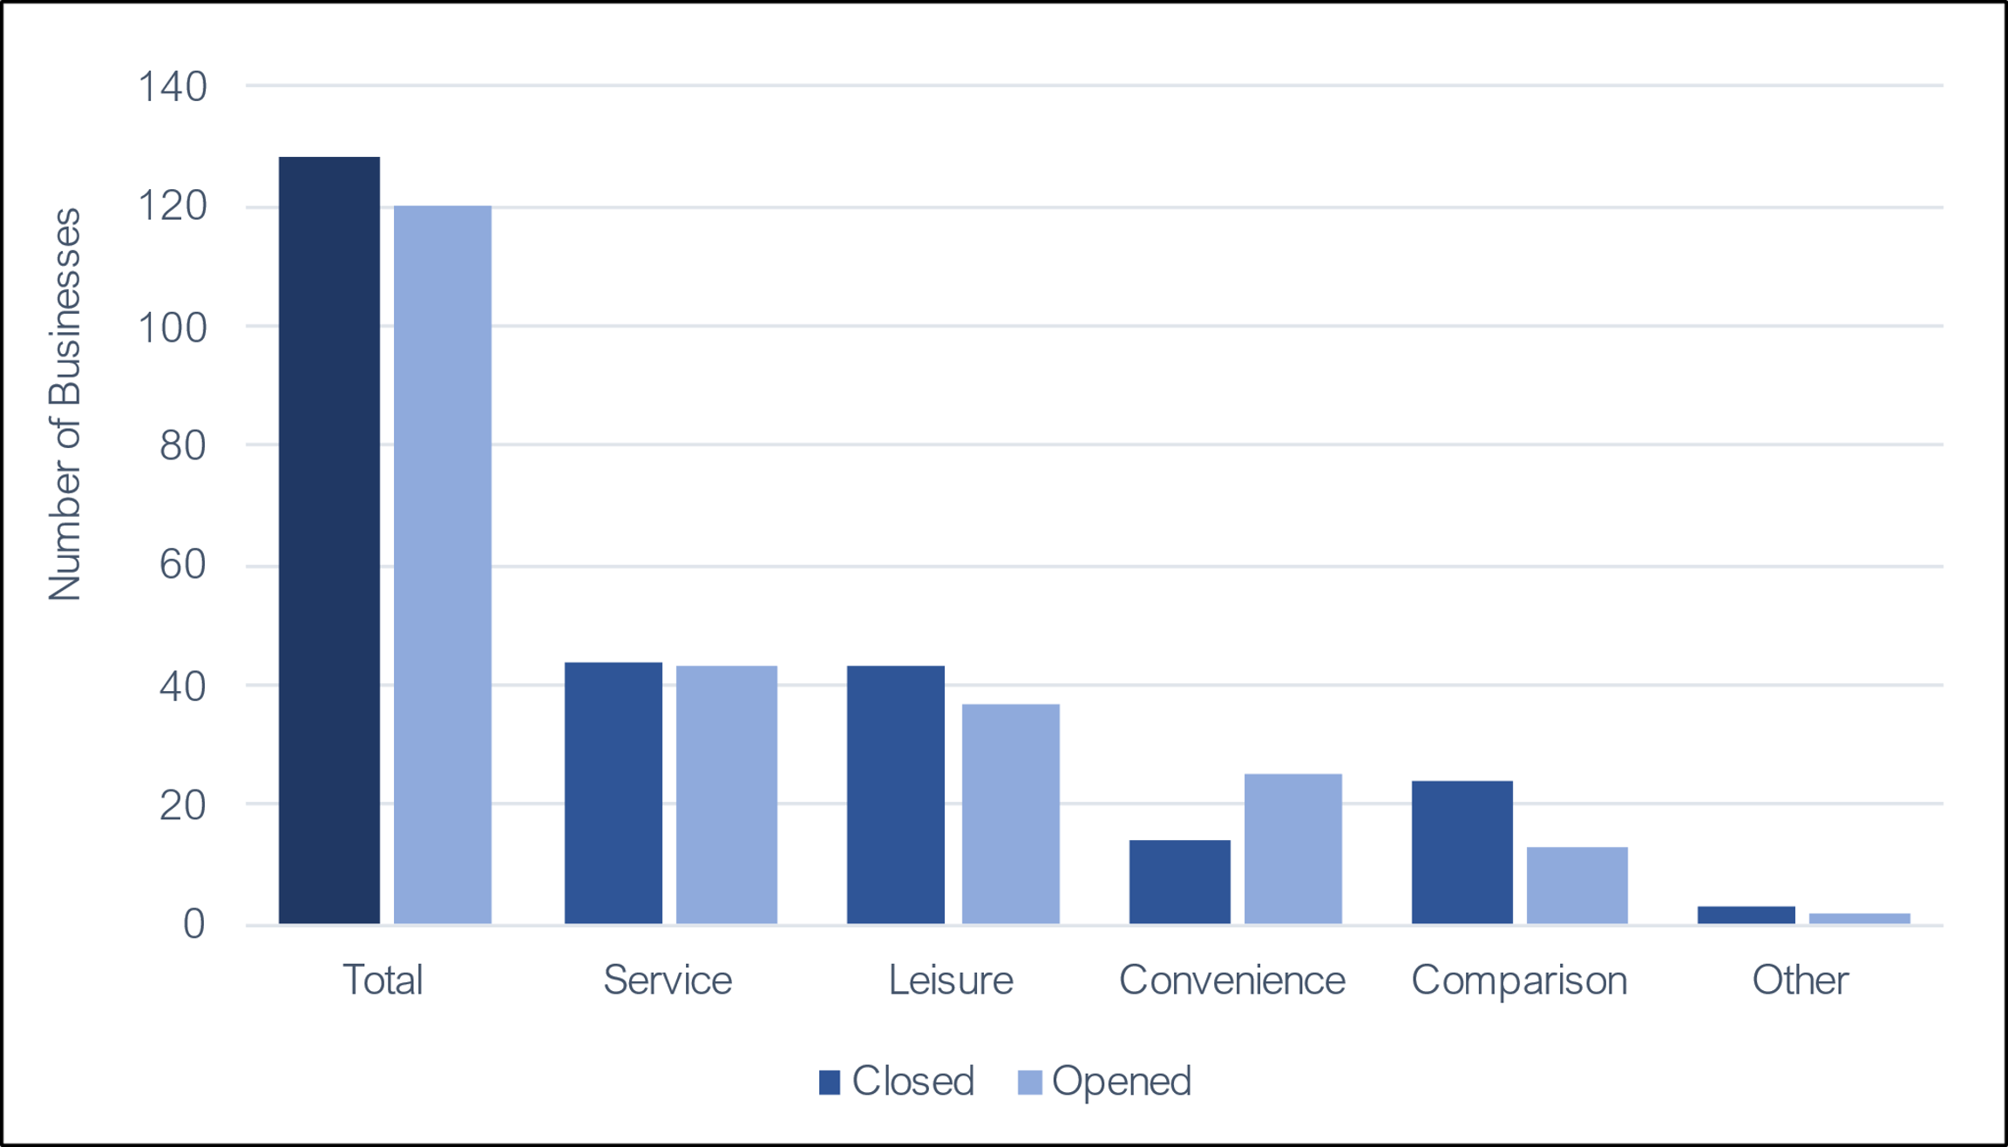
RQ3 Findings
Notes:
The really interesting story is the convininece and the comariosns.
Entrprenerus have figured out they don’t want to compete with people like Amazon and hence they are not opning more fashion stores etc.
But the convinince stores, took on digitlal brands like Groillaz and won mainly due to convinince also being as convinite and not having to pay for delivery charge etc.

Slide 12
So what…

Slide 13
It’s not as bad as reported
Good news doesn’t sell papers or get clicks.
This longitudinal and systematic approach fills the need of understanding the effectiveness of this methodology and develops measures along common widely understood principles (Findley & Sparks, 2012).
This study gives a clear indication from looking at the balance of the opening and closing, which parts of the borough are most at risk.
It sets a contradictory case for independent stores to compete with online giants.
They are already getting a good strategy for opening on the high street in the first place.
Businesses in Lewisham want help in scaling their online platforms. This kind of insight can feed into their strategy.
The innovation displayed online, looks like they need a store and therefore businesses are saying they need to be on the high street.

Slide 14
What are we going to do next
Continue for years.
Extend to Rye Lane and different cities.
Extend to Malls.
Develop a metric.

Slide 15
Thank You
Kamran Khan | khank27@lsbu.ac.uk

