Slide 1
"Pathological Demand-Avoidance" (PDA): A "pathological"/ extreme avoidance to its hype.
Mr. Richard Woods.
London South Bank University PhD Student.

Slide 2
PROFILING MYSELF.
Conflicts of interest.
Developing various PDA tools, e.g., Pathological Demand-Avoidance-Beliefs Scale (PDA-BS).
Income from delivering training sessions on PDA.
Reluctantly advocates for it to be diagnosed as a standalone construct.

Slide 3
PROFILING MYSELF.
My perspective.
Diagnosed as autistic in 2012.
Meets Newson’s PDA profile, is not emotionally attached to it.
Presently, no-longer basing identity on diagnostic categories.
Favours a transdiagnostic approach & we should be aspiring to stop utilising Disorder based constructs in the future.
Equally respects divergent views & evidence to critically synthesise appropriate interpretations on PDA.
PhD is investigating PDA & part of CADS at LSBU.
My interpretation of PDA & its literature, others may disagree.

Slide 4
IN THE BEGINNING.
Introduction.
Societal & cultural context of autism & “PDA Profile of ASD”.
Ongoing-historical PDA debates.
Risk non-autism features are reattributed with autism via “PDA Profile of ASD”.
Controversies surrounding PDA.
Transactional stress model for PDA.
PDA strategies.
Critique of PDA strategies.
Conclusion.
Quotes are often there to substantiate point
There are some brief activities.

Slide 5
FOOD FOR THOUGHT.
Is this person autistic?
Have a unique talent e.g., role play.
Preference for stability in e.g., best friend or routines.
Sensory sensitivities e.g., cannot wear certain clothes or finds certain sounds painful.
Likes to have friends.
Perfectionism e.g., will not stop until their work is perfect.
Avoidance of eye contact.
Has high anxiety.
Restricted range of interests.
Social awkwardness.
Had language delay e.g., only spoke after 4 years old.
Is clumsy.

Slide 6
AVOIDING DEMANDS OF ORDINARY RESEARCH.
Broader issues in autism studies.
Autistic persons are systemically poorly treated by society (Botha 2021; Grant et al 2023; Woods 2017b).
Much/ most autism research & practice is poor quality (Bottema-Beutel et al 2021a; Bottema-Beutel et al 2021b; Bottema-Beutel & Crowley 2021; Dawson & Fletcher-Watson 2021a).
Poor quality research is often associated with poor quality ethics (Dawson & Fletcher-Watson 2021b; Waltz 2007).

Slide 7
AVOIDING DEMANDS OF ORDINARY RESEARCH.
Broader issues in autism studies.
A theory-to-research-to-practice gap (Chown 2015).
General lack of good quality theories (e.g., see Bottema- Boutel et al 2019).
Pathologising theories often are poor quality, with weak evidence & their associated interventions often lack efficacy (Botha 2021).
A lack of inclusive research (Chown 2019).
Some are striving to improve autism research & practice standards (Fletcher-Watson et al 2021).

Slide 8
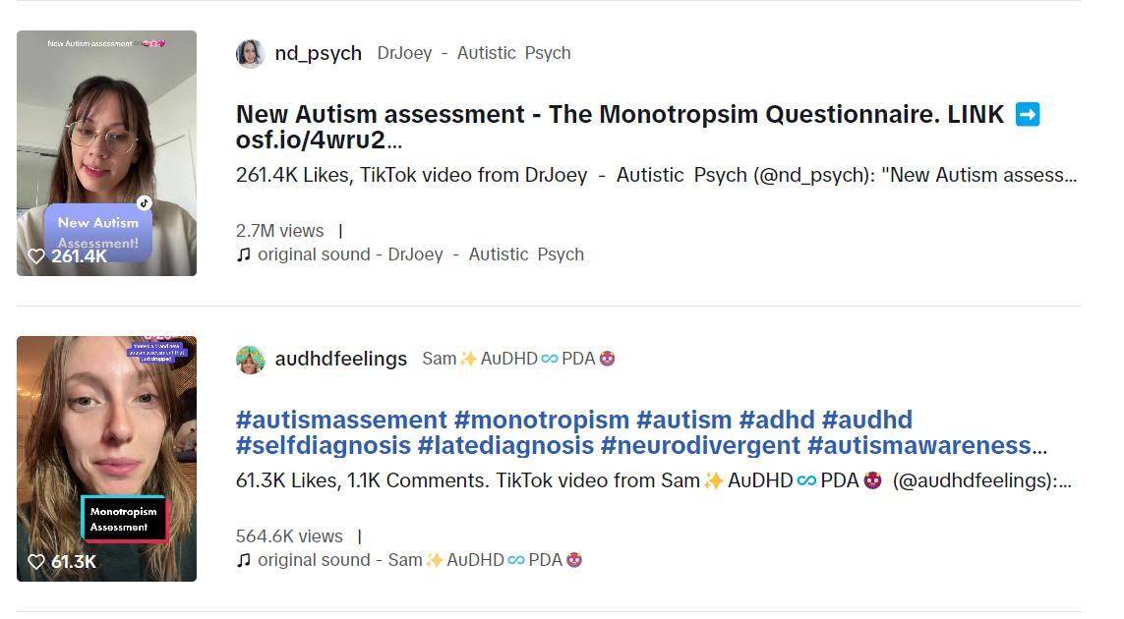
OF PEAK INTEREST?

Slide 9
AVOIDING DEMANDS OF ORDINARY RESEARCH.
PDA in the UK.
Research PDA via their autism understandings.
Caregivers are highly motivated to take part in research (O’Nions et al 2016b).
“interest in the concept of PDA largely centres on the UK, it is at present a culture-bound concept” (O’Nions et al 2020, p398).
UK PDA interest has risen sharply over last 10 years & it way outstrips its research base (O’Nions & Eaton 2021).
Due to campaigning efforts persons can be on the look-out for PDA & is a potential source of bias (Woods 2020a).

Slide 10
AVOIDING DEMANDS OF ORDINARY RESEARCH.
Should there be a bubble on “PDA Profile of ASD”? – NO!
PDA is controversial (Falk 2020; Fidler & Christie 2019; Green et al 2018b; O’Nions et al 2014a; O’Nions et al 2014b; O’Nions et al 2016b).
Independent reputable parties recently concluded no good quality evidence to suggest what PDA is, or what features are associated with it. Divergent opinion was treated equally (Berney et al 2020; Howlin et al 2021; Kildahl et al 2021; Mols & Danckaerts 2022; NICE 2021).
Robustly challenged for almost 2 decades (Garralda 2003; Green 2020 Green et al 2018a; Green et al 2018b; Malik & Baird 2018; McElroy 2016; Milton 2017; Moore 2020; Wing 2002; Wing & Gould 2002; Woods 2017; Woods 2019; Woods 2020b).

Slide 11
A NEED FOR CONTROL.
PDA’s clinical need.
Needed to explain a person’s actions & PDA does this better than autism/ other accepted Disorders (Christie 2007; Newson et al 2003; PDA Society 2022).
Autistic persons with PDA & families want it, & their difficulties warrant it (O’Nions et al 2021).

Slide 12
A NEED FOR CONTROL.
PDA’s clinical need.
PDA has distinct educational strategies, different to “traditional” autism strategies (Christie 2007; Newson et al 2003).
“Praise, reward, reproof, and punishment ineffective; behavioural approaches fail.” Newson et al (2003, p597)
Reinforcement-based approaches may remove CYP only coping mechanism to aversive environments (O’Nions & Eaton 2020).
PDA diagnosis needed to protect CYP from caregiver interventions for disruptive behaviour disorders (O’Nions & Neons 2018).

Slide 13
WHO HAS A “PATHOLOGICAL” NEED TO CONTROL WHOM?
Are usual autism approaches effective?
“The primary reasons for identifying a PDA profile are to help individuals, and those living and working with them, make sense of a complex presentation that is otherwise difficult to explain; and to signpost the differentiated strategies and approaches - based on an indirect, low arousal style that gives an individual more choice and control…” (PDA Society 2022, p4).

Slide 14
A NEED FOR CONTROL.
PDA’s clinical need.
PDA better explains aspects of a person, than autism does.
A supportive community has formed around the diagnosis, both those identifying with PDA (Thompson 2019), & caregivers (O’Nions et al 2021).
Difficulties faced by persons with PDA & their families requires validation & support (O’Nions et al 2021).

Slide 15
AVOIDANCE OF DOUBT.
Core PDA Traits.
Anxiety-based Restricted & Repetitive Behaviours & Interests (RRBIs): | Universal.
Avoidance of everyday demands. | Yes
Comfortable in role play & pretence. | No
Consistent mood swings & impulsivity. | No
Frequent & intense actions. | Yes
Social avoidance behaviours. | Yes
Universality of features is based on Newson et al (2003) statistics.

Slide 16
ROLEPLAYING A “PROFILE OF ASD”.
“PATHOLOGICAL DEMAND-AVOIDANCE (PDA) PROFILE OF ASD” CONSTELLATION OF TRAITS WITHIN AUTISM SPECTRUM.
“PDA PROFILE OF ASD”.
“CLASSIC”/ “MORE STRAIGHT-FORWARD” AUTISM.
Anxiety.
High.
Low-none.
Avoidance of “ordinary” demands.
Pervasive.
Low-none.
Bullying, harassment, lying, stalking, stealing etc.
High.
Low-none.
Fantasy & roleplay.
Comfortable-excessive.
Low-none.
Please do not reify this diagram. Based on RW interpretations of “PDA Profile of ASD” clinical literature, diagnostic & screening tools.
Impulsivity.
High.
Low-none.
Obsessive behaviour focused on people-characters.
High-excessive.
Low-none.
“Need for control”/ “Drive for Autonomy”.
High-pervasive.
Low-none.
Rapid mood changes.
High.
Low-none.
Reinforcement-based approaches, e.g., ABA/ PBS.
Ineffective & causes distress.
“Effective & gold standard.”
Socially “strategic”-”manipulative” avoidance behaviour.
High.
“Theory of Mind.”
Low-none.
“Normal.”
“Deficits.”
ADHD, ANXIETY, CD, ODD & TRAUMA FEATURES.
AUTISM.

Slide 17
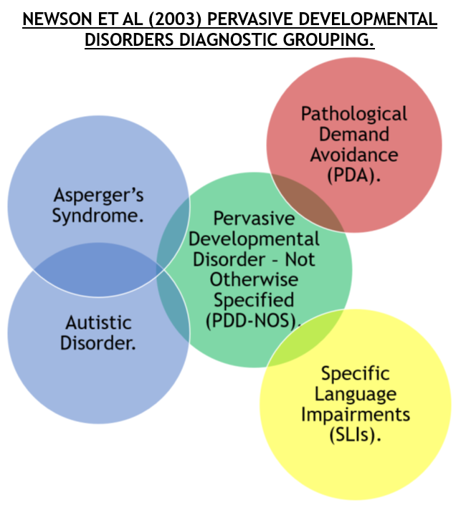
CIRCLE WARS?

Slide 18
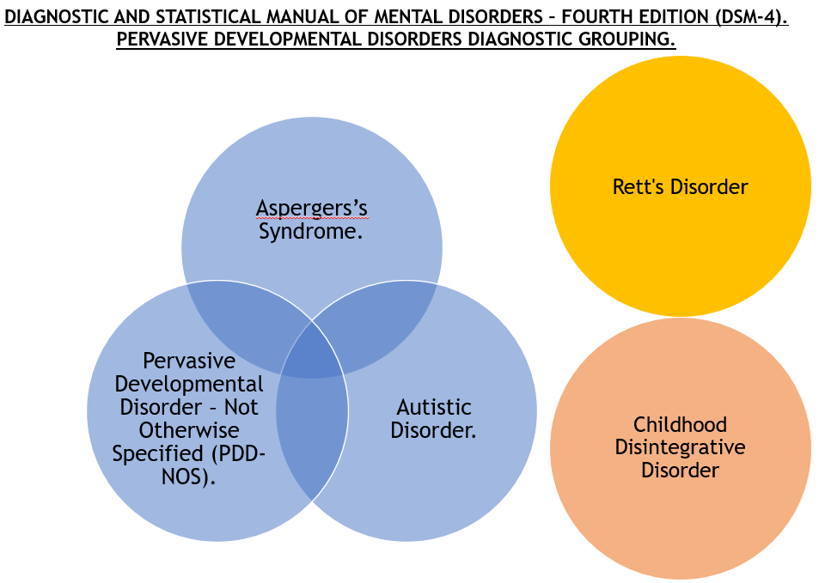
CIRCLE WARS?

Slide 19
Diagnostic and Statistical Manual of Mental Disorders, 4th Edition (DSM-4) Pervasive Developmental Disorders diagnostic grouping. | Newson et al (2003) Pervasive Developmental Disorders diagnostic grouping.
Contains: Autistic Disorder, Asperger’s Syndrome, Rett’s Syndrome, Childhood Disintegrative Disorder, and Pervasive Developmental Disorder-Not Otherwise Specified (PDD-NOS). | Contains: Autistic Disorder, Asperger’s Syndrome, Pathological Demand-Avoidance Syndrome (PDA), Specific Language Impairments (SLIs), and Pervasive Developmental Disorder-Not Otherwise Specified (PDD-NOS).
Autism Spectrum contains: Autistic Disorder, Asperger’s Syndrome, and PDD-NOS. | Autism Spectrum contains: Autistic Disorder, and Asperger’s Syndrome.
PDD-NOS is a residual diagnosis, for when a person does not meet clinical threshold for either Autistic Disorder or Asperger’s Syndrome. | PDD-NOS is a residual diagnosis for when a person does not meet clinical diagnosis threshold for any of Autistic Disorder, Asperger’s Syndrome, PDA and SLIs.
PDD-NOS is part of the autism spectrum. | PDD-NOS is not part of the autism spectrum and includes non-autistic persons.
Requires it 5 diagnostic categories to have social communication issues and Restrictive and Repetitive Behaviours and Interests (RRBIs). | Requires its 5 diagnostic categories to have coding issues, i.e., when a person struggles to process or understand certain aspects of communication. SLIs do not have any RRBIs.
Autism spectrum is based upon Triad of Impairment. | Autism Spectrum is based upon Triad of Impairment. PDA is not based upon Triad of Impairment.
Is narrower than Newson et al (2003) Pervasive Developmental Disorders diagnostic grouping. | Those showing autism characteristics were removed from PDA database. SLIs prevalence rate 3% - 7% (Bishop et al 2016), is substantially larger than DSM-4 Pervasive Development Disorder diagnostic grouping, and thus includes many non-autistic persons.

Slide 20
UNPASSIVE EARLY HISTORY.
Newson’s consistent views on PDA not being autism.
“…I believe this referral pattern is significant in having brought so many of these children to my notice, because they tend to remind people of autism. However, I am very clear these children are not autistic children.” (Newson 1983, p3).
“A few children whose clinical picture is less certain, often because of additional autistic characteristics, but atypical of autism also, were excluded.” (Newson et al 2003, p596).
“Clearly, “hanging together as an entity” is not enough if that entity is not significantly different from both autism and Asperger’s syndrome, either separately or apart,…“ (Newson et al 2003, p599).
“PDA is a pervasive developmental disorder but not an autistic spectrum disorder: to describe it as such would be like describing every person in a family by the name of one of its members.” (Newson et al 2003 Supplementary Notes p1).
There are other examples in Newson’s scholarship to support this position.

Slide 21
TIME TO PROFILE YOU.
How do PDA thresholds compare to each other (Woods 2021)?
Features need to be compulsory. | DSM-5 OCD. | Eaton and Weaver (2020). | EDA-Q Threshold. | Gillberg et al (2015). | Newson et al (2003). | Wing et al (2011).
Demand avoidance Pervasive? | No. | Yes. | No. | No. | Yes. | Yes.
Demand avoidance from early infancy? | No. | Yes. | No. | No. | No. | No.
Person is autistic? | No. | Yes. | No. | No. | No. | Yes
Core 5 traits present? | Yes. | Yes. | No. | No. | No. | No.
Coding issues present? | No. | Yes. | No. | Yes. | Yes. | Unsure.

Slide 22
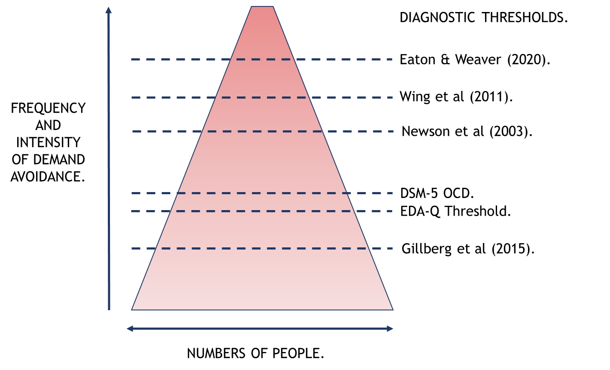
TIME TO PROFILE YOU.
Different PDA diagnostic thresholds (Woods 2021).

Slide 23
BOB THE BUILDER’S PROFILE.
Outlook PDA is a separate clustering of features from autism.
1) “Key features of a PDA profile
a. Resists and avoids the ordinary demands of life
b. Uses social strategies as part of the avoidance
c. Appears sociable on the surface, but lacking depth in understanding
d. Experiences excessive mood swings and impulsivity
e. ‘Obsessive’ behaviour, often focused on other people
f. Appears comfortable in role play and pretend, sometimes to an extreme extent (this feature is not always present)” (PDA Society 2022, p7).
2) Need 5 of 6 traits.

Slide 24
BOB THE BUILDER’S PROFILE.
Outlook PDA is a separate clustering of features from autism.
1) “PDA children are MORE likely:
….to be female
….to resist demands obsessively (100%)
….to be socially manipulative (100% by age six)
….to show normal eye contact
….to show excessive lability of mood
….to show social mimicry (includes gestures and personal style)
….to show role play (more extended and complete than mimicry)
….to show other types of symbolic play” (Newson et al 2003, Supplementary material).
2) Only obsessive resistance of demands & socially manipulative are universal. This is lower threshold “PDA Profile of ASD”.

Slide 25
EMPATHY DEFICITS?
Empathising other’s difficulties & rationale.
“Equally contributors have noted that, with increased awareness, there has been some over-identification by other practitioners.” (PDA Society 2022, p1).
There is a reason why clinician diagnosed PDA at lower thresholds, because there is a clinical need to in that situation…
Will affect CYP’s & others’ lives, irrespective of if twice per week, or every day per week.
"the disturbance causes clinically significant distress or impairment in social, occupational, or other important areas of functioning.“ (APA 2013, p21).

Slide 26
A KLING-ON?
PDA as a form of Attachment Disorder.
“Since that time, there has been much debate between professionals as to whether this is indeed a separate condition or whether the behaviours found in PDA can be explained within other disorders such as attachment disorder or personality disorder or a female form of autism.” (Christie 2007, p3).
“PDA describes a child who is primarily led by a need to avoid demands and control situations, struggles with social communication and relationships. However, these exact same characteristics could equally be used to describe a child with disordered attachment (NICE, 2015). Furthermore, research has shown that children with a diagnosed attachment disorder may be as impaired as autistic children in their social relatedness and language skills (Sadiq, et al., 2012), and one study found that the symptoms of ASD and attachment disorder can be comorbid (Giltaij, et al., 2015). Therefore, given that PDA is currently considered a form of ASD, it is fair to assume that a similar overlap in symptoms may exist between PDA and attachment disorders.” (McElroy 2016).

Slide 27
A KLING-ON?
PDA as a form of Attachment Disorder continued.
“Resistance to the inclusion of PDA into the DSM being predicated on it being a false identification of a form of attachment disorder rather than having a neurological basis (PDA Contact Centre, 2012).” (Milton 2017, p30).
“…There is simply not enough evidence to support a claim such as this, especially when there are similar traits associated with both developmental and attachment disorders. It is more than possible that autistic people can be traumatised by social relationships and by negating such factors as ever having a causative association with avoidance behaviours could be potentially negligent…” (Milton 2017, p33).
“Those clinicians who feel it does warrant a separate diagnostic category feel it fits within the autism spectrum whereas others question whether it is better placed as an attachment disorder.” (Flackhill et al 2017, p65).

Slide 28
THEY ARE BREEDING LIKE RABBITS.
Examples of PDA is found in non-autistic persons.
“A “manipulative child” in the 1970s might get the label of Pathological Demand Avoidance Syndrome in the 2000s.” (Goodley 2011, p10).
Chapter 5 study has one CYP with diagnosed with Attachment Disorder & ADOS Score of 1 (O’Nions 2013, p226).
Chapter 8 study has 23% of CYP diagnosed with PDA are non-autistic. (O’Nions 2013, p176).
“As well as significant symptoms of PDA, the four children met criteria for a range of neurobehavioural disorders; all four had cognitive impairment (IQ < 85) and met DSM-IV-TR criteria for ADHD. Three, in addition, met criteria for ASD…” (Reilly et al 2014, p3236).
8 out of 11 (73%) CYP with PDA are non-autistic (Kaushik et al 2015, p8).
“Pathological (or extreme) demand avoidance is a term sometimes applied to complex behaviours in children within— or beyond—autism spectrum disorder.” (Green et al 2018a, p455).
7 out of 24 (29%) CYP with PDA are non-autistic (McFadzen 2020, p27).

Slide 29
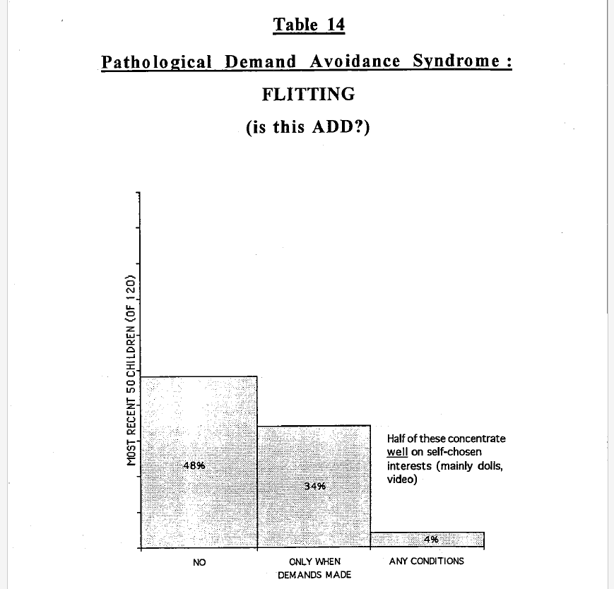
ROLEPLAYING A DIAGNOSTIC CATEGORY?
Newson 1996, p20.

Slide 30
ROLEPLAYING A DIAGNOSTIC CATEGORY?
Consistent doubts of constituent nature.
Newson’s descriptions indicate co-occurring difficulties, e.g., ADHD, anxiety disorder of childhood, ODD (Garralda 2003).
Maybe a “double-hit”, potentially caused by psychopathic tendencies, instead of autism (Wing et al 2011).
How well do co-occurring difficulties, like ADHD, SAD & ODD describe component features of PDA? (Green et al 2018a).
“Disagreement remains about whether pathological demand avoidance should be recognised as a distinct diagnosis. Some topic experts considered that appropriate recognition of coexisting conditions and individualised management strategies are sufficient.” (NICE 2021a, p47).

Slide 31
UNCOMFORTABLE PRETENCE.
NICE Position on PDA.
Three NICE autism guidelines.
PDA only mentioned in CG128, diagnosing autism in CYP…
“Pathological demand avoidance (PDA) has been described as a particular subgroup of autism with passive early onset, obsessive behaviours which are often person focussed with superficial social skills in whom the most striking feature is refusal to comply (excessive demand avoidance) even to events which the child enjoys. This oppositional behaviour can also be described as ODD.(emphasis added by speaker)” (NICE 2021b, pp.288-289).

Slide 32
ROLEPLAYING A DIAGNOSTIC CATEGORY?
PDA tool question or sub-question denoting intent/ manipulative (Woods 2022, p70).
1) Good at getting round others and making them do as s/he wants.
2) I blame or target a particular person/persons.
3) Does A harass other people? (e.g. writing threatening letters, making verbal threats, stalking, untrue accusations of sexual abuse).
4) Does A frequently tease, bully, refuse to take turns, make trouble.
5) Socially shocking behaviour with deliberate intent
6) Lies, cheats, steals, fantasises, causing distress to others.
7) Would you describe A as good at getting round others and making them do as s/he wants, or playing people off against each other?
8) What strategies does A use to get out of things? Are these strategies targeted at a particular person?
o Distracting (e.g. asking questions)
o Apologising and making excuses
o Withdrawing into role play or toy play
o Charm
o Passively (e.g. selective mutism)
o Other
9) Does A ever threaten to hurt him/herself, or do things to hurt him/herself?
10) Is this behaviour impulsive, or does A do it on purpose to show s/he is in control, cause distress or get attention?

Slide 33
EMPATHY DEFICITS?
PDA is constructed from problematic behaviours.
11 Revised PDA DISCO Items (O’Nions et al 2016a, supplementary material):
“…tantrums, scratches, bites, kicks or passively resists… …runs away, hides, removes clothes, uses doll or puppet to make excuse. If all else fails, screams, hits, kicks in a panic… …tearing up another person’s work, pulling off someone’s spectacles, taking pants down and urinating on floor, injuring someone else’s pet animal… …lie, or cheat, or steal… …‘I hate you’ in a sweet voice while hugging. May hug others too long and too hard… …frequently tease, bully, refuse to take turns, make trouble… …writing threatening letters, making verbal threats, stalking, untrue accusations of sexual abuse.”

Slide 34
ROLEPLAYING A DIAGNOSTIC CATEGORY?
Examples of studies indicating is a pseudo-syndrome.
“Triple hit” of autism, conduct problems & (assumed) anxiety. (O’Nions et al 2014b).
PDA features predicted by anxiety, conduct problems & hyperactivity (Green et al 2018a).
“EF was significantly related to global PDA traits in the context of ASD, as well as to dimensional measures of specific associated behaviours such as emotional dysregulation and behavioural noncompliance. Executive Function accounted for a significant proportion of the variance (r2 = 34%) in PDA traits.” (Goodson 2018, p64).

Slide 35
ROLEPLAYING A DIAGNOSTIC CATEGORY?
Examples of studies indicating is a pseudo-syndrome.
“ToM was not found to relate to PDA traits in ASC, implying that there are at least partially distinct mechanisms underlying these behaviours compared to core ASC traits.” (Bishop 2018, p75).
PDA features predicted by attention issues, antagonism & lower emotional stability (Egan et al 2020).
“Unlike psychiatric comorbidities and adaptive behaviour, PDA was not discriminating. Our results are therefore in agreement with the authors who questioned the validity of PDA as a distinct entity.” (Schneider et al 2022, p8).
A + B + C ≠ A, PDA cannot be something it is more than.

Slide 36
ROLEPLAYING A DIAGNOSTIC CATEGORY?
Examples of studies indicating is a pseudo-syndrome.
A replicated results is PDA features decrease with age (Johnson & Saunderson 2023).
“…observed DAP behaviours substantially decrease with age and this has ramifications for clinical practice. The EDA-Q has 2 thresholds, with the lower one for those aged 12 and above (O’Nions et al, 2014). Wider literature suggests between 44% and 89% of participants do not meet the caseness for DAP into adulthood (Woods, 2019b), and this is significantly higher than found in autism“ (Woods 2020a, p69).
Autism 91% stability into adulthood (Kapp 2023), 9% not meeting caseness into adulthood…

Slide 37
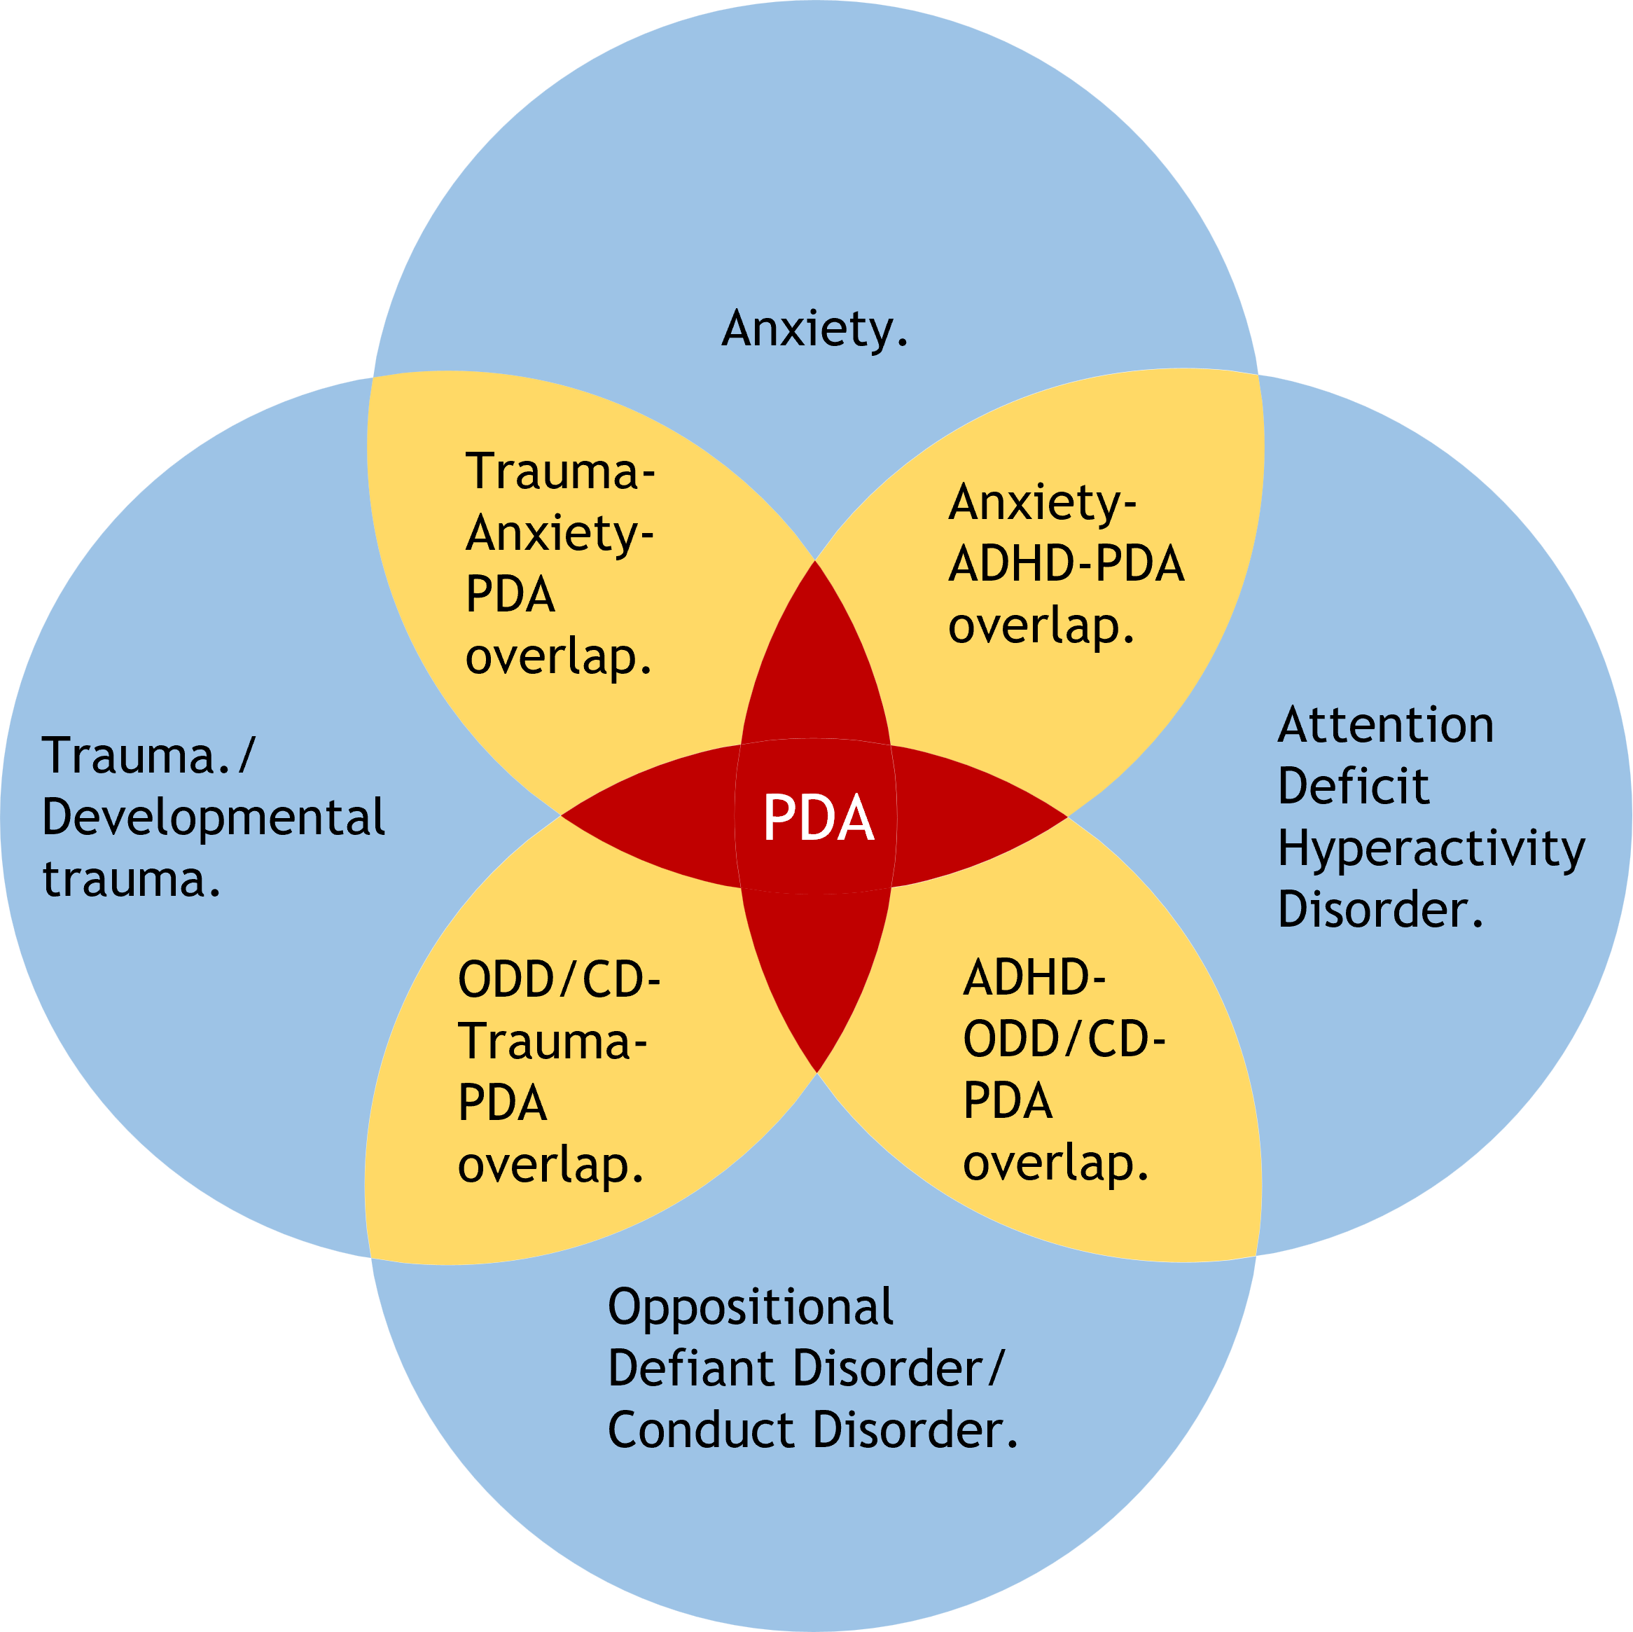
CIRCLE WARS?
“PDA Profile of ASD” as co-occurring difficulties.

Slide 38
SPITTING IMAGES OR SPLITTING IMAGES?
Combining different PDA.
Co-occurring categories can unpredictably interact.
Making some features more intense, while other characteristics less intense.
Sometimes creating novel features, that can be more intense than features associated with original categories; creating novel categories (Petrolini & Vincente 2022).

Slide 39
SPITTING IMAGES OR SPLITTING IMAGES?
Combining different PDA.
Co-occurring difficulties often present differently in autistics, compared to non-autistics (Kildahl et al 2021).
PDA maybe result of such unpredictable interactions between competing co-occurring conditions.
PDA likely presents differently in non-autistic persons.
Assuming PDA is a “Profile of ASD” &/ or basing PDA clinical descriptions from suspected autistic populations is unlikely to be representative of PDA in non-autistic populations…

Slide 40
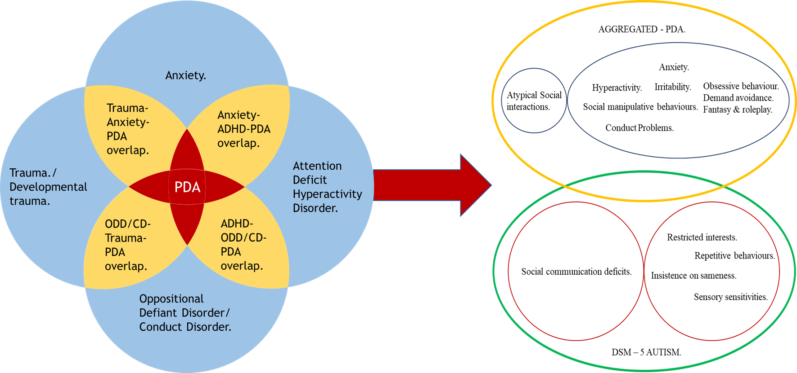
SPITTING IMAGES OR SPLITTING IMAGES?
Co-occurring difficulties interacting might create PDA?

Slide 41
ROLEPLAYING A DIAGNOSTIC CATEGORY?
Recurring doubts over PDA causing confusionn.
PDA’s reification will create confusion for caregivers & others involved (including clinicians) (Garralda 2003).
Strong recognition factor/ pattern recognition reported for “PDA Profile of ASD” “however, be subject to a range of expectation and confirmation biases.” (Green et al 2018a, p457).
Risk to clinical language’s validity & turning nosology upside down & recipe for clinical & research confusion (Green et al 2018b).

Slide 42
ROLEPLAYING A DIAGNOSTIC CATEGORY?
Other pertinent factors to consider.
General failure to take account of alternative explanations for behaviours.
Sourcing participants from places knowledgeable in “PDA Profile of ASD” is a risk of bias (Kildahl et al 2021).
Clear risk that non-autism features could be confused with autism due to “PDA Profile of ASD”.
This possibility should already be actively considered!

Slide 43
PROFOUNDLY DISTURBING?
Subtyping autism & DSM-5.
All attempts to divide autism have failed (Kapp 2023)
Its why “Profound Autism” constructed from co-occurring ID &/ or language issues (Woods et al 2023b).
Indicates “PDA Profile of ASD” features are not-autism.
DSM-5 replaced autism subtypes with autism & SCD (APA 2013).
PDA was informally excluded from DSM-5.
Most autistics do not want autism subtyped.
Seems SCD is not used much (Kapp & Ne’eman 2019).
DSM-5 autism criteria not designed to create autism subtypes (Kapp 2023), let alone identify “PDA Profile of ASD”…

Slide 44
BOB THE BUILDER’S PROFILE.
Biasing PDA research & descriptions.
PDA descriptions changed away from indicating not autism, to become autism-like features.
E.g., “manipulative” behaviours are not indicative of autism (Woods 2022).
E.g., “strategies of avoidance are essentially socially manipulative” (Newson et al 2003, p597) to “strategies of avoidance that are essentially ‘socially manipulative’” (O’Nions et al 2016a, p415), then to “Uses social strategies as part of avoidance, eg, distracting, giving excuses” (Green et al 2018a, p457).

Slide 45
BOB THE BUILDER’S PROFILE.
Biasing PDA research & descriptions.
“This was combined with sufficient social understanding and sociability enable the child to be “socially manipulative” in their avoidance”. (Fidler & Christie 2019, p10).
“They are also able to use social strategies in attempts to avoid demands in a way that Elizabeth Newson described as “socially manipulative” but others tend to describe as socially “strategic” (Fidler & Christie 2019, p11).
Socially “strategic” denotes with intent as done part of a plan.
PDA not related to ToM issues (Bishop 2018).
“Socially manipulative” = socially “strategic”.

Slide 46
AVOIDANCE OF “ORDINARY” DEMANDS.
PDA Controversies.
Associating criminal acts with autism.
Autistic persons tend to not want to be divided (Fletcher-Watson & Happé 2019; Kapp & Ne’eman 2019).
Interest is driven by non-autistic stakeholders (Christie et al 2012; Newson et al 2003).
Can adversely impact a person’s life chances, e.g. who would wish to employ someone who has a “pathological”/ “extreme” aversion to demands?
Clinical need is severely contested for two decades (Woods 2020b).

Slide 47
AVOIDANCE OF “ORDINARY” DEMANDS.
Other PDA controversies.
PDA lacks consensus on what it is, or how to assess for it (it (Langton & Frederickson 2016; O’Nions et al 2014a; O’Nions et al 2016a).
PDA stereotypes are opposite of many autism stereotypes, so it can be hard to escape stigma of both.
Interest in PDA as an ASD has outstripped its research (O’Nions & Eaton 2020), & it is a culturally based construct, to the UK (O’Nions et al 2020).

Slide 48
AVOIDANCE OF “ORDINARY” DEMANDS.
Other PDA controversies.
Highly circular, & prematurely forming a community of practice around “PDA is an ASD” narrative. It is unethical & unscientific to conduct research which favours one outlook over another (Woods 2019).
Lack of disclosure of Conflict of Interests.
Lack of cogent accounts of PDA, & attempts to rectify nonsensical logic; e.g., PDA cannot be more than a constituent component e.g., A + B + C ≠ A. Or, how do deficits in social identity/ pride/ shame cause panic attacks? (they do not).

Slide 49
AVOIDANCE OF “ORDINARY” DEMANDS.
Other PDA controversies.
Scientific research is not conducted to support one outlook, but to falsify hypotheses, “PDA Profile of ASD” seems to be a self-validation exercise (Woods 2019).
There appears to be a market for “PDA Profile of ASD” (Woods 2017a).
What happens to vulnerable persons who brought into “PDA is an ASD” narrative when “bubble” bursts?

Slide 50
CIRCLE WARS?
DSM-5 AUTISM, “PROFOUND AUTISM”, & “PATHOLOGICAL” DEMAND-AVOIDANCE RELATIVE SUPPORT NEEDS COMPARED TO IQ.
Functioning (Inverse Support Needs.)
DSM-5 Autism.
Diagram is an aid to discussion, please do not take it literally & reify it.
“Profound Autism.”
“Pathological” Demand-Avoidance.
IQ.

Slide 51
A FEATURE FILM?
Associated with trauma or highly distressed individuals:
“Seems as if s/he is distracted ‘from within’” (O’Nions et al 2014a, p763).
“Knows what to do or say to upset specific people.” (O’Nions et al 2014, p763).
“(Lacks) Awareness of own identity.” (O’Nions et al 2016a, P415).
“I am driven by the need to be in charge.” (Egan et al 2019, p485).

Slide 52
A FEATURE FILM?
An act any person would display to assert their self-agency:
“I complain about illness or physical incapacity to avoid a request or demand.” (Egan et al 2019, p485).
“Attempts to negotiate better terms with adults.” (O’Nions et al 2014a, p763).
“Apparently manipulative behaviour.” (O’Nions et al 2016a, p415).

Slide 53
A STRESSFUL SITUATION.
Stress & PDA.
Transactional with environment.
A person becomes stressed when a stressor exceeds our resources of our coping mechanisms. Person finds the situation taxing.
Reduce someone’s stress by improving their coping mechanisms.
Two thirds of distress behaviour triggered by demands or questions of others (McDonnell 2019).
“Symptoms must be present in the early developmental period (but may not become fully manifest until social demands exceed limited capacities, or may be masked by learned strategies in later life).” (APA 2013, p50).

Slide 54
DEMANDING UNCONDITIONAL SURRENDER.
Stress & self-agency.
Two thirds of distress behaviour triggered by demands or questions of others (McDonnell 2019).
“Problem” behaviours: non-compliance, defiance, leaving area, stereotypy, self-injury, or aggression (Brewer et al 2014; Lucyshyn et al 2015).
Triggered by everyday demands, e.g., CYP find situation aversive. Uncertainty & transitioning from preferred task to lesser preferred task (Lucyshyn et al 2004).
Distress behaviours associated with PDA exist in continua.

Slide 55
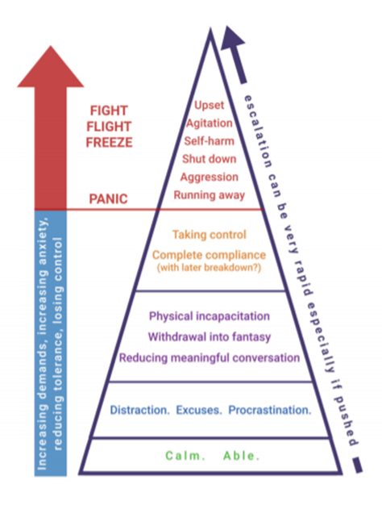
A STRESSFUL SITUATION.
How are demands avoided. (PDA Society 2020, p7).

Slide 56
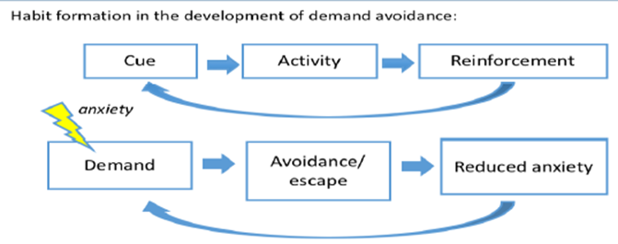
A STRESSFUL SITUATION.
PDA & Stress.
Behaviours escalate in severity, until demand is removed, can swiftly escalate.
Demand avoidance process works in a cycle like this (O’Nions 2019 p8).

Slide 57
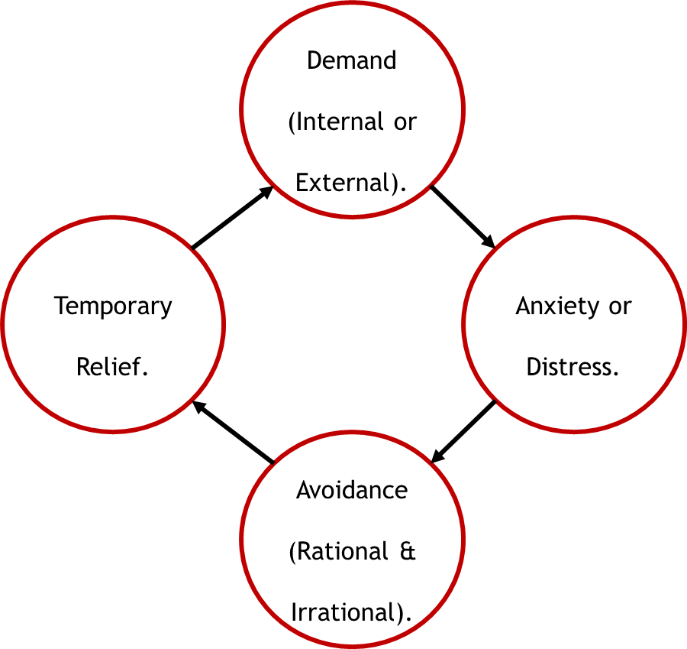
A STRESSFUL SITUATION.
Demand Management Cycle (Woods 2022, p64).

Slide 58
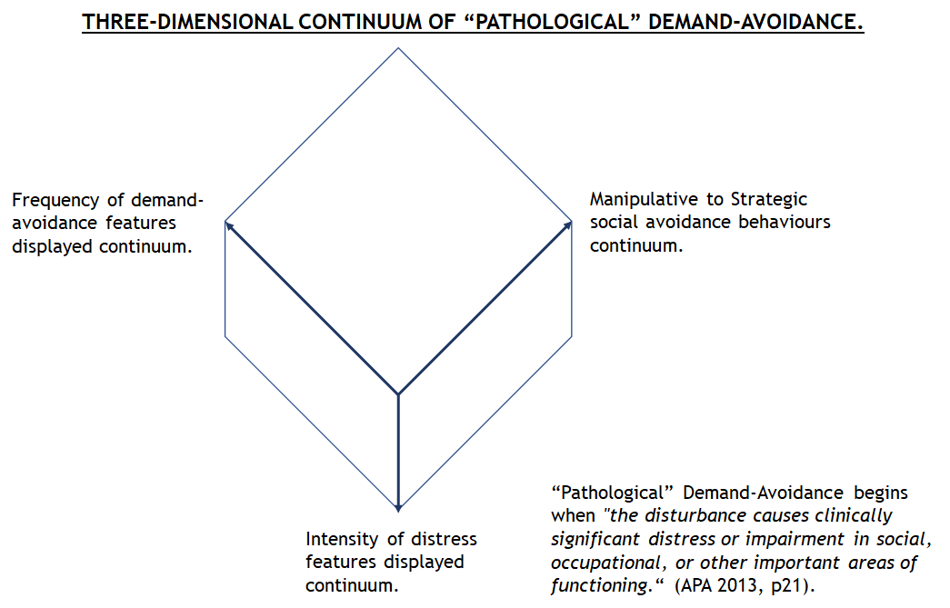
A STRESSFUL SITUATION.

Slide 59
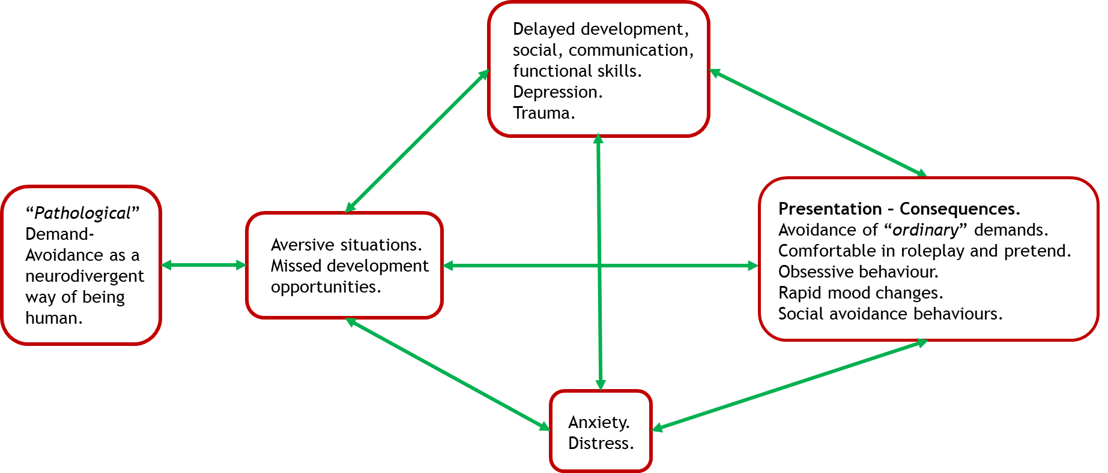
A STRESSFUL SITUATION.
A transactional stress developmental model for PDA.

Slide 60
A STRESSFUL SITUATION.
Example one.
Please watch this video.
Please note what happens when male investors are uncomfortable, what do they do?
https://www.bbc.co.uk/news/av/business-56294680

Slide 61
A STRESSFUL SITUATION.
Demand Management Cycle.
How does the demand management cycle describe what happened to male investors in the video?
Demand: Anxiety/ distress: Avoidance: Temporary relief:

Slide 62
A CASE AND POINT.
Example two.
Clinical assessment for autism, some CYP expressed would go into tents or under tables, conducting assessments to toys or teddies, or with CYP pretending to be superheroes or animals. Provide various “inventive” and “elaborate” excuses. Repetitively asking questions, or offering large amount of information relating to prescribed interests or previous experiences to an intense degree. Some CYP knocked objects of tables, threw objects, or removed themselves or assessment materials from the room. Rarely, CYP threatened clinicians with physical violence, usually after other attempts have failed. CYP had many methods like ways in which clinicians “were allowed” to deliver requests. (Eaton & Weaver 2020, pp35-36).

Slide 63
A STRESSFUL SITUATION.
Demand Management Cycle.
How does the demand management cycle describe what is happening in example three?
Demand: Anxiety/ distress: Avoidance: Temporary relief:

Slide 64
A GOOD APPROACH?
Good practice.
Please can you list strategies that you think are good practice?
E.g. allowing someone time to process information.

Slide 65
A FIAT PANDA?
AET PDA Strategies (Woods 2019).
A specific keyworker & trusted relationship.
Being flexible & adaptable.
Indirect praise.
Letting things go.
Negotiating by providing choices to pupils.
Positive relations.
Thinking aloud.
Tone of voice.
Treating anger as communication.
Use humour.
Use role play, novelty & various materials.
Visual communication methods.

Slide 66
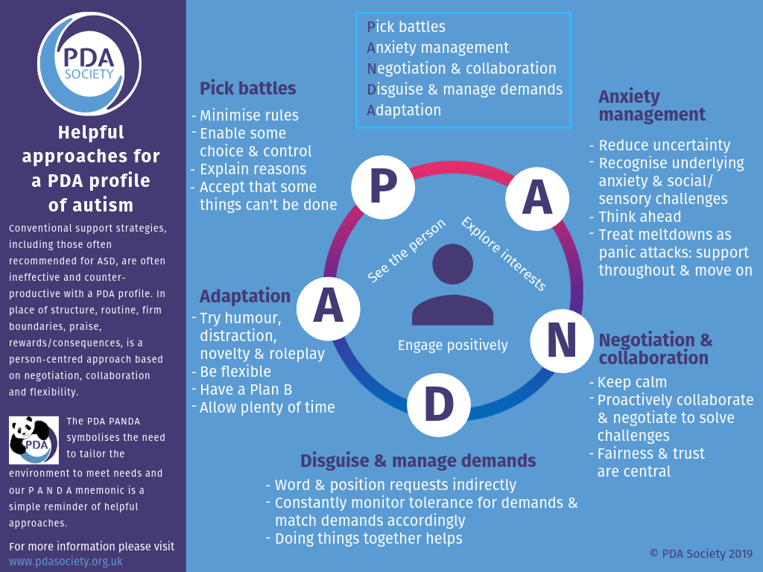
A FIAT PANDA?
PANDA Strategies Infographic (PDA Society 2019).

Slide 67
A GOOD APPROACH?
Good practice.
Please compare your ideal approaches to the PDA strategies?
You should see that PDA strategies overlap your own list of generic good practice strategies.
PDA strategies heavily overlap LA Approach, perhaps even a personalised variation of LA Approach.

Slide 68
WHO HAS A “PATHOLOGICAL” NEED TO CONTROL WHOM?
Are usual autism approaches effective?
Reinforcement-based approaches are ineffective with PDA (Christie 2007; Eaton & Weaver 2020; Newson et al 2003).
Similar mechanisms for demand-avoidance are seen outside of PDA.
Common caregiving interventions use reinforcement-based approaches (O’Nions & Neons 2018).
Other CYP also need protecting from reinforcement-based approaches…

Slide 69
WHO HAS A “PATHOLOGICAL” NEED TO CONTROL WHOM?
Are usual autism approaches effective?
Simplistic & reactive approaches are stressful to teachers & do not adequately teach children why their behaviours should change (O’Hare 2019).
Pertinent with demographic known for experiencing social problems, such as autistic persons.
“Warm supportive relationships with adults, a sense of belonging, high expectations, teaching social-emotional skills and autonomy are the key ‘ingredients’ to positive behaviour change for children and young people.” (O’Hare 2019).
Strategies/ “interventions” tend to be issues/ “symptoms” specific.

Slide 70
WHO HAS A “PATHOLOGICAL” NEED TO CONTROL WHOM?
Are usual autism approaches effective?
“a substantial proportion of the risk of poor outcomes is likely to be socially produced” (p. 277) and “the course of an autistic individual’s development is determined by other factors as much as the condition itself” (p. 291), including the enrichment and modification of the social environment [1]. Social context also affects autistic people’s functioning, such as the benefits from parental acceptance of autism [53–57] and inclusive educational settings [58–67].” (Kapp 2023, p4).

Slide 71
WHO HAS A “PATHOLOGICAL” NEED TO CONTROL WHOM?
Are usual autism approaches effective?
“For example, bidirectional effects exist between autistic people’s externalizing behaviors and parental distress or criticism, but they appear more driven by parents’ impacts on their children [177,178].” (Kapp 2023, p10).
Autism “interventions” equivalent to PDA strategies have been practiced independent of PDA for years (Green et al 2018b).
Teachers already use strategies & resources which might be effective with PDA (Crosby 2023).
LA Approach intrinsically is personalised independent of categories attributed to them.

Slide 72
WHO HAS A “PATHOLOGICAL” NEED TO CONTROL WHOM?
Are usual autism approaches effective?
PBS should only be used with those with Intellectual Disability (Gore et al 2022).
PBS “can” be used with those with “Profound Autism”…

Slide 73
WHO HAS A “PATHOLOGICAL” NEED TO CONTROL WHOM?
Are usual autism approaches effective?
No evidence of differential treatments between subtypes (Happé 2011).
Autistic persons note traditional autism interventions are often ineffective (Milton 2017).
Early autism interventions have little to no good quality evidence suggesting they are work (Sandbank et al 2020).

Slide 74
WHO HAS A “PATHOLOGICAL” NEED TO CONTROL WHOM?
Are usual autism approaches effective?
Generally poor state of autistic population’s wellbeing indicates usual autism approaches are ineffective.
Ethically problematic linking good practice strategies to a particular (sub)group of autistic persons, as depriving such strategies risks contributing to autistic populations general distress and high suicide rates.
“PDA strategies and comparable methods like the Low Arousal Approach (Woods 2019), require large scale RCTs to investigate their effectiveness.” (Woods et al 2023a, p852).

Slide 75
AVOIDING VARIANCE.
Concluding comments.
Significant hype surrounding “PDA Profile of ASD”.
PDA has significant controversy & ongoing-historical debates.
Claims surrounding “PDA Profile of ASD” need to be critically evaluated & contextualised in broader discourses.
At least plausible non-autism features are confusingly reattributed with autism via “PDA Profile of ASD”.
PDA strategies replicate good practice.
Plausible that “PDA Profile of ASD” is result of factors other than those intrinsic to the person, such as autism.
Need to follow typical ethical standards with PDA.
Prioritise integrity of accepted categories, like autism.

Slide 76
ANY QUESTIONS?
The End Game.
Contact Details: richardwoodsautism@gmail.com
Twitter handle: @Richard_Autism
My researchgate: https://www.researchgate.net/profile/Richard_Woods10
My Youtube channel: https://www.youtube.com/@autimedes
Any questions?

Slide 77
THE FIRST JOB REFERENCE.
References.
American Psychiatric Association. (1994). Diagnostic and Statistical Manual of Mental Disorders, 4th Edition. Washington: American Psychiatric Association.
American Psychiatric Association. (2013). Diagnostic and Statistical Manual of Mental Disorders, Fifth Edition. Washington, DC, American Psychiatric Association.
Berney, T., Bevan, R., Carpenter, P., Clarke, F. Doherty, M… Young, G.. (2020). The psychiatric management of autism in adults CR228, July 2020 (Online report). Retrieved https://www.rcpsych.ac.uk/docs/default-source/improving-care/better-mh-policy/college-reports/college-report-cr228.pdf?sfvrsn=c64e10e3_2 (Accessed 04 August 2023).
Bishop, E. (2018). The Relationship between Theory of Mind and Traits Associated with Autism Spectrum Condition and Pathological Demand Avoidance Presentations. Doctorate of Clinical Psychology, University College London.
Botha, M. (2021). Academic, Activist, or Advocate? Angry, Entangled, and Emerging: A Critical Reflection on Autism Knowledge Production. Frontiers in Psychology. DOI: https://doi.org/10.3389/fpsyg.2021.727542
Bottema-Boutel, K., So Yoon, K., & Crowley, S. (2019). A systematic review and meta-regression analysis of social functioning correlates in autism and typical development. Autism Research, 12(2), 152-175.
Bottema-Beutel, K., Crowley, S., Sandbank, M., Woynaroski, T. (2021a). Research Review: Conﬂicts of Interest (COIs) in autism early intervention research – a meta-analysis of COI inﬂuences on intervention effects. Journal of Child Psychology and Psychiatry, 62(1), 5-15.
Bottema-Beutel, K., Crowley, S., Sandbank, M., & Woynaroski, T. (2021b) Adverse event reporting in intervention research for young autistic children. Autism, 25(2), 322-335.

Slide 78
THE SECOND JOB REFERENCE.
References.
Brewer, A.T., Strickland-Cohen, K., Dotson, W., & Williams, D.C. (2014). Advance notice for transition-related problem behavior: Practice guidelines. Behavior Analysis in Practice, 7(2014), 117–125.
Chown, N. (2015). Do Researchers Evaluate Psychosocial Interventions for Autism from the Perspective of the Three Dominant Cognitive Autism Theories? Review Journal of Autism and Developmental Disorders, 2(2015), 243–261
Chown, N. (2019). Who benefits from autism research? And to what extent is it participatory and/or emancipatory?: A brief follow-up to Pellicano, Dinsmore and Charman (2014). Autism Policy & Practice, 2(1), 93-95.
Christie, P. (2007). The distinctive clinical and educational needs of children with pathological demand avoidance syndrome: guidelines for good practice. Good Autism Practice, 8(1), 3–11.
Crosby, H. (2023). Strategies and resources teachers in primary school can draw upon if they find a child with suspected characteristics of pathological demand avoidance in the classroom. BA Thesis, University of Chicester.
Dawson, M., & Fletcher-Watson, S. (2021a). Commentary: What conflicts of interest tell us about autism intervention research—a commentary on Bottema-Beutel et al. (2020). Journal of Child Psychology and Psychiatry, 62(1), 16-18.
Dawson, M., & Fletcher-Watson, S. (2021b). When autism researchers disregard harms: A commentary. Autism, 26(2), 564-566.
Eaton, J., & Weaver, K. (2020). An exploration of the Pathological (or Extreme) Demand Avoidant profile in children referred for an autism diagnostic assessment using data from ADOS-2 assessments and their developmental histories. Good Autism Practice, 21(2), 33-51.

Slide 79
THE THIRD JOB REFERENCE.
References.
Egan, V., Linenburg, O., & O’Nions, L. (2019). The Measurement of Adult Pathological Demand Avoidance Traits. Journal of Autism and Developmental Disorders, 49(2), 481-494.
Egan, V., Bull, E., & Trundle, G. (2020). Individual differences, ADHD, adult pathological demand avoidance, and delinquency. Research in Developmental Disabilities, 105(2020), 103733.
Falk, D. (2020). Non-complicit: Revisiting Hans Asperger’s Career in Nazi-era Vienna. Journal of Autism and Developmental Disorders, 50(2020), 2573–2584.
Fidler, R. (2019). Girls who “can’t help won’t”: Understanding the distinctive profile of Pathological Demand Avoidance (PDA) and developing approaches to support girls with PDA. In: Carpenter, B., Happe, F., & Egerton, J (Eds.), Girls and Autism: Educational, Family and Personal Perspectives (pp. 93 101).Abbingdon, Routledge.
Flackhill, C., James, S., Soppitt, R., & Milton, K. (2017). The Coventry Grid Interview (CGI): exploring autism and attachment difficulties. Good Autism Practice, 18(1), 62-80.
Fletcher-Watson, S., & Happé, F. (2019). Autism: a new introduction to psychological theory and current debate, 2nd edition. Abingdon-on-Thames, UK: Routledge.
Fletcher-Watson, S., Bölte. S., Crompton, C., Jones, D., Lai, M., Mandy, W.,… Mandell, D. (2021). Publishing standards for promoting excellence in autism research. Autism, 25(6), 1501–1504.
Garralda, E. (2003). Pathological demand avoidance syndrome or psychiatric disorder? Archives of Disease in Childhood (online only article). Retrieved from: https://adc.bmj.com/content/88/7/595.responses (Accessed 04 August 2023).
Goodley, D. (2011). Disability Studies: An Interdisciplinary Introduction. London, Sage Publications Limited.
Goodson, A. (2018). Emotion Regulation and Executive Function in Children and Adolescents with Autism Spectrum Disorder and Pathological Demand Avoidance Traits. Doctorate of Clinical Psychology, University College London.

Slide 80
THE FOURTH JOB REFERENCE.
References.
Gore, N., Sapiets, S., Denne, L., Hastings, R., Toogood, S., Anne MacDonald, A., &… Williams, D.(2022). Positive Behavioural Support in the UK: A State of the Nation Report. Journal of Positive Behavioural Support, 12, Supplement 1, 4-39.
Grant, A., Williams, G., Williams, K., & Woods, R. (2023). Unmet need, epistemic injustice and early death: how social policy for Autistic adults in England and Wales fails to slay Beveridge’s Five Giants. In Cefalo, R., Rose, R., & Jolly, A. (Eds). Social Policy Review 35 Analysis and Debate in Social Policy, 2023 (pp. 239-257). Bristol, UK, Bristol University Press.
Green, J. (2020). Commentary: Anxiety and behaviour in and beyond ASD; does the idea of ‘PDA’ really help? – a commentary on Stuart et al. (2020). Child and Adolescent Mental Health, 25(2), 74-76.
Green, J., Absoud, M., Grahame, V., Malik, O., Simonoff, E., Le Couteur, A., & Baird, G. (2018a). Demand avoidance is not necessarily defiance: Authors’ reply. Lancet Child & Adolescent Health, 2 (9), e21.
Green, J., Absoud, M., Grahame, V., Malik, O., Simonoff, E., Le Couteur, A., & Baird, G. (2018b). Demand avoidance is not necessarily defiance: Authors’ reply. Lancet Child & Adolescent Health, 2 (9), e21.
Happé, F. (2011). Criteria, categories, and continua: Autism and related disorders in DSM-5. American Academy of Child and Adolescent Psychiatry, 50(6), 540–542.
Howlin, P., Back, E., Bates. A., Conallen, K., Crabtree, J., Daves-Hales.,… O’Dell, L. (2021). Working with autism Best practice guidelines for psychologists (Online guidance). https://explore.bps.org.uk/binary/bpsworks/9fabc49fd3a5d277/8fa6f84a95698866f37795234835fc3ccb672854ae62f1ca1e1d71bd861a5154/bpsrep_rep156.pdf (Accessed 25 04 August 2023).

Slide 81
THE FIFTH JOB REFERENCE.
References.
Johnson, M., & Saunderson, H. (2023). Examining the relationship between anxiety and pathological demand avoidance in adults: a mixed methods approach. Frontiers in Education. DOI: https://www.frontiersin.org/articles/10.3389/feduc.2023.1179015/full
Kapp, S. (2023). Profound Concerns about “Profound Autism”: Dangers of Severity Scales and Functioning Labels for Support Needs. Education Sciences. Doi: https://doi.org/10.3390/educsci13020106
Kapp, S., & Ne’eman, A. (2019). Lobbying autism’s diagnostic revision in the DSM-5. In: Kapp, S. (Ed.), Autistic Community and the Neurodiversity Movement (pp. 167–194). New York: Springer Nature.
Kaushik, A., Ozsivadjian, A., Baird, G., Kyriakopoulos, M., and Absoud, M (2015, 09, 16). Extreme Demand Avoidance: towards a dimensional approach in children presenting with complex neurodevelopmental disorders and avoidance of demands. Paper presented at Royal College of Psychiatrists Faculty of Child and Adolescent Psychiatry Annual Conference. Brighton, United Kingdom. London: Royal College of Psychiatrists.
Kildahl, A., Helverschou, S., Rysstad, A., Wigaard, E., Hellerud, J., Ludvigsen, L., & Howlin, P. (2021). Pathological demand avoidance in children and adolescents: A systematic review. Autism, 25(8), 2162–2176.
Langton, E., & Frederickson, N. (2016). Mapping the educational experiences of children with pathological demand avoidance. Journal of Research in Special Educational Need, 16(4), 254–263.
Lucyshyn, J., Irvin, L., Blumberg, E., Laverty, R., Horner, R., & Sprague, J. (2004). Validating the construct of coercion in family routines: Expanding the unit of analysis in behavioral assessment with families of children with developmental disabilities. Research and Practice for Persons with Severe Disabilities, 29(2), 104–121.
Lucyshyn, J., Fossett, B., Bakeman, R., Cheremshynski, C., Miller, L., Lohrmann, S.,… & Irvin, L.K. (2015). Transforming parent-child interaction in family routines: Longitudinal analysis with families of children with developmental disabilities. Journal of Child and Family Studies, 24(2015), 3526–3541.

Slide 82
THE SIXTH JOB REFERENCE.
References.
Malik, O., & Baird, G. (2018). Commentary: PDA - what’s in a name? Dimensions of difficulty in children reported to have an ASD and features of extreme/pathological demand avoidance: a commentary on O’Nions et al. (2018). Child and Adolescent Mental Health, 23(4), 387–388.
McDonnell, A. (2019). The reflective journey: A practitioner's guide to the Low Arousal Approach. Alcester, UK: Studio 3.
McElroy, R. (2016). PDA – is there another explanation? (Online Magazine). Retrieved from: https://www.bps.org.uk/psychologist/pda-there-another-explanation (Accessed 08 August 2023).
McFadzen, C. (2020). Exploring the presence of pathological demand avoidance in school aged children. Masters of Art, Simon Fraser University.
Milton, D. (2017). 'Natures answer to over-conformity': deconstructing Pathological Demand Avoidance. In: Milton, D. (Ed), A Mismatch of Salience: Explorations of the nature of autism from theory to practice (pp. 27-38). Hove, UK, Pavilion Publishing and Media Limited.
Mols, D., & Danckaerts, M. (2022). Diagnostische validiteit van het concept Pathological Demand Avoidance: een systematische literatuurreview. TVGG. Retrieved from: https://tvgg.be/nl/proefschriften/diagnostische-validiteit-van-het-concept-pathological-demand-avoidance-een-systematische-literatuurreview (Accessed 04 August 2023).
Moore, A. (2020). Pathological Demand Avoidance: what and who are being pathologized and in whose interests? Global Studies of Childhood, 10(1), 39-52.

Slide 83
THE SEVENTH JOB REFERENCE.
References.
National Institute for Health and Care Excellence (NICE). (2021a). Autism spectrum disorder in under 19s: recognition, referral and diagnosis (Online guidance). Retrieved from: https://www.nice.org.uk/guidance/cg128/resources/autism-spectrum-disorder-in-under-19s-recognition-referral-and-diagnosis-pdf-35109456621253 (Accessed 20 October 2021).
National Institute for Health and Care Excellence (NICE). (2021b). Autism: recognition, referral and diagnosis of children and young people on the autism spectrum. London: National Institute for Health and Care Excellence.
Newson, E. (1983). Pathological Demand-Avoidance Syndrome. Communication, 17, 3-8.
Newson, E. (1996). Pathological Demand Avoidance Syndrome: a statistical update (Conference paper). Retrieved from: https://www.autismeastmidlands.org.uk/wp-content/uploads/2016/10/Pathological-Demand-Avoidance-a-statistical-update.pdf (Accessed 11 October 2020).
Newson, E., Le Maréchal, K., & David, C. (2003). Pathological demand avoidance syndrome: A necessary distinction within the pervasive developmental disorders. Archives of Disease in Childhood, 88, 595–600.
O’Hare, D. (2019). Educational psychologists concerned about government proposals that will marginalise, exclude and harm vulnerable children (Online article). Retrieved from: https://www.bps.org.uk/blog/educational-psychologists-concerned-about-government-proposals-will-marginalise-exclude-and (Accessed 08 August 2023).
O’Nions, E. (2013). Understanding thoughts and responding to emotions: exploring similarities and differences between autism spectrum disorders, conduct problems with callous- unemotional traits, and pathological demand avoidance. Doctor of Philosophy, King’s College London.

Slide 84
THE EIGHTH JOB REFERENCE.
References.
O’Nions, E. (2019). Child behaviour and parenting strategies – a research update (Online resource). Retrieved from: https://lizonions.files.wordpress.com/2019/09/1909childbehaviourparentingstrategiessummary.pdf (Accessed 08 August 2023).
O'Nions, E., Christie, P., Gould, J., Viding, E., & Happé, F. (2014a). Development of the ‘Extreme Demand Avoidance Questionnaire’ (EDA-Q): Preliminary observations on a trait measure for Pathological Demand Avoidance. Journal of Child Psychology and Psychiatry, 55, 758–768.
O’Nions, E., Viding, E., Greven, C., Ronald, A., & Happé, F., (2014b). Pathological demand avoidance: Exploring the behavioural profile. Autism, 18(5), 538-544.
O'Nions, E., Gould, J., Christie, P., Gillberg, C., Viding, E., & Happé, F. (2016a). Identifying features of ‘pathological demand avoidance’ using the Diagnostic Interview for Social and Communication Disorders (DISCO). European Child & Adolescent Psychiatry, 25(4), 407–419.
O’Nions, E., Happé, F., & Viding, E. (2016b). Extreme/’pathological’ demand avoidance. British Psychological Society DECP Debate, issue 160.
O’Nions, E., & Neons, I. (2018). Commentary: Conceptualising demand avoidance in an ASD context – a response to Osman Malik & Gillian Baird (2018). Child & Adolescent Mental Health, 23(4), 389-390.
O’Nions, E., Ceulemans, E., Happé, H., Benson. P., Evers, K., Neons, I. (2020). Parenting Strategies Used by Parents of Children with ASD: Diferential Links with Child Problem Behaviour. Journal of Autism and Developmental Disorders, 50(2020), 386–401.
O’Nions, E., Happé, F., Viding, E., & Neons, I. (2021). Extreme Demand Avoidance in Children with Autism Spectrum Disorder: Refinement of a Caregiver-Report Measure. Advances in Neurodevelopmental Disorders, 5(2021),269–281.

Slide 85
THE NINTH JOB REFERENCE.
References.
O’Nions, E., & Eaton, J. (2021). Extreme/‘pathological’ demand avoidance: an overview. Paediatrics and Child Health, 30(12), 411-415.
PDA Society (2019). Helpful approaches infographic: PANDA approaches (Online resource). Retrieved from: https://www.pdasociety.org.uk/resources/helpful-approaches-infographic/ (Accessed 26 June 2021).
PDA Society. (2020). What is PDA? Booklet (Online booklet). Retrieved from: https://www.pdasociety.org.uk/wp-content/uploads/2020/07/What-is-PDA-booklet-website-v1.1.pdf (Accessed 19 March 2021).
PDA Society. (2022). Identifying & Assessing a PDA profile - Practice Guidance (Online research). Retrieved from: https://www.pdasociety.org.uk/wp-content/uploads/2023/02/Identifying-Assessing-a-PDA-profile-Practice-Guidance-v1.1.pdf (Accessed 07 May 2023).
Pretolini, V., & Vincente, A. (2022). The challenges raised by comorbidity in psychiatric research: The case of autism. Philosophical Psychology. DOI: https://doi.org/10.1080/09515089.2022.2052829
Reilly, C., Atkinson, P., Menlove, L., Gillberg, C., O’Nions, E., Happé, F., & Neville, B. (2014). Pathological Demand Avoidance in a population-based cohort of children with epilepsy: Four case studies. Research in Developmental Disabilities, 35: 3236–3244.
Sandbank, M., Bottema-Beutel, K., Crowley, S., Cassidy, M., Dunham, K., Feldman, J. I., &…Woynaroski, T. G. (2020). Project AIM: Autism intervention meta-analysis for studies of young children. Psychological Bulletin, 146(1), 1–29.
Schneider, S., Clément, C., Goltzene, M., Meyer, N., Gras‑Vincendon, A., Schröder, C., & Coutelle, R. (2022). Determinants of the evolutions of behaviours, school adjustment and quality of life in autistic children in an adapted school setting: an exploratory study with the International Classification of Functioning, disability and health (ICF). BMC Psychiatry, 22, 323(2022). DOI: https://doi.org/10.1186/s12888-022-03924-0

Slide 86
ARE WE THERE YET?
References.
Thompson, H. (2019). The PDA paradox: the highs and lows of my life on a little known part of the autism spectrum. London: Jessica Kingsley Publishers.
Waltz, M., (2007). The relationship of ethics to quality: a particular case of research in autism. International Journal of Research & Method in Education, 30(3), 353-361.
White, R., Livingston, A., Taylor, E., Close, S., Shah, P., & Callan, M. (2022). Understanding the Contributions of Trait Autism and Anxiety to Extreme Demand Avoidance in the Adult General Population. Journal of Autism and Developmental Disorders, 53(2023), 2680–2688.
Wing, L. (2002). The Autistic Spectrum: A guide for parents and professionals. London: Constable & Robinson Limited.
Wing, L., & Gould, J. (2002). Pathological Demand Avoidance. London: National Autistic Society. Referenced in Christie (2007) & Milton (2017).
Wing, L., Gould, J., & Gillberg, C. (2011). Autism spectrum disorders in the DSM-V: Better or worse than the DSM-IV? Research in Developmental Disabilities, 32(2011), 768-773.
Woods, R. (2017a). Pathological demand avoidance: my thoughts on looping effects and commodification of autism. Disability & Society, 34(5), 753–758.
Woods, R. (2017b). Pathological demand avoidance: my thoughts on looping effects and commodification of autism. Disability & Society, 34(5), 753–758
Woods, R. (2019). Demand avoidance phenomena: circularity, integrity and validity – A commentary on the 2018 National Autistic Society PDA Conference. Good Autism Practice, 20, 28–40.

Slide 87
THE LAST JOB REFERENCE.
References.
Woods, R. (2020a). Commentary: Demand Avoidance Phenomena, a manifold issue? Intolerance of uncertainty and anxiety as explanatory frameworks for extreme demand avoidance in children and adolescents – a commentary on Stuart et al. (2019). Child and Adolescent Mental Health, 25(2), 68-70.
Woods, R. (2020b). Pathological Demand Avoidance and the DSM-5: a rebuttal to Judy Eaton’s response. Good Autism Practice, 21(2), 74-76.
Woods, R. (2021). PDA Behaviour Intensity and Prevalence at different Diagnostic Thresholds (Online blog). Retrieved from: https://rationaldemandavoidance.com/2021/04/25/pda-behaviour-intensity-and-prevalance-at-different-thresholds/ (Accessed 04 August 2023).
Woods, R. (2022). Rational (Pathological) Demand Avoidance: As a mental disorder and an evolving social construct. In: Milton, D., & Ryan, S. (Eds), The Routledge International Handbook of Critical Autism Studies (pp. 56-75), Abingdon-on-Thames, UK, Routledge Publishing.
Woods, R., Waldock, K., Keates, N., & Morgan, H. (2023a). Empathy and a Personalised Approach in Autism. Journal of Autism and Developmental Disorders, 53(2023), 850–852.
Woods. R., Williams, K., & Watts, C. (2023b) ‘Profound Autism’: The Dire Consequences of Diagnostic Overshadowing. Autism Research. DOI: 10.1002/aur.2985

