Slide 1
“Pathological Demand-Avoidance” as a “Profile of ASD” & “Profound Autism”.
Mr. Richard Woods.
London South Bank University PhD Student.
25th of May 2023.

Slide 2
PROFILING MYSELF.
Conflicts of interest.
Developing various PDA tools, e.g., Pathological Demand-Avoidance-Beliefs Scale (PDA-BS).
Income from delivering training sessions on PDA.
Reluctantly advocates for it to be diagnosed as a standalone construct.

Slide 3
PROFILING MYSELF.
My perspective.
Diagnosed as autistic in 2012.
Meets Newson’s PDA profile, is not emotionally attached to it.
Presently, no-longer basing identity on diagnostic categories.
Favours a transdiagnostic approach & we should be aspiring to stop utilising Disorder based constructs in the future.
Agenda is for at least inclusive good quality scientific-method based research & practice.
PhD is investigating PDA & part of CADS at LSBU.
My interpretation of PDA & its literature, others may disagree.
Sometimes use medical model, because it is where the source material is. Recognise mental disorders are social constructs.

Slide 4
IN THE BEGINNING.
Introduction.
Purpose of diagnoses & autism subgroups.
How “Profound Autism” & “PDA Profile of ASD” are defined.
Pertinent critique of “PDA Profile of ASD” & “Profound Autism”.
Self-advocacy, “PDA Profile of ASD”, & “Profound Autism”.
Evaluating PDA strategies.

Slide 5
FOOD FOR THOUGHT.
Is this person autistic?
Have a unique talent e.g. role play.
Preference for stability in e.g. best friend or routines.
Sensory sensitivities e.g. cannot wear certain clothes or finds certain sounds painful.
Likes to have friends.
Perfectionism e.g. will not stop until their work is perfect.
Avoidance of eye contact.
Has high anxiety.
Restricted range of interests.
Social awkwardness.
Had language delay e.g. only spoke after 4 years old.
Is clumsy.

Slide 6
ASSESSMENT OPTIONS?
“Diagnoses”.
What are is the purpose of a diagnosis of a mental disorder?

Slide 7
ASSESSMENT OPTIONS?
“Diagnoses”.
“…to better understand and make sense of individuals and to use that understanding to help us formulate more effective forms of intervention and provision.” (Christie 2007, p6).
“Until incontrovertible etiological or pathophysiological mechanisms are identified to fully validate specific disorders or disorder spectra, the most important standard for the DSM-5 disorder criteria will be their clinical utility for the assessment of clinical course and treatment response of individuals grouped by a given set of diagnostic criteria.” (APA 2013, p20).

Slide 8
SPLITTING HAIRS?
“Subgroups”.
What are your views on autism subgroups?

Slide 9
WHO HAS A “PATHOLOGICAL” NEED TO CONTROL WHOM?
Rationale for “Profound Autism” vs “PDA Profile of ASD”.
Has different support needs from other autistic persons.
Clinical communities to prioritise needs of this vulnerable & underserved group.
Group is often excluded from research & research prioritised by those with HFA.
Prioritise research funding to this group (Lutz 2021).
Split autism category into two (Singer 2022).
Strategic planning.
Comparison of research findings.
Enabling access to certain resources.
To better understand CYP (Christie 2019).

Slide 10
A LEVEL PLAYING FIELD.
What are your thoughts on the below diagram?
AUTISM FUNCTIONING SPECTRUM WITH PATHOLOGICAL DEMAND AVOIDANCE.
Kanner’s Autism/
Low Functioning.
Asperger’s Syndrome/
High Functioning.
Autistic Features.
Pathological Demand Avoidance.
Functioning (Inverse Severity).

Slide 11
PROFOUNDLY DISTURBING?
“Profound Autism” definitions.
Co-occurring “intellectual” disability &/or language impairment (Lord et al 2021).
“Severe” autism, with co-occurring “intellectual” disability &/or language impairment (Waizbard-Bartov et al 2023).
“…to include research on severe and challenging behaviors including self-injury, aggression, and irritability and research focused on children under age 8.” (ASF 2022).
ASF definition could include “PDA Profile of ASD”.
For those who need 24/7 support & cannot advocate for themselves…

Slide 12
LET’S TALK.
Main PDA Discourse.
Originally a Pervasive Developmental Disorder.
A rare autism profile/ subgroup/ subtype.
Has unique strategies that are different to autism.
Mainly called “Pathological Demand Avoidance” or “Extreme Demand Avoidance”.
Sometimes called “Persistent/ Pervasive Drive for Autonomy”.
“Some PDA individuals refer to PDA as a ‘Pervasive Drive for Autonomy’.” (PDA Society 2022, p7).

Slide 13
CIRCLE WARS.
DSM-5 AUTISM, “PROFOUND AUTISM”, & “PATHOLOGICAL” DEMAND-AVOIDANCE RELATIVE SUPPORT NEEDS COMPARED TO IQ.
Functioning (Inverse Support Needs.)
DSM-5 Autism.
Diagram is an aid to discussion, please do not take it literally & reify it.
“Profound Autism.”
“Pathological” Demand-Avoidance.
IQ.

Slide 14
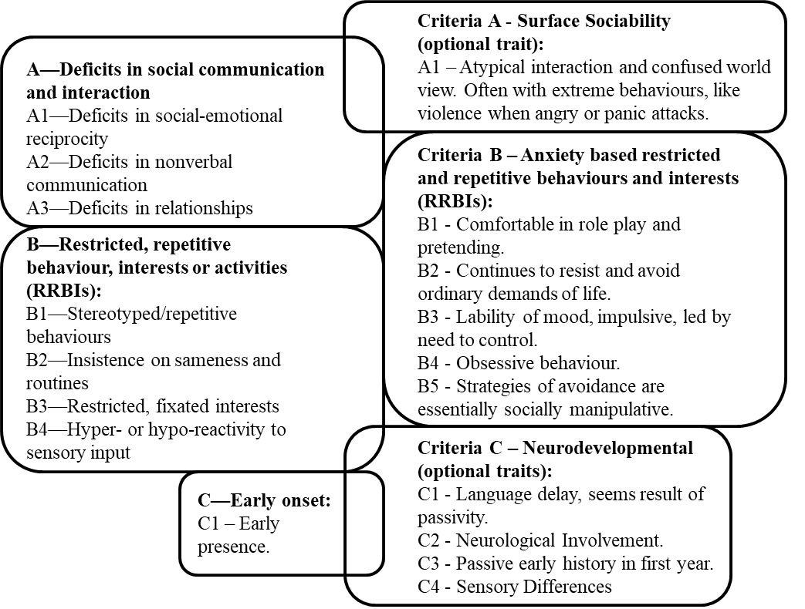
TIME TO PROFILE YOU.
Autism (left) + PDA Traits (right), my view (Woods 2021, p11).

Slide 15
ROLEPLAYING A “PROFILE OF ASD”.
“PATHOLOGICAL DEMAND-AVOIDANCE (PDA) PROFILE OF ASD” CONSTELLATION OF TRAITS WITHIN AUTISM SPECTRUM.
“PDA PROFILE OF ASD”.
“CLASSIC”/ “MORE STRAIGHT-FORWARD” AUTISM.
Anxiety.
High.
Low-none.
Avoidance of “ordinary” demands.
Pervasive.
Low-none.
Bullying, harassment, lying, stalking, stealing etc.
High.
Low-none.
Fantasy & roleplay.
Comfortable-excessive.
Low-none.
Please do not reify this diagram. Based on RW interpretations of “PDA Profile of ASD” clinical literature, diagnostic & screening tools.
Impulsivity.
High.
Low-none.
Obsessive behaviour focused on people-characters.
High-excessive.
Low-none.
“Need for control”/ “Drive for Autonomy”.
High-pervasive.
Low-none.
Rapid mood changes.
High.
Low-none.
Reinforcement-based approaches, e.g., ABA/ PBS.
Ineffective & causes distress.
“Effective & gold standard.”
Socially “strategic”-”manipulative” avoidance behaviour.
High.
“Theory of Mind.”
Low-none.
“Normal.”
“Deficits.”
ADHD, ANXIETY, CD, ODD & TRAUMA FEATURES.
AUTISM.

Slide 16
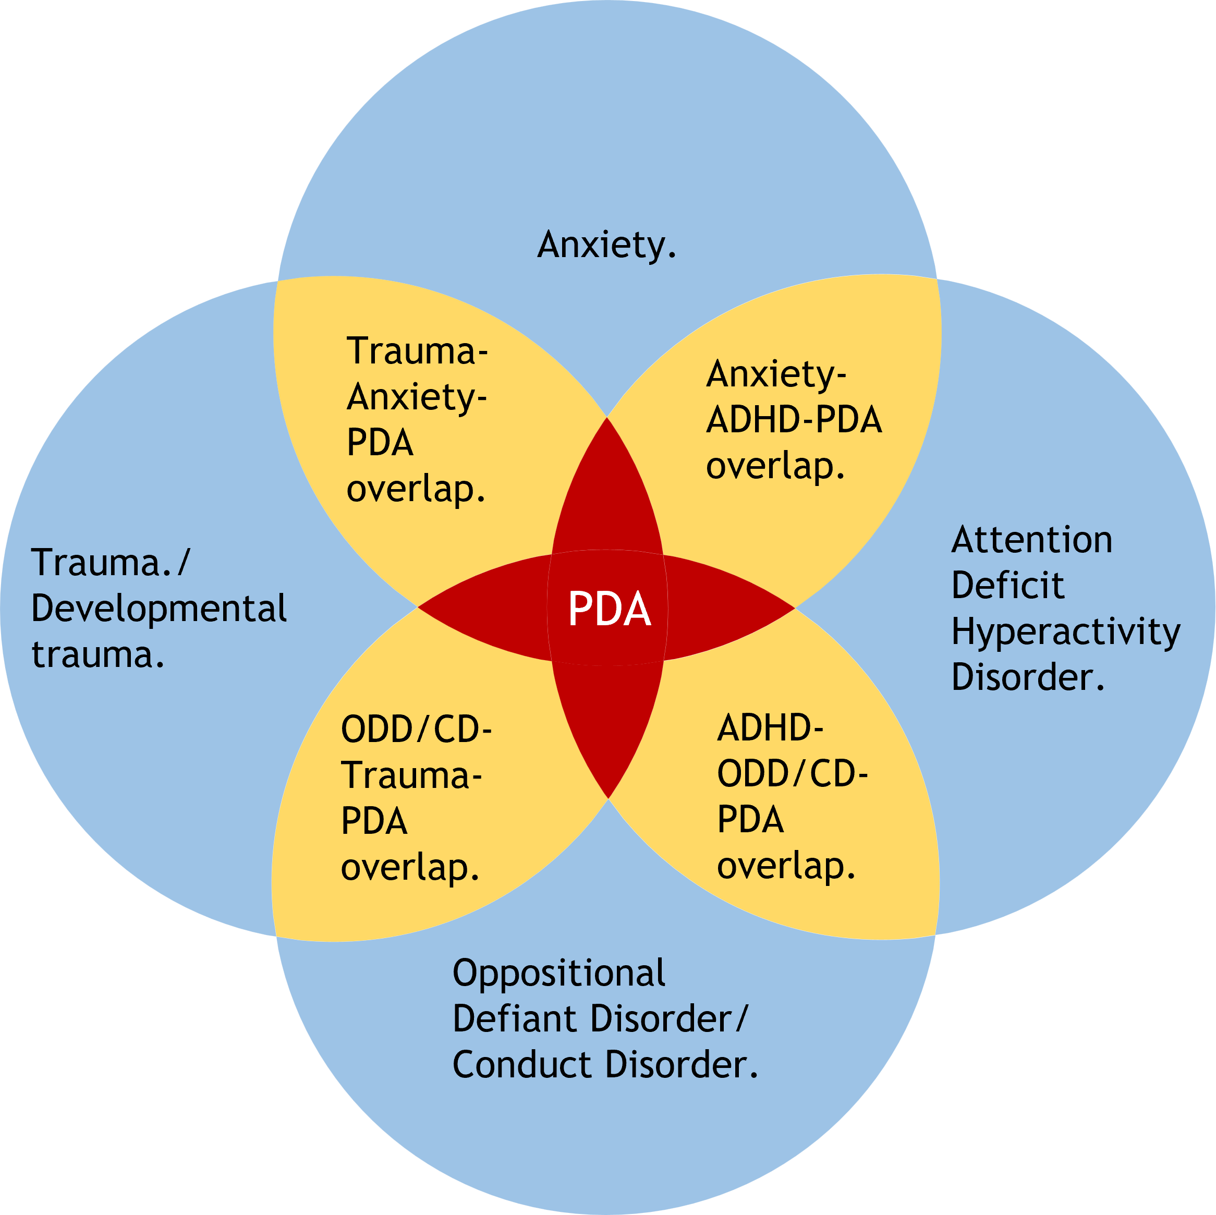
CIRCLE WARS?
“PDA Profile of ASD” as co-occurring difficulties.

Slide 17
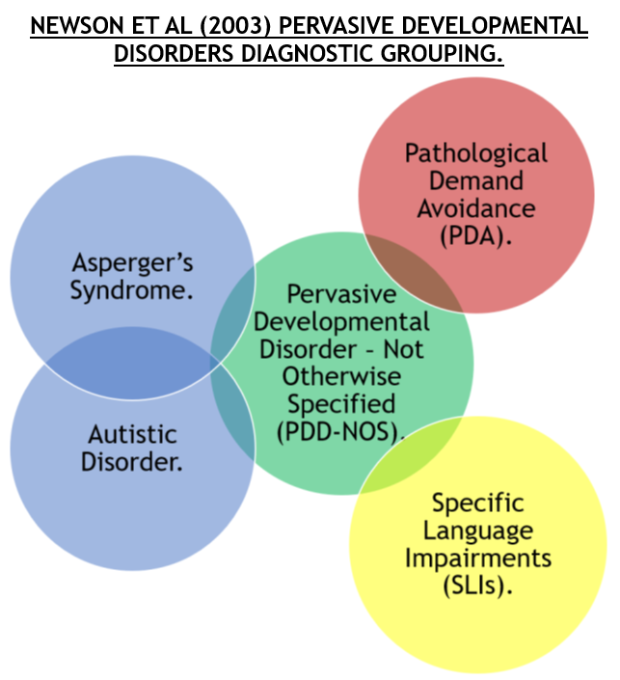
CIRCLE WARS- SEE YERGEAU (2010).

Slide 18
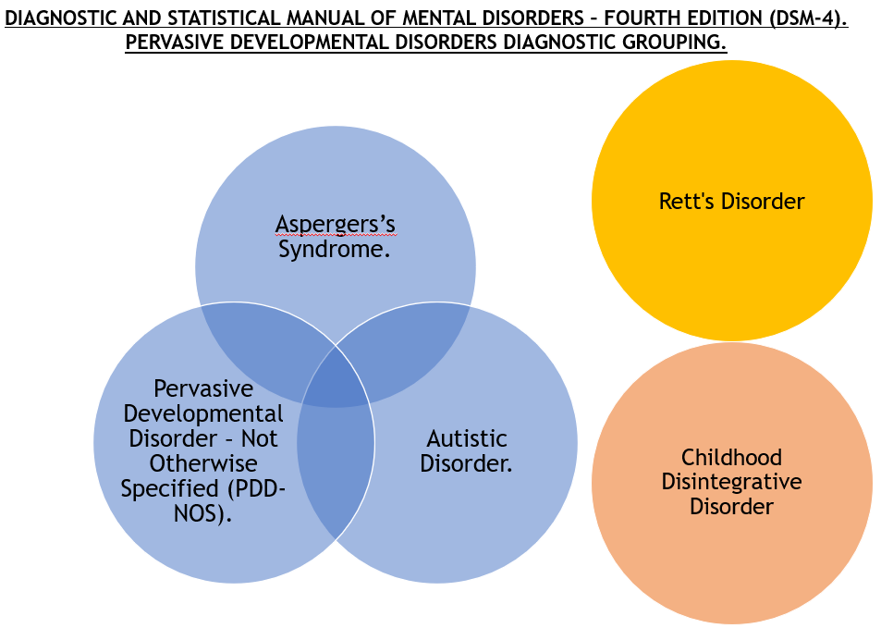
CIRCLE WARS- SEE YERGEAU (2010).

Slide 19
CIRCLE WARS?
Proposed subgroups.
Are there any issues with “PDA Profile of ASD” &/ or “Profound Autism”?

Slide 20
DEFINITION OF MADNESS?
It is impossible to successfully subtype autism.
“Reasons for this include: (1) that persons with autism frequently transition between subtypes; (2) it can be exceedingly challenging marking the boundaries between subtypes (Woods 2019); considering the concept of ‘spiky profiles’ in the autistic population i.e. atypical developmental trajectories compared to their age-matched non-autistic peers; (4) persons with autism can have different responses to the same task (Kapp 2019).” (Woods et al 2023).

Slide 21
DEFINITION OF MADNESS?
It is impossible to successfully subtype autism.
“As the Commission states, “a substantial proportion of the risk of poor outcomes is likely to be socially produced” (p. 277) and “the course of an autistic individual’s development is determined by other factors as much as the condition itself” (p. 291), including the enrichment and modification of the social environment [1].” (Kapp 2023, p5).

Slide 22
DEFINITION OF MADNESS?
It is impossible to successfully subtype autism.
“Even researchers who have championed the idea of multiple “autisms” [3] and described the need to “take autism apart” [4] have abandoned this fruitless quest to instead call for identifying features that are shared between multiple diagnostic categories, e.g., [5]” (Kapp 2023, p1).
“Our aim in proposing the new ASD diagnosis is to stop trying to “carve meatloaf at the joints” and instead recognize the essential shared features of the autism spectrum while attempting to individualize diagnosis through dimensional descriptors.“ (Happé 2011, p541).

Slide 23
DEFINITION OF MADNESS?
Practical & ethical problems with proposed autism subtypes.
Most autistic persons do not want autism subgroups (Fletcher-Watson & Happé 2019; Kapp & Ne’eman 2019).
Many autistic advocates & autistic researchers are against “Profound Autism” & functioning labels (Kapp 2023).
Subtypes excluded from DSM-5 to reduce stigma (Happé 2011).
No consensus over what features should be attributed to both “PDA Profile of ASD” & “Profound Autism” (Woods et al submitted).
Not sufficient evidence to say what PDA is (Berney et al 2020; Howlin et al 2021; Kildahl et al 2021; Mols & Danckaerts 2022; NICE 2021).

Slide 24
DEFINITION OF MADNESS?
Practical & ethical problems with proposed autism subtypes.
No scientific basis for “Profound Autism” (Kapp 2023; Pellicano et al 2022).
Anxiety overlaps many autism features, in various domains (Kapp 2023).
Both proposed subgroups risk diagnosing non-autistic persons with autism (Kapp 2023; Woods 2022a), & risks confusing co-occurring issue with autism (Pukki et al 2022; Woods 2022a).

Slide 25
DEFINITION OF MADNESS?
Practical & ethical problems with proposed autism subtypes.
“Profound Autism” is unhelpful descriptive term as it does not convey a person’s specific features & support needs (Pukki et al 2022).
Same can be said of “PDA Profile of ASD”, as it is meant to much more than only demand-avoidance (PDA Society 2022).
Both “Pathological Demand Avoidance” & “Profound Autism” are demeaning & negative terms to attribute to a person (Pellicano et al 2022; Woods 2020).

Slide 26
THE GREAT DEPRESSION.
Effects of “PDA Profile of ASD” & “Profound Autism” for other autistics.
TRIGGER WARNING. Preventable autistic deaths, suicides, & filicides.

Slide 27
NO RESISTANCE IS FUTILE.
Proposed autism subgroups are likely a risk to autistic lives.
“This is particularly important for some people with autism, including those with Asperger syndrome, who may face very significant challenges in their everyday lives, despite having average or above average IQ.” (DoH 2015, p15).
Seems autistic persons not attributed with either proposed subgroup will often have their difficulties dismissed due to misconception it is ‘mild’ autism or is not autism (Woods 2017b).
Both proposed subgroups likely contribute to suicides & preventable deaths due to having their other issues conflated with autism.
Likewise, contribute to filicide of autistic persons…

Slide 28
A FEATURE FILM?
What do these features indicate about a person’s present situation?
“I complain about illness or physical incapacity to avoid a request or demand.” (Egan et al 2019, p485).
“Attempts to negotiate better terms with adults.” (O’Nions et al 2014, p763).
“Apparently manipulative behaviour.” (O’Nions et al 2016, p415).

Slide 29
WHO HAS A “PATHOLOGICAL” NEED TO CONTROL WHOM?
Self-advocacy, “PDA Profile of ASD” & “Profound Autism”.
Many features pathologised in PDA, are those people often express to exert their self-agency when distressed/ stressed (Moore 2020).
“PDA Profile of ASD” represents pathologising of autistic advocacy (Milton 2017; Woods 2017a).
“When people generally said to be incapable of communication find ways of making clear what they do and don’t want through means other than words, this is self-advocacy” (p. 223). Baggs clarified that self-advocacy includes what some refer to as behavioral problems in response to abuse or violence against them [176].” (Kapp 2023, p10).

Slide 30
WHO HAS A “PATHOLOGICAL” NEED TO CONTROL WHOM?
Self-advocacy, “PDA Profile of ASD” & “Profound Autism”.
PDA contains many unpleasant-criminal behaviours which requires intent to commit them (Woods 2022b).
PDA, but not autistic traits predicted stalking (Linenberg 2021).
PDA does not have ToM deficits (Bishop 2018).
PDA’s social avoidance behaviours described as “manipulative” or “strategic”, gives others carte blanche to ignore our views (Woods 2017a).

Slide 31
WHO HAS A “PATHOLOGICAL” NEED TO CONTROL WHOM?
Self-advocacy, “PDA Profile of ASD” & “Profound Autism”.
“Profound Autism” advocates claiming autistic neurodiversity supporters are harassing them (Singer et al 2023).
Likewise, non-disabled autistic persons cannot advocate for those with “Profound Autism” (Singer 2022).
Ignore preferences of non-disabled autistic persons.
“Profound Autism” & other ableist terms should be used (Singer et al 2023).
“Profound Autism” intended for those who cannot advocate (ASF 2022; Singer 2022; Singer et al 2023).
Autistic IQ scores often depends on context of the IQ test & the tool being used, e.g., best tool to RPM (Kapp 2023).

Slide 32
WHO HAS A “PATHOLOGICAL” NEED TO CONTROL WHOM?
Self-advocacy, “PDA Profile of ASD” & “Profound Autism”.
What are the implications of “PDA Profile of ASD” & “Profound Autism” for autistic-advocacy?

Slide 33
CIRCLE WARS.
DSM-5 AUTISM, “PROFOUND AUTISM”, & “PATHOLOGICAL” DEMAND-AVOIDANCE RELATIVE SUPPORT NEEDS COMPARED TO IQ.
Functioning (Inverse Support Needs.)
DSM-5 Autism.
Diagram is an aid to discussion, please do not take it literally & reify it.
“Profound Autism.”
“Pathological” Demand-Avoidance.
IQ.

Slide 34
PROFOUNDLY DISTURBING?
“Profound Autism” definitions.
DSM-5 has residual categories due to spiky profiles.
PDD-NOS was DSM-4 autism residual category & most commonly diagnosed subtype
SCD is DSM-5 autism residual category (APA 2013).
Seems SCD is not used much (Kapp & Ne’eman 2019).
“PDA Profile of ASD” can be used to split autism category to create “Profound Autism” vs “PDA Profile of ASD”.
Risk of many autistic persons missing support if autism category is bifurcated.

Slide 35
PROFOUNDLY DISTURBING?
“Profound Autism” definitions.
False dichotomy of autistic persons who themselves cannot advocate vs those whose self-advocacy is excessive & is pathologised.
“PDA Profile of ASD” can be used to minimise & silent autistic critique of “Profound Autism”.

Slide 36
A GOOD APPROACH?
Good practice.
Please can you list strategies that you think are good practice?
E.g. allowing someone time to process information.

Slide 37
A FIAT PANDA?
AET PDA Strategies (Woods 2019).
A specific keyworker & trusted relationship.
Being flexible & adaptable.
Indirect praise.
Letting things go.
Negotiating by providing choices to pupils.
Positive relations.
Thinking aloud.
Tone of voice.
Treating anger as communication.
Use humour.
Use role play, novelty & various materials.
Visual communication methods.

Slide 38
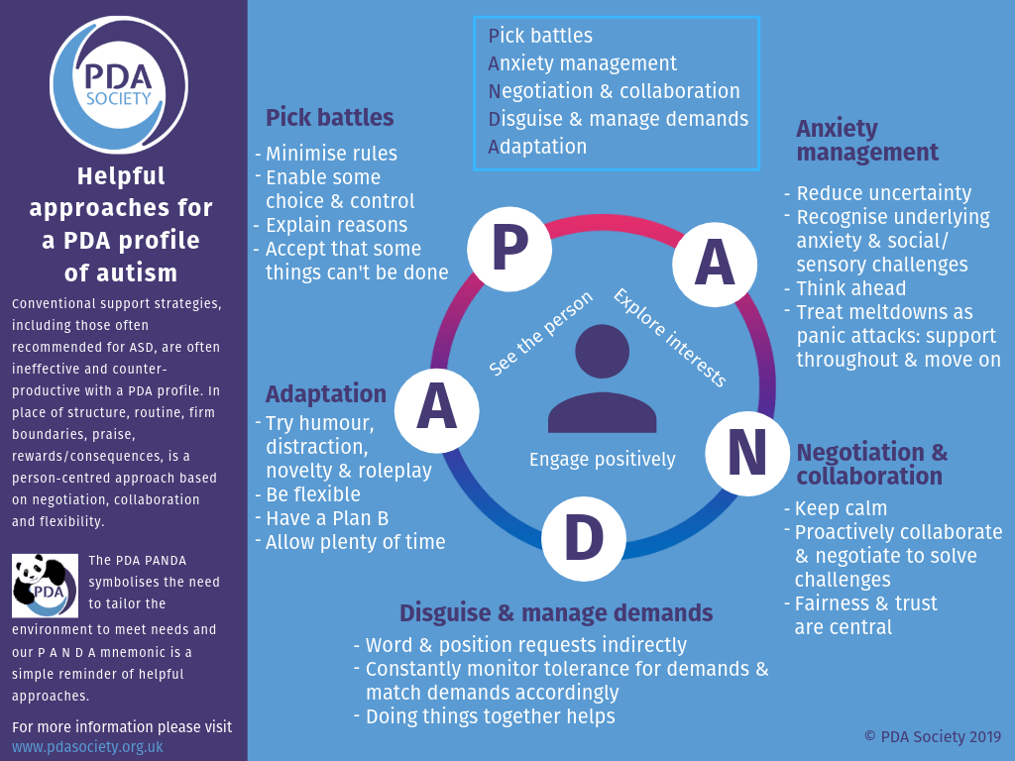
A FIAT PANDA?
PANDA Strategies Infographic (PDA Society 2019).

Slide 39
A GOOD APPROACH?
Good practice.
Please compare your ideal approaches to the PDA strategies?
You should see that PDA strategies overlap your own list of generic good practice strategies.
PDA strategies heavily overlap LA Approach, perhaps even a personalised variation of LA Approach.

Slide 40
WHO HAS A “PATHOLOGICAL” NEED TO CONTROL WHOM?
Are usual autism approaches effective?
No evidence of differential treatments between subtypes (Happé 2011).
Autistic persons note traditional autism interventions are often ineffective (Milton 2017).
Early autism interventions have little to no good quality evidence suggesting they are work (Sandbank et al 2020).
Autism “interventions” equivalent to PDA strategies have been practiced independent of PDA for years (Green et al 2018).
PBS should only be used with those with Intellectual Disability (Gore et al 2022).
PBS “can” be used with those with “Profound Autism”…

Slide 41
WHO HAS A “PATHOLOGICAL” NEED TO CONTROL WHOM?
Are usual autism approaches effective?
“For example, bidirectional effects exist between autistic people’s externalizing behaviors and parental distress or criticism, but they appear more driven by parents’ impacts on their children [177,178].” (Kapp 2023, p10).
LA Approach intrinsically is personalised independent of categories attributed to them.
Strategies/ “interventions” tend to be issues/ “symptoms” specific.
Generally poor state of autistic population’s wellbeing indicates usual autism approaches are ineffective.

Slide 42
WHO HAS A “PATHOLOGICAL” NEED TO CONTROL WHOM?
Are usual autism approaches effective?
Simplistic & reactive approaches are stressful to teachers & do not adequately teach children because their behaviours should change (O’Hare 2019).
Pertinent with demographic known for experiencing social problems, such as autistic persons.
“Warm supportive relationships with adults, a sense of belonging, high expectations, teaching social-emotional skills and autonomy are the key ‘ingredients’ to positive behaviour change for children and young people.” (O’Hare 2019).

Slide 43
A PANORAMIC VIEW?
Final reflective point.
Is it reasonable for BBC Panorama to investigate “PDA Profile of ASD” &/ “Profound Autism?

Slide 44
THE GREAT DEPRESSION.
Safeguarding note.
TRIGGER WARNING. Preventable autistic deaths, suicides, & filicides.

Slide 45
AVOIDING VARIANCE.
Concluding comments.
“PDA Profile of ASD” & “Profound Autism” are two proposed autism subgroups.
Much critique of “PDA Profile of ASD” is applicable to “Profound Autism”, & vice versa.
Many good reasons to stop wasting time & resources attempting to create autism subgroups.
Including to protect lives autistic lives against preventable deaths, suicide, & filicide.
Should prioritise integrity of autism category over “PDA Profile of ASD” & “Profound Autism”.

Slide 46
ANY QUESTIONS?
The End Game.
Contact Details: richardwoodsautism@gmail.com
Twitter handle: @Richard_Autism
My researchgate: https://www.researchgate.net/profile/Richard_Woods10
Any questions?

Slide 47
THE FIRST JOB REFERENCE.
References.
American Psychiatric Association. (2013). Diagnostic and Statistical Manual of Mental Disorders, Fifth Edition. Washington, DC, American Psychiatric Association.
Autism Science Foundation. (2022). Apply for a Profound Autism Pilot Grant (Online resource). Retrieved from: https://autismsciencefoundation.org/apply-for-a-profound-autism-pilot-grant/#:~:text=Autism%20Science%20Foundation%20will%20award,used%20to%20cover%20tuition%20payments (Accessed 25 May 2023).
Berney, T., Bevan, R., Carpenter, P., Clarke, F. Doherty, M… Young, G.. (2020). The psychiatric management of autism in adults CR228, July 2020 (Online report). Retrieved https://www.rcpsych.ac.uk/docs/default-source/improving-care/better-mh-policy/college-reports/college-report-cr228.pdf?sfvrsn=c64e10e3_2 (Accessed 25 May 2023).
Bishop, E. (2018). The Relationship between Theory of Mind and Traits Associated with Autism Spectrum Condition and Pathological Demand Avoidance Presentations. Doctorate of Clinical Psychology, University College London.
Christie, P. (2007). The distinctive clinical and educational needs of children with pathological demand avoidance syndrome: guidelines for good practice. Good Autism Practice, 8(1), 3–11.
Christie, P. (2019). Towards an understanding of Pathological Demand Avoidance (PDA): clinical, research and educational perspectives. In: National Autistic Society (Ed), Pathological Demand Avoidance Conference. London: National Autistic Society.

Slide 48
THE SECOND JOB REFERENCE.
References.
Department of Health. (2015). Statutory guidance for Local Authorities and NHS organisations to support implementation of the Adult Autism Strategy (Online Government Guidance). Retrieved from: https://assets.publishing.service.gov.uk/government/uploads/system/uploads/attachment_data/file/422338/autism-guidance.pdf (Accessed 25 May 2023).
Egan, V., Linenburg, O., & O’Nions, L. (2019). The Measurement of Adult Pathological Demand Avoidance Traits. Journal of Autism and Developmental Disorders, 49(2), 481-494.
Fletcher-Watson, S., & Happé, F. (2019). Autism: a new introduction to psychological theory and current debate, 2nd edition. Abingdon-on-Thames, UK: Routledge.
Gore, N., Sapiets, S., Denne, L., Hastings, R., Toogood, S., Anne MacDonald, A., &… Williams, D.(2022). Positive Behavioural Support in the UK: A State of the Nation Report. Journal of Positive Behavioural Support, 12, Supplement 1, 4-39.
Green, J., Absoud, M., Grahame, V., Malik, O., Simonoff, E., Le Couteur, A., & Baird, G. (2018). Demand avoidance is not necessarily defiance: Authors’ reply. Lancet Child & Adolescent Health, 2 (9), e21.
Happé, F. (2011). Criteria, categories, and continua: Autism and related disorders in DSM-5. American Academy of Child and Adolescent Psychiatry, 50(6), 540–542.
Howlin, P., Back, E., Bates. A., Conallen, K., Crabtree, J., Daves-Hales.,… O’Dell, L. (2021). Working with autism Best practice guidelines for psychologists (Online guidance). Retrieved from: https://cms.bps.org.uk/sites/default/files/2022-06/Working%20with%20autism%20-%20best%20practice%20guidelines%20for%20psychologists.pdf (Accessed 25 May 2023).

Slide 49
THE THIRD JOB REFERENCE.
References.
Kapp, S. (2023). Profound Concerns about “Profound Autism”: Dangers of Severity Scales and Functioning Labels for Support Needs. Education Sciences. Doi: https://doi.org/10.3390/educsci13020106
Kapp, S., & Ne’eman, A. (2019). Lobbying autism’s diagnostic revision in the DSM-5. In: Kapp, S. (Ed.), Autistic Community and the Neurodiversity Movement (pp. 167–194). New York: Springer Nature.
Kildahl, A., Helverschou, S., Rysstad, A., Wigaard, E., Hellerud, J., Ludvigsen, L., & Howlin, P. (2021). Pathological demand avoidance in children and adolescents: A systematic review. Autism, 25(8), 2162–2176.
Linenberg, O. (2021). The relationship of Stalking to Autism Spectrum Disorders and Personality. Doctor of Forensic Psychology thesis. University of Nottingham.
Lord, C., Charman, T., Havdahl, A., Carbone, P., Anagnostou, E., Boyd, B.,… McCauley, J. (2021). The Lancet Commission on the future of care and clinical research in autism. The Lancet, 399(10321), 271-334.
Lutz, A. (2021). Lancet Commission Calls for New Category: "Profound Autism" (Online magazine article). Retrieved from: https://www.psychologytoday.com/gb/blog/inspectrum/202112/lancet-commission-calls-new-category-profound-autism (Accessed 25 May 2023).
Milton, D. (2017). 'Natures answer to over-conformity': deconstructing Pathological Demand Avoidance. In: Milton, D. (Ed), A Mismatch of Salience: Explorations of the nature of autism from theory to practice (pp. 27-38). Hove, UK, Pavilion Publishing and Media Limited.
Mols, D., & Danckaerts, M. (2022). Diagnostische validiteit van het concept Pathological Demand Avoidance: een systematische literatuurreview. TVGG. Retrieved from: https://tvgg.be/nl/proefschriften/diagnostische-validiteit-van-het-concept-pathological-demand-avoidance-een-systematische-literatuurreview (Accessed 25 May 2023).

Slide 50
THE FOURTH JOB REFERENCE.
References.
Moore, A. (2020). Pathological Demand Avoidance: what and who are being pathologized and in whose interests? Global Studies of Childhood, 10(1), 39-52.
National Institute for Health and Care Excellence (NICE). (2021a). Surveillance consultation report October 2020 – Autism theme (NICE guidelines CG128, CG142 and CG170) (Online document). Retrieved from: https://www.nice.org.uk/guidance/cg128/documents/surveillance-review-proposal (Accessed 25 May 2023).
Newson, E., Le Maréchal, K., & David, C. (2003). Pathological demand avoidance syndrome: A necessary distinction within the pervasive developmental disorders. Archives of Disease in Childhood, 88, 595–600.
O’Hare, D. (2019). Educational psychologists concerned about government proposals that will marginalise, exclude and harm vulnerable children (Online article). Retrieved from: https://www.bps.org.uk/blog/educational-psychologists-concerned-about-government-proposals-will-marginalise-exclude-and (Accessed 25 May 2023).
O'Nions, E., Christie, P., Gould, J., Viding, E., & Happé, F. (2014). Development of the ‘Extreme Demand Avoidance Questionnaire’ (EDA-Q): Preliminary observations on a trait measure for Pathological Demand Avoidance. Journal of Child Psychology and Psychiatry, 55, 758–768.
O'Nions, E., Gould, J., Christie, P., Gillberg, C., Viding, E., & Happé, F. (2016). Identifying features of ‘pathological demand avoidance’ using the Diagnostic Interview for Social and Communication Disorders (DISCO). European Child & Adolescent Psychiatry, 25(4), 407–419.
PDA Society (2019). Helpful approaches infographic: PANDA approaches (Online resource). Retrieved from: https://www.pdasociety.org.uk/resources/helpful-approaches-infographic/ (Accessed 26 June 2021).

Slide 51
THE FIFTH JOB REFERENCE.
References.
PDA Society. (2022). Identifying & Assessing a PDA profile - Practice Guidance (Online research). Retrieved from: https://www.pdasociety.org.uk/wp-content/uploads/2023/02/Identifying-Assessing-a-PDA-profile-Practice-Guidance-v1.1.pdf (Accessed 25 May 2023).
Pellicano, E., Fatima, U., Hall, G., Heyworth, M., Lawson, W., Lilley, R.,… Stears, M. (2022). A capabilities approach to understanding and supporting autistic adulthood. Nature Reviews Psychology, 1(2022), 624–639.
Pukki, H., Bettin. J., Outlaw. A., Hennessy, J., Brook, K., Dekker, M.,… Yoon, W. (2022). Autistic Perspectives on the Future of Clinical Autism Research. Autism in Adulthood, 4(2), 93-101.
Sandbank, M., Bottema-Beutel, K., Crowley, S., Cassidy, M., Dunham, K., Feldman, J. I., &…Woynaroski, T. G. (2020). Project AIM: Autism intervention meta-analysis for studies of young children. Psychological Bulletin, 146(1), 1–29.
Singer, A. (2022). It’s time to embrace ‘profound autism’ (Online news article). Retrieved from: https://doi.org/10.53053/HPJN5392 (Accessed 26 May 2023).
Singer, A., Lutz, A., Escher, J., & Halladay, A. (2023). A full semantic toolbox is essential for autism research and practice to thrive. Autism Research, 16(3), 497-501.
Waizbard-Bartov. F., Fein, D., Lord, C., & Amaral, D. (2023). Autism severity and its relationship to disability. Autism Research, 16(4), 685-696.
Woods, R. (2017a). Pathological demand avoidance: my thoughts on looping effects and commodification of autism. Disability & Society, 34(5), 753–758
Woods, R. (2017b). Exploring how the social model of disability can be re-invigorated for autism: in response to Jonathan Levitt. Disability & Society, 32(7), 1090–1095.

Slide 52
THE LAST JOB REFERENCE.
References.
Woods, R. (2019). Demand avoidance phenomena: circularity, integrity and validity – A commentary on the 2018 National Autistic Society PDA Conference. Good Autism Practice, 20, 28–40.
Woods, R. (2020). Pathological Demand Avoidance and the DSM-5: a rebuttal to Judy Eaton’s response. Good Autism Practice, 21(2), 74-76.
Woods, R. (2021). Pathological demand avoidance (DAP): Its four schools of thought. Neurodevelopmental Psychology Forum: Newsletter of the Developmental Section, 94(2), 10-14. ISSN: 2396-8699.
Woods, R. (2022). Demand Avoidance Phenomena (Pathological Extreme ” Demand Avoidance): What if it is a Neurodevelopmental Disorder? (Online conference paper). Retrieved from: https://www.researchgate.net/publication/366205629_Demand_Avoidance_Phenomena_Pathological_Extreme_Demand_Avoidance_What_if_it_is_a_Neurodevelopmental_Disorder (Accessed 26 May 2023).
Woods, R. (2022b). Rational (Pathological) Demand Avoidance: As a mental disorder and an evolving social construct. In: Milton, D., & Ryan, S. (Eds), The Routledge International Handbook of Critical Autism Studies (pp. 56-75), Abingdon-on-Thames, UK, Routledge Publishing.
Woods, R., Waldock, K., Keates, N., & Morgan, H. (2023). Empathy and a Personalised Approach in Autism. Journal of Autism and Developmental Disorders, 53(2023), 850–852.
Woods et al. (Submitted) ‘Profound Autism’: The Dire Consequences of Diagnostic Overshadowing. Under review.
Yergeau, M. (2010). Circle Wars: Reshaping the Typical Autism Essay (Online journal article). Disability Studies Quarterly. Retrieved from: https://dsq-sds.org/index.php/dsq/article/view/1063/1222 (Accessed 25 May 2023).

