Slide 1
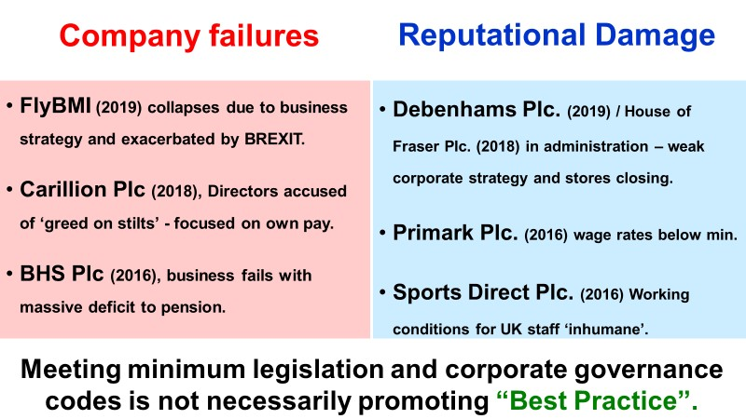
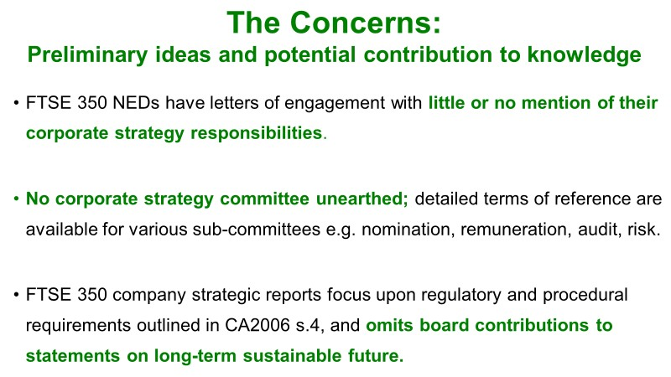
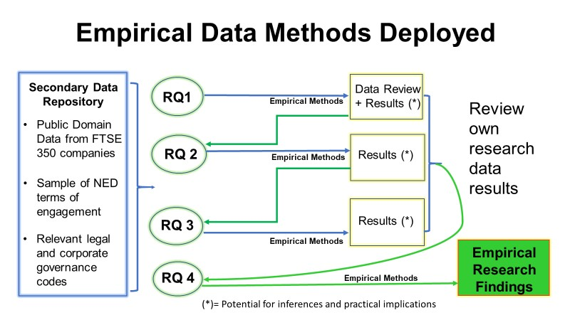
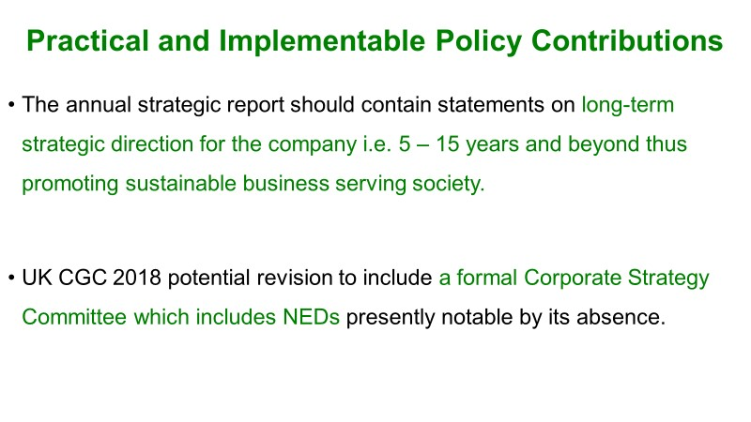
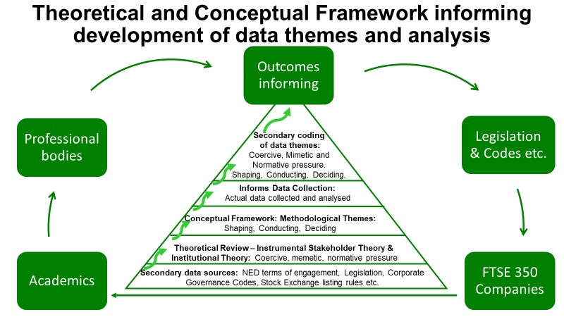
Non-Executive Directors and Corporate Strategy: Theory and exploratory empirical insights from FTSE 350 companies
Muriel Lisson PhD Student 3401770
Can NEDs have a beneficial effect on corporate strategy
UK Companies Act 2006 Section 172,
“A director of a company must act in the way he considers… most likely to promote the success of the company… and the likely consequences of any decision in the long-term,”
Why is this research so important?
References available on request: Lissonm@LSBU.ac.uk

