Slide 1
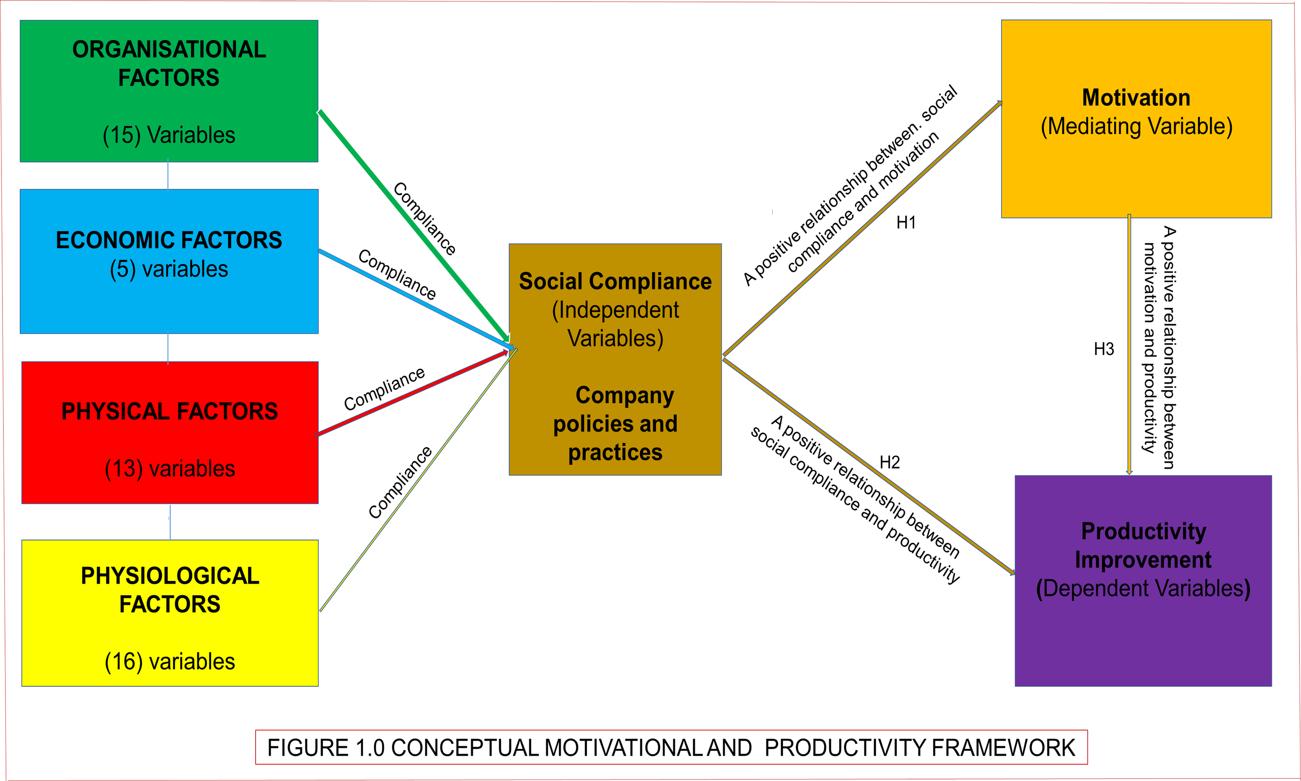
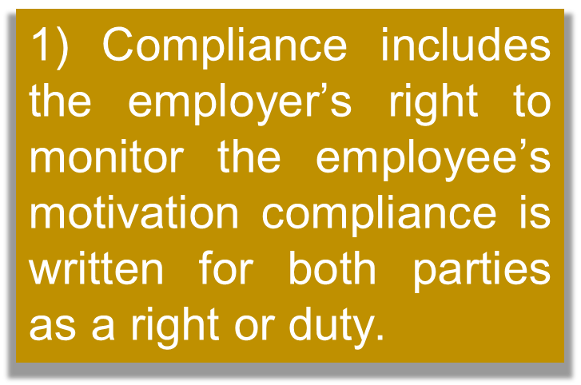
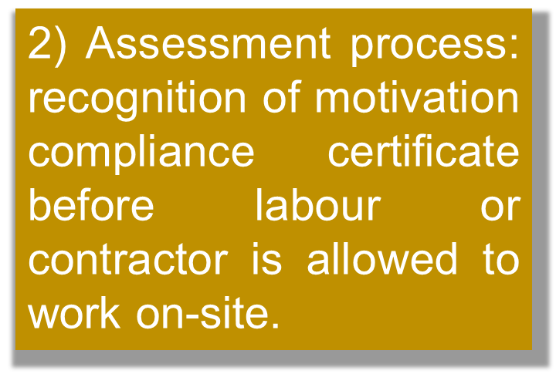
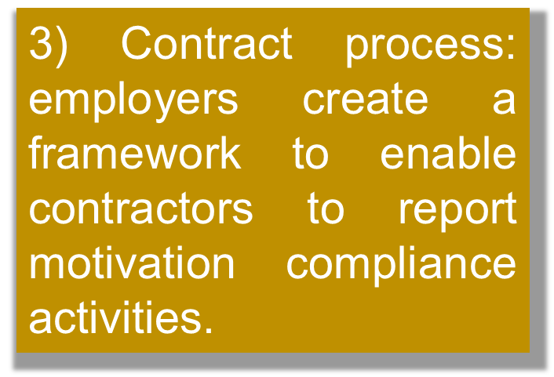
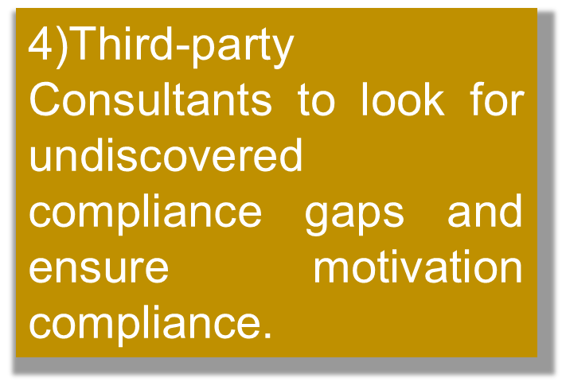
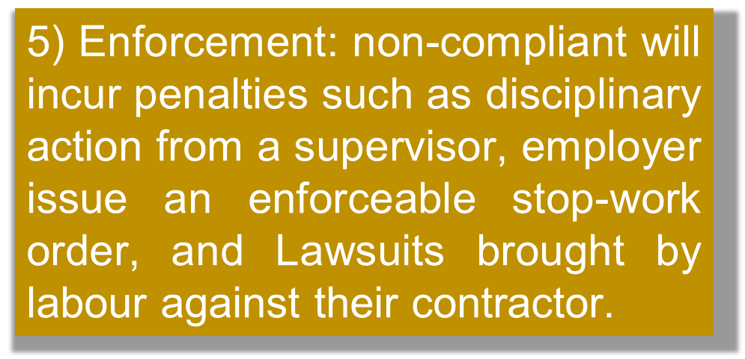
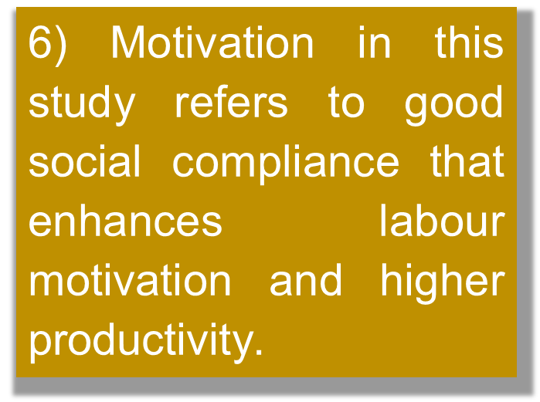
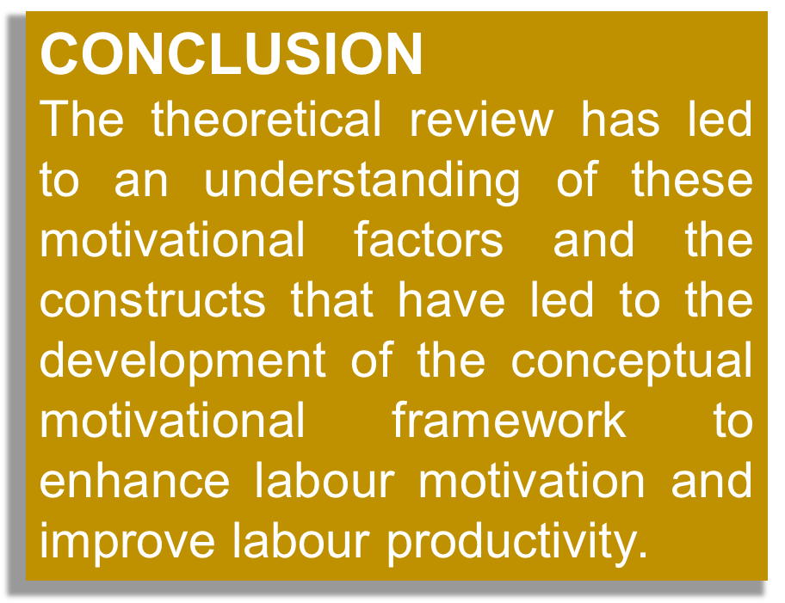
DEVELOPMENT OF CONCEPTUAL MOTIVATIONAL FRAMEWORK TO IMPROVE
CONSTRUCTION LABOUR PRODUCTIVITY IN THE U.K.
Researcher: John Kojo Tawiah Hayford
Supervisory Team: Dr Timothy Eccles & Dr Daniel Fong
Problem = The construction industry in the U.K. to become largest market by 2030. Government called to cut cost of construction by 33% and deliver 50% faster projects by 2025 + Low productivity growth
OJECTIVE
To identify the motivational factors which influence construction labour productivity in the U.K.
To examine the relationship between motivation, social compliance, and labour productivity
Examine the motivational factors that could improve labour productivity
Develop a conceptual motivational framework to improve construction labour productivity
FOR
For
AIM: The research aims to identify the motivational factors that influence labour productivity to develop a conceptual motivational framework to improve construction labour productivity in the U.K.
Scope: U.K. Construction Industry
Semi-structured Interview of 30 management in the construction site
Responses to 300 Web and Self-administered survey questionnaires to skilled and unskilled labours and Management
Methods for data collection
Managers involved with the decision-making to develop a framework to improve labour productivity
09th December 2022

