Slide 1
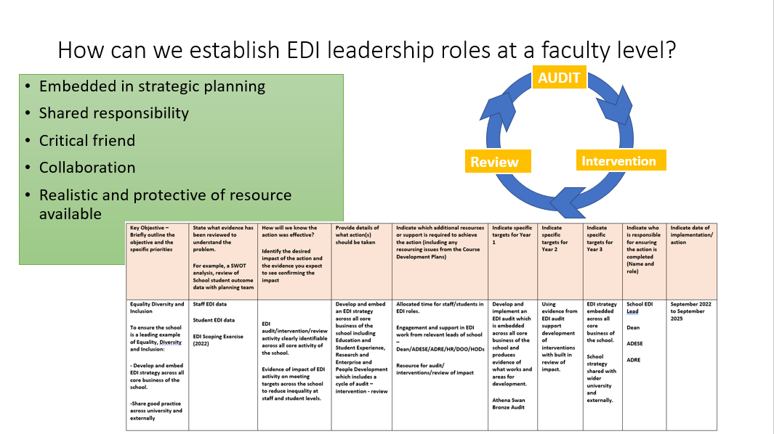
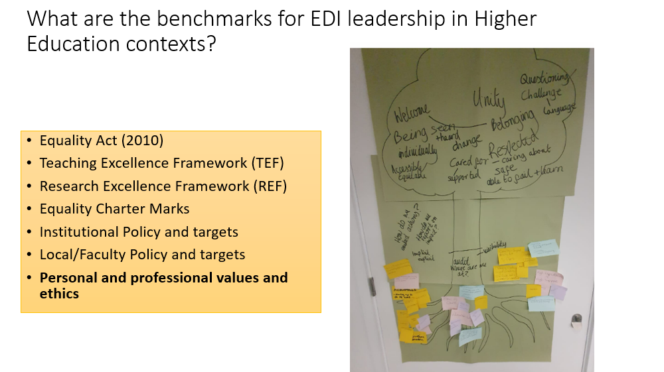
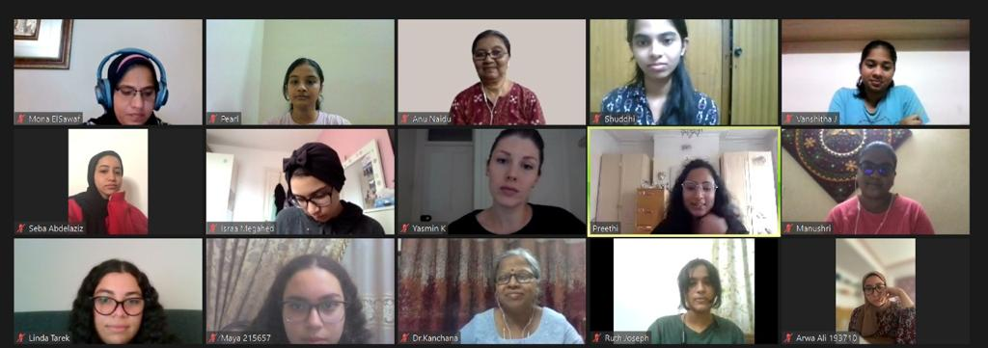
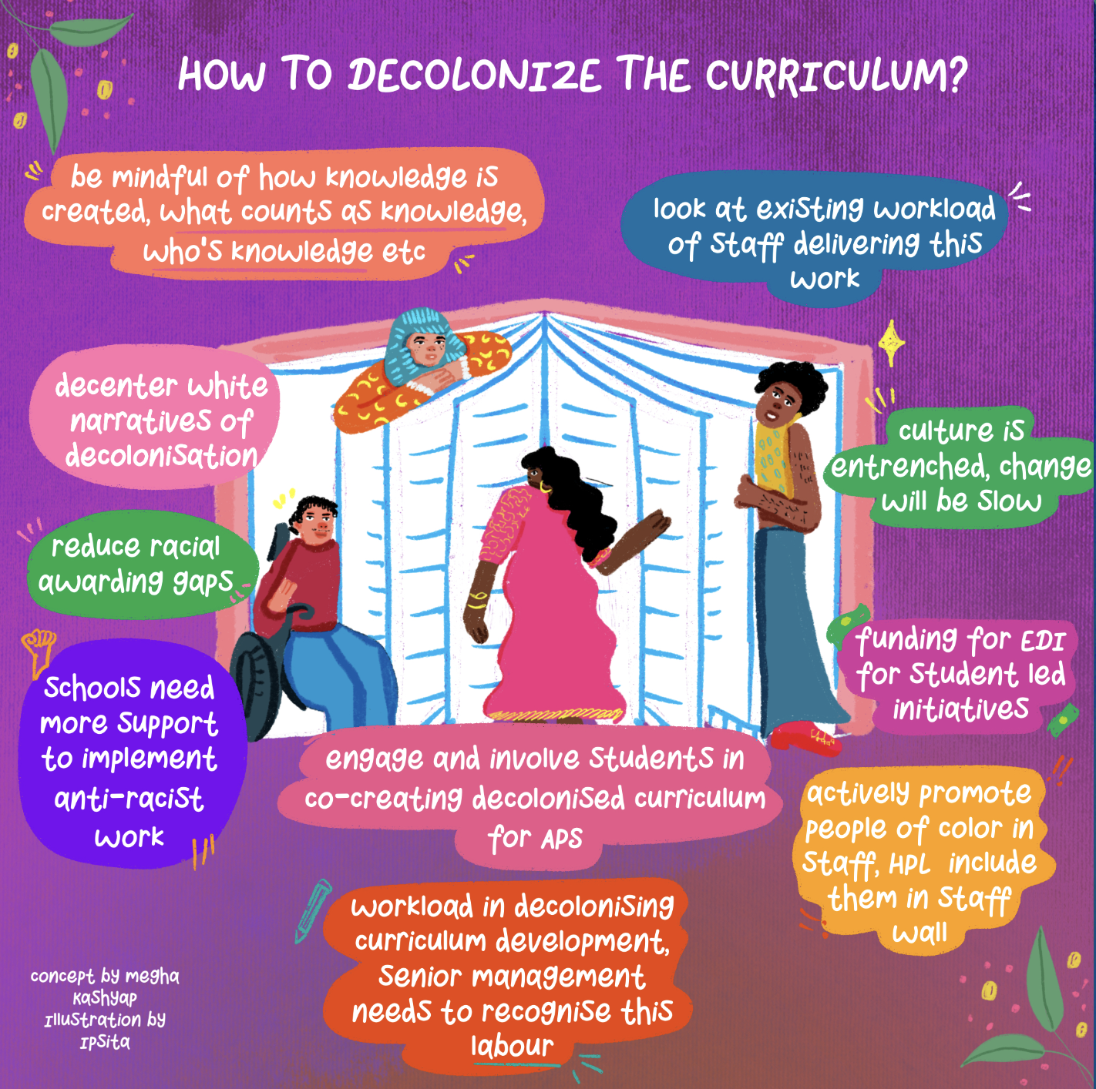
Reflecting on the experiential journey: Creating, developing and understanding leadership in Equality, Diversity and Inclusion within a Faculty
Preethi Premkumar¹, Zoë Leadley-Meade², Calvin Moorely³, Sarah Rye⁴, Danny Clegg⁵ and Sanchia Alasia⁶
¹School of Applied Sciences, ²School of Law and Social Sciences, ³School of Nursing and Midwifery, ⁴School of Business, ⁵School of Allied and Community Health, ⁶EDI Team, London South Bank University
Championing EDI at LSBU
Enhancing staff experiences
Developing and enhancing our approaches for embedding equality, diversity, and inclusivity (EDI) into everything we do
Basing our approaches to EDI on recognised models of best practice
Engaging with our staff and students at regular intervals, ensuring we hear their lived experiences that informs our actions
Leaders who role model; whose population reflect the characteristics of our staff and students
Establishing EDI Leadership Roles at a Faculty Level
Enhancing student experiences
Student-Centred Active Learning Environment with Upside-down Pedagogies
Active, collaborative learning approaches addresses barriers in student outcomes
Reduces and, in some cases, removes gaps in student engagement and attendance, attainment and progression
Reinforces good academic practices:
1. Flipped Learning - engaging students in content PRIOR to your sessions,
2. Strategic Groupwork - placing students in enduring, mixed ability groups, and
3. Students as Creators - focusing on the role of students as creators of knowledge, including teaching other students
Benchmarks for EDI leadership in Higher Education
Three-hour training of seminar leaders by an external facilitator
Modifying seminar worksheets to suit SCALE-UP
Seminar leaders delivered modified seminars to students
Written feedback on the experience of SCALE-UP
Applying for the Equality Charters
Staff feedback: “[SCALE-UP] was making them work harder…In other modules is a lot easier for them to stay quiet and don't say anything”
Athena Swan Gender
Engaging the school in reviewing the data on staff and student experiences
Understanding how EDI informs policies
Developing action plans to address gaps in gender equality
Online International Learning
EDI monthly bulletins
Students from different countries meet online to deliver short project
Decolonising the Curriculum
A dedicated Decolonsing the Curriculum research fellow conducts a series of training workshops for academic staff
Contact us
Preethi Premkumar: Email: premkump@lsbu.ac.uk; Twitter: @preethipremkum2
Zoë Leadley-Meade: Email: leadleyzoe@lsbu.ac.uk;

