Slide 1
What if “PDA Profile of ASD” advocates are confusing non-autism features with autism?
Mr. Richard Woods.
London South Bank University PhD Student.

Slide 2
PROFILING MYSELF.
Conflicts of interest.
Developing various PDA tools, e.g., Pathological Demand-Avoidance-Beliefs Scale (PDA-BS).
Income from delivering training sessions on PDA.
Reluctantly advocates for it to be diagnosed as a standalone construct.

Slide 3
PROFILING MYSELF.
My perspective.
Diagnosed as autistic in 2012.
Meets Newson’s PDA profile, is not emotionally attached to it.
Presently, no-longer basing identity on diagnostic categories.
Favours a transdiagnostic approach & we should be aspiring to stop utilising Disorder based constructs in the future.
Agenda is for at least inclusive good quality scientific-method based research & practice.
PhD is investigating PDA & part of CADS at LSBU.
My interpretation of PDA & its literature, others may disagree.

Slide 4
IN THE BEGINNING.
Introduction.
PDA models.
PDA’s controversial status.
Typical standards.
Reasons to consider if non-autism features are confused in PDA.
PDA & autism subtypes literature.
PDA & fallacies.
Conclusion.

Slide 5
ROLEPLAYING A “PROFILE OF ASD”.
“PATHOLOGICAL DEMAND-AVOIDANCE (PDA) PROFILE OF ASD” CONSTELLATION OF TRAITS WITHIN AUTISM SPECTRUM.
“PDA PROFILE OF ASD”.
“CLASSIC”/ “MORE STRAIGHT-FORWARD” AUTISM.
Anxiety.
High.
Low-none.
Avoidance of “ordinary” demands.
Pervasive.
Low-none.
Bullying, harassment, lying, stalking, stealing etc.
High.
Low-none.
Fantasy & roleplay.
Comfortable-excessive.
Low-none.
Please do not reify this diagram. Based on RW interpretations of “PDA Profile of ASD” clinical literature, diagnostic & screening tools.
Impulsivity.
High.
Low-none.
Obsessive behaviour focused on people-characters.
High-excessive.
Low-none.
“Need for control”/ “Drive for Autonomy”.
High-pervasive.
Low-none.
Rapid mood changes.
High.
Low-none.
Reinforcement-based approaches, e.g., ABA/ PBS.
Ineffective & causes distress.
“Effective & gold standard.”
Socially “strategic”-”manipulative” avoidance behaviour.
High.
“Theory of Mind.”
Low-none.
“Normal.”
“Deficits.”
ADHD, ANXIETY, CD, ODD & TRAUMA FEATURES.
AUTISM.

Slide 6
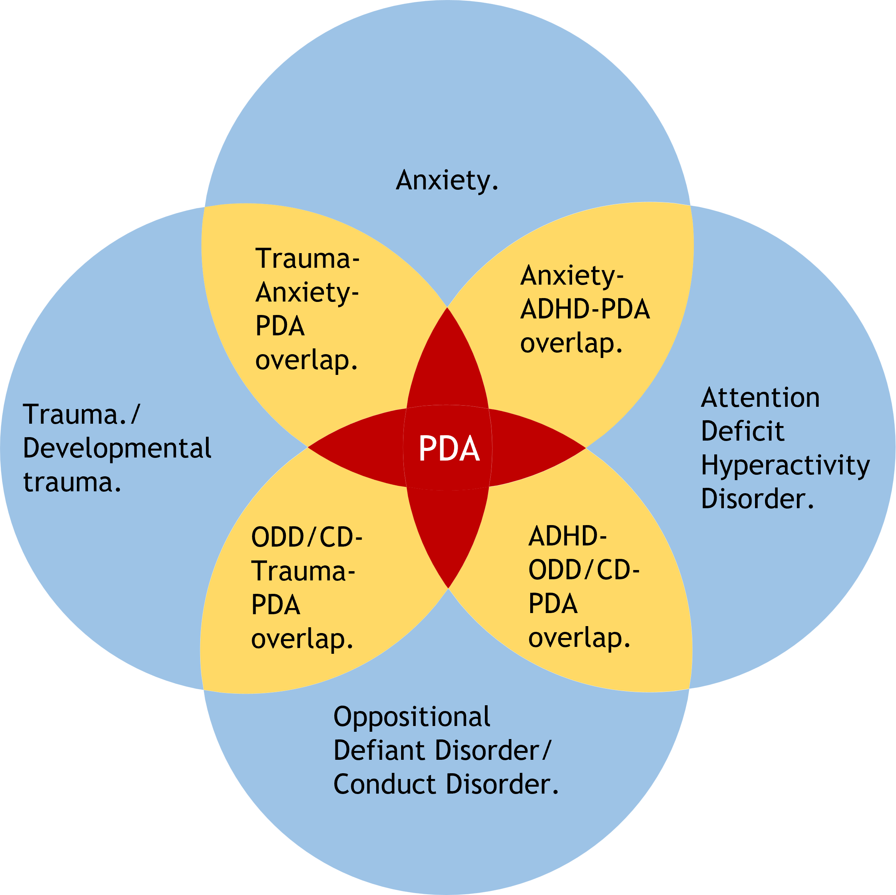
CIRCLE WARS?
“PDA Profile of ASD” as co-occurring difficulties.

Slide 7
SPITTING IMAGES OR SPLITTING IMAGES?
Combining different PDA.
Co-occurring categories can unpredictably interact.
Making some features more intense, while other characteristics less intense.
Sometimes creating novel features, that can be more intense than features associated with original categories; creating novel categories (Petrolini & Vincente 2022).

Slide 8
SPITTING IMAGES OR SPLITTING IMAGES?
Combining different PDA.
Co-occurring difficulties often present differently in autistics, compared to non-autistics (Kildahl et al 2021).
PDA maybe result of such unpredictable interactions between competing co-occurring conditions.
PDA likely presents differently in non-autistic persons.
Assuming PDA is a “Profile of ASD” &/ or basing PDA clinical descriptions from suspected autistic populations is unlikely to be representative of PDA in non-autistic populations…

Slide 9
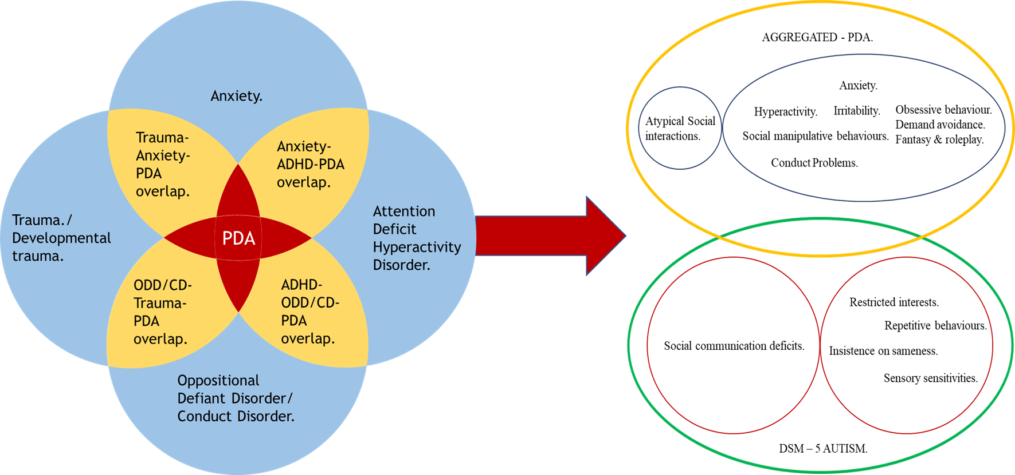
SPITTING IMAGES OR SPLITTING IMAGES?
Co-occurring difficulties interacting might create PDA?

Slide 10
AVOIDING DEMANDS OF ORDINARY RESEARCH.
PDA in the UK.
Research PDA via their autism understandings.
Caregivers are highly motivated to take part in research (O’Nions et al 2016b).
“interest in the concept of PDA largely centres on the UK, it is at present a culture-bound concept” (O’Nions et al 2020, p398).
UK PDA interest has risen sharply over last 10 years & it way outstrips its research base (O’Nions & Eaton 2021).
Due to campaigning efforts persons can be on the look-out for PDA & is a potential source of bias (Woods 2020).

Slide 11
AVOIDING DEMANDS OF ORDINARY RESEARCH.
Should there be a bubble on “PDA Profile of ASD”? – NO!
PDA is controversial (Falk 2020; Fidler & Christie 2019; Green et al 2018b; O’Nions et al 2014a; O’Nions et al 2014b; O’Nions et al 2016b).
Independent reputable parties recently concluded no good quality evidence to suggest what PDA is, or what features are associated with it. Divergent opinion was treated equally (Berney et al 2020; Howlin et al 2021; Kildahl et al 2021; Mols & Danckaerts 2022; NICE 2021).
Robustly challenged for almost 2 decades (Garralda 2003; Green et al 2018a; Green et al 2018b; Green 2020; Malik & Baird 2018; McElroy 2016; Milton 2017; Moore 2020; Wing 2002; Wing & Gould 2002; Woods 2017; Woods 2019; Woods 2020).

Slide 12
ROLEPLAYING ANOTHER AUTISM SCANDAL?
Warnings from autism history.
Autism often has poor quality theory, research, & practice.
Many cases of bold claims leading to perverse adverse ramifications, e.g.,: - Refrigerator mother. - Vaccines causes autism. - Theory of Mind dificits. - Empathy deficits. - Extreme Male Brain.
Autism stakeholders need to adhere to typical ethical standards.

Slide 13
MEETING DEMANDS OF ORDINARY RESEARCH.
MQ case study in researchers acting to prevent harm.
Researchers have a responsibility to minimise & avoid causing harm.
Significant community interest in Monotropism.
700+ autistics in initial MQ validation study (Garau et al 2023).

Slide 14
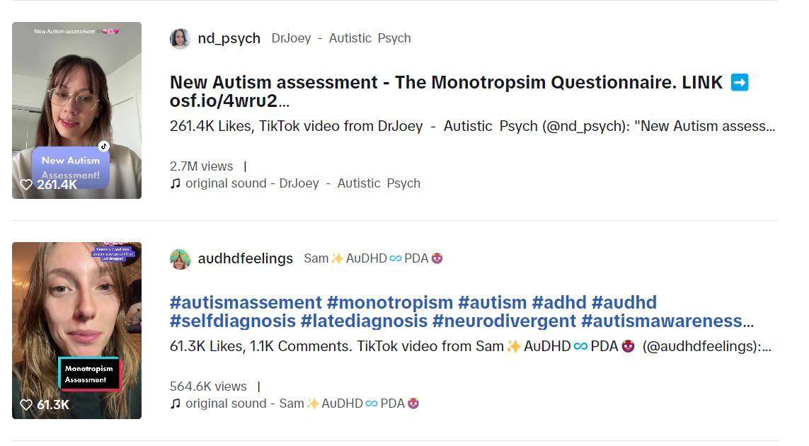
OF PEAK INTEREST?

Slide 15
MEETING DEMANDS OF ORDINARY RESEARCH.
MQ case study in researchers acting to prevent harm.
MQ went viral as an autism self-assessment test.
Debate if Monotropism is seen in non-autistics (Woods 2020).
MQ may not be representative of non-white autistics.
Assesses a version of Monotropism, not autism (Garau et al 2023).
Thankfully, co-authors acted swiftly to prevent potential erroneous reification of MQ.
Indicates responsibility for potential harm from reification of PDA as a “Profile of ASD” is with those advocating for “PDA Profile of ASD”.

Slide 16
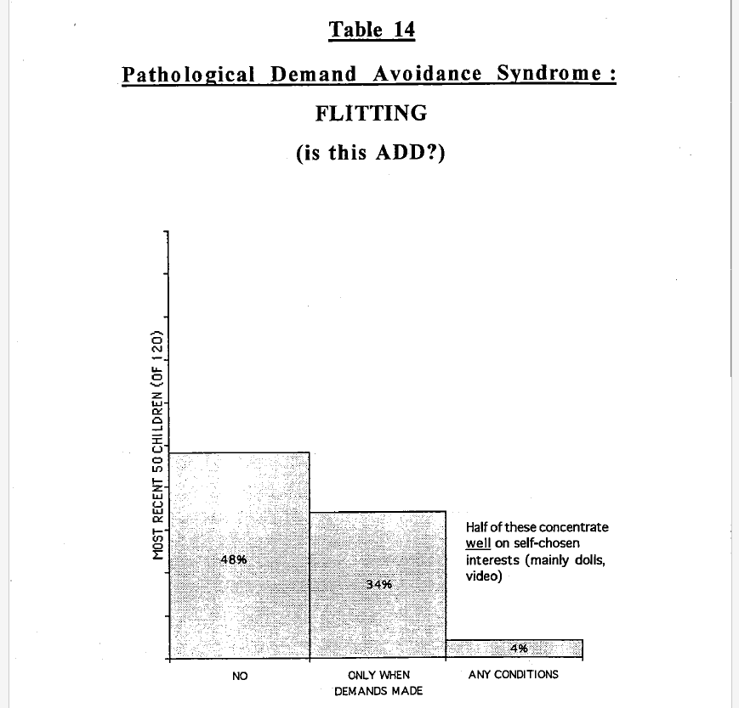
ROLEPLAYING A DIAGNOSTIC CATEGORY?
Newson 1996, p20.

Slide 17
ROLEPLAYING A DIAGNOSTIC CATEGORY?
Consistent doubts of constituent nature.
Newson’s descriptions indicate co-occurring difficulties, e.g., ADHD, anxiety disorder of childhood, ODD (Garralda 2003).
Maybe a “double-hit”, potentially caused by psychopathic tendencies, instead of autism (Wing et al 2011).
Questions wow well do co-occurring difficulties, like ADHD, SAD & ODD describe the component features of PDA? (Green et al 2018a).

Slide 18
ROLEPLAYING A DIAGNOSTIC CATEGORY?
Examples of studies indicating is a pseudo-syndrome.
“Triple hit” of autism, conduct problems & (assumed) anxiety. (O’Nions et al 2014b).
PDA features predicted by anxiety, conduct problems & hyperactivity (Green et al 2018a).
PDA features predicted by attention issues, antagonism & lower emotional stability (Egan et al 2020).
“Unlike psychiatric comorbidities and adaptive behaviour, PDA was not discriminating. Our results are therefore in agreement with the authors who questioned the validity of PDA as a distinct entity.” (Schneider et al 2022, p8).
A + B + C ≠ A, PDA cannot be something it is more than.

Slide 19
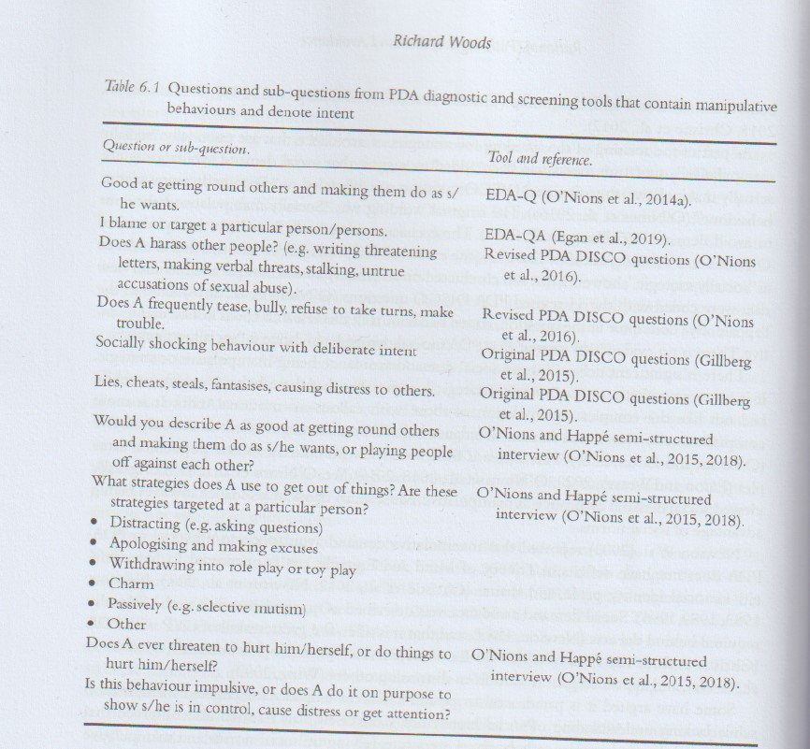
ROLEPLAYING A DIAGNOSTIC CATEGORY?
Woods 2022, p70.

Slide 20
ROLEPLAYING A DIAGNOSTIC CATEGORY?
Recurring doubts over PDA causing confusionn.
PDA’s use will create confusion for caregivers & others involved (including clinicians) (Garralda 2003).
Risk to clinical language’s validity & turning nosology upside down & recipe for clinical and research confusion (Green et al 2018b).

Slide 21
ROLEPLAYING A DIAGNOSTIC CATEGORY?
Other pertinent factors to consider.
General failure to take account of alternative explanations for behaviours.
Sourcing participants from places knowledgeable in “PDA Profile of ASD” is a risk of bias (Kildahl et al 2021).
Clear risk that non-autism features could be confused with autism due to “PDA Profile of ASD”.
This possibility should already be actively considered!

Slide 22
BOB THE BUILDER’S PROFILE.
Outlook PDA is a separate clustering of features from autism.
PDA needs to be different to autism (Newson et al 2003).
“There is a growing acknowledgement that individuals with PDA have a recognisable pattern of characteristics that are similar to each other and distinct from those of others with more straightforward presentation of autism.” (Fidler 2019, p100).
“PDA is currently best understood as a ‘profile’ (or cluster of traits) on the autism spectrum.” (PDA Society 2022, p3).
“Equally contributors have noted that, with increased awareness, there has been some over-identification by other practitioners.” (PDA Society 2022, p1)

Slide 23
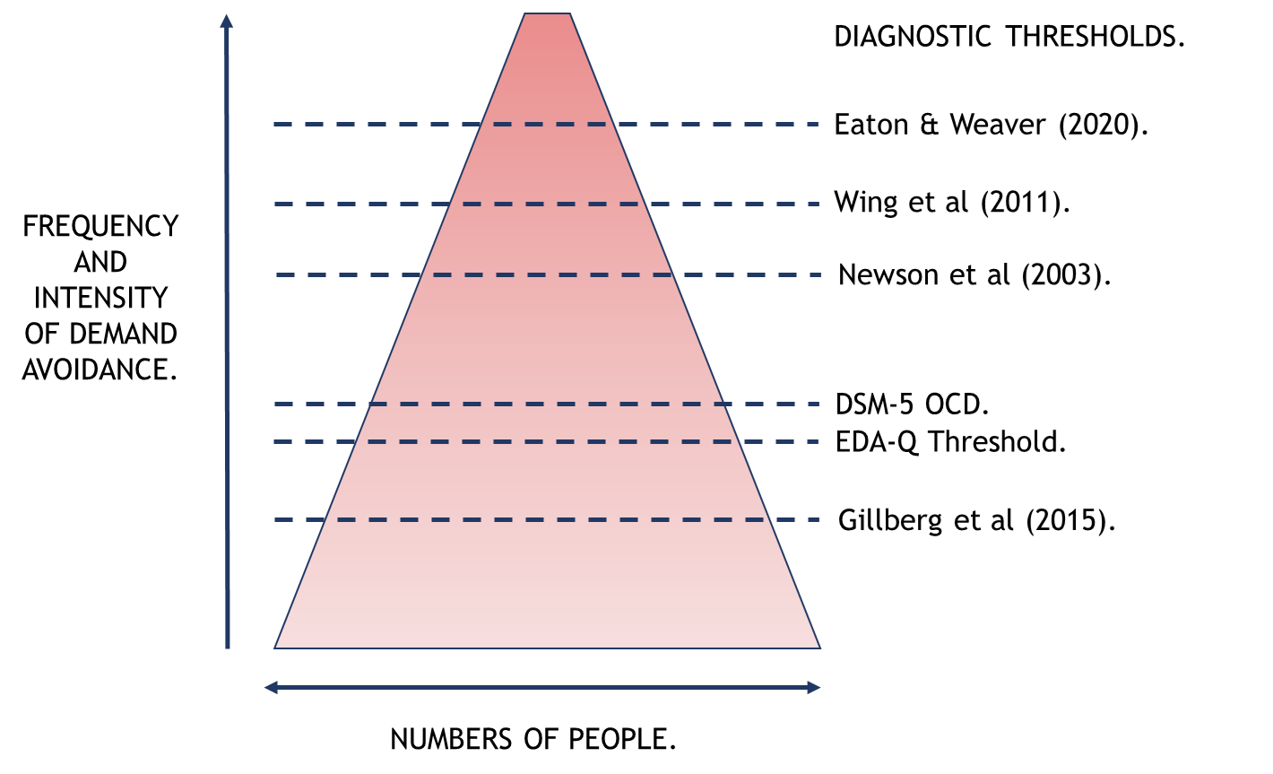
TIME TO PROFILE YOU.
Different PDA diagnostic thresholds (Woods 2021).

Slide 24
CIRCLE WARS.
DSM-5 AUTISM, “PROFOUND AUTISM”, & “PATHOLOGICAL” DEMAND-AVOIDANCE RELATIVE SUPPORT NEEDS COMPARED TO IQ.
Functioning (Inverse Support Needs.)
DSM-5 Autism.
Diagram is an aid to discussion, please do not take it literally & reify it.
“Profound Autism.”
“Pathological” Demand-Avoidance.
IQ.

Slide 25
WHO HAS A “PATHOLOGICAL” NEED TO CONTROL WHOM?
Self-advocacy, “PDA Profile of ASD” & “Profound Autism”.
“Profound Autism” advocates claiming autistic neurodiversity supporters are harassing them (Singer et al 2023).
Likewise, non-disabled autistic persons cannot advocate for those with “Profound Autism” (Singer 2022).
Ignore preferences of non-disabled autistic persons.
“Profound Autism” & other ableist terms should be used (Singer et al 2023).
Similar actions taken by “PDA Profile of ASD” advocates, to prioritise their outlooks on PDA, as examples shown throughout talk and elsewhere, or another example is in Milton (2022).

Slide 26
BOB THE BUILDER’S PROFILE.
Biasing PDA research & descriptions.
PDA descriptions changed to become autism-like features.
E.g., Social avoidance behaviours being “manipulative”, “manipulative” behaviours are not indicative of autism (Woods 2022).
E.g., “strategies of avoidance are essentially socially manipulative” (Newson et al 2003, p597) to “strategies of avoidance that are essentially ‘socially manipulative’” (O’Nions et al 2016a, p415), then to “Uses social strategies as part of avoidance, eg, distracting, giving excuses” (Green et al 2018a, p457).

Slide 27
BOB THE BUILDER’S PROFILE.
Biasing PDA research & descriptions..
Axiom that “PDA Profile of ASD” proponents views on PDA are only valid outlook on PDA.
Disregarding other topic experts’ views & supporting evidence.

Slide 28
PROFOUNDLY DISTURBING?
Subtyping autism & DSM-5.
All attempts to divide autism have failed (Kapp 2023)
Its why “Profound Autism” constructed from co-occurring ID &/ or language issues (Woods et al 2023).
Indicates “PDA Profile of ASD” features are not-autism.
DSM-5 replaced autism subtypes with autism & SCD (APA 2013).
PDA was informally excluded from DSM-5.
Most autistics do not want autism subtyped.
Seems SCD is not used much (Kapp & Ne’eman 2019).
DSM-5 autism criteria not designed to create autism subtypes (Kapp 2023), let alone identify “PDA Profile of ASD”…

Slide 29
MAKING SENSE?
Fallacies seem applicable to “PDA Profile of ASD”.
1) Begging the question = Assumes PDA is distinct thing and arguing to prove it is a thing.
2) No True Scotsman = if PDA descriptions/ diagnoses do not conform to “PDA Profile of ASD”, they are not PDA, such as instead are “Rational Demand Avoidance”.

Slide 30
MAKING SENSE?
Fallacies seem applicable to “PDA Profile of ASD”.
3) Appeal to popularity = Claiming that many hundreds/ thousands of people believe in “PDA Profile of ASD”, so it must be a thing.
4) Equivalence = Claiming “PDA Profile of ASD” is a different and distinct thing, with its features being different in nature to autism, but “PDA Profile of ASD” is a “Profile of ASD.”. A + B + C ≠ A is applicable.

Slide 31
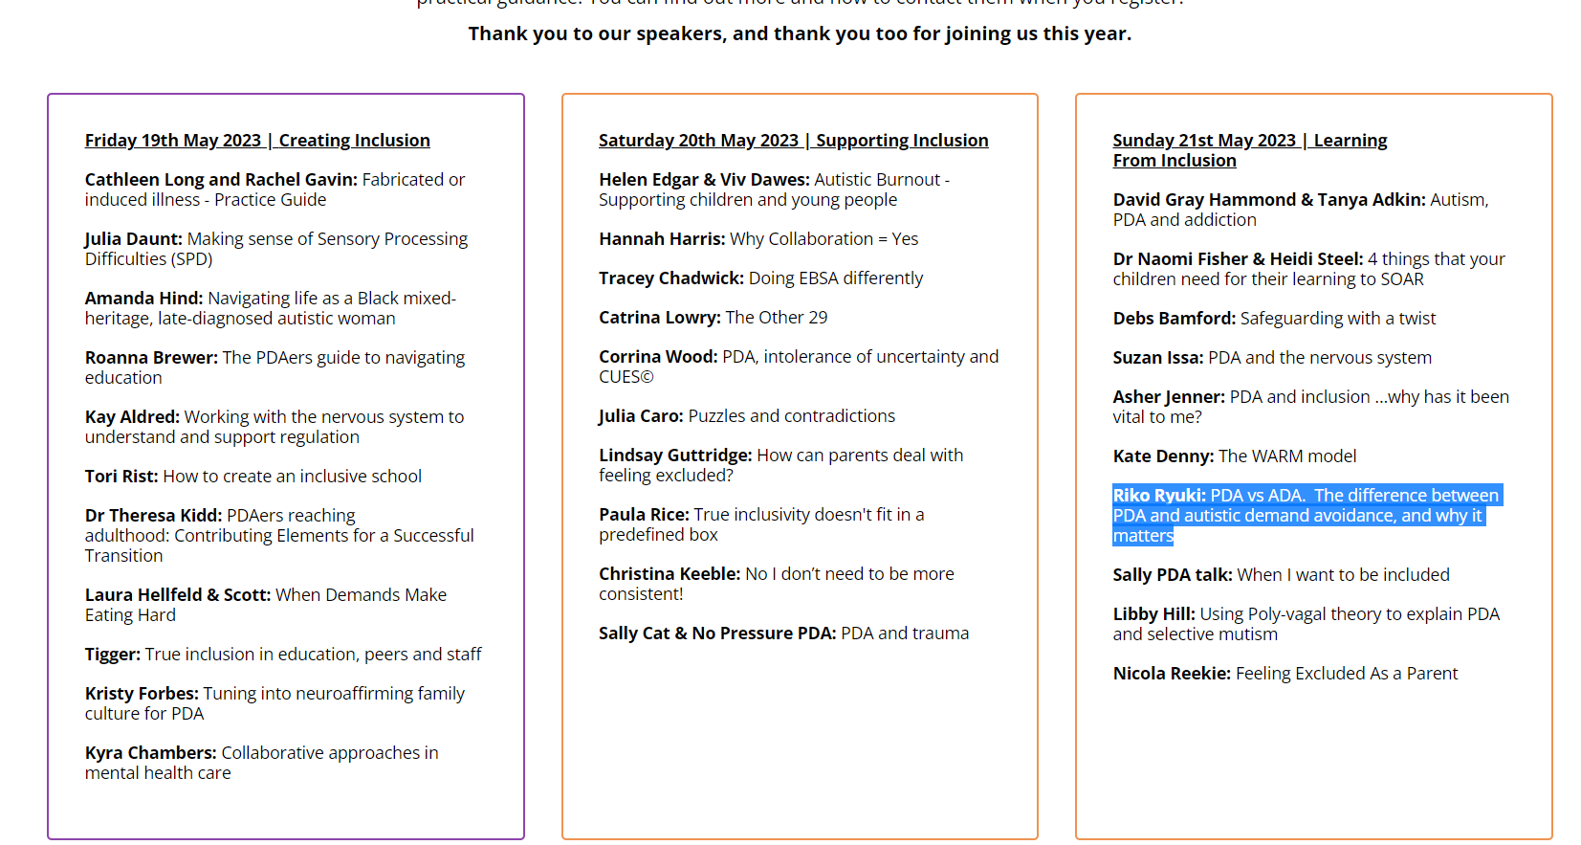
THE “LIGHT-BULB MOMENT”?
“PDA Profile of ASD” used to other (from PDA Space, 2023).

Slide 32
THE “LIGHT-BULB MOMENT”?
Fallacies seem applicable to “PDA Profile of ASD”.
5) False dichotomy = “PDA Profile of ASD” is “complex” / “perplexing” versus non-“Profile of ASD” autism is “more straightforward”/ “classic”.
6) Texas sharpshooter = Assuming PDA is a “Profile of ASD” and then conducting research to support it:
- Assuming PDA features = autism features.
- Only investigating PDA ins entirely autistic population samples.
- Designing tools which assume PDA is a “Profile of ASD”.
- Recruiting participants from sources which are knowledgeable in “PDA Profile of ASD”.

Slide 33
AVOIDING VARIANCE.
Concluding comments.
It is reasonable to consider if accounts of “PDA Profile of ASD” confusingly, reattributes non-autism features with autism.
Plausible, perhaps probable that PDA represents non-autism features.
This possibility should already be actively considered…
Responsibility for potential harm from premature reification of “PDA Profile of ASD” is from those advocating for “PDA Profile of ASD”.
Adhering to typical standards & be cautious over PDA claims.
Prioritise integrity of autism & accepted categories over “PDA Profile of ASD”.

Slide 34
ANY QUESTIONS?
The End Game.
Contact Details: richardwoodsautism@gmail.com
Twitter handle: @Richard_Autism
My researchgate: https://www.researchgate.net/profile/Richard_Woods10
My Youtube channel: https://www.youtube.com/@autimedes
Any questions?

Slide 35
THE FIRST JOB REFERENCE.
References.
American Psychiatric Association. (2013). Diagnostic and Statistical Manual of Mental Disorders, Fifth Edition. Washington, DC, American Psychiatric Association.
Berney, T., Bevan, R., Carpenter, P., Clarke, F. Doherty, M… Young, G.. (2020). The psychiatric management of autism in adults CR228, July 2020 (Online report). Retrieved https://www.rcpsych.ac.uk/docs/default-source/improving-care/better-mh-policy/college-reports/college-report-cr228.pdf?sfvrsn=c64e10e3_2 (Accessed 04 August 2023).
Egan, V., Bull, E., & Trundle, G. (2020). Individual differences, ADHD, adult pathological demand avoidance, and delinquency. Research in Developmental Disabilities, 105(2020), 103733.
Falk, D. (2020). Non-complicit: Revisiting Hans Asperger’s Career in Nazi-era Vienna. Journal of Autism and Developmental Disorders, 50(2020), 2573–2584.
Fidler, R. (2019). Girls who “can’t help won’t”: Understanding the distinctive profile of Pathological Demand Avoidance (PDA) and developing approaches to support girls with PDA. In: Carpenter, B., Happé, F., & Egerton, J (Eds.), Girls and Autism: Educational, Family and Personal Perspectives (pp. 93 101).Abbingdon, Routledge.
Fidler, R and Christie, P. (2019). Collaborative Approaches to Learning for Pupils with PDA: Strategies for Education Professionals. London: Jessica Kingsley Publishers.
Garau, V., Murray, A., Woods, R.. Chown, N., Hallett, S., Murray, F., & Fletcher-Watson, S. (2023). Development and Validation of a Novel Self-Report Measure of Monotropism in Autistic and Non-Autistic People: The Monotropism Questionnaire. Preprint. DOI: https://osf.io/ft73y/

Slide 36
THE SECOND JOB REFERENCE.
References.
Garralda, E. (2003). Pathological demand avoidance syndrome or psychiatric disorder? Archives of Disease in Childhood (online only article). Retrieved from: https://adc.bmj.com/content/88/7/595.responses (Accessed 04 August 2023).
Green, J. (2020). Commentary: Anxiety and behaviour in and beyond ASD; does the idea of ‘PDA’ really help? – a commentary on Stuart et al. (2020). Child and Adolescent Mental Health, 25(2), 74-76.
Green, J., Absoud, M., Grahame, V., Malik, O., Simonoff, E., Le Couteur, A., & Baird, G. (2018a). Demand avoidance is not necessarily defiance: Authors’ reply. Lancet Child & Adolescent Health, 2 (9), e21.
Green, J., Absoud, M., Grahame, V., Malik, O., Simonoff, E., Le Couteur, A., & Baird, G. (2018b). Demand avoidance is not necessarily defiance: Authors’ reply. Lancet Child & Adolescent Health, 2 (9), e21.
Howlin, P., Back, E., Bates. A., Conallen, K., Crabtree, J., Daves-Hales.,… O’Dell, L. (2021). Working with autism Best practice guidelines for psychologists (Online guidance). https://explore.bps.org.uk/binary/bpsworks/9fabc49fd3a5d277/8fa6f84a95698866f37795234835fc3ccb672854ae62f1ca1e1d71bd861a5154/bpsrep_rep156.pdf (Accessed 25 04 August 2023).
Kapp, S. (2023). Profound Concerns about “Profound Autism”: Dangers of Severity Scales and Functioning Labels for Support Needs. Education Sciences. Doi: https://doi.org/10.3390/educsci13020106
Kapp, S., & Ne’eman, A. (2019). Lobbying autism’s diagnostic revision in the DSM-5. In: Kapp, S. (Ed.), Autistic Community and the Neurodiversity Movement (pp. 167–194). New York: Springer Nature.
Kildahl, A., Helverschou, S., Rysstad, A., Wigaard, E., Hellerud, J., Ludvigsen, L., & Howlin, P. (2021). Pathological demand avoidance in children and adolescents: A systematic review. Autism, 25(8), 2162–2176.

Slide 37
THE THIRD JOB REFERENCE.
References.
Malik, O., & Baird, G. (2018). Commentary: PDA - what’s in a name? Dimensions of difficulty in children reported to have an ASD and features of extreme/pathological demand avoidance: a commentary on O’Nions et al. (2018). Child and Adolescent Mental Health, 23(4), 387–388.
McElroy, R. (2015). PDA – is there another explanation? (Online Magazine). Retrieved from: https://www.bps.org.uk/psychologist/pda-there-another-explanation (Accessed 04 August 2023).
Milton, D. (2017). 'Natures answer to over-conformity': deconstructing Pathological Demand Avoidance. In: Milton, D. (Ed), A Mismatch of Salience: Explorations of the nature of autism from theory to practice (pp. 27-38). Hove, UK, Pavilion Publishing and Media Limited.
Milton, D. (2022). A personal account of neurodiversity, academia and activism. In: Milton, D., & Ryan, S. (Eds), The Routledge International Handbook of Critical Autism Studies (pp. 150-156), Abingdon-on-Thames, UK, Routledge Publishing.
Mols, D., & Danckaerts, M. (2022). Diagnostische validiteit van het concept Pathological Demand Avoidance: een systematische literatuurreview. TVGG. Retrieved from: https://tvgg.be/nl/proefschriften/diagnostische-validiteit-van-het-concept-pathological-demand-avoidance-een-systematische-literatuurreview (Accessed 04 August 2023).
Moore, A. (2020). Pathological Demand Avoidance: what and who are being pathologized and in whose interests? Global Studies of Childhood, 10(1), 39-52.
National Institute for Health and Care Excellence (NICE). (2021a). Surveillance consultation report October 2020 – Autism theme (NICE guidelines CG128, CG142 and CG170) (Online document). Retrieved from: https://www.nice.org.uk/guidance/cg128/documents/surveillance-review-proposal (Accessed 04 August 2023).

Slide 38
THE FOURTH JOB REFERENCE.
References.
Newson, E. (1996). Pathological Demand Avoidance Syndrome: a statistical update (Conference paper). Retrieved from: https://www.autismeastmidlands.org.uk/wp-content/uploads/2016/10/Pathological-Demand-Avoidance-a-statistical-update.pdf (Accessed 11 October 2020).
Newson, E., Le Maréchal, K., & David, C. (2003). Pathological demand avoidance syndrome: A necessary distinction within the pervasive developmental disorders. Archives of Disease in Childhood, 88, 595–600.
O'Nions, E., Christie, P., Gould, J., Viding, E., & Happé, F. (2014a). Development of the ‘Extreme Demand Avoidance Questionnaire’ (EDA-Q): Preliminary observations on a trait measure for Pathological Demand Avoidance. Journal of Child Psychology and Psychiatry, 55, 758–768.
O’Nions, E., Viding, E., Greven, C., Ronald, A., & Happé, F., (2014b). Pathological demand avoidance: Exploring the behavioural profile. Autism, 18(5), 538-544.
O'Nions, E., Gould, J., Christie, P., Gillberg, C., Viding, E., & Happé, F. (2016a). Identifying features of ‘pathological demand avoidance’ using the Diagnostic Interview for Social and Communication Disorders (DISCO). European Child & Adolescent Psychiatry, 25(4), 407–419.
O’Nions, E., Happé, F., & Viding, E. (2016b). Extreme/’pathological’ demand avoidance. British Psychological Society DECP Debate, issue 160.
O’Nions, E., Ceulemans, E., Happé, H., Benson. P., Evers, K., Neons, I. (2020). Parenting Strategies Used by Parents of Children with ASD: Diferential Links with Child Problem Behaviour. Journal of Autism and Developmental Disorders, 50(2020), 386–401.
O’Nions, E., & Eaton, J. (2021). Extreme/‘pathological’ demand avoidance: an overview. Paediatrics and Child Health, 30(12), 411-415.

Slide 39
THE FIFTH JOB REFERENCE.
References.
PDA Society. (2022). Identifying & Assessing a PDA profile - Practice Guidance (Online research). Retrieved from: https://www.pdasociety.org.uk/wp-content/uploads/2023/02/Identifying-Assessing-a-PDA-profile-Practice-Guidance-v1.1.pdf (Accessed 07 May 2023).
PDA Space. (2023). The PDA Space Summit 2023 (Online webpage). Retrieved from: https://www.thepdaspace.com/summit-2023 (Accessed 07 May 2023).
Pretolini, V., & Vincente, A. (2022). The challenges raised by comorbidity in psychiatric research: The case of autism. Philosophical Psychology, 35(8), 1234-1263.
Schneider, S., Clément, C., Goltzene, M., Meyer, N., Gras‑Vincendon, A., Schröder, C., & Coutelle, R. (2022). Determinants of the evolutions of behaviours, school adjustment and quality of life in autistic children in an adapted school setting: an exploratory study with the International Classification of Functioning, disability and health (ICF). BMC Psychiatry, 22, 323(2022). DOI: https://doi.org/10.1186/s12888-022-03924-0
Singer, A. (2022). It’s time to embrace ‘profound autism’ (Online news article). Retrieved from: https://doi.org/10.53053/HPJN5392 (Accessed 04 August 2023).
Singer, A., Lutz, A., Escher, J., & Halladay, A. (2023). A full semantic toolbox is essential for autism research and practice to thrive. Autism Research, 16(3), 497-501.
Wing, L. (2002). The Autistic Spectrum: A guide for parents and professionals. London: Constable & Robinson Limited.
Wing, L., & Gould, J. (2002). Pathological Demand Avoidance. London: National Autistic Society. Referenced in Christie (2007) & Milton (2017).

Slide 40
THE LAST JOB REFERENCE.
References.
Wing, L., Gould, J., & Gillberg, C. (2011). Autism spectrum disorders in the DSM-V: Better or worse than the DSM-IV? Research in Developmental Disabilities, 32(2011), 768-773.
Woods, R. (2017). Pathological demand avoidance: my thoughts on looping effects and commodification of autism. Disability & Society, 34(5), 753–758
Woods, R. (2019). Demand avoidance phenomena: circularity, integrity and validity – A commentary on the 2018 National Autistic Society PDA Conference. Good Autism Practice, 20, 28–40.
Woods, R. (2020). Commentary: Demand Avoidance Phenomena a manifold issue? Intolerance of uncertainty and anxiety as explanatory frameworks for extreme demand avoidance in children and adolescents: a commentary on Stuart et al (2019). Child and Adolescent Mental Health, 25(2), 68-70.
Woods, R. (2021). PDA Behaviour Intensity and Prevalence at different Diagnostic Thresholds (Online blog). Retrieved from: https://rationaldemandavoidance.com/2021/04/25/pda-behaviour-intensity-and-prevalance-at-different-thresholds/ (Accessed 04 August 2023).
Woods, R. (2022). Rational (Pathological) Demand Avoidance: As a mental disorder and an evolving social construct. In: Milton, D., & Ryan, S. (Eds), The Routledge International Handbook of Critical Autism Studies (pp. 56-75), Abingdon-on-Thames, UK, Routledge Publishing.
Woods, R., Williams, K., & Watts, C. (2023) ‘Profound Autism’: The Dire Consequences of Diagnostic Overshadowing. Autism Research. DOI: 10.1002/aur.2985

