Slide 1
Embedding E-Learning into Accounting Education
Usha Mistry
usha.mistry@lsbm.ac.uk

Slide 2
Embedding E-Learning into Accounting Education
Contents
1. Introduction
2. Current E-Learning tools on AFM degree - ETPACK
3. Literature Review
4. Research Method
5. Findings + Discussion
6. Conclusion
www.lsbm.ac.uk

Slide 3
Introduction
The aim of the research is to examine from student’s perspective, the effectiveness of current accounting education’s E-Learning tools used on the BA (Hons) Accounting and Financial Management degree.
The topic area was chosen as a result of:-
Implementation of BA (Hons) AFM degree.
New VLE Canvas system installation.
Fourth Industrial Revolution (fusion of physical, biological and digital technologies) and new technology.
PSRB ACCA and CIMA student membership paid by LSBM.
Free Ebook for each module to all students.
Contributing to literature - ELearning and Accounting education which is limited.
www.lsbm.ac.uk

Slide 4
2. Current E-Learning tools on the AFM degree E-TPACK
Model [TPACK model – Koehler, Mishra, Cain 2013]
The ETPACK model (Embedding Technology, Pedagogical, And Content Knowledge) starts with the heart of learning that is: content and pedagogy, and followed by the technology layered in to ensure that students learning took place and the modules aims and learning objectives were met rather than getting excited about or fearing new technology.
www.lsbm.ac.uk

Slide 5
The TPACK Framework [Koehler, Mishra, Cain 2013]
A
Application
Level 4 students content knowledge Financial Accounting and Management Accounting
Level 5 Technological application Excel spreadsheet and SAGE
Submit reflective assignment based on pedagogy - point A.

Slide 6
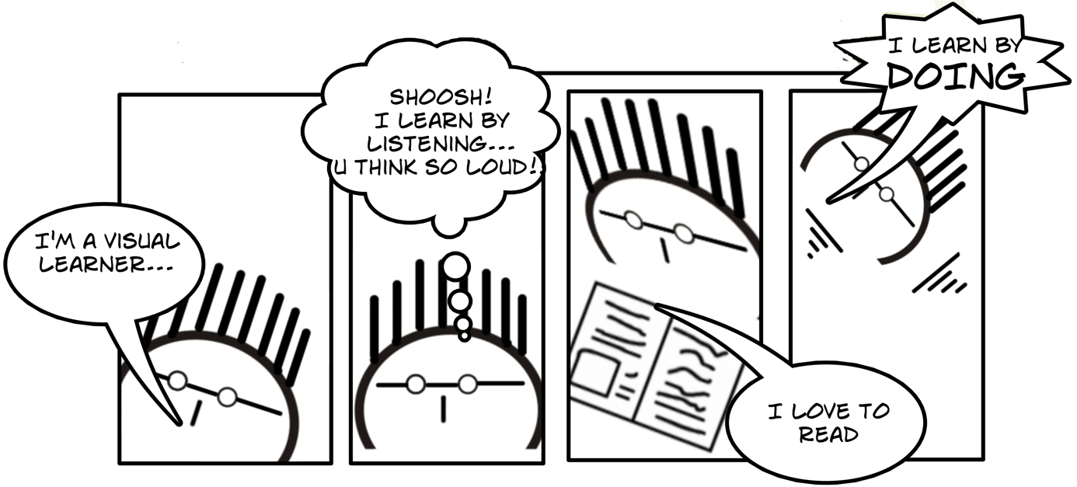
3. Literature review: Learning mode or preferences – [Fleming 2005] VARK Model – Visual, Auditory, Read/Write, Kinesthetic
Class Contact time, Listen to Ebooks, webinars, Events
Workshops Excel, Sage, Financial statements Business Game
OpenTuition, ACCA, CIMA, HS talks, videos, graph and chart.
PPT, e-book, articles via PSRB, HMRC website, Google Scholar etc
Photo source:
http://benptlls.blogspot.co.uk/2012/03/teachers-guide-to-inclusive-learning.html
www.lsbm.ac.uk

Slide 7
Literature review Effectiveness of E-Learning
Internet connections have made it impossible for academics to ignore technology which if used in innovative ways can lead to improvements in learning and teaching (Donnelly and O'Rouke 2007) as well as have a positive effect in reducing dropout rates and improving exam marks. (Lopez-Perez et al 2011).
Several studies and authors have shown benefits from adopting E-Learning in education. (Arkorful and Abaidoo 2015) literature review identified to list a few following:
Flexible i.e. access anytime and place.
Enhances the efficacy of knowledge and qualifications – ease of access to vast information.
Improved relations between learners by the use of discussion forums and breaking barriers between learners and tutors.
Cost effective saving travel time and building space.
Ability to focus on the needs of individual learners and allows the learner to self-pace their learning.
Compensates for scarcities of academic staff.
www.lsbm.ac.uk

Slide 8
Literature review Effectiveness of E-Learning
E-learning eliminates the obstacles of time and distance, so it has potential to reach a global audience through networking. (Makkar et al 2016 and Zhang 2006). permits the exploration and flexible learning.
(Al-Drees et al 2015) studies reported the effective use of these E-Learning tools especially VLE does lie with both students (abilities) and academics (interface design and abilities).
VLE permits information availability in real time and prompt feedback, creating two-way interactions among students and academics to create an environment for efficient learning (Lawson-Body et al 2015; Mayisela, 2013; Wagner et al, 2007; AI-Rahmi et al, 2017 and Ehrmann and Chickering 2006) respects diverse talents and ways of learning.
Usage of VLE enables academics to monitor students’ progress carefully through using student engagement data and communicating with students through announcements, creating discussion forums, in order to improve students’ academic performance. (Mishra and Ramgopal 2015).
www.lsbm.ac.uk

Slide 9
Literature review Effectiveness of E-Learning
(Mbarek & Zadem 2013) states effectiveness of E-learning depends on following factors: computer self-efficacy, ease of use, perceived usefulness, face to face interaction, email interaction, social presence, learning achievement and knowledge transfer through e-learning. Among them perceived usefulness is rated as the most crucial factor by others. For example, if students understand that learning Excel and SAGE will enhance their CV they are more likely to engage with these learning tools. (Masrom.M, 2007; Leem and Lim.2007 and Al-Rahmi et al, 2015).
Accounting topic generally requires a more hands on approach to learning i.e. learning by doing than reading (Lawson-Body et al 2015) – e.g. preparing final accounts, Excel, Sage.
www.lsbm.ac.uk

Slide 10
Literature review
www.lsbm.ac.uk

Slide 11
4. Research Method
Paper Questionnaire filled by all Levels 4 – 6 in the last week of semester 1 containing both quantitative and qualitative attitudes to current E-Learning tools used on the accounting degree.
Likert style 5 point scale rating where 5 being a very useful E-Learning tool to 1 being not at all useful.
Data analysis via excel.
Compliance with Ethics and participant consent form had to be met.
The paper addresses the following areas:
Effectiveness of excel spreadsheet in teaching and learning topics Financial and Management accounting at Level 4?
Effectiveness of designing excel spreadsheet in the Level 5 module, Computer Application in accounting summative assessment?
Effectiveness of E-Learning tools such as Sage, E-books, online lectures, online articles, Canvas VLE, ACCA and CIMA student membership in supporting their accounting education?
Other E-Learning tools used by Accounting students.

Slide 12
- 42% response rate
- 60% response rate
-100% response rate

Slide 13
5. Findings – Effectiveness of Excel in teaching and learning Financial and Management Accounting at Level 4 learning
www.lsbm.ac.uk

Slide 14
Findings – Effectiveness of Excel as E-Learning tool
Students Quotes
‘Excel spreadsheet enhances my ability to analyse large amounts of data.’
‘Excel is more useful learning tool compared to paper based method in accounting. Excel saves time, can back up all data etc.’
www.lsbm.ac.uk

Slide 15
5. Findings – Effectiveness of Excel spreadsheet in preparing for summative assessments, Level 5, Computer Application in Accounting.
The analysis of results indicates that student found all three tasks very useful at equal scoring of mean of 4.78.
www.lsbm.ac.uk

Slide 16
Findings – Effectiveness of Excel spreadsheet in preparing for summative assessments.
Student quotes’ -
‘Yes – Taxation, Financial Reporting, Computer application. Less time consuming when using for calculations. Easy to prepare spreadsheet.’

Slide 17
5. Findings – Effectiveness of other E-Learning tools in Accounting Education.

Slide 18
Findings – Effectiveness of - SAGE.
Student Quotes
‘SAGE make the process easier and quicker especially when there’s a lot of information to put in, everything is in one place so makes it very useful and enjoyable.’
‘It is very useful and easy to do accounts, faster and more integrated.’

Slide 19
5. Findings – Effectiveness of - EBooks.

Slide 20
Findings – Effectiveness of - EBooks.
Student Quotes
‘Using e-books was very important in my studies. The use of internet and digital devices like laptops, kindle, smartphones and tablets mean that I always have the e-book I need with me. Digital books are convenient and portable. I can carry as many e-books as I want in a small format. Digital books do not use paper, are environmentally friendly and help to protect the forest.
Examples of e-books I used “How to write Dissertations & Project Reports” “International Financial Reporting, A Practical Guide” “Auditing and Assurance Services.’

Slide 21
Findings – Effectiveness of Online Lecture and Articles
Online Lecture student quote
‘Convenient and able to use time suitable for you to use. Explanations of topics are very helpful.’
Online Article student quote
‘Key elements for preparing our assignments. Improves our knowledge.’

Slide 22
Findings – Effectiveness of Canvas VLE
Student Quotes-
‘We are informed of all event dates, assignments dates, exam dates. All lectures and e-book are on canvas. Easy to access.’
‘On Canvas we can find everything that we learn during the weeks, especially when I wasn’t able to come to the class, I could find all the information of that day on Canvas. The teachers are always uploading exercises.’

Slide 23
Findings – Effectiveness of ACCA and CIMA student membership
Students quotes - ACCA
‘It has broadened my knowledge especially in terms of how to deal with interview questions and what employers want from me.’
Students quotes - CIMA
‘There are lot of blogs and advice so many different aspects, it tells you what you need to have a better chance of getting employed and the study materials is vast, so there’s endless amount of help there.’
‘I Haven’t used it yet.’

Slide 24
5. Findings – Effectiveness of Other E-Learning tools
Other websites such as YouTube, Kaplan Knowledge Bank and Accounting Coach, Accounting education, AAT, ICAEW website, LinkedIn articles by accountants,
Student quote:
‘The support of the teachers was the main source of learning’

Slide 25
6. Conclusion
The aim of the research is to examine from student’s perspective, the effectiveness of current accounting education’s E-Learning tools used on the BA (Hons) Accounting and Financial Management degree.
Used the (Koehler, Mishra, Cain 2013) TPACK model to develop ETPACK model whereby we start with the heart of learning, the content and pedagogy, and then we layer the technology to ensure that students learning took place deeply, effectively and is long lasting.
Research findings indicate a very positive impact of various E-Learning tools on student’s accounting education with most tools being rated from being useful to very useful.
Some E-Learning tools such as PSRB student membership give students a platform to connect nationally and globally with other students and professionals allowing sharing wealth of knowledge.
www.lsbm.ac.uk

Slide 26
6. Conclusion
Accounting topic generally requires more hands on approach to learning i.e. learning by doing than reading [Lawson-Body et al 2015] and this evidenced by students evaluation i.e. SAGE most useful with Ebook least useful.
These E-Learning tools support learning, but as one student participant stated: ‘The support from teachers was the main source of learning.’
Limitation of study:
Small sample size, which can be extended by gathering demographic data.
Analysis of E-Learning and student performance.
As E-Learning tools evolves, future research is necessary to keep up with these changes.
www.lsbm.ac.uk

Slide 27
Thank You
Questions?

